Slide 1
Signal Formation in Particle Detectors
Werner Riegler, CERN, werner.riegler@cern.ch
II Seminario Nazionale Rivelatori Innovativi
18-22 October 2010, Trieste
Lecture3/3
Signals in Detectors

Slide 2
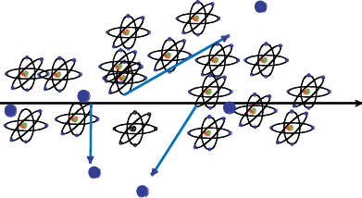
Creation of the Signal
Charged particles traversing matter leave excited atoms, electron-ion pairs (gases) or electrons-hole pairs (solids) behind.
Excitation:
The photons emitted by the excited atoms in transparent materials can be detected with photon detectors like photomultipliers or semiconductor photon detectors.
Ionization:
By applying an electric field in the detector volume, the ionization electrons and ions are moving, which induces signals on metal electrodes. These signals are then read out by appropriate readout electronics.

Slide 3

Gas Detectors with internal Electron Multiplication
Principle: At sufficiently high electric fields (100kV/cm) the electrons gain energy in excess of the ionization energy → secondary ionzation etc. etc.
  dN = N α dx α…Townsend Coefficient
  N(x) = N₀ exp (αx) N/ N₀ = A (Amplification, Gas Gain)
  Avalanche in a homogeneous field:
  Problem: High field on electrode surface
  → breakdown
  In an inhomogeneous Field: α(E) → N(x) = N₀ exp [α(E(x’))dx’]
Ions
Electrons
E

Slide 4

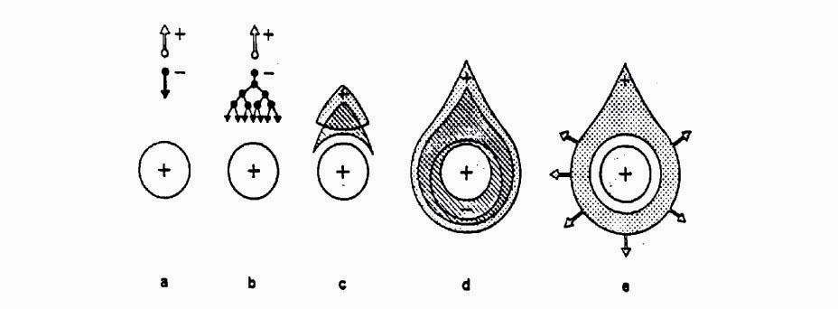
Wire Chamber Signals
Wire with radius (10-25μm) in a tube of radius b (1-3cm):
Electric field close to a thin wire (100-300kV/cm). E.g. V₀=1000V, a=10μm, b=10mm, E(a)=150kV/cm
Electric field is sufficient to accelerate electrons to energies which are sufficient to produce secondary ionization → electron avalanche → signal.
b
b
a
Wire

Slide 5




Wire Chamber Signals
The electrons are produced very close to the wire, so for now we assume that N_{tot} ions are moving from the wire surface to the tube wall
Ions move with a velocity proportional to the electric field.
b
Weighting Field of the wire: Remove charge and set wire to V_{w} while grounding the tube wall.
The induced current is therefore
b
a

Slide 6
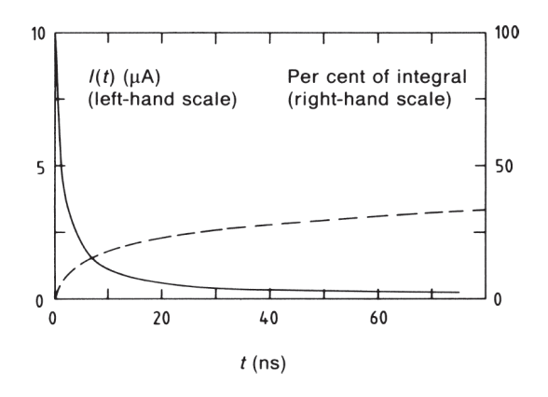
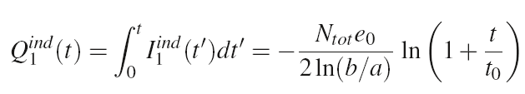
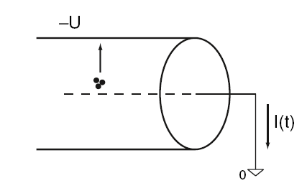
Wire Chamber Signals
b
b
a

Slide 7
Wire Chamber: Electron Avalanches on the Wire
Proportional region: A≈10³-10⁴
Semi proportional region: A≈10⁴-10⁵
(space charge effect)
Saturation region: A >10⁶
Independent the number of primary electrons.
Streamer region: A >10⁷
Avalanche along the particle track.
Limited Geiger region:
Avalanche propagated by UV photons.
Geiger region: A≈10⁹
Avalanche along the entire wire.
LHC
1970ies
1950ies

Slide 8

Wire Chamber: Signals from Electron Avalanches
The electron avalanche happens very close to the wire. First multiplication only around R =2x wire radius. Electrons are moving to the wire surface very quickly (<<1ns). Ions are difting towards the tube wall (typically several 100μs. )
The signal is characterized by a very fast ‘spike’ from the electrons and a long Ion tail.
The total charge induced by the electrons, i.e. the charge of the current spike due to the short electron movement amounts to 1-2% of the total induced charge.

Slide 9
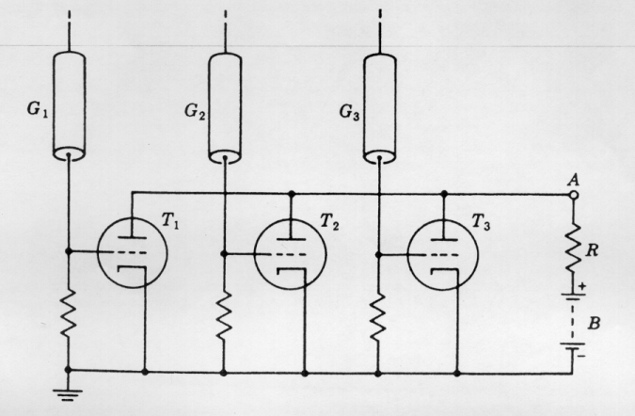
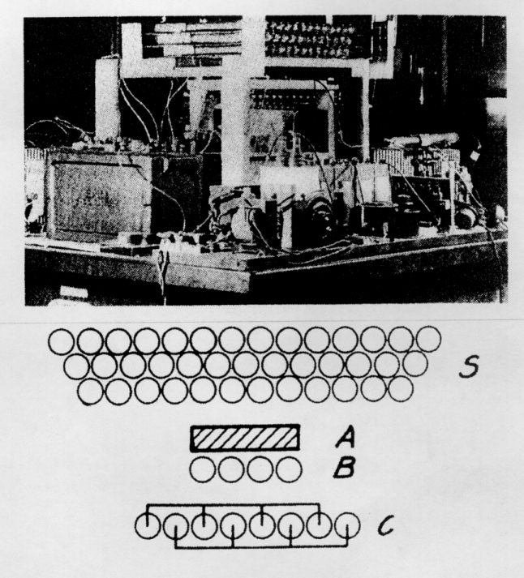
Detectors with Electron Multiplication
Rossi 1930: Coincidence circuit for n tubes
Cosmic ray telescope 1934
Geiger mode, large deadtime
Position resolution is determined by the size of the tubes.
Signal was directly fed into an electronic tube.

Slide 10
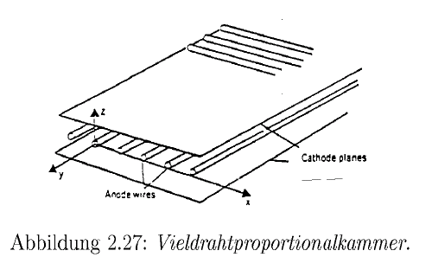
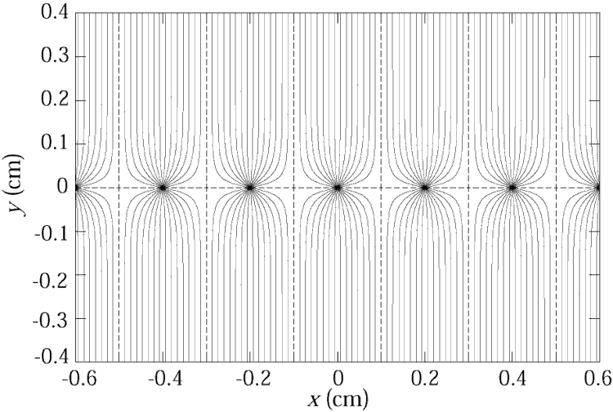
Multi Wire Proportional Chamber
Classic geometry (Crossection), Charpak 1968 :
One plane of thin sense wires is placed between two parallel plates.
Typical dimensions:
Wire distance 2-5mm, distance between cathode planes ~10mm.
Electrons (v≈5cm/μs) are collected within ≈ 100ns. The ion tail can be eliminated by electronics filters → pulses of <100ns length.
For 10% occupancy → every μs one pulse
→ 1MHz/wire rate capabiliy !
→ Compare to Bubble Chamber with 10 Hz !

Slide 11
Multi Wire Proportional Chamber
In order to eliminate the left/right ambiguities: Shift two wire chambers by half the wire pitch.
For second coordinate:
Another chamber at 90⁰ relative rotation
Signal propagation to the two ends of the wire.
Pulse height measurement on both ends of the wire. Because of resisitvity of the wire, both ends see different charge.
Segmenting of the cathode into strips or pads:
The movement of the charges induces a signal on the wire AND on the cathode. By segmentation of the cathode plane and charge interpolation, resolutions of 50μm can be achieved.

Slide 12

Multi Wire Proportional Chamber
Cathode strip:
Width (1σ) of the charge distribution ≈ distance between Wires and cathode plane.
‘Center of gravity’ defines the particle trajectory.
Avalanche

Slide 13
Drift Chambers
Amplifier: t=T
E
Scintillator: t=0
In an alternating sequence of wires with different potentials one finds an electric field between the ‘sense wires’ and ‘field wires’.
The electrons are moving to the sense wires and produce an avalanche which induces a signal that is read out by electronics.
The time between the passage of the particle and the arrival of the electrons at the wire is measured.
The drift time T is a measure of the position of the particle !
By measuring the drift time, the wire distance can be increased (compared to the Multi Wire Proportional Chamber) → save electronics channels !

Slide 14
Drift Chambers, typical Geometries
Electric Field ≈ 1kV/cm
U.Becker Instr. of HEP, Vol#9, p516 World Scientific (1992) ed F.Sauli

Slide 15
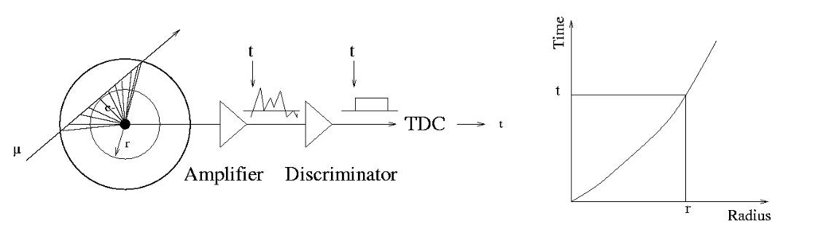
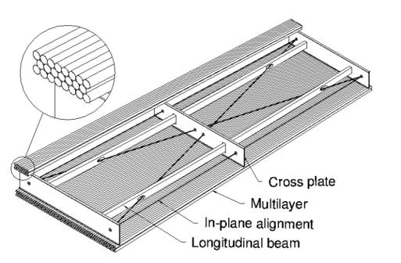
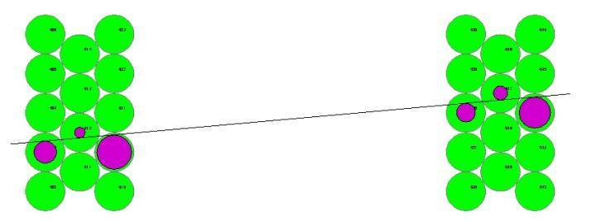
The Geiger Counter reloaded: Drift Tube
Primary electrons are drifting to the wire.
Electron avalanche at the wire.
The measured drift time is converted to a radius by a (calibrated) radius-time correlation.
Many of these circles define the particle track.
ATLAS MDT R(tube) =15mm
Calibrated Radius-Time correlation
ATLAS Muon Chambers
ATLAS MDTs, 80μm per tube

Slide 16

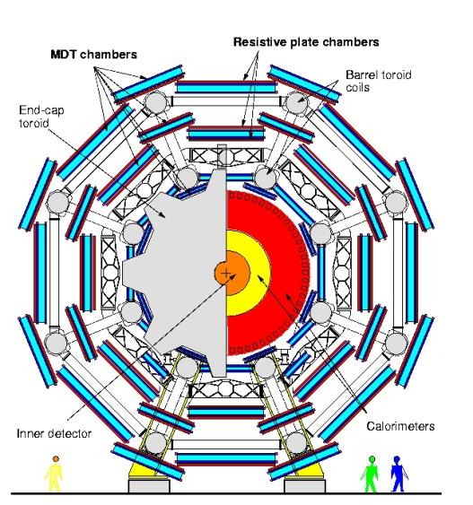
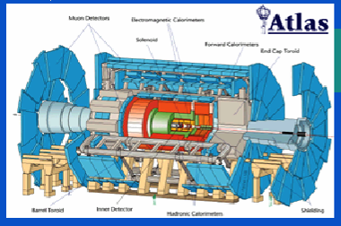
The Geiger counter reloaded: Drift Tube
Atlas Muon Spectrometer, 44m long, from r=5 to11m.
1200 Chambers
6 layers of 3cm tubes per chamber.
Length of the chambers 1-6m !
Position resolution: 80μm/tube, <50μm/chamber (3 bar)
Maximum drift time ≈700ns
Gas Ar/CO₂ 93/7

Slide 17
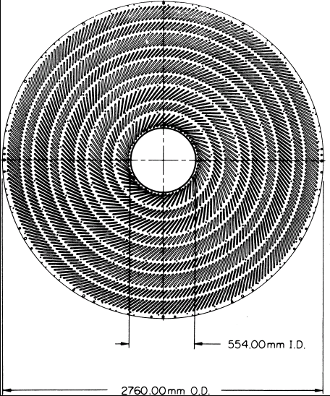
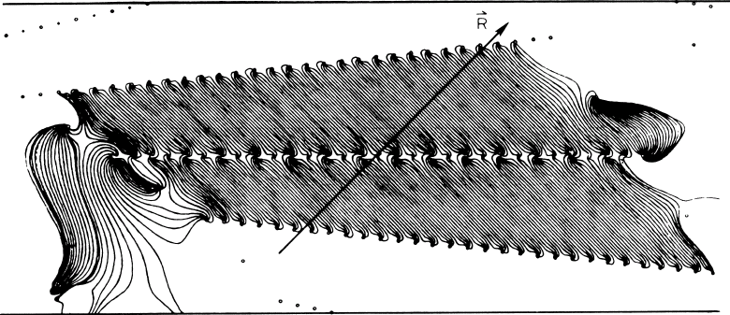
Large Drift Chambers
Central Tracking Chamber CDF Experiment.
660 drift cells tilted 45⁰ with respect to the particle track.
Drift cell

Slide 18
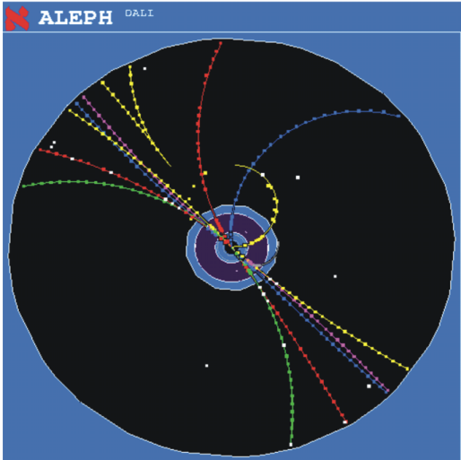
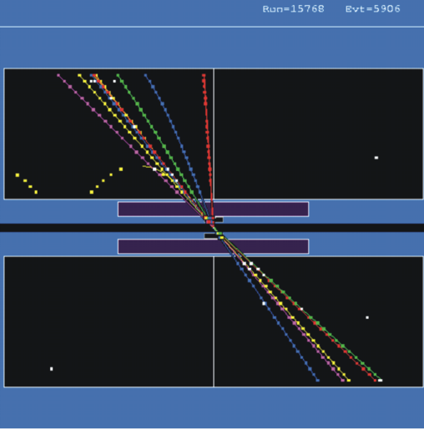
Time Projection Chamber (TPC):
Gas volume with parallel E and B Field.
B for momentum measurement. Positive effect: Diffusion is strongly reduced by E//B (up to a factor 5).
Drift Fields 100-400V/cm. Drift times 10-100 μs.
Distance up to 2.5m !
gas volume
B
drift
E
y
x
z
charged track
Wire Chamber to detect the tracks

Slide 19
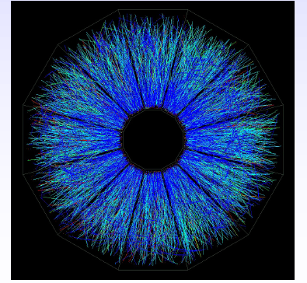
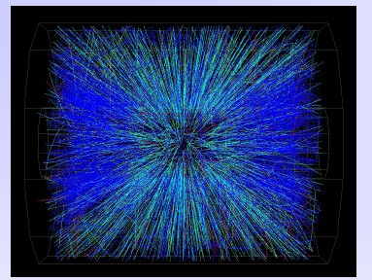
STAR TPC (BNL)
Event display of a Au Au collision at CM energy of 130 GeV/n.
Typically around 200 tracks per event.
Great advantage of a TPC: The only material that is in the way of the particles is gas → very low multiple scattering → very good momentum resolution down to low momenta !

Slide 20
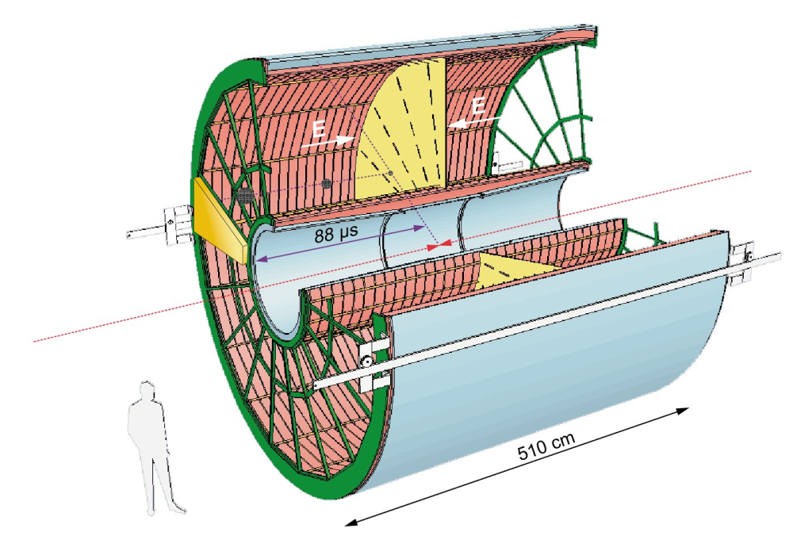
ALICE TPC: Detector Parameters
Gas Ne/ CO₂ 90/10%
Field 400V/cm
Gas gain >10⁴
Position resolution σ= 0.25mm
Diffusion: σ_{t}= 250μm
Pads inside: 4x7.5mm
Pads outside: 6x15mm
B-field: 0.5T

Slide 21
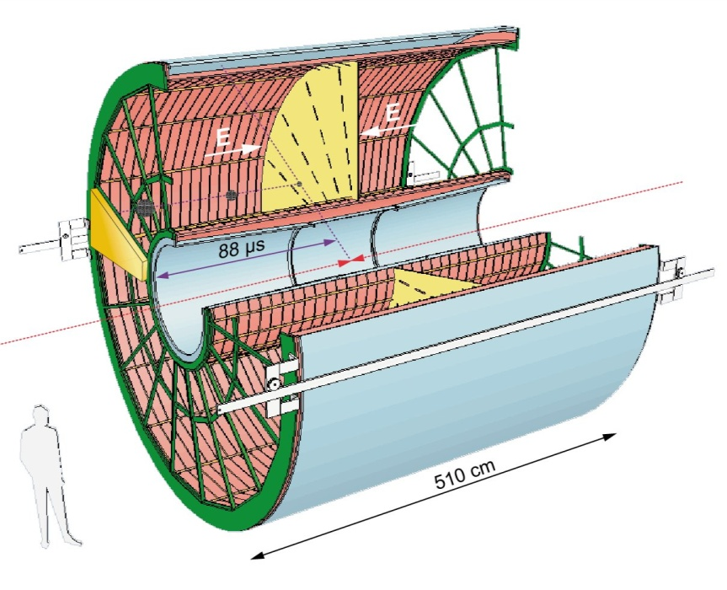
ALICE TPC: Construction Parameters
Largest TPC:
  Length 5m
  Diameter 5m
  Volume 88m³
  Detector area 32m²
  Channels ~570 000
High Voltage:
  Cathode -100kV
Material X₀
  Cylinder from composite materials from airplane industry (X₀= ~3%)

Slide 22
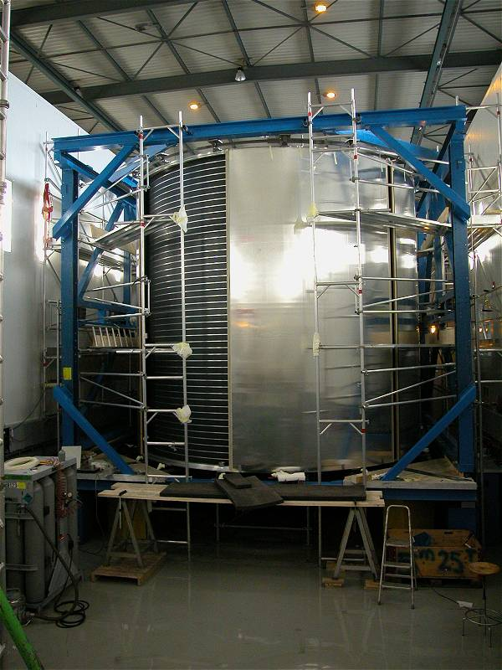
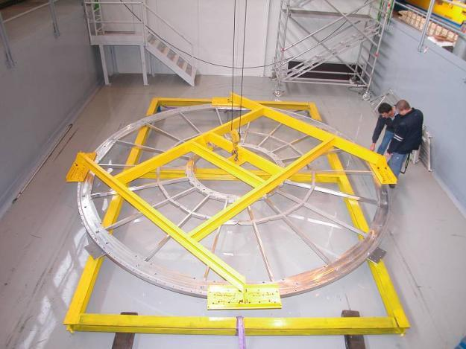
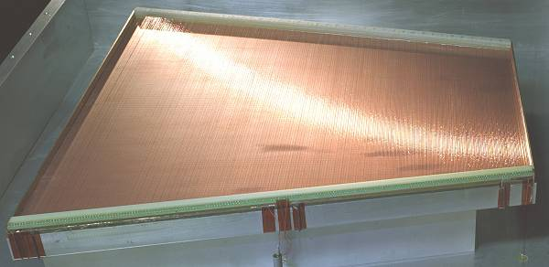
ALICE TPC: Pictures of the Construction
Precision in z: 250μm End plates 250μm
Wire chamber: 40μm

Slide 23
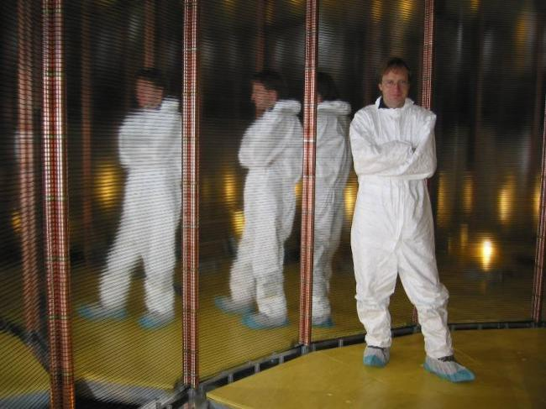
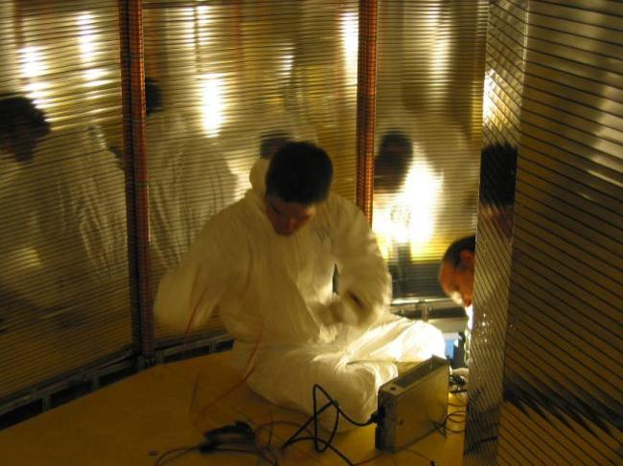
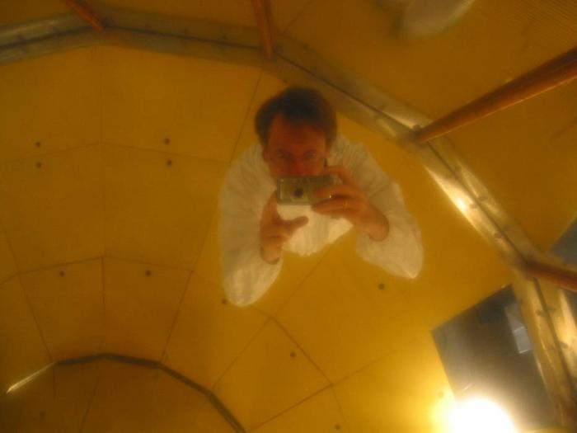
ALICE TPC Construction
My personal contribution:
A visit inside the TPC.

Slide 24
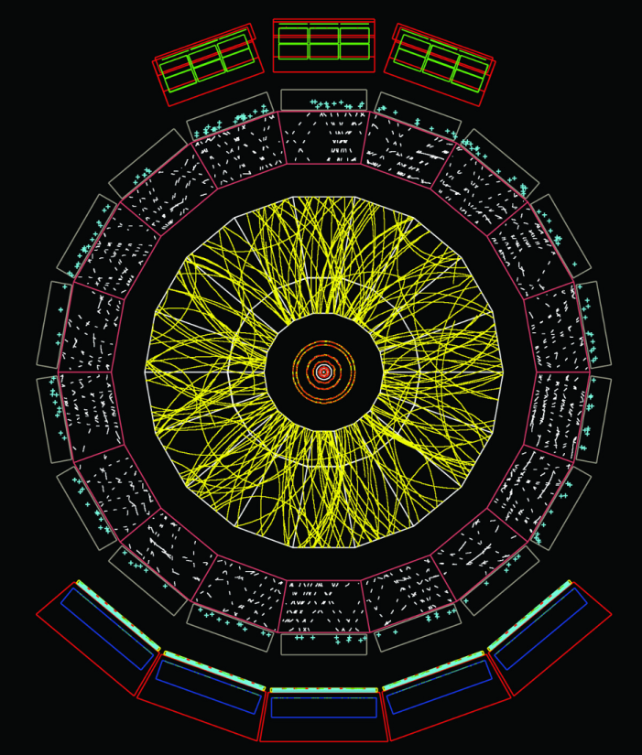
ALICE : Simulation of Particle Tracks
Simulation of particle tracks for a Pb Pb collision (dN/dy ~8000)
Angle: Θ=60 to 62º
If all tracks would be shown the picture would be entirely yellow !
Up to 40 000 tracks per event !
TPC is currently under commissioning

Slide 25
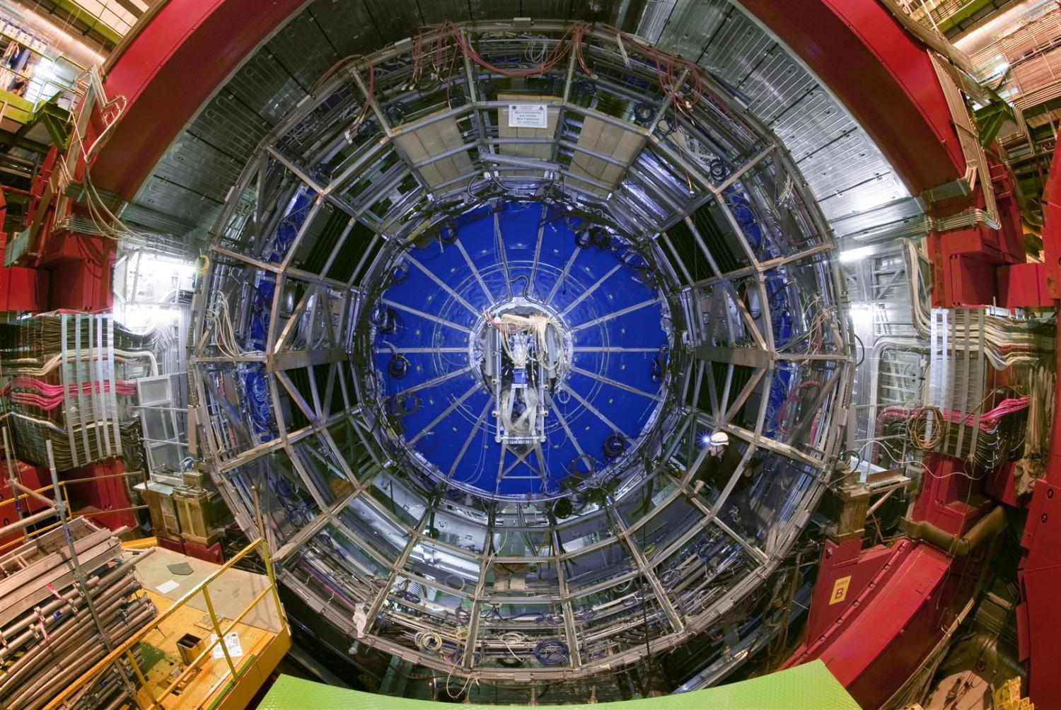
TPC installed in the ALICE Experiment

Slide 26
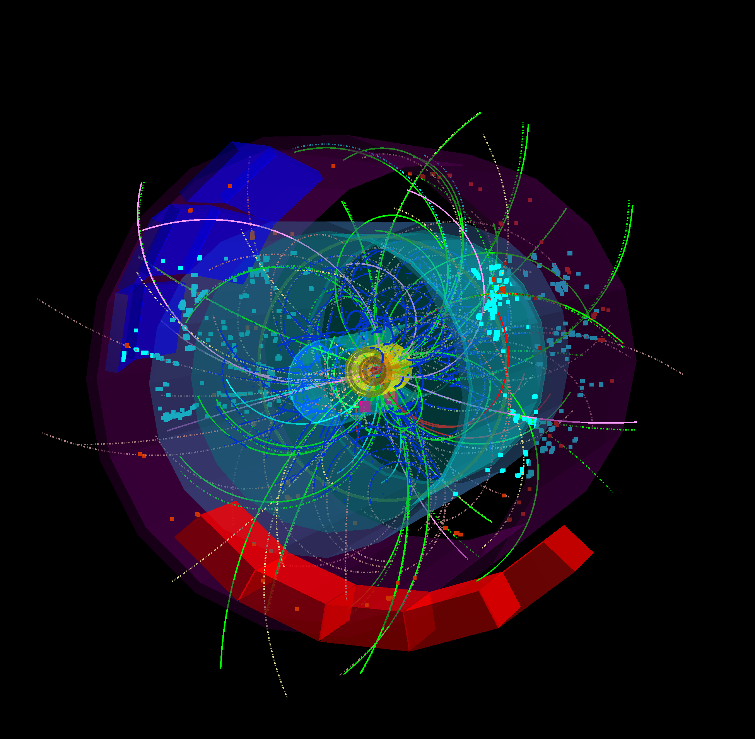
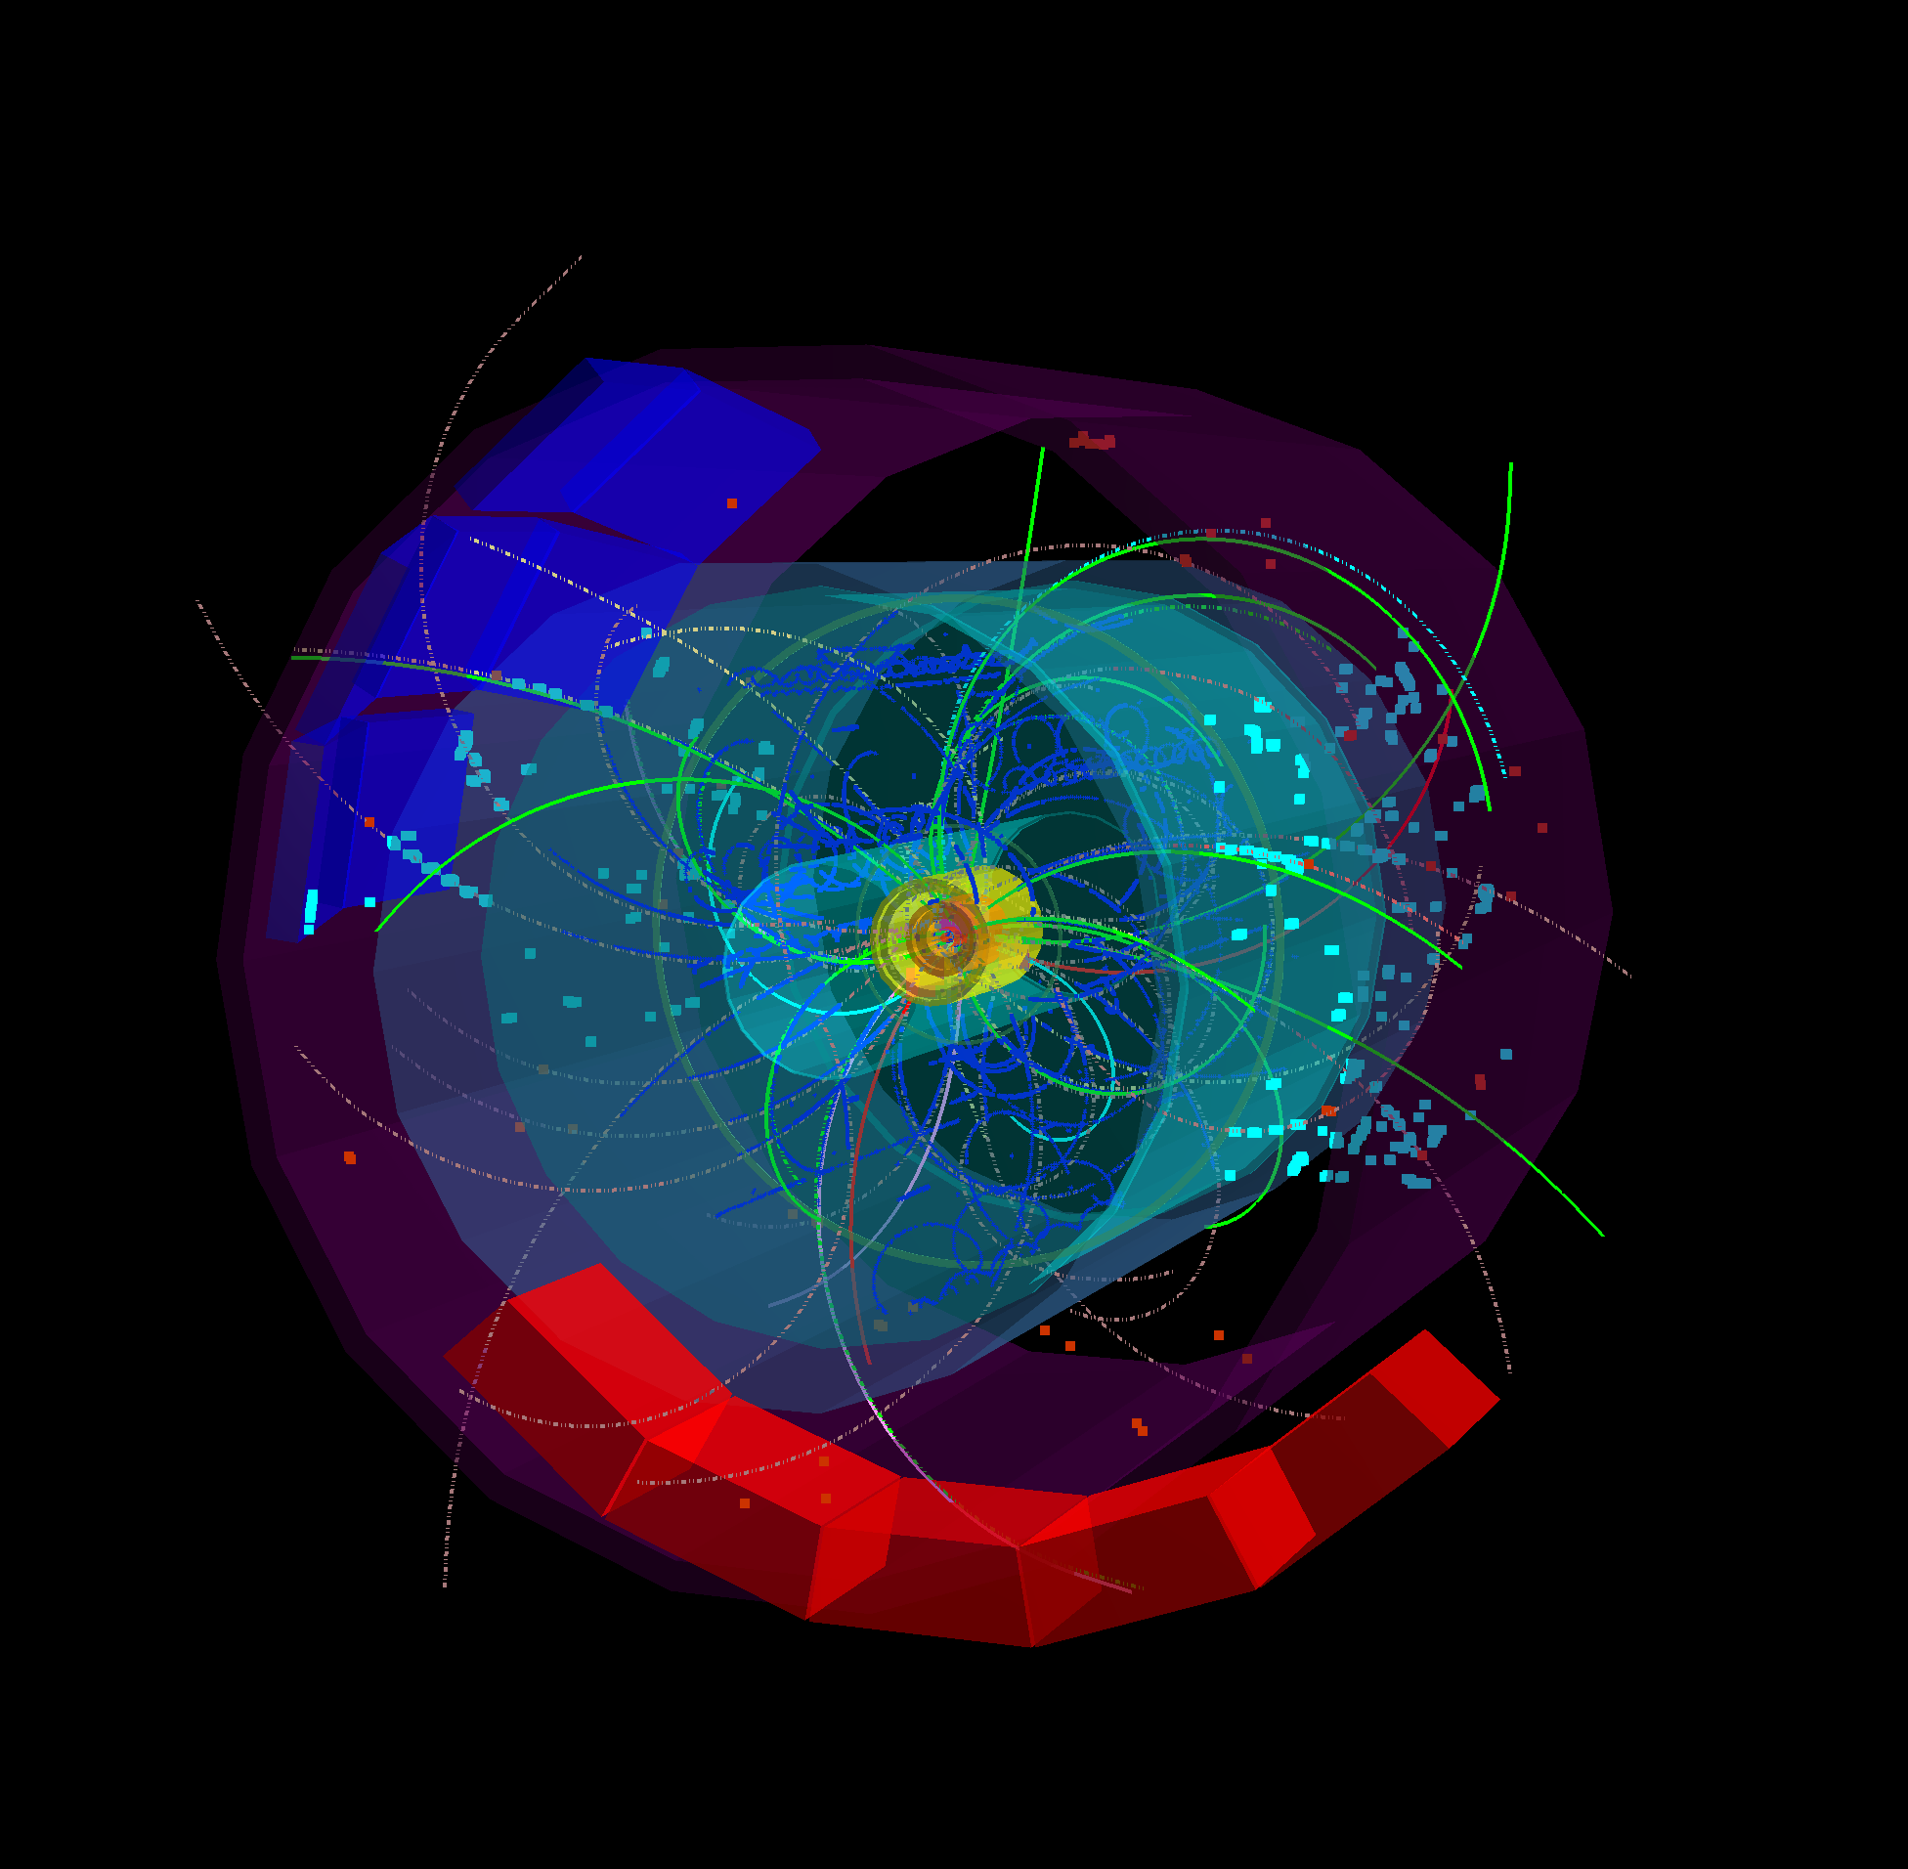
First 7 TeV Collisions in the ALICE TPC in March 2010 !

Slide 27
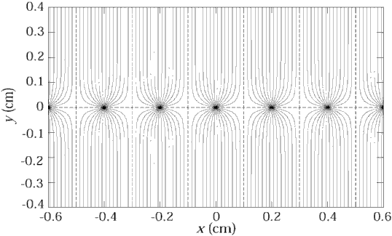
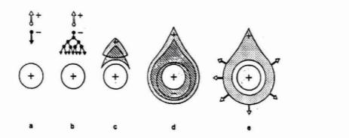
Position Resolution/Time resolution
Up to now we discussed gas detectors for tracking applications. Wire chambers can reach tracking precisions down to 50 micrometers at rates up to <1MHz/cm².
What about time resolution of wire chambers ?
It takes the electrons some time to move from thir point of creation to the wire. The fluctuation in this primary charge deposit together with diffusion limits the time resolution of wire chambers to about 5ns (3ns for the LHCb trigger chambers).
By using a parallel plate geometry with high field, where the avalanche is starting immediately after the charge deposit, the timing fluctuation of the arriving electrons can be eliminated and time resolutions down to 50ps can be achieved !

Slide 28
Resistive Plate Chambers (RPCs)
Keuffel ‘Spark’ Counter:
High voltage between two metal plates. Charged particle leaves a trail of electrons and ions in the gap and causes a discharge (Spark).
Excellent Time Resolution(<100ps).
Discharged electrodes must be recharged → Dead time of several ms.
Parallel Plate Avalanche Chambers (PPAC):
At more moderate electric fields the primary charges produce avalanches without forming a conducting channel between the electrodes. No Spark → induced signal on the electrodes.
Higher rate capability.
However, the smallest imperfections on the metal surface cause sparks and breakdown.
→ Very small (few cm²) and unstable devices.
In a wire chamber, the high electric field (100-300kV/cm) that produces the avalanche exists only close to the wire. The fields on the cathode planes area rather small 1-5kV/cm.

Slide 29
Resistive Plate Chambers (RPCs)
→ Place resistive plates in front of the metal electrodes.
No spark can develop because the resistivity together with the capacitance (tau ~ e*ρ) will only allow a very localized ‘discharge’. The rest of the entire surface stays completely unaffected.
→ Large area detectors are possible !
Resistive plates from Bakelite (ρ = 10¹⁰-10¹² Ωcm) or window glass (ρ = 10¹²-10¹³ Ωcm).
Gas gap: 0.25-2mm.
Electric Fields 50-100kV/cm.
Time resolutions: 50ps (100kV/cm), 1ns(50kV/cm)
Application: Trigger Detectors, Time of Flight (TOF)
Resistivity limits the rate capability: Time to remove avalanche charge from the surface of the resistive plate is (tau ~ e*ρ) = ms to s.
Rate limit of kHz/cm² for 10¹⁰ Ωcm.

Slide 30



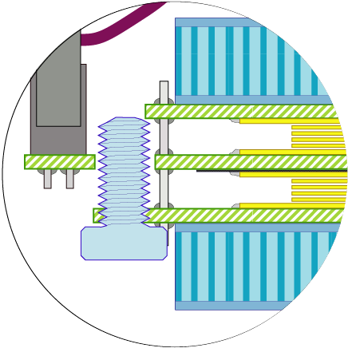
ALICE TOF RPCs
130 mm
active area 70 mm
Several gaps to increase efficiency. Stack of glass plates.
Small gap for good time resolution: 0.25mm.
Fishing lines as high precision spacers !
Large TOF systems with 50ps time resolution made from window glass and fishing lines !
Before RPCs → Scintillators with very special photomultipliers – very expensive. Very large systems are unaffordable.
Flat cable connector
Differential signal sent from strip to interface card
honeycomb panel
(10 mm thick)
PCB with cathode pickup pads
external glass plates
0.55 mm thick
internal glass plates
(0.4 mm thick)
PCB with
anode pickup pads
Mylar film
(250 micron thick)
5 gas gaps
of 250 micron
PCB with cathode pickup pads
M5 nylon screw to hold
fishing-line spacer
Honeycomb panel (10 mm thick)
connection to bring cathode signal
Silicon sealing compound
to central read-out PCB

Slide 31
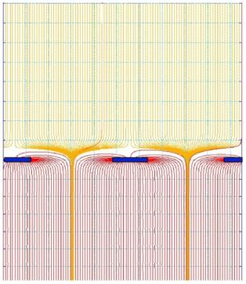
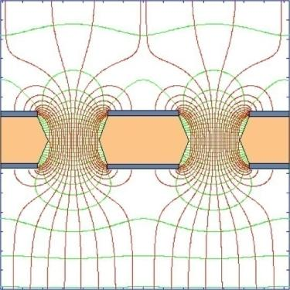
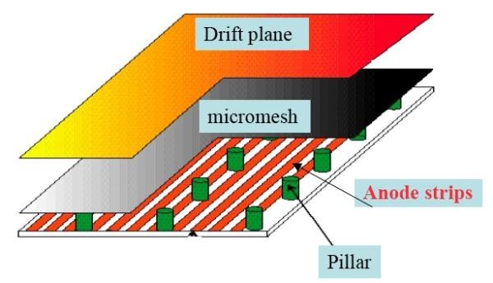
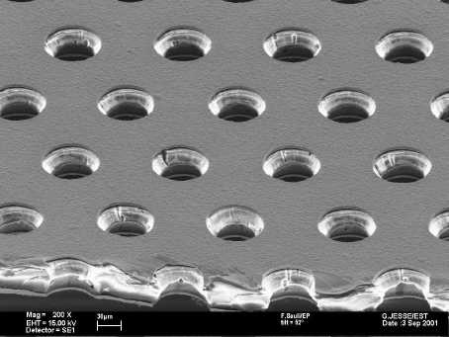
GEMs & MICROMEGAS
MICROMEGAS
Narrow gap (50-100 µm) PPC with thin cathode mesh
Insulating gap-restoring wires or pillars
GEM
Thin metal-coated polymer foils
70 µm holes at 140 mm pitch
Y. Giomataris et al, Nucl. Instr. and Meth. A376(1996)239
F. Sauli, Nucl. Instr. and Methods A386(1997)531

Slide 32
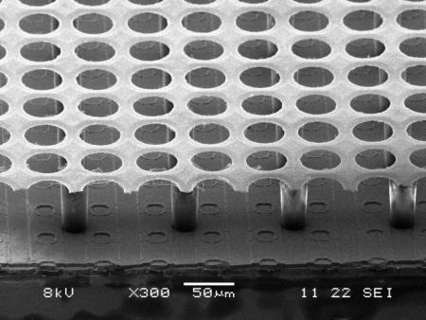
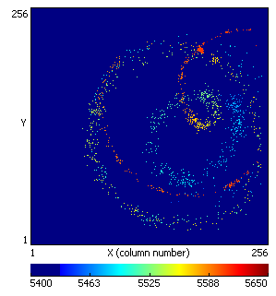
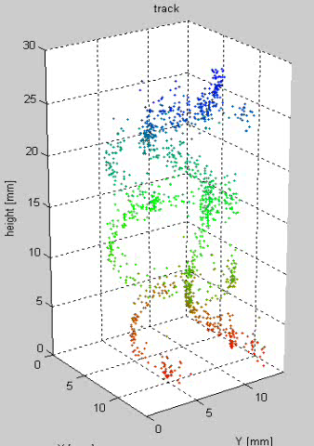
MPGDs with Integrate Micromesh, INGRID
Going even another step further, by wafer post-processing techniques, MPGD structure scan be put on top of a pixelized readout chip, making the entire detector a monolithic unit !
→ IntegratedGrid (INGRID) . In addition a TDC was put on each pixel measuring drift times →
Micromesh on a pixelized readout chip produced by Opto-Chemical Wafer Post-Processing Techniques.
With 3cm Drift gap: 5 cm³ Mini TPC !
Tracks from Sr90 source in 0.2T Magnetic Field !
Single ionization electrons are seen.
Fantastic position resolution …
14 x 14 mm²

Slide 33
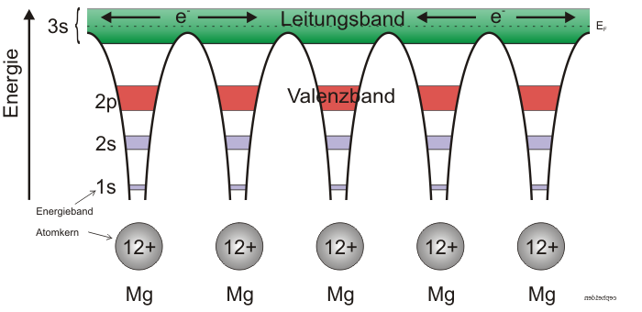
Solid State Detectors
Gas Detectors
In gaseous detectors, a charged particle is liberating electrons from the atoms, which are freely bouncing between the gas atoms.
An applied electric field makes the electrons and ions move,
which induces signals on the metal readout electrodes.
For individual gas atoms, the electron energy levels are discrete.
Solid State Detectors
In solids (crystals), the electron energy levels are in ‘bands’.
Inner shell electrons, in the lower energy bands, are closely bound to the individual atoms and always stay with ‘their’ atoms.
In a crystal there are however energy bands that are still bound states of the crystal, but they belong to the entire crystal. Electrons in these bands and the holes in the lower band can freely move around the crystal, if an electric field is applied.

Slide 34
Solid State Detectors
Free Electron Energy
Unfilled Bands
Conduction Band
Band Gap
Valance Band
Conductor, Insulator, Semiconductor
In case the conduction band is filled the crystal is a conductor.
In case the conduction band is empty and ‘far away’ from
the valence band, the crystal is an insulator.
In case the conduction band is empty but the distance to the valence band is small, the crystal is a semiconductor.

Slide 35
Solid State Detectors
Band Gap, e-h pair Energy
The energy gap between the last filled band – the valence band – and the conduction band is called band gap E_{g}.
The band gap of Diamond/Silicon/Germanium is 5.5, 1.12, 0.66 eV.
The average energy to produce an electron/hole pair for Diamond/Silicon/Germanium is 13, 3.6, 2.9eV.
Temperature, Charged Particle Detection
In case an electron in the valence band gains energy by some process, it can be excited into the conduction band and a hole in the valence band is left behind.
Such a process can be the passage of a charged particle, but also thermal excitation → probability is proportional Exp(-E_{g}/kT).
The number of electrons in the conduction band is therefore increasing with temperature i.e. the conductivity of a semiconductor increases with temperature.
Band Gap

Slide 36

Solid State Detectors
Electron, Hole Movement:
It is possible to treat electrons in the conduction band and holes in the valence band similar to free particles, but with an effective mass different from elementary electrons not embedded in the lattice.
This mass is furthermore dependent on other parameters such as the direction of movement with respect to the crystal axis. All this follows from the QM treatment of the crystal (solid state physics).
Cooling:
If we want to use a semiconductor as a detector for charged particles, the number of charge carriers in the conduction band due to thermal excitation must be smaller than the number of charge carriers in the conduction band produced by the passage of a charged particle.
Diamond (E_{g}=5.5eV) can be used for particle
detection at room temperature,
Silicon (E_{g}=1.12 eV) and Germanium (E_{g}=0.66eV)
must be cooled, or the free charge carriers
must be eliminated by other tricks → doping → see later.

Slide 37
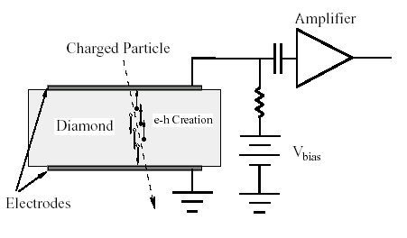
Solid State Detectors
Primary ‘ionization’:
The average energy to produce an electron/hole pair is: Diamond (13eV), Silicon (3.6eV), Germanium (2.9eV)
Comparing to gas detectors, the density of a solid is about a factor 1000 larger than that of a gas and the energy to produce and electron/hole pair e.g. for Si is a factor 7 smaller than the energy to produce an electron-ion pair in Argon.
Solid State vs. Gas Detector:
The number of primary charges in a Si detector is therefore about 10⁴ times larger than the one in gas → while gas detectors need internal charge amplification, solid state detectors don’t need internal amplification.
While in gaseous detectors, the velocity of electrons and ions differs by a factor 1000, the velocity of electrons and holes in many semiconductor detectors is quite similar → very short signals.
Diamond → A solid state ionization chamber

Slide 38
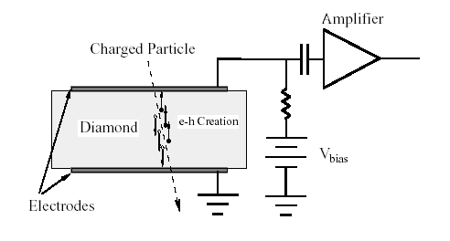
Diamond Detector
Typical thickness – a few 100μm.
<1000 charge carriers/cm³ at room temperature due to large band gap.
Velocity:
μ_{e}=1800 cm²/Vs, μ_{h}=1600 cm²/Vs
Velocity = μE, 10kV/cm → v=180 μm/ns → Very fast signals of only a few ns length !
I₂
Z=D
I₁(t)
z
E
q,v_{h}
Z=z₀
-q, v_{e}
A single e/h par produced in the center
Z=0
I₁
T=2-3ns

Slide 39
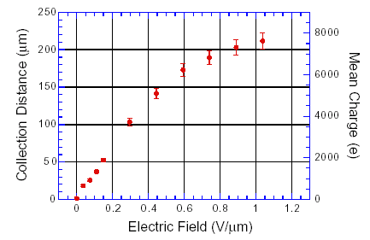
Diamond Detector
I₂
Z=D
E
-q, v_{e}
q,v_{h}
Z=0
I₁
However, charges are trapped along the track, only about 50% of produced primary charge is induced →
I₁(t)
I₁(t)
T=2-3ns
T=2-3ns

Slide 40
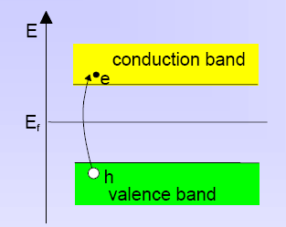
Silicon Detector
Velocity:
μ_{e}=1450 cm²/Vs, μ_{h}=505 cm²/Vs, 3.63eV per e-h pair.
~33000 e/h pairs in 300μm of silicon.
However: Free charge carriers in Si:
T=300 K: e,h = 1.45 x 10¹⁰ / cm³ but only 33000 e/h pairs in 300μm produced by a high energy particle.
Why can we use Si as a solid state detector ???

Slide 41
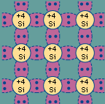
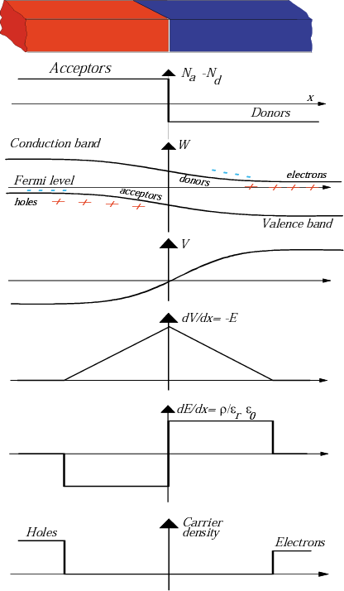
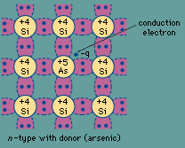

Doping of Silicon
In a silicon crystal at a given temperature the number of electrons in the conduction band is equal to the number of holes in the valence band.
Doping Silicon with Arsen (+5) it becomes and n-type conductor (more electrons than holes).
Doping Silicon with Boron (+3) it becomes a p-type conductor (more holes than electrons).
Bringing p and n in contact makes a diode.
p
n
doping

Slide 42

Si-Diode used as a Particle Detector !
At the p-n junction the charges are depleted and a zone free of charge carriers is established.
By applying a voltage, the depletion zone can be extended to the entire diode → highly insulating layer.
An ionizing particle produces free charge carriers in the diode, which drift in the electric field and induce an electrical signal on the metal electrodes.
As silicon is the most commonly used material in the electronics industry, it has one big advantage with respect to other materials, namely highly developed technology.

Slide 43
Under-Depleted Silicon Detector
-
-
+
+
+
+
+
+
-
+
+
-
+
+
+
+
-
+
+
-
+
+
+
+
+
+
+
+
+
-
p
n
Zone without free charge carriers positively charged.
Sensitive Detector Volume.
Zone with free electrons. Conductive.
Insensitive to particles.
Electric Field

Slide 44
Fully-Depleted Silicon Detector
-
-
+
+
+
+
+
+
+
+
+
+
-
+
+
+
+
-
+
+
+
+
+
+
+
+
+
+
-
+
+
+
+
+
-
+
+
+
+
+
+
+
+
-
+
+
+
+
p
n
Zone without free charge carriers positively charged.
Sensitive Detector Volume.
Electric Field

Slide 45
Over-Depleted Silicon Detector
-
-
+
+
+
+
+
+
+
+
+
+
-
+
+
+
+
-
+
+
+
+
+
+
+
+
+
+
-
+
+
+
+
+
-
+
+
+
+
+
+
+
+
-
+
+
+
+
In contrast to the (un-doped) diamond detector where the bulk is neutral and the electric field is therefore constant, the sensitive volume of a doped silicon detector is charged (space charge region) and the field is therefore changing along the detector.
→ Velocity of electrons and holes is not constant along the detector.
p
n
Zone without free charge carriers positively charged.
Sensitive Detector Volume.
Electric Field

Slide 46

Silicon Detector
ca. 50-150 μm
readout capacitances
Fully depleted zone
SiO₂
passivation
300μm
N (e-h) = 11 000/100μm
Position Resolution down to ~ 5μm !
Solid State Detectors

Slide 47





Silicon Detector Signals
-V
p+
n-
n+
What is the signal induced on the p+ ‘electrode’ for a single e/h pair created at x₀=d/2 for a 300um Si detector ?
x_{h}
hole
x_{e}
x₀
x
d
E
electron

Slide 48





Silicon Detector Signals
-V
p+
n-
n+
x_{h}
hole
x_{e}
x₀
x
d
E
electron

Slide 49

Silicon Detector Signals
-V
p+
n-
n+
What is the signal induced on the p+ ‘electrode’ for a single e/h pair created at x₀=d/2 for a 300um Si detector ?
x_{h}
hole
x_{e}
x₀
x
d
electron
To calculate the signal from a track one has to sum up all the e/h pair signal for different positions x₀.
Si Signals are fast T<10-15ns. In case the amplifier peaking time is >20-30ns, the induced current signal shape doesn’t matter at all.
The entire signal is integrated and the output of the electronics has always the same shape (delta response) with a pulse height proportional to the total deposited charge.
Total
Electron
Hole

Slide 50


Silicon Detector
Every electrode is connected to an amplifier →
Highly integrated readout electronics.
Two dimensional readout is possible.
CMS Outer Barrel Module
Solid State Detectors

Slide 51


Slide 52


CMS Tracker

Slide 53


Silicon Drift Detector (like gas TPC !)
bias HV divider
Collection
drift cathodes
pull-up
cathode
ionizing particle
Solid State Detectors

Slide 54

Silicon Drift Detector (like gas TPC !)
Anode axis (Z)
Drift time axis (R-Φ)
Resolution (μm)
Drift distance (mm)
Solid State Detectors

Slide 55
Pixel-Detectors
Problem:
2-dimensional readout of strip detectors results in ‘Ghost Tracks’ at high particle multiplicities i.e. many particles at the same time.
Solution:
Si detectors with 2 dimensional ‘chessboard’ readout. Typical size 50 x 200 μm.
Problem:
Coupling of readout electronics to the detector
Solution:
Bump bonding
Solid State Detectors

Slide 56



Bump Bonding of each Pixel Sensor to the Readout Electronics
ATLAS: 1.4x10⁸ pixels
Solid State Detectors

Slide 57


Radiation Effects ‘Aging’
Increase in leakage current
Increase in depletion voltage
Decrease in charge collection efficiency due to under-depletion and charge trapping.

Slide 58

Next Time
More details of signals in Solid State Detectors and Wire Chamber,
Signals in MICROMEGAs, GEMs, RPCs and Liquid Calorimeters.
MICROMEGA MSGC GEM
MicroMeshGasdetector MicroStripGasChamber GasElectronMultiplier

Slide 59
Conclusion
This principle of signal generation is identical for Solid State Detectors, Gas Detectors and Liquid Detectors.
The signals are due to charges (currents) induced on metal electrodes by moving charges.
The easiest way to calculate signals induced by moving charges on metal electrodes is the use of Weighting fields (Ramo – Shockley theorem) for calculation of currents induced on grounded electrodes.
These currents can then be placed as ideal current sources on an equivalent circuit diagram representing the detector.

