Slide 1
Particle Physics Instrumentation
Werner Riegler, CERN, werner.riegler@cern.ch
The 2011 CERN – Latin-American School of High-Energy Physics
Natal, Brazil, 23 March - 5 April 2011
Lecture2/3
Tracking with Gas and Solid State Detectors,
Calorimetry,
Particle Identification

Slide 2
Particle Detectors
Summer Student Lectures 2010
Werner Riegler, CERN, werner.riegler@cern.ch
History of Instrumentation ↔ History of Particle Physics
The ‘Real’ World of Particles
Interaction of Particles with Matter
Tracking with Gas and Solid State Detectors
Calorimetry, Particle ID, Detector Systems

Slide 3
Electromagnetic Interaction of Particles with Matter
Z₂ electrons, q=-e₀
M, q=Z₁ e₀
Interaction with the atomic electrons. The incoming particle loses energy and the atoms are excited or ionized.
Interaction with the atomic nucleus. The particle is deflected (scattered) causing multiple scattering of the particle in the material. During this scattering a Bremsstrahlung photon can be emitted.
In case the particle’s velocity is larger than the velocity of light in the medium, the resulting EM shockwave manifests itself as Cherenkov Radiation. When the particle crosses the boundary between two media, there is a probability of the order of 1% to produced and X ray photon, called Transition radiation.

Slide 4
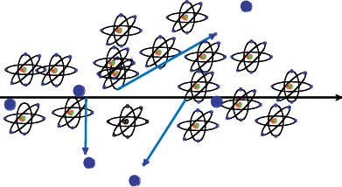
Creation of the Signal
Charged particles traversing matter leave excited atoms, electron-ion pairs (gases) or electrons-hole pairs (solids) behind.
Excitation:
The photons emitted by the excited atoms in transparent materials can be detected with photon detectors like photomultipliers or semiconductor photon detectors.
Ionization:
By applying an electric field in the detector volume, the ionization electrons and ions are moving, which induces signals on metal electrodes. These signals are then read out by appropriate readout electronics.

Slide 5
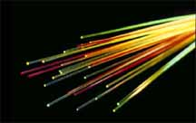
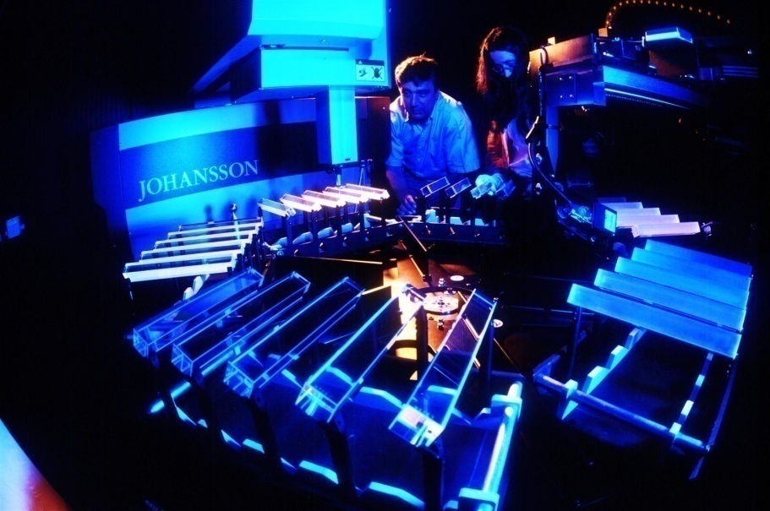
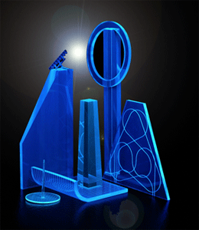
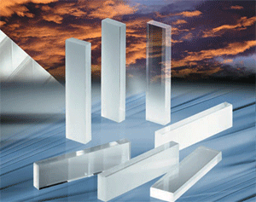
Detectors based on registration of excited Atoms → Scintillators
Scintillator Detectors

Slide 6
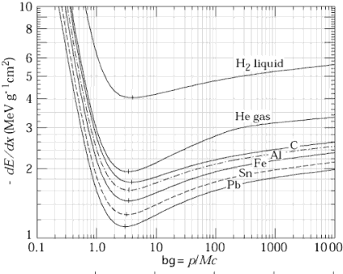
Detectors based on Registration of excited Atoms → Scintillators
Emission of photons of by excited Atoms, typically UV to visible light.
  Observed in Noble Gases (even liquid !)
  b) Inorganic Crystals
  Substances with largest light yield. Used for precision measurement of energetic Photons. Used in Nuclear Medicine.
  c) Polyzyclic Hydrocarbons (Naphtalen, Anthrazen, organic Scintillators)
  Most important category. Large scale industrial production, mechanically and chemically quite robust. Characteristic are one or two decay times of the light emission.
Typical light yield of scintillators:
Energy (visible photons) ≈ few % of the total energy Loss.
z.B. 1cm plastic scintillator, ρ ≈ 1, dE/dx=1.5 MeV, ~15 keV in photons; i.e. ~ 15 000 photons produced.
Scintillator Detectors

Slide 7
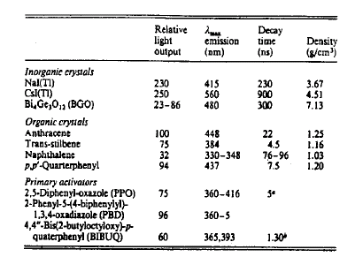
Detectors based on Registration of excited Atoms → Scintillators
Organic (‘Plastic’) Scintillators
Inorganic (Crystal) Scintillators
Low Light Yield Fast: 1-3ns
Large Light Yield Slow: few 100ns
LHC bunchcrossing 25ns LEP bunchcrossing 25μs
Scintillator Detectors

Slide 8
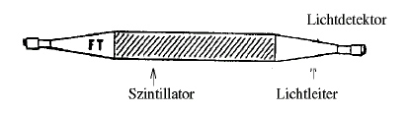
Scintillators
Photons are being reflected towards the ends of the scintillator.
A light guide brings the photons to the Photomultipliers where the photons are converted to an electrical signal.
Scintillator
Light Guide
Photon Detector
By segmentation one can arrive at spatial resolution.
Because of the excellent timing properties (<1ns) the arrival time, or time of flight, can be measured very accurately → Trigger, Time of Flight.
Scintillator Detectors

Slide 9
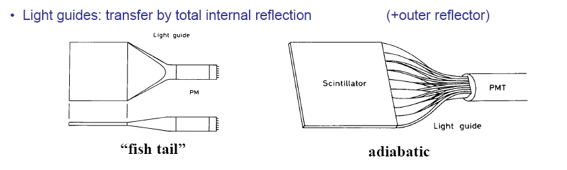
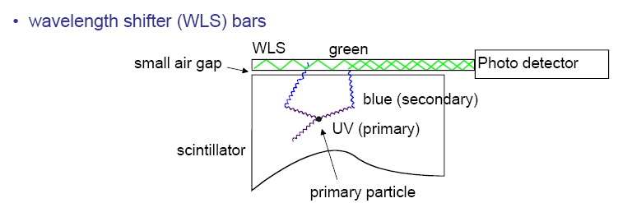
Typical Geometries:
UV light enters the WLS material
Light is transformed into longer wavelength
Total internal reflection inside the WLS material
‘transport’ of the light to the photo detector
From C. Joram
Scintillator Detectors

Slide 10
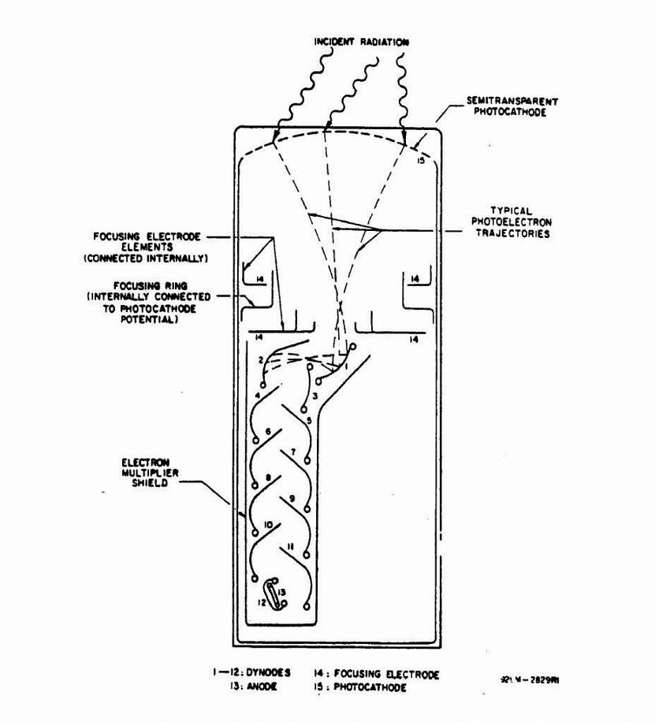
The frequent use of Scintillators is due to:
  Well established and cheap techniques to register Photons → Photomultipliers and the fast response time → 1 to 100ns
Semitransparent photocathode
γ
Schematic of a Photomultiplier:
Typical Gains (as a function of the applied voltage): 10⁸ to 10¹⁰
Typical efficiency for photon detection:
< 20%
For very good PMs: registration of single photons possible.
Example: 10 primary Elektrons, Gain 10⁷→ 10⁸ electrons in the end in T ≈ 10ns. I=Q/T = 10⁸*1.603*10⁻¹⁹/10*10⁻⁹= 1.6mA.
Across a 50 Ω Resistor → U=R*I= 80mV.
glass
PC
e⁻
Scintillator Detectors

Slide 11
Fiber Tracking
Light transport by total internal reflection
Planar geometries
(end cap)
Circular geometries
(barrel)
High geometrical flexibility
Fine granularity
Low mass
Fast response (ns)
(R.C. Ruchti, Annu. Rev. Nucl. Sci. 1996, 46,281)
From C. Joram
Scintillator Detectors

Slide 12
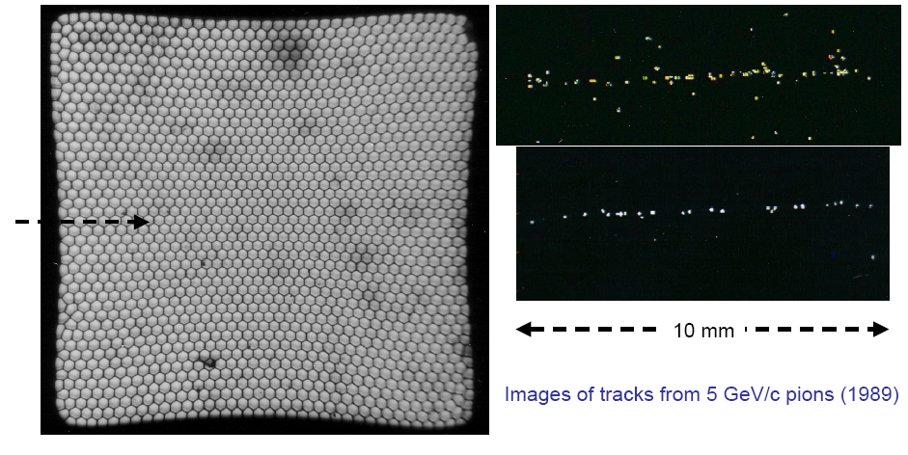
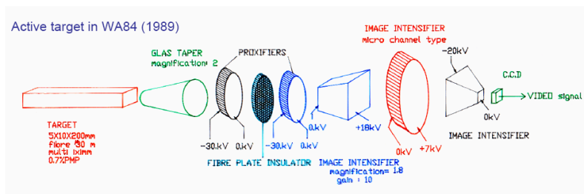
Fiber Tracking
Readout of photons in a cost effective way is rather challenging.
From C. Joram
Scintillator Detectors

Slide 13
Detectors based on Registration of Ionization: Tracking in Gas and Solid State Detectors
Charged particles leave a trail of ions (and excited atoms) along their path: Electron-Ion pairs in gases and liquids, electron hole pairs in solids.
The produced charges can be registered → Position measurement → Tracking Detectors.
Cloud Chamber: Charges create drops → photography.
Bubble Chamber: Charges create bubbles → photography.
Emulsion: Charges ‘blacked’ the film.
Gas and Solid State Detectors: Moving Charges (electric fields) induce electronic signals on metallic electrons that can be read by dedicated electronics.
In solid state detectors the charge created by the incoming particle is sufficient.
In gas detectors (e.g. wire chamber) the charges are internally multiplied in order to provide a measurable signal.
Tracking Detectors

Slide 14
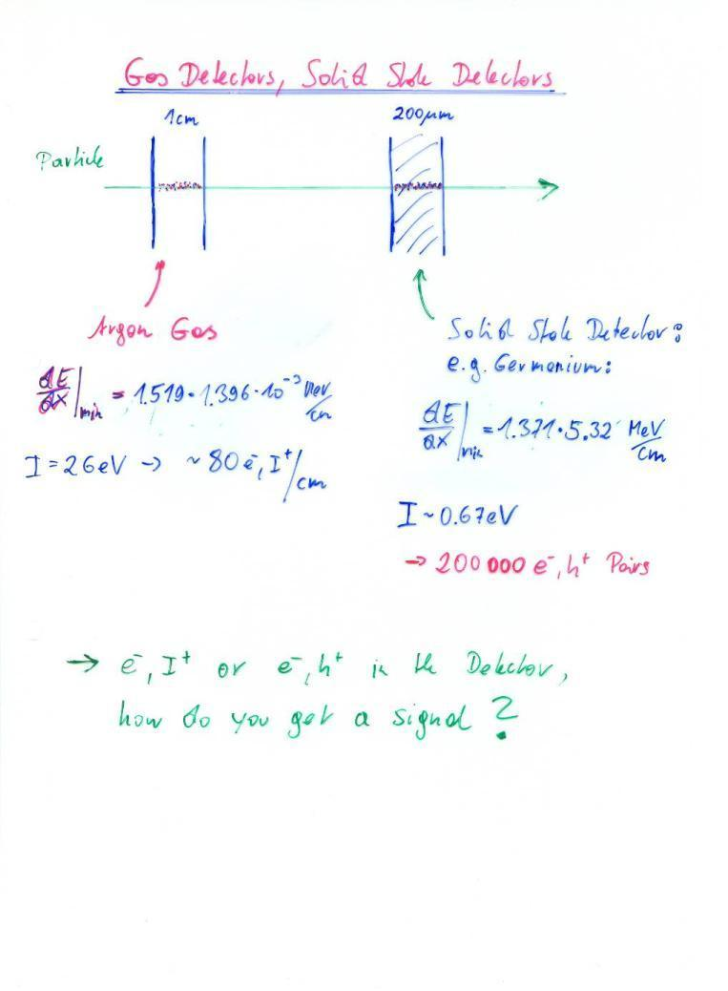
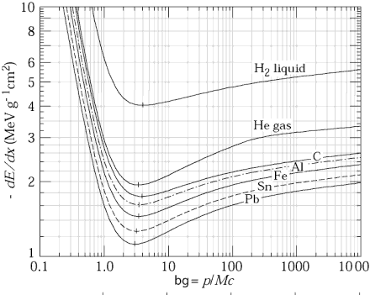
The induced signals are readout out by dedicated electronics.
The noise of an amplifier determines whether the signal can be registered. Signal/Noise >>1
The noise is characterized by the ‘Equivalent Noise Charge (ENC)’ = Charge signal at the input that produced an output signal equal to the noise.
ENC of very good amplifiers can be as low as 50e-, typical numbers are ~ 1000e-.
In order to register a signal, the registered charge must be q >> ENC i.e. typically q>>1000e-.
Gas Detector: q=80e- /cm → too small.
Solid state detectors have 1000x more density and factor 5-10 less ionization energy.
Primary charge is 10⁴-10⁵ times larger than is gases.
Gas detectors need internal amplification in order to be sensitive to single particle tracks.
Without internal amplification they can only be used for a large number of particles that arrive at the same time (ionization chamber).
I=2.9eV
2.5 x 10⁶ e/h pairs/cm
1/ρ
ßγ

Slide 15



Principle of Signal Induction by Moving Charges
The electric field of the charge must be calculated with the boundary condition that the potential φ=0 at z=0.
For this specific geometry the method of images can be used. A point charge –q at distance –z₀ satisfies the boundary condition → electric field.
The resulting charge density is
σ(x,y) = ε₀ E_{z}(x,y)
∫σ(x,y)dxdy = -q
A point charge q at a distance z₀
Above a grounded metal plate ‘induces’ a surface charge.
The total induced charge on the surface is –q.
Different positions of the charge result in different charge distributions.
The total induced charge stays –q.
q
q
-q
-q
I=0

Slide 16


Principle of Signal Induction by Moving Charges
If we segment the grounded metal plate and if we ground the individual strips the surface charge density doesn’t change with respect to the continuous metal plate.
q
The charge induced on the individual strips is now depending on the position z₀ of the charge.
If the charge is moving there are currents flowing between the strips and ground.
→ The movement of the charge induces a current.
V
-q
-q
I₁(t) I₂(t) I₃(t) I₄(t)

Slide 17
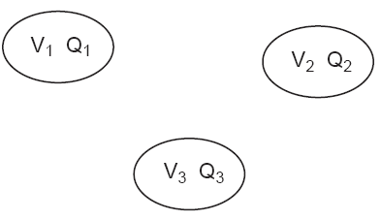
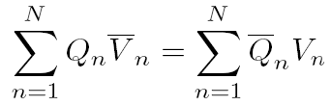
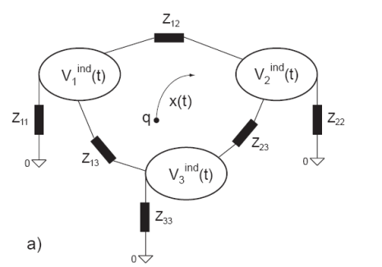
Signal Theorems
Placing charges on metal electrodes results in certain potentials of these electrodes. A different set of charges results in a different set of potentials. The reciprocity theorem states that
Using this theorem we can answer the following general question: What are the signals created by a moving charge on metal electrodes that are connected with arbitrary discrete (linear) components ?

Slide 18
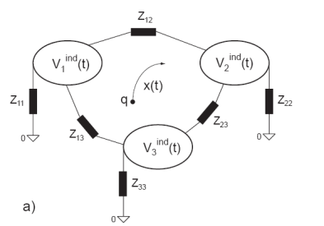
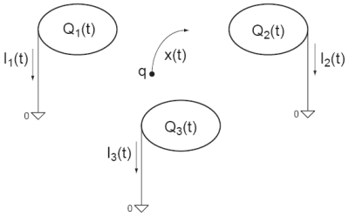
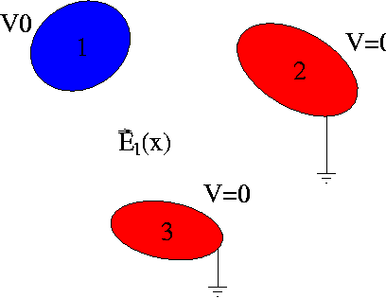

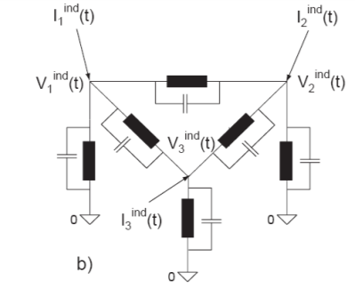


Signal Theorems
What are the charges induced by a moving charge on electrodes that are connected with arbitrary linear impedance elements ?
One first removes all the impedance elements, connects the electrodes to ground and calculates the currents induced by the moving charge on the grounded electrodes.
The current induced on a grounded electrode by a charge q moving along a trajectory x(t) is calculated the following way (Ramo Theorem):
One removes the charge q from the setup, puts the electrode to voltage V₀ while keeping all other electrodes grounded. This results in an electric field E_{n}(x), the Weighting Field, in the volume between the electrodes, from which the current is calculated by
These currents are then placed as ideal current sources on a circuit where the electrodes are ‘shrunk’ to simple nodes and the mutual electrode capacitances are added between the nodes. These capacitances are calculated from the weighting fields by

Slide 19

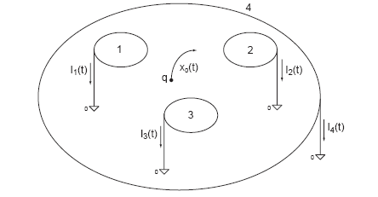
Signal Theorems
The following relations hold for the induced currents:
The charge induced on an electrode in case a charge in between the electrode has moved from a point x₀ to a point x₁ is
and is independent on the actual path.
2) Once ALL charges have arrived at the electrodes, the total induced charge in the electrodes is equal to the charge that has ARRIVED at this electrode.
3) In case there is one electrode enclosing all the others, the sum of all induced currents is zero at any time.

Slide 20

More on signal theorems, readout electronics etc. can be found in this book →

Slide 21
Signals in a Parallel Plate Geometry
I₂
E.g.: Elektron-ion pair in gas
or Electron-ion pair in a liquid
or Electron-hole pair in a solid
Z=D
z
E
q,v_{I}
Z=z₀
-q, v_{e}
Z=0
I₁
E₁=V₀/D
E₂=-V₀/D
I₁= -(-q)/V₀*(V₀/D)*v_{e} - q/V₀ (V₀/D) (-v_{I})
= q/D*v_{e}+q/D*v_{I}
I₂=-I₁
I₁(t)
T_{e}
T_{I}
t
q
Q^{tot}₁= ∫I₁dt = q/D*v_{e} T_{e} + q/D*v_{I}*T_{I}
= q/D*v_{e}*(D-z₀)/v_{e} + q/D*v_{I}*z₀/v_{I}
= q(D-z₀)/D + qz₀/D =
q_{e}+q_{I}=q
Q₁(t)
T_{e}
T_{I}
t
The total induced charge on a specific electrode, once all the charges have arrived at the electrodes, is equal to the charge that has arrived at this specific electrode.

Slide 22
Detectors based on Ionization
Gas detectors:
  Wire Chambers
  Drift Chambers
  Time Projection Chambers
  Transport of Electrons and Ions in Gases
Solid State Detectors
  Transport of Electrons and Holes in Solids
  Si- Detectors
  Diamond Detectors

Slide 23

Gas Detectors with internal Electron Multiplication
Principle: At sufficiently high electric fields (100kV/cm) the electrons gain energy in excess of the ionization energy → secondary ionzation etc. etc.
  dN = N α dx α…Townsend Coefficient
  N(x) = N₀ exp (αx) N/ N₀ = A (Amplification, Gas Gain)
  Avalanche in a homogeneous field:
  Problem: High field on electrode surface
  → breakdown
  In an inhomogeneous Field: α(E) → N(x) = N₀ exp [α(E(x’))dx’]
Ions
Electrons
E

Slide 24

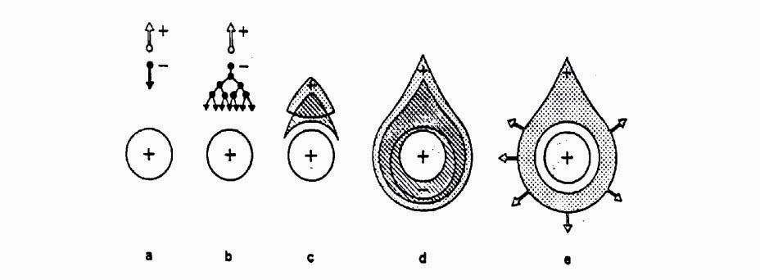
Wire Chamber: Electron Avalanche
Wire with radius (10-25μm) in a tube of radius b (1-3cm):
Electric field close to a thin wire (100-300kV/cm). E.g. V₀=1000V, a=10μm, b=10mm, E(a)=150kV/cm
Electric field is sufficient to accelerate electrons to energies which are sufficient to produce secondary ionization → electron avalanche → signal.
b
b
a
Wire

Slide 25
Wire Chamber: Electron Avalanches on the Wire
Proportional region: A≈10³-10⁴
Semi proportional region: A≈10⁴-10⁵
(space charge effect)
Saturation region: A >10⁶
Independent the number of primary electrons.
Streamer region: A >10⁷
Avalanche along the particle track.
Limited Geiger region:
Avalanche propagated by UV photons.
Geiger region: A≈10⁹
Avalanche along the entire wire.
LHC
1970ies
1950ies

Slide 26
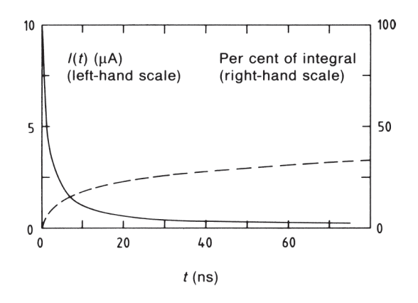

Wire Chamber: Signals from Electron Avalanches
The electron avalanche happens very close to the wire. First multiplication only around R =2x wire radius. Electrons are moving to the wire surface very quickly (<<1ns). Ions are difting towards the tube wall (typically several 100μs. )
The signal is characterized by a very fast ‘spike’ from the electrons and a long Ion tail.
The total charge induced by the electrons, i.e. the charge of the current spike due to the short electron movement amounts to 1-2% of the total induced charge.

Slide 27
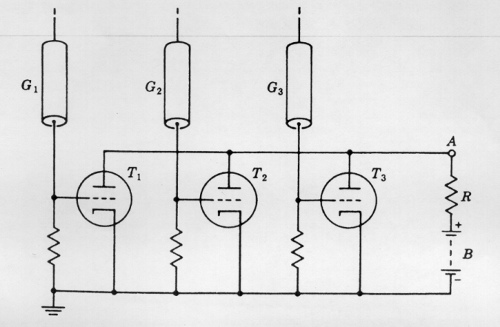
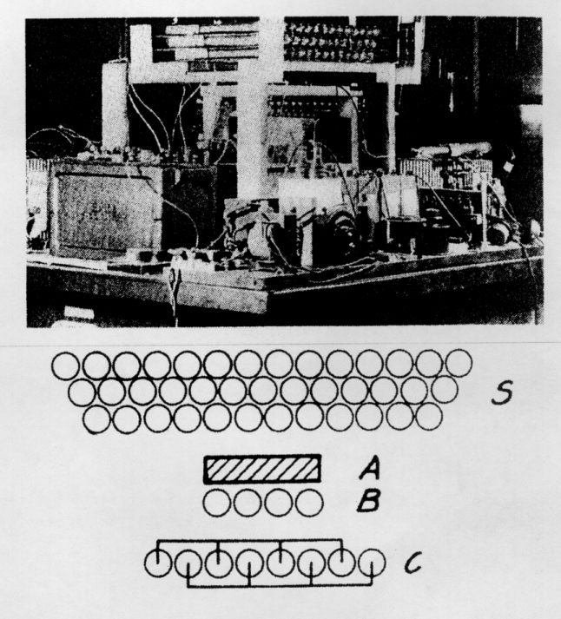
Detectors with Electron Multiplication
Rossi 1930: Coincidence circuit for n tubes
Cosmic ray telescope 1934
Geiger mode, large deadtime
Position resolution is determined by the size of the tubes.
Signal was directly fed into an electronic tube.

Slide 28
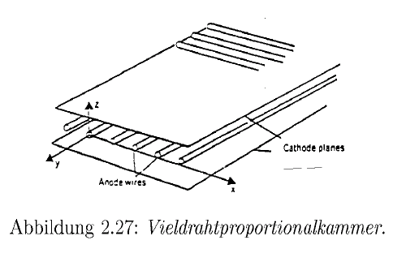
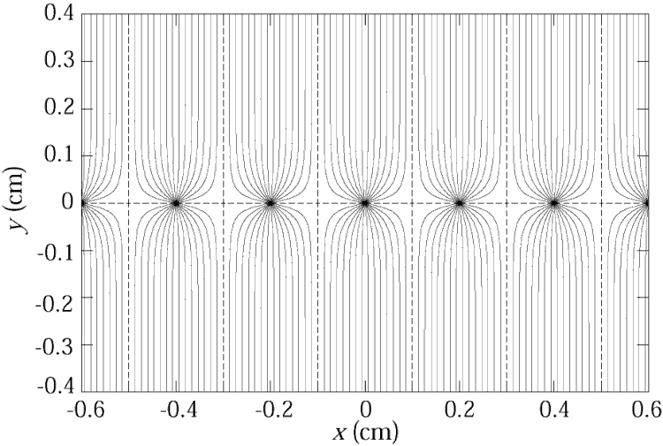
Multi Wire Proportional Chamber
Classic geometry (Crossection), Charpak 1968 :
One plane of thin sense wires is placed between two parallel plates.
Typical dimensions:
Wire distance 2-5mm, distance between cathode planes ~10mm.
Electrons (v≈5cm/μs) are collected within ≈ 100ns. The ion tail can be eliminated by electronics filters → pulses of <100ns length.
For 10% occupancy → every μs one pulse
→ 1MHz/wire rate capabiliy !
→ Compare to Bubble Chamber with 10 Hz !

Slide 29
Multi Wire Proportional Chamber
In order to eliminate the left/right ambiguities: Shift two wire chambers by half the wire pitch.
For second coordinate:
Another chamber at 90⁰ relative rotation
Signal propagation to the two ends of the wire.
Pulse height measurement on both ends of the wire. Because of resisitvity of the wire, both ends see different charge.
Segmenting of the cathode into strips or pads:
The movement of the charges induces a signal on the wire AND on the cathode. By segmentation of the cathode plane and charge interpolation, resolutions of 50μm can be achieved.

Slide 30

Multi Wire Proportional Chamber
Cathode strip:
Width (1σ) of the charge distribution ≈ distance between Wires and cathode plane.
‘Center of gravity’ defines the particle trajectory.
Avalanche

Slide 31
Drift Chambers
Amplifier: t=T
E
Scintillator: t=0
In an alternating sequence of wires with different potentials one finds an electric field between the ‘sense wires’ and ‘field wires’.
The electrons are moving to the sense wires and produce an avalanche which induces a signal that is read out by electronics.
The time between the passage of the particle and the arrival of the electrons at the wire is measured.
The drift time T is a measure of the position of the particle !
By measuring the drift time, the wire distance can be increased (compared to the Multi Wire Proportional Chamber) → save electronics channels !

Slide 32
Drift Chambers, typical Geometries
Electric Field ≈ 1kV/cm
U.Becker Instr. of HEP, Vol#9, p516 World Scientific (1992) ed F.Sauli

Slide 33
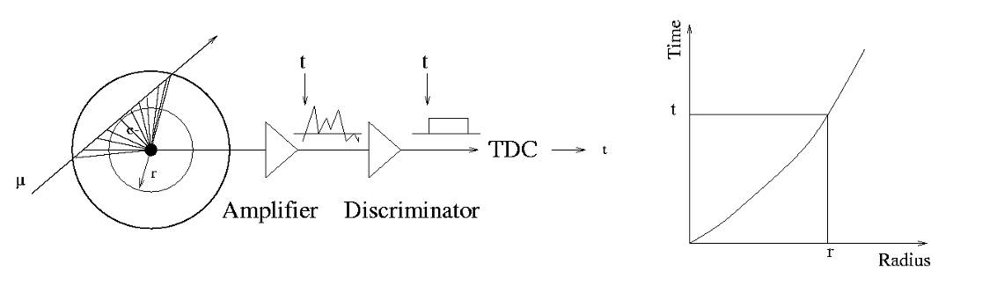
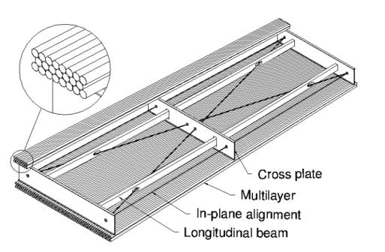
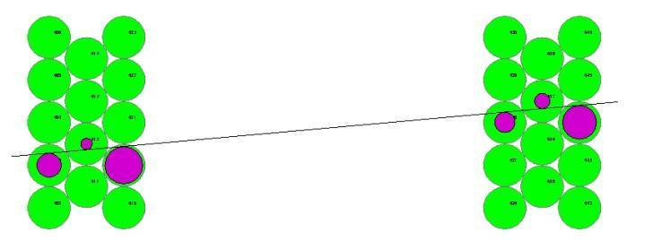
The Geiger Counter reloaded: Drift Tube
Primary electrons are drifting to the wire.
Electron avalanche at the wire.
The measured drift time is converted to a radius by a (calibrated) radius-time correlation.
Many of these circles define the particle track.
ATLAS MDT R(tube) =15mm
Calibrated Radius-Time correlation
ATLAS Muon Chambers
ATLAS MDTs, 80μm per tube

Slide 34

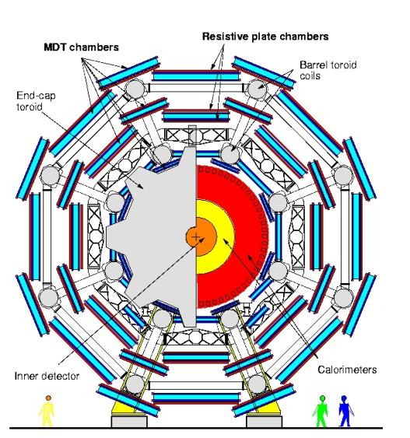
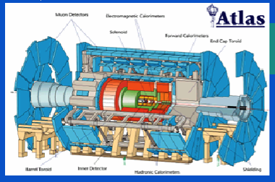
The Geiger counter reloaded: Drift Tube
Atlas Muon Spectrometer, 44m long, from r=5 to11m.
1200 Chambers
6 layers of 3cm tubes per chamber.
Length of the chambers 1-6m !
Position resolution: 80μm/tube, <50μm/chamber (3 bar)
Maximum drift time ≈700ns
Gas Ar/CO₂ 93/7

Slide 35
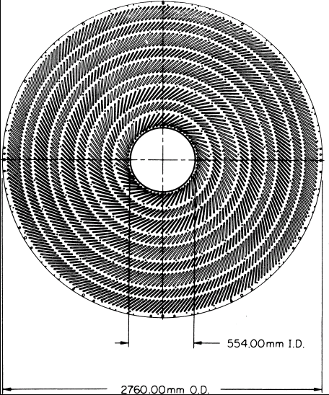
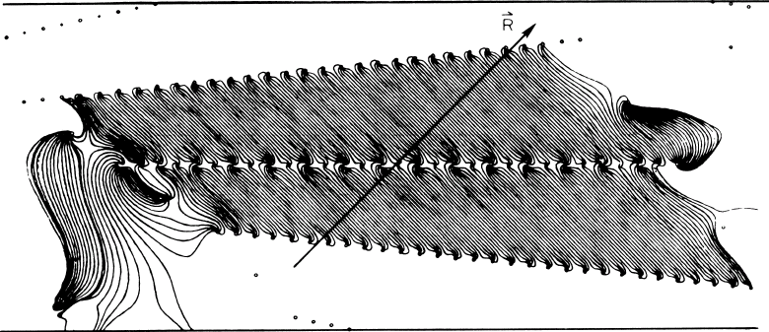
Large Drift Chambers
Central Tracking Chamber CDF Experiment.
660 drift cells tilted 45⁰ with respect to the particle track.
Drift cell

Slide 36
Transport of Electrons in Gases: Drift-velocity
Electrons are completely ‘randomized’ in each collision.
The actual drift velocity v along the electric field is quite different from the average velocity u of the electrons i.e.
about 100 times smaller.
The velocities v and u are determined by the atomic crossection σ(ε ) and the fractional energy loss Δ(ε) per collision (N is the gas density i.e. number of gas atoms/m³, m is the electron mass.):
Because σ(ε )und Δ(ε) show a strong dependence on the electron energy in the typical electric fields, the electron drift velocity v shows a strong and complex variation with the applied electric field.
v is depending on E/N: doubling the electric field and doubling the gas pressure at the same time results in the same electric field.
Ramsauer Effect
Δ

Slide 37
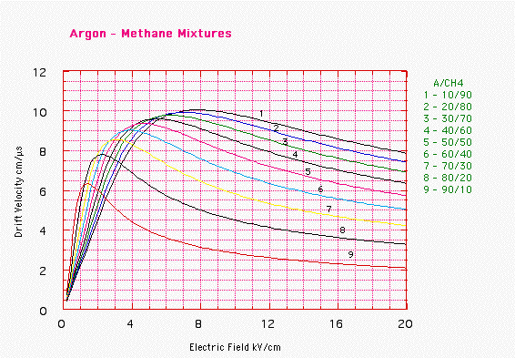
Transport of Electrons in Gases: Drift-velocity
Typical Drift velocities are v=5-10cm/μs (50 000-100 000m/s).
The microscopic velocity u is about ca. 100mal larger.
Only gases with very small electro negativity are useful (electron attachment)
Noble Gases (Ar/Ne) are most of the time the main component of the gas.
Admixture of CO₂, CH₄, Isobutane etc. for ‘quenching’ is necessary (avalanche multiplication – see later).

Slide 38
Transport of Electrons in Gases: Diffusion
An initially point like cloud of electrons will ‘diffuse’ because of multiple collisions and assume a Gaussian shape. The diffusion depends on the average energy of the electrons. The variance σ² of the distribution grows linearly with time. In case of an applied electric field it grows linearly with the distance.
Electric
Field
x
Solution of the diffusion equation (l=drift distance)
Thermodynamic limit:
Because ε= ε(E/P)

Slide 39
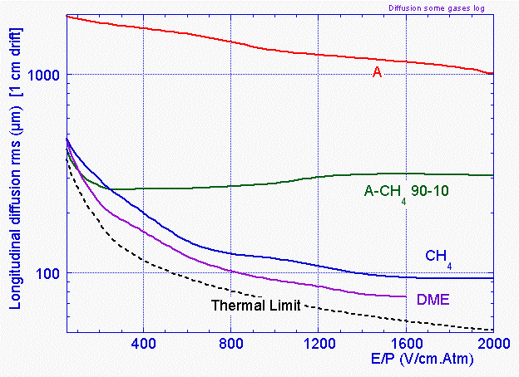
Transport of Electrons in Gases: Diffusion
The electron diffusion depends on E/P and scales in addition with 1/√P.
At 1kV/cm and 1 Atm Pressure the thermodynamic limit is σ=70μm for 1cm Drift.
‘Cold’ gases are close to the thermodynamic limit i.e. gases where the average microscopic energy ε=1/2mu² is close to the thermal energy 3/2kT.
CH₄ has very large fractional energy loss → low ε → low diffusion.
Argon has small fractional energy loss/collision → large ε → large diffusion.
Δ

Slide 40
Drift of Ions in Gases
Because of the larger mass of the Ions compared to electrons they are not randomized in each collision.
The crossections are ≈ constant in the energy range of interest.
Below the thermal energy the velocity is proportional to the electric field
v = μE (typical). Ion mobility μ ≈ 1-10 cm²/Vs.
Above the thermal energy the velocity increases with √E .
V= μE, μ(Ar)=1.5cm²/Vs → 1000V/cm → v=1500cm/s=15m/s → 3000-6000 times slower than electrons !

Slide 41
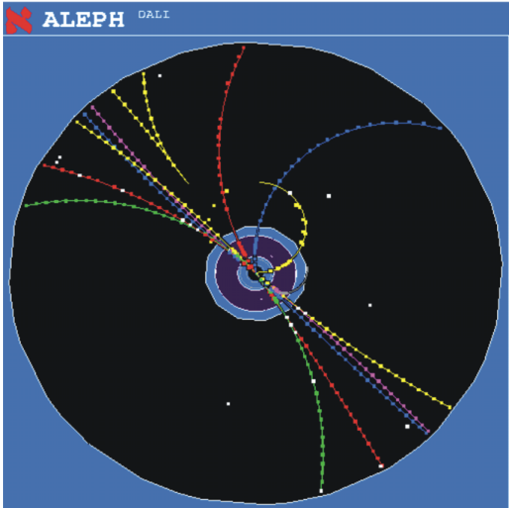
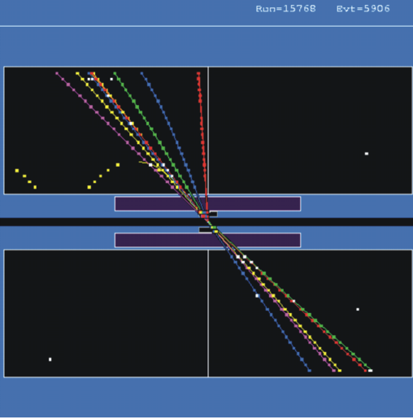
Time Projection Chamber (TPC):
Gas volume with parallel E and B Field.
B for momentum measurement. Positive effect: Diffusion is strongly reduced by E//B (up to a factor 5).
Drift Fields 100-400V/cm. Drift times 10-100 μs.
Distance up to 2.5m !
gas volume
B
drift
E
y
x
z
charged track
Wire Chamber to detect the tracks

Slide 42
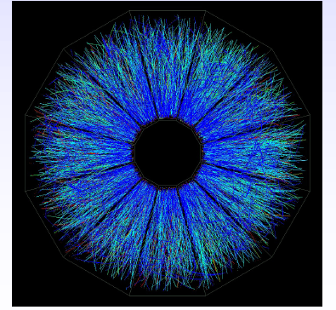
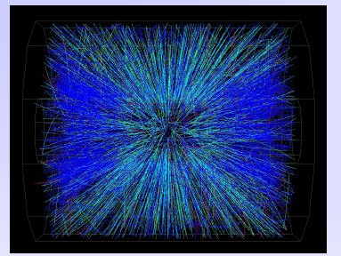
STAR TPC (BNL)
Event display of a Au Au collision at CM energy of 130 GeV/n.
Typically around 200 tracks per event.
Great advantage of a TPC: The only material that is in the way of the particles is gas → very low multiple scattering → very good momentum resolution down to low momenta !

Slide 43
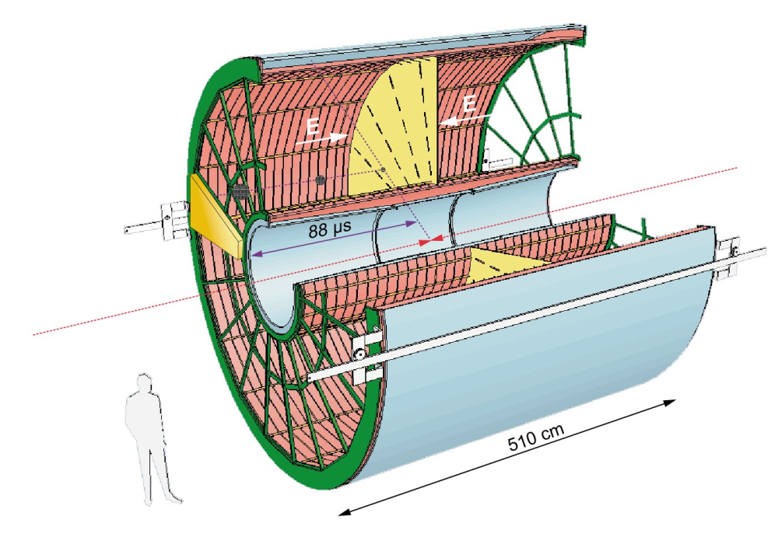
ALICE TPC: Detector Parameters
Gas Ne/ CO₂ 90/10%
Field 400V/cm
Gas gain >10⁴
Position resolution σ= 0.25mm
Diffusion: σ_{t}= 250μm
Pads inside: 4x7.5mm
Pads outside: 6x15mm
B-field: 0.5T

Slide 44
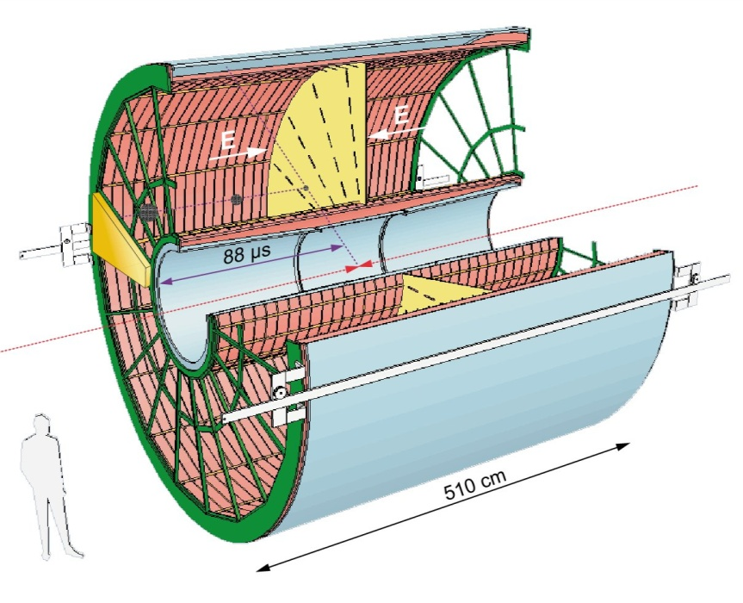
ALICE TPC: Construction Parameters
Largest TPC:
  Length 5m
  Diameter 5m
  Volume 88m³
  Detector area 32m²
  Channels ~570 000
High Voltage:
  Cathode -100kV
Material X₀
  Cylinder from composite materials from airplane industry (X₀= ~3%)

Slide 45
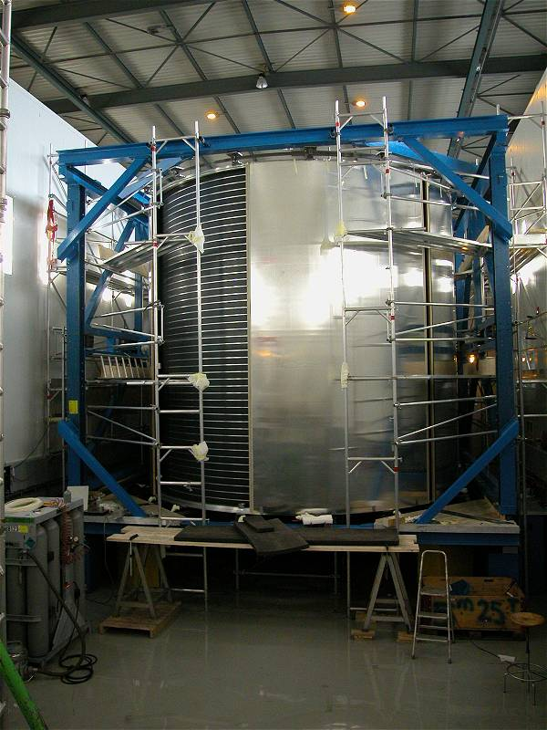
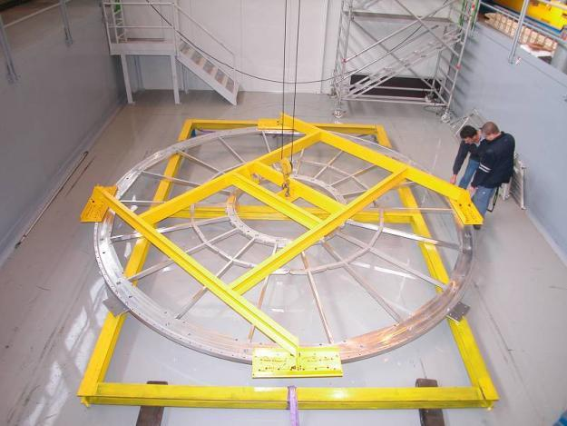
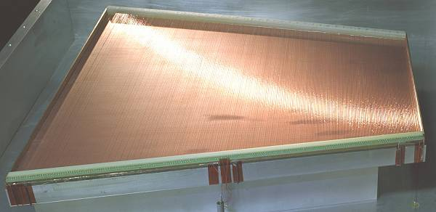
ALICE TPC: Pictures of the Construction
Precision in z: 250μm End plates 250μm
Wire chamber: 40μm

Slide 46
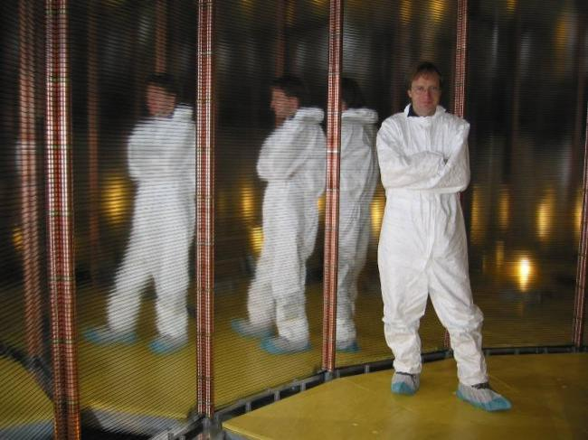
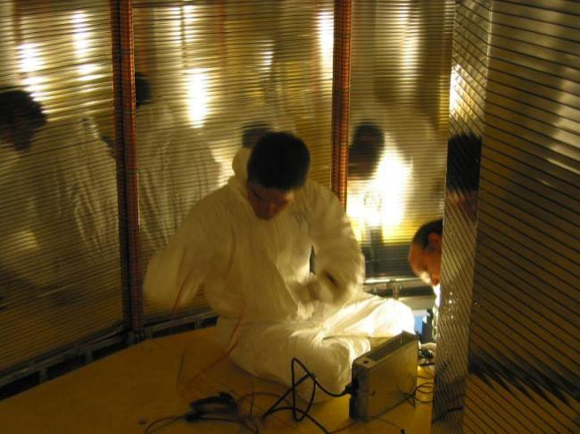
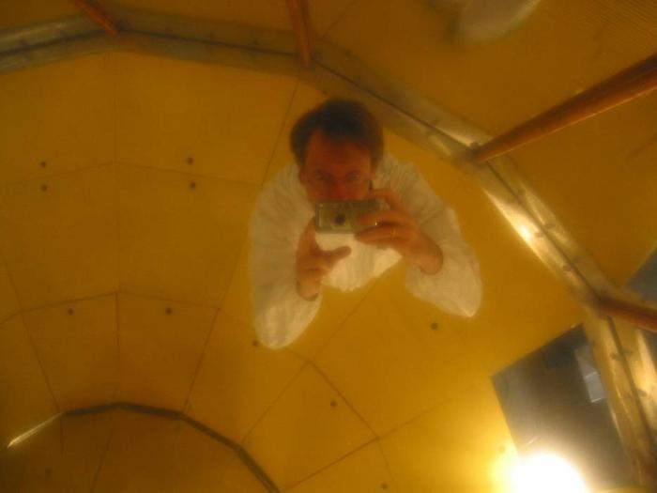
ALICE TPC Construction
My personal contribution:
A visit inside the TPC.

Slide 47

ALICE : Simulation of Particle Tracks
Simulation of particle tracks for a Pb Pb collision (dN/dy ~8000)
Angle: Θ=60 to 62º
If all tracks would be shown the picture would be entirely yellow !
Up to 40 000 tracks per event !
TPC is currently under commissioning

Slide 48

TPC installed in the ALICE Experiment

Slide 49


First 7 TeV Collisions in the ALICE TPC in March 2010 !

Slide 50


Position Resolution/Time resolution
Up to now we discussed gas detectors for tracking applications. Wire chambers can reach tracking precisions down to 50 micrometers at rates up to <1MHz/cm².
What about time resolution of wire chambers ?
It takes the electrons some time to move from thir point of creation to the wire. The fluctuation in this primary charge deposit together with diffusion limits the time resolution of wire chambers to about 5ns (3ns for the LHCb trigger chambers).
By using a parallel plate geometry with high field, where the avalanche is starting immediately after the charge deposit, the timing fluctuation of the arriving electrons can be eliminated and time resolutions down to 50ps can be achieved !

Slide 51
Resistive Plate Chambers (RPCs)
Keuffel ‘Spark’ Counter:
High voltage between two metal plates. Charged particle leaves a trail of electrons and ions in the gap and causes a discharge (Spark).
Excellent Time Resolution(<100ps).
Discharged electrodes must be recharged → Dead time of several ms.
Parallel Plate Avalanche Chambers (PPAC):
At more moderate electric fields the primary charges produce avalanches without forming a conducting channel between the electrodes. No Spark → induced signal on the electrodes.
Higher rate capability.
However, the smallest imperfections on the metal surface cause sparks and breakdown.
→ Very small (few cm²) and unstable devices.
In a wire chamber, the high electric field (100-300kV/cm) that produces the avalanche exists only close to the wire. The fields on the cathode planes area rather small 1-5kV/cm.

Slide 52
Resistive Plate Chambers (RPCs)
→ Place resistive plates in front of the metal electrodes.
No spark can develop because the resistivity together with the capacitance (tau ~ e*ρ) will only allow a very localized ‘discharge’. The rest of the entire surface stays completely unaffected.
→ Large area detectors are possible !
Resistive plates from Bakelite (ρ = 10¹⁰-10¹² Ωcm) or window glass (ρ = 10¹²-10¹³ Ωcm).
Gas gap: 0.25-2mm.
Electric Fields 50-100kV/cm.
Time resolutions: 50ps (100kV/cm), 1ns(50kV/cm)
Application: Trigger Detectors, Time of Flight (TOF)
Resistivity limits the rate capability: Time to remove avalanche charge from the surface of the resistive plate is (tau ~ e*ρ) = ms to s.
Rate limit of kHz/cm² for 10¹⁰ Ωcm.

Slide 53




ALICE TOF RPCs
130 mm
active area 70 mm
Several gaps to increase efficiency. Stack of glass plates.
Small gap for good time resolution: 0.25mm.
Fishing lines as high precision spacers !
Large TOF systems with 50ps time resolution made from window glass and fishing lines !
Before RPCs → Scintillators with very special photomultipliers – very expensive. Very large systems are unaffordable.
Flat cable connector
Differential signal sent from strip to interface card
honeycomb panel
(10 mm thick)
PCB with cathode pickup pads
external glass plates
0.55 mm thick
internal glass plates
(0.4 mm thick)
PCB with
anode pickup pads
Mylar film
(250 micron thick)
5 gas gaps
of 250 micron
PCB with cathode pickup pads
M5 nylon screw to hold
fishing-line spacer
Honeycomb panel (10 mm thick)
connection to bring cathode signal
Silicon sealing compound
to central read-out PCB

Slide 54




GEMs & MICROMEGAS
MICROMEGAS
Narrow gap (50-100 µm) PPC with thin cathode mesh
Insulating gap-restoring wires or pillars
GEM
Thin metal-coated polymer foils
70 µm holes at 140 mm pitch
Y. Giomataris et al, Nucl. Instr. and Meth. A376(1996)239
F. Sauli, Nucl. Instr. and Methods A386(1997)531

Slide 55



MPGDs with Integrate Micromesh, INGRID
Going even another step further, by wafer post-processing techniques, MPGD structure scan be put on top of a pixelized readout chip, making the entire detector a monolithic unit !
→ IntegratedGrid (INGRID) . In addition a TDC was put on each pixel measuring drift times →
Micromesh on a pixelized readout chip produced by Opto-Chemical Wafer Post-Processing Techniques.
With 3cm Drift gap: 5 cm³ Mini TPC !
Tracks from Sr90 source in 0.2T Magnetic Field !
Single ionization electrons are seen.
Fantastic position resolution …
14 x 14 mm²

Slide 56



Detector Simulation

Slide 57

Detector Simulation

Slide 58
Summary on Gas Detectors
Wire chambers feature prominently at LHC. A decade of very extensive studies on gases and construction materials has lead to wire chambers that can track up to MHz/cm² of particles, accumulate up to 1-2C/cm of wire and 1-2 C/cm² of cathode area.
While silicon trackers currently outperform wire chambers close to the interaction regions, wire chambers are perfectly suited for the large detector areas at outer radii.
Large scale next generation experiments foresee wire chambers as large area tracking devices.
The Time Projection Chamber – if the rate allows it’s use – is unbeatable in terms of low material budget and channel economy. There is no reason for replacing a TPC with a silicon tracker.
Gas detectors can be simulated very accurately due to excellent simulation programs.
Novel gas detectors, the Micro Pattern Gas Detectors, have proven to work efficiently as high rate, low material budget trackers in the ‘regime’ between silicon trackers and large wire chambers.

Slide 59
Particle Detectors
Summer Student Lectures 2010
Werner Riegler, CERN, werner.riegler@cern.ch
History of Instrumentation ↔ History of Particle Physics
The ‘Real’ World of Particles
Interaction of Particles with Matter
Tracking with Gas and Solid State Detectors
Calorimetry, Detector Systems

Slide 60
Detectors based on Ionization
Gas detectors:
  Wire Chambers
  Drift Chambers
  Time Projection Chambers
  Transport of Electrons and Ions in Gases
Solid State Detectors
  Transport of Electrons and Holes in Solids
  Si- Detectors
  Diamond Detectors

Slide 61

Solid State Detectors
Gas Detectors
In gaseous detectors, a charged particle is liberating electrons from the atoms, which are freely bouncing between the gas atoms.
An applied electric field makes the electrons and ions move,
which induces signals on the metal readout electrodes.
For individual gas atoms, the electron energy levels are discrete.
Solid State Detectors
In solids (crystals), the electron energy levels are in ‘bands’.
Inner shell electrons, in the lower energy bands, are closely bound to the individual atoms and always stay with ‘their’ atoms.
In a crystal there are however energy bands that are still bound states of the crystal, but they belong to the entire crystal. Electrons in these bands and the holes in the lower band can freely move around the crystal, if an electric field is applied.

Slide 62
Solid State Detectors
Free Electron Energy
Unfilled Bands
Conduction Band
Band Gap
Valance Band
Conductor, Insulator, Semiconductor
In case the conduction band is filled the crystal is a conductor.
In case the conduction band is empty and ‘far away’ from
the valence band, the crystal is an insulator.
In case the conduction band is empty but the distance to the valence band is small, the crystal is a semiconductor.

Slide 63
Solid State Detectors
Band Gap, e-h pair Energy
The energy gap between the last filled band – the valence band – and the conduction band is called band gap E_{g}.
The band gap of Diamond/Silicon/Germanium is 5.5, 1.12, 0.66 eV.
The average energy to produce an electron/hole pair for Diamond/Silicon/Germanium is 13, 3.6, 2.9eV.
Temperature, Charged Particle Detection
In case an electron in the valence band gains energy by some process, it can be excited into the conduction band and a hole in the valence band is left behind.
Such a process can be the passage of a charged particle, but also thermal excitation → probability is proportional Exp(-E_{g}/kT).
The number of electrons in the conduction band is therefore increasing with temperature i.e. the conductivity of a semiconductor increases with temperature.
Band Gap

Slide 64

Solid State Detectors
Electron, Hole Movement:
It is possible to treat electrons in the conduction band and holes in the valence band similar to free particles, but with an effective mass different from elementary electrons not embedded in the lattice.
This mass is furthermore dependent on other parameters such as the direction of movement with respect to the crystal axis. All this follows from the QM treatment of the crystal (solid state physics).
Cooling:
If we want to use a semiconductor as a detector for charged particles, the number of charge carriers in the conduction band due to thermal excitation must be smaller than the number of charge carriers in the conduction band produced by the passage of a charged particle.
Diamond (E_{g}=5.5eV) can be used for particle
detection at room temperature,
Silicon (E_{g}=1.12 eV) and Germanium (E_{g}=0.66eV)
must be cooled, or the free charge carriers
must be eliminated by other tricks → doping → see later.

Slide 65

Solid State Detectors
Primary ‘ionization’:
The average energy to produce an electron/hole pair is: Diamond (13eV), Silicon (3.6eV), Germanium (2.9eV)
Comparing to gas detectors, the density of a solid is about a factor 1000 larger than that of a gas and the energy to produce and electron/hole pair e.g. for Si is a factor 7 smaller than the energy to produce an electron-ion pair in Argon.
Solid State vs. Gas Detector:
The number of primary charges in a Si detector is therefore about 10⁴ times larger than the one in gas → while gas detectors need internal charge amplification, solid state detectors don’t need internal amplification.
While in gaseous detectors, the velocity of electrons and ions differs by a factor 1000, the velocity of electrons and holes in many semiconductor detectors is quite similar → very short signals.
Diamond → A solid state ionization chamber

Slide 66

Diamond Detector
Typical thickness – a few 100μm.
<1000 charge carriers/cm³ at room temperature due to large band gap.
Velocity:
μ_{e}=1800 cm²/Vs, μ_{h}=1600 cm²/Vs
Velocity = μE, 10kV/cm → v=180 μm/ns → Very fast signals of only a few ns length !
I₂
Z=D
I₁(t)
z
E
q,v_{h}
Z=z₀
-q, v_{e}
A single e/h par produced in the center
Z=0
I₁
T=2-3ns

Slide 67

Diamond Detector
I₂
Z=D
E
-q, v_{e}
q,v_{h}
Z=0
I₁
However, charges are trapped along the track, only about 50% of produced primary charge is induced →
I₁(t)
I₁(t)
T=2-3ns
T=2-3ns

Slide 68

Silicon Detector
Velocity:
μ_{e}=1450 cm²/Vs, μ_{h}=505 cm²/Vs, 3.63eV per e-h pair.
~33000 e/h pairs in 300μm of silicon.
However: Free charge carriers in Si:
T=300 K: e,h = 1.45 x 10¹⁰ / cm³ but only 33000 e/h pairs in 300μm produced by a high energy particle.
Why can we use Si as a solid state detector ???

Slide 69




Doping of Silicon
In a silicon crystal at a given temperature the number of electrons in the conduction band is equal to the number of holes in the valence band.
Doping Silicon with Arsen (+5) it becomes and n-type conductor (more electrons than holes).
Doping Silicon with Boron (+3) it becomes a p-type conductor (more holes than electrons).
Bringing p and n in contact makes a diode.
p
n
doping

Slide 70

Si-Diode used as a Particle Detector !
At the p-n junction the charges are depleted and a zone free of charge carriers is established.
By applying a voltage, the depletion zone can be extended to the entire diode → highly insulating layer.
An ionizing particle produces free charge carriers in the diode, which drift in the electric field and induce an electrical signal on the metal electrodes.
As silicon is the most commonly used material in the electronics industry, it has one big advantage with respect to other materials, namely highly developed technology.

Slide 71
Under-Depleted Silicon Detector
-
-
+
+
+
+
+
+
-
+
+
-
+
+
+
+
-
+
+
-
+
+
+
+
+
+
+
+
+
-
p
n
Zone without free charge carriers positively charged.
Sensitive Detector Volume.
Zone with free electrons. Conductive.
Insensitive to particles.
Electric Field

Slide 72
Fully-Depleted Silicon Detector
-
-
+
+
+
+
+
+
+
+
+
+
-
+
+
+
+
-
+
+
+
+
+
+
+
+
+
+
-
+
+
+
+
+
-
+
+
+
+
+
+
+
+
-
+
+
+
+
p
n
Zone without free charge carriers positively charged.
Sensitive Detector Volume.
Electric Field

Slide 73
Over-Depleted Silicon Detector
-
-
+
+
+
+
+
+
+
+
+
+
-
+
+
+
+
-
+
+
+
+
+
+
+
+
+
+
-
+
+
+
+
+
-
+
+
+
+
+
+
+
+
-
+
+
+
+
In contrast to the (un-doped) diamond detector where the bulk is neutral and the electric field is therefore constant, the sensitive volume of a doped silicon detector is charged (space charge region) and the field is therefore changing along the detector.
→ Velocity of electrons and holes is not constant along the detector.
p
n
Zone without free charge carriers positively charged.
Sensitive Detector Volume.
Electric Field

Slide 74

Silicon Detector
ca. 50-150 μm
readout capacitances
Fully depleted zone
SiO₂
passivation
300μm
N (e-h) = 11 000/100μm
Position Resolution down to ~ 5μm !
Solid State Detectors

Slide 75


Silicon Detector
Every electrode is connected to an amplifier →
Highly integrated readout electronics.
Two dimensional readout is possible.
CMS Outer Barrel Module
Solid State Detectors

Slide 76


Slide 77


CMS Tracker

Slide 78


Silicon Drift Detector (like gas TPC !)
bias HV divider
Collection
drift cathodes
pull-up
cathode
ionizing particle
Solid State Detectors

Slide 79

Silicon Drift Detector (like gas TPC !)
Anode axis (Z)
Drift time axis (R-Φ)
Resolution (μm)
Drift distance (mm)
Solid State Detectors

Slide 80
Pixel-Detectors
Problem:
2-dimensional readout of strip detectors results in ‘Ghost Tracks’ at high particle multiplicities i.e. many particles at the same time.
Solution:
Si detectors with 2 dimensional ‘chessboard’ readout. Typical size 50 x 200 μm.
Problem:
Coupling of readout electronics to the detector
Solution:
Bump bonding
Solid State Detectors

Slide 81



Bump Bonding of each Pixel Sensor to the Readout Electronics
ATLAS: 1.4x10⁸ pixels
Solid State Detectors

Slide 82


Radiation Effects ‘Aging’
Increase in leakage current
Increase in depletion voltage
Decrease in charge collection efficiency due to under-depletion and charge trapping.

Slide 83

Obvious Goal: Monolithic Solid State Detectors
→Sensor and Readout Electronics as integral unit
Large variety of
monolithic pixel
Detectors are explored,
Currently mostly adapted
to low collision rates of Linear Colliders.

Slide 84
Summary on Solid State Detectors
Solid state detectors provide very high precision tracking in particle physics experiments (down to 5um) for vertex measurement but also for momentum spectroscopy over large areas (CMS).
Technology is improving rapidly due to rapid Silicon development for electronics industry.
Typical numbers where detectors start to strongly degrade are 10¹⁴-10¹⁵ hadron/cm².
Diamond, engineered Silicon and novel geometries provide higher radiation resistance.
Clearly, monolithic solid state detectors are the ultimate goal. Current developments along these lines are useful for low rate applications.

Slide 85


Calorimetry

Slide 86
Bremsstrahlung
A charged particle of mass M and charge q=Z₁e is deflected by a nucleus of charge Ze (which is partially ‘shielded’ by the electrons). During this deflection the charge is ‘accelerated’ and it therefore radiates → Bremsstrahlung.
Z₂ electrons, q=-e₀
M, q=Z₁ e₀

Slide 87

Bremsstrahlung + Pair Production → EM Shower

Slide 88

Electro-Magnetic Shower of High Energy Electrons and Photons

Slide 89


Calorimetry: Energy Measurement by total Absorption of Particles
Only Electrons and High Energy Photons show EM cascades at current GeV-TeV level Energies.
Strongly interacting particles like Pions, Kaons, produce hadonic showers in a similar fashion to the EM cascade
Hadronic calorimetry
Momentum Spectrometer: Δp/p α p
Calorimeter: Δ E/E α 1/ √ E
Energy measurement improves with higher particle energies – LHC !

Slide 90

Calorimetry: Energy Measurement by total Absorption of Particles
Liquid Nobel Gases
(Nobel Liquids)
Scintillating Crystals,
Plastic Scintillators

Slide 91
Calorimetry
Calorimeters can be classified into:
Electromagnetic Calorimeters,
to measure electrons and photons through their EM interactions.
Hadron Calorimeters,
Used to measure hadrons through their strong and EM interactions.
The construction can be classified into:
Homogeneous Calorimeters,
that are built of only one type of material that performs both tasks, energy degradation and signal generation.
Sampling Calorimeters,
that consist of alternating layers of an absorber, a dense material used to degrade the energy of the incident particle, and an active medium that provides the detectable signal.
C.W. Fabjan and F. Gianotti, Rev. Mod. Phys., Vol. 75, N0. 4, October 2003

Slide 92
Calorimetry
Calorimeters are attractive in our field for various reasons:
In contrast with magnet spectrometers, in which the momentum resolution deteriorates linearly with the particle momentum, on most cases the calorimeter energy resolution improves as 1/Sqrt(E), where E is the energy of the incident particle. Therefore calorimeters are very well suited for high-energy physics experiments.
In contrast to magnet spectrometers, calorimeters are sensitive to all types of particles, charged and neutral. They can even provide indirect detection of neutrinos and their energy through a measurement of the event missing energy.
Calorimeters are commonly used for trigger purposes since they can provide since they can provide fast signals that are easy to process and interpret.
They are space and therefore cost effective. Because the shower length increases only logarithmically with energy, the detector thickness needs to increase only logarithmically with the energy of the particles. In contrast for a fixed momentum resolution, the bending power BL² of a magnetic spectrometer must increase linearly with the particle momentum.
C.W. Fabjan and F. Gianotti, Rev. Mod. Phys., Vol. 75, N0. 4, October 2003

Slide 93


EM Calorimetry
Approximate longitudinal shower development Approximate transverse shower development
Radiation Length X₀ and Moliere Radius are two key parameters for choice of calorimeter materials

Slide 94

Crystals for Homogeneous EM Calorimetry
In crystals the light emission is related to the crystal structure of the material. Incident charged particles create electron-hole pairs and photons are emitted when electrons return to the valence band.
The incident electron or photon is completely absorbed and the produced amount of light, which is reflected through the transparent crystal, is measured by photomultipliers or solid state photon detectors.

Slide 95

Crystals for Homogeneous EM Calorimetry
Barbar@PEPII,
10ms interaction rate, good light yield, good S/N
KTeV@Tevatron,
High rate,
Good resolution
L3@LEP, 25us bunch crossing,
Low radiation dose
CMS@LHC, 25ns bunch crossing,
high radiation dose

Slide 96


Crystals for Homogeneous EM Calorimetry

Slide 97


Noble Liquids for Homogeneous EM Calorimetry
When a charge particle traverses these materials, about half the lost energy is converted into ionization and half into scintillation.
The best energy resolution would obviously be obtained by collecting both the charge and light signal. This is however rarely done because of the technical difficulties to extract light and charge in the same instrument.
Krypton is preferred in homogeneous detectors due to small radiation length and therefore compact detectors. Liquid Argon is frequently used due to low cost and high purity in sampling calorimeters (see later).

Slide 98
Noble Liquids for Homogeneous EM Calorimetry
I₂
Z=D
E
-q, v_{I}
q,v_{e}
Z=0
I₁
E.g. Liquid Argon, 5mm/ μs at 1kV/cm, 5mm gap → 1 μs for all electrons to reach the electrode.
The ion velocity is 10³ to 10⁵ times smaller → doesn’t contribute to the signal for electronics of μs integration time.
I₁(t)
T~1μs

Slide 99




Homogeneous EM Calorimeters, Examples
NA48 Liquid Krypton
2cmx2cm cells
X₀ = 4.7cm
125cm length (27X₀)
ρ = 5.5cm
KTeV CsI
5cmx5cm and
X₀ = 1.85cm
2.5cmx2.5cm crystals
50cm length (27X₀)
ρ = 3.5cm
NA48 Experiment at CERN and KTeV Experiment at Fermilab, both built for measurement of direct CP violation. Homogenous calorimeters with Liquid Krypton (NA48) and CsI (KTeV). Excellent and very similar resolution.
1%
0.8%
0.6%
1%
0.8%
0.6%

Slide 100


Sampling Calorimeters
Energy resolution of sampling calorimeters is in general worse than that of homogeneous calorimeters, owing to the sampling fluctuations – the fluctuation of ratio of energy deposited in the active and passive material.
The resolution is typically in the range 5-20%/Sqrt[E(GeV)] for EM calorimeters. On the other hand they are relatively easy to segment longitudinally and laterally and therefore they usually offer better space resolution and particle identification than homogeneous calorimeters.
The active medium can be scintillators (organic), solid state detectors, gas detectors or liquids.
Sampling Fraction = Energy deposited in Active/Energy deposited in passive material.

Slide 101


Hadronic Calorimetry

Slide 102


Hadron Calorimeters are Large because  is large
Hadron Calorimeters are large and heavy because the hadronic interaction length , the ‘strong interaction equivalent’ to the EM radiation length X₀, is large (5-10 times larger than X₀)
Because part of the energy is ‘invisible’ (nuclear excitation, slow nucleons), the resolution of hadron calorimeters is typically worse than in EM calorimeters 20-100%/Sqrt[E(GeV)] .

