Slide 1
Particle Physics Instrumentation
Werner Riegler, CERN, werner.riegler@cern.ch
The 2011 CERN – Latin-American School of High-Energy Physics Natal, Brazil, 23 March - 5 April 2011
Lecture3/3
Signals, Electronics, Trigger, DAQ

Slide 2
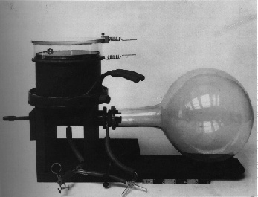
Cloud Chambers 1910-1950ies
Wilson Cloud Chamber 1911

Slide 3
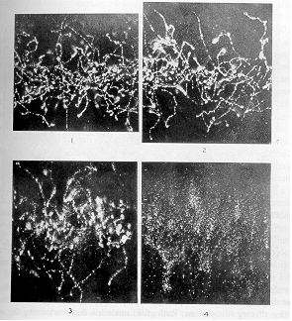
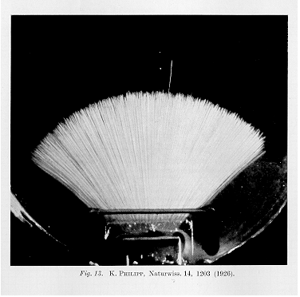
Cloud Chamber
X-rays, Wilson 1912
Alphas, Philipp 1926

Slide 4
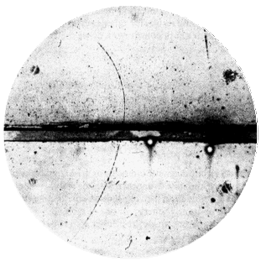
Cloud Chamber
Magnetic field 15000 Gauss,
chamber diameter 15cm. A 63 MeV
positron passes through a 6mm lead plate,
leaving the plate with energy 23MeV.
The ionization of the particle, and its
behaviour in passing through the foil are
the same as those of an electron.
Positron discovery,
Carl Andersen 1933

Slide 5
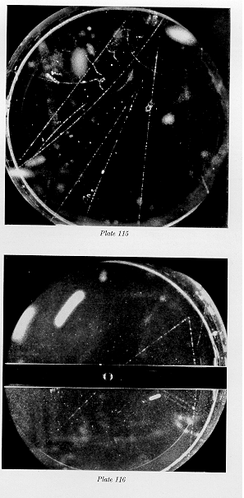
Cloud Chamber
Particle momenta are measured by the bending
in the magnetic field.
‘ … The V0 particle originates in a nuclear
Interaction outside the chamber and decays after
traversing about one third of the chamber.
The momenta of the secondary particles are
1.6+-0.3 BeV/c and the angle between them is 12 degrees … ‘
By looking at the specific ionization one can try to identify the particles and by assuming a two body decay on can find the mass of the V0.
‘… if the negative particle is a negative proton, the mass of the V0 particle is 2200 m, if it is a Pi or Mu
Meson the V0 particle mass becomes about 1000m
…’
Rochester and Wilson

Slide 6
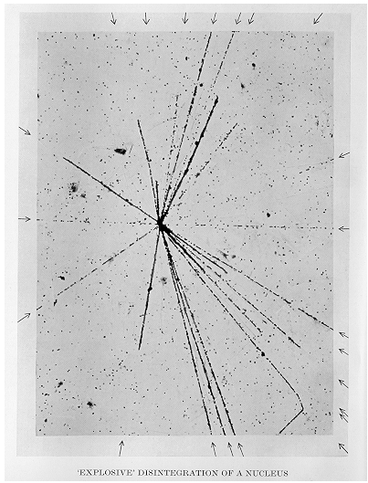
Nuclear Emulsion 1930ies to Present
Film played an important role in the
discovery of radioactivity but was first seen
as a means of studying radioactivity rather
than photographing individual particles.
Between 1923 and 1938 Marietta Blau
pioneered the nuclear emulsion technique.
E.g.
Emulsions were exposed to cosmic rays
at high altitude for a long time (months)
and then analyzed under the microscope.
In 1937, nuclear disintegrations from cosmic
rays were observed in emulsions.
The high density of film compared to the
cloud chamber ‘gas’ made it easier to see
energy loss and disintegrations.

Slide 7
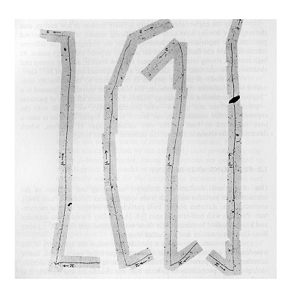
Nuclear Emulsion
Discovery of the Pion:
The muon was discovered in the 1930ies
and was first believed to be Yukawa’s meson
that mediates the strong force.
The long range of the muon was however
causing contradictions with this hypothesis.
In 1947, Powell et. al. discovered the
Pion in Nuclear emulsions exposed to
cosmic rays, and they showed that it decays
to a muon and an unseen partner.
The constant range of the decay muon indicated a
two body decay of the pion.
Discovery of muon and pion

Slide 8
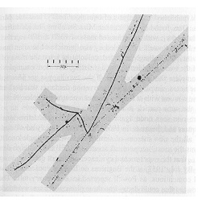
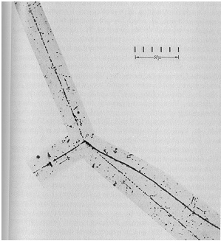
Nuclear Emulsion
First evidence of the decay of the Kaon into 3 Pions was found in 1949.
Pion
Kaon
Pion
Pion

Slide 9
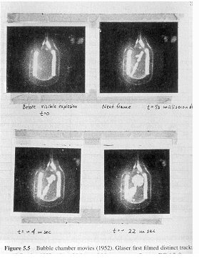
Bubble Chamber 1950ies to early 1980ies
In the early 1950ies Donald Glaser tried to build
on the cloud chamber analogy:
Instead of supersaturating a gas with a vapor
one would superheat a liquid. A particle
depositing energy along it’s path would
then make the liquid boil and form bubbles along
the track.
In 1952 Glaser photographed first Bubble chamber
tracks. Luis Alvarez was one of the main proponents
of the bubble chamber.
The size of the chambers grew quickly
1954: 2.5’’(6.4cm)
1954: 4’’ (10cm)
1956: 10’’ (25cm)
1959: 72’’ (183cm)
1963: 80’’ (203cm)
1973: 370cm

Slide 10
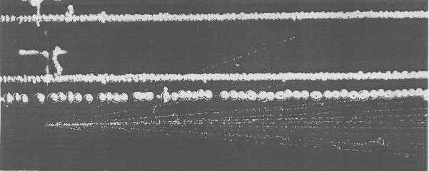
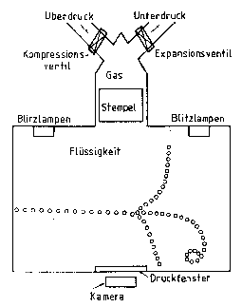
Bubble Chamber
‘old bubbles’
‘new bubbles’
Unlike the Cloud Chamber, the Bubble Chamber
could not be triggered, i.e. the bubble chamber
had to be already in the superheated state when
the particle was entering. It was therefore not
useful for Cosmic Ray Physics, but as in the 50ies
particle physics moved to accelerators it was
possible to synchronize the chamber compression
with the arrival of the beam.
For data analysis one had to look through millions
of pictures.

Slide 11
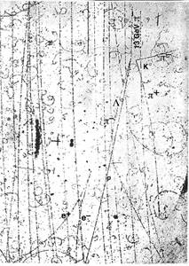
Bubble Chamber
In the bubble chamber, with a density about
1000 times larger that the cloud chamber, the
liquid acts as the target and the detecting
medium.
Figure:
A propane chamber with a magnet discovered the Σ° in 1956.
A 1300 MeV negative pion hits a proton to produce a neutral kaon and a Σ°, which decays into a Λ° and a photon.
The latter converts into an electron-positron pair.

Slide 12
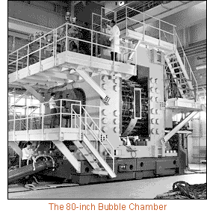
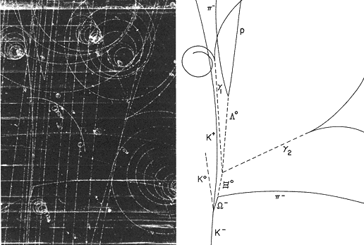
Bubble Chamber
BNL, First Pictures 1963, 0.03s cycle
Discovery of the ⁻ in 1964

Slide 13
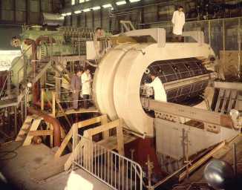
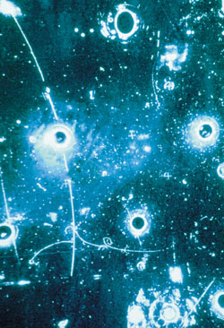
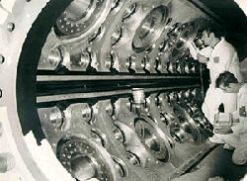
Bubble Chamber
Gargamelle, a very large heavy-liquid (freon) chamber constructed at Ecole Polytechnique in Paris, came to CERN in 1970.
It was 2 m in diameter, 4 m long and filled with Freon at 20 atm.
With a conventional magnet producing a field of almost 2 T, Gargamelle in 1973 was the tool that permitted the discovery of neutral currents.
Can be seen outside the Microcosm Exhibition

Slide 14
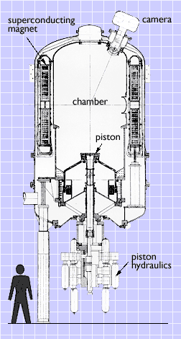
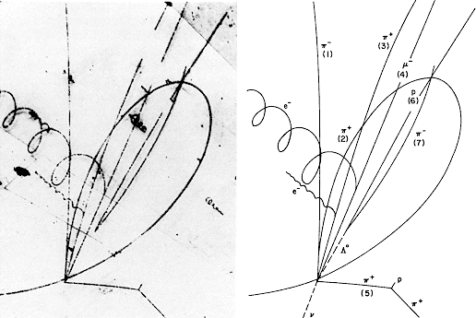
Bubble Chamber
The photograph of the event in the Brookhaven 7-foot bubble chamber which led to the discovery of the charmed baryon (a three-quark particle) is shown at left.
A neutrino enters the picture from below (dashed line) and collides with a proton in the chamber's liquid. The collision produces five charged particles:
A negative muon, three positive pions, and a negative pion and a neutral lambda.
The lambda produces a characteristic 'V' when it decays into a proton and a pi-minus.
The momenta and angles of the tracks together imply that the lambda and the four pions produced with it have come from the decay of a charmed sigma particle, with a mass of about 2.4 GeV.
The detector began routine operations in 1974. The following year, the 7-foot chamber was used to discover the charmed baryon, a particle composed of three quarks, one of which was the "charmed" quark.

Slide 15
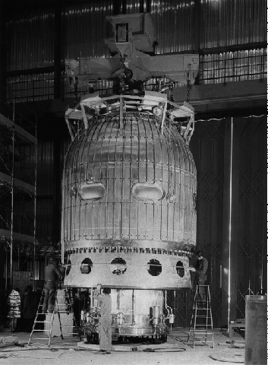
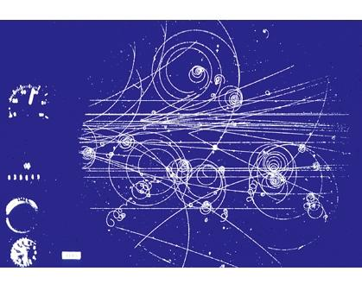
Bubble Chamber
3.7 meter hydrogen bubble chamber at CERN, equipped with the largest superconducting magnet in the world.
During its working life from 1973 to 1984, the "Big European Bubble Chamber" (BEBC) took over 6 million photographs.
Can be seen outside the Microcosm Exhibition

Slide 16
Bubble Chambers
The excellent position (5μm) resolution and the fact that target and detecting volume are the same (H chambers) makes the Bubble chamber almost unbeatable for reconstruction of complex decay modes.
The drawback of the bubble chamber is the low rate capability (a few tens/ second). E.g. LHC 10⁹ collisions/s.
The fact that it cannot be triggered selectively means that every interaction must be photographed.
Analyzing the millions of images by ‘operators’ was a quite laborious task.
That’s why electronics detectors took over in the 70ties.

Slide 17
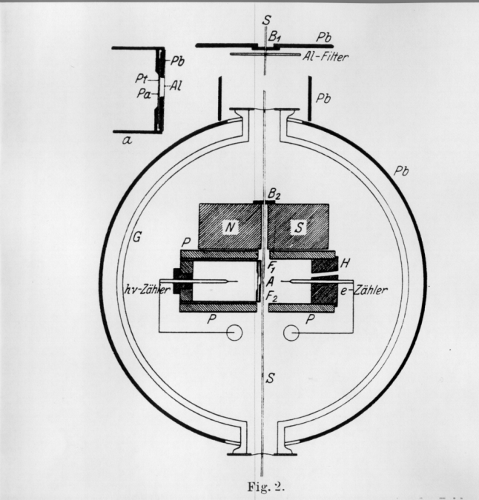
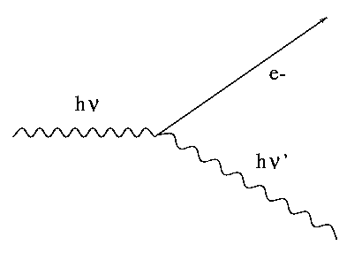
Detector + Electronics 1925
‘Über das Wesen des Compton Effekts’
W. Bothe, H. Geiger, April 1925
Bohr, Kramers, Slater Theorie:
Energy is only conserved statistically
testing Compton effect
‘ Spitzenzähler ’

Slide 18
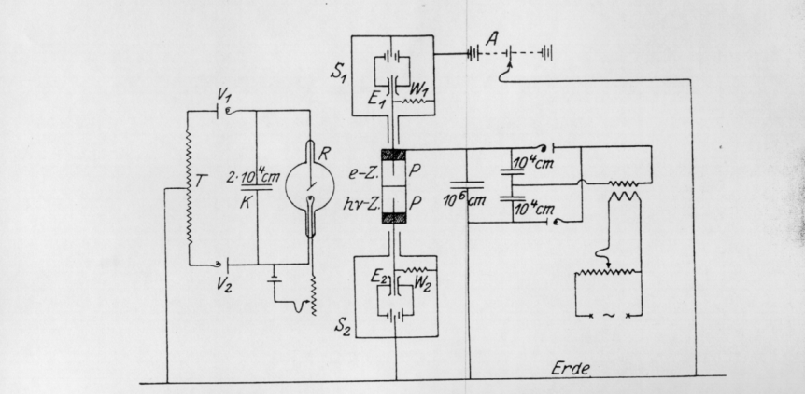
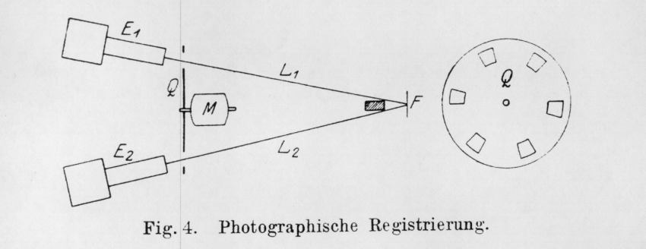
Detector + Electronics 1925
‘Über das Wesen des Compton Effekts’, W. Bothe, H. Geiger, April 1925
‘’Electronics’’:
Cylinders ‘P’ are on HV.
The needles of the counters are insulated and connected to electrometers.
Coincidence Photographs:
A light source is projecting both electrometers on a moving film role.
Discharges in the counters move the electrometers , which are recorded on the film.
The coincidences are observed by looking through many meters of film.

Slide 19
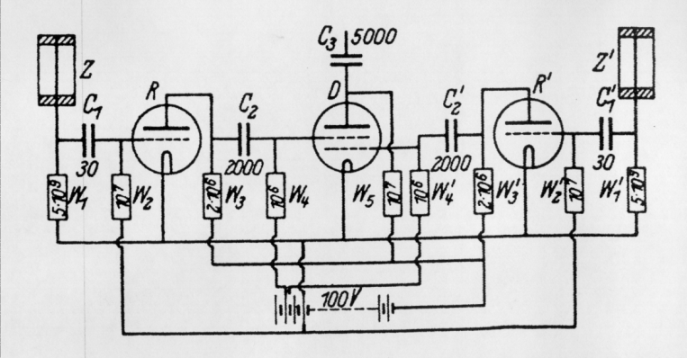
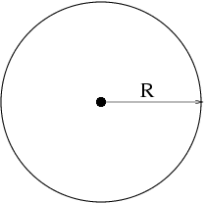
Detector + Electronics 1929
In 1928 Walther Müller started
to study the sponteneous
discharges systematically and
found that they were actually caused
by cosmic rays discovered by
Victor Hess in 1911.
By realizing that the wild discharges
were not a problem of the counter, but
were caused by cosmic rays, the
Geiger-Müller counter went, without
altering a single screw from a device with
‘fundametal limits’ to the most sensitive
intrument for cosmic rays physics.
‘Zur Vereinfachung von Koinzidenzzählungen’
W. Bothe, November 1929
Coincidence circuit for 2 tubes

Slide 20
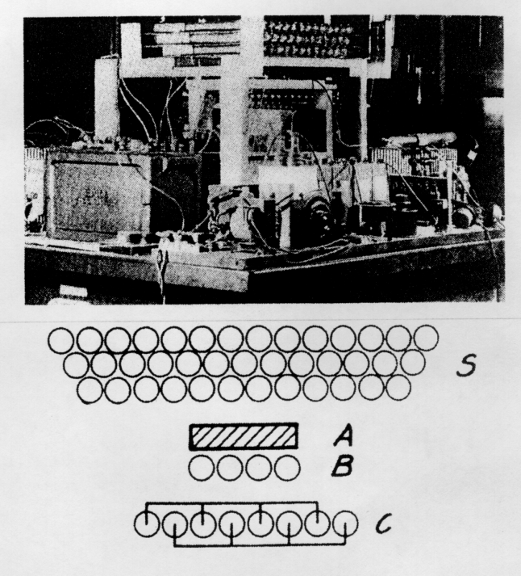
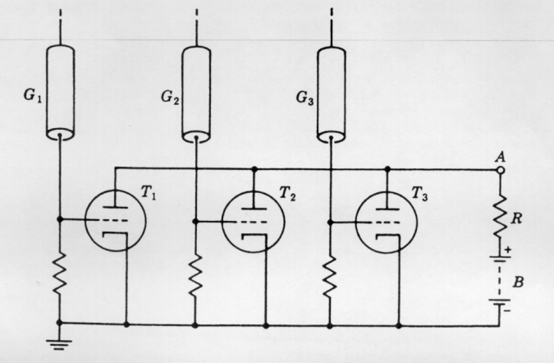
1930 - 1934
Cosmic ray telescope 1934
Rossi 1930: Coincidence circuit for n tubes

Slide 21
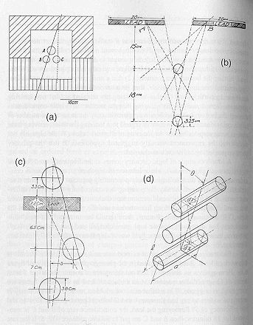
Geiger Counters
By performing coincidences of Geiger Müller tubes e.g. the angular distribution of cosmic ray particles could be measured.

Slide 22
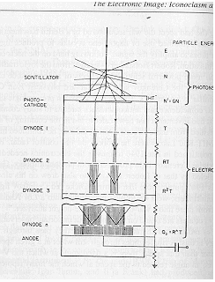
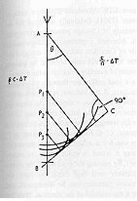
Scintillators, Cerenkov light, Photomultipliers
In the late 1940ies, scintillation counters and Cerenkov counters exploded into use.
Scintillation of materials on passage of particles was long known.
By mid 1930 the bluish glow that accompanied the passage of
radioactive particles through liquids was analyzed and largely explained
(Cerenkov Radiation).
Mainly the electronics revolution begun during the war initiated this development.
High-gain photomultiplier tubes, amplifiers, scalers, pulse-height analyzers.

Slide 23
Antiproton
One was looking for a negative particle with the mass of the proton. With a bending magnet, a certain particle momentum was selected (p=mv).
Since Cerenkov radiation is only emitted if v>c/n, two Cerenkov counters (C1, C2) were set up to measure a velocity comparable with the proton mass.
In addition the time of flight between S1 and S2 was required to be between 40 and 51ns, selecting the same mass.

Slide 24
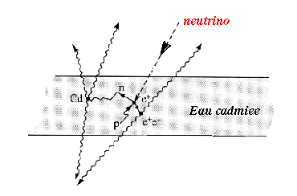
Anti Neutrino Discovery 1959
Reines and Cowan experiment principle consisted in using a target made of around 400 liters of a mixture of water and cadmium chloride.
The anti-neutrino coming from the nuclear reactor interacts with a proton of the target matter, giving a positron and a neutron.
The positron annihilates with an electron of the surrounding material, giving two simultaneous photons and the neutron slows down until it is eventually captured by a cadmium nucleus, implying the emission of photons some 15 microseconds after those of the positron annihilation.
■ + p → n + e⁺

Slide 25
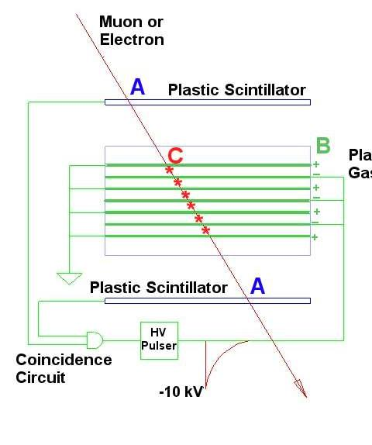
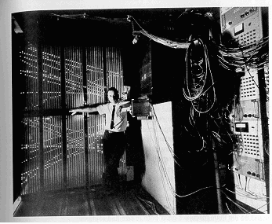
Spark Counters
The Spark Chamber was developed in the early 60ies.
Schwartz, Steinberger and Lederman used it in
discovery of the muon neutrino
A charged particle traverses the detector and leaves an ionization trail.
The scintillators trigger an HV pulse between the metal plates and sparks form in the place where the ionization took place.

Slide 26
The Electronic Image
During the 1970ies, the Image and Logic devices merged into
‘Electronics Imaging Devices’

Slide 27
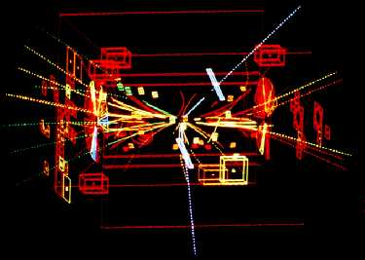
W, Z-Discovery 1983/84
UA1 used a very large
wire chamber.
Can now be seen in the CERN Microcosm Exhibition
This computer reconstruction shows the tracks of charged particles from the proton-antiproton collision. The two white tracks reveal the Z's decay. They are the tracks of a high-energy electron and positron.

Slide 28
Moore’s Law
Moore's law describes a long-term trend in the history of computing hardware. The number of transistors that can be placed inexpensively on an integrated circuit doubles approximately every two years. This trend has continued for more than half a century and is expected to continue until 2015 or 2020 or later.
The capabilities of many digital electronic devices are strongly linked to Moore's law: processing speed, memory capacity, sensors and even the number and size of pixels in digital cameras All of these are improving at (roughly) exponential rates as well.
This exponential improvement has dramatically enhanced the impact of digital electronics in nearly every segment of the world economy → and clearly in Particle Physics.

Slide 29
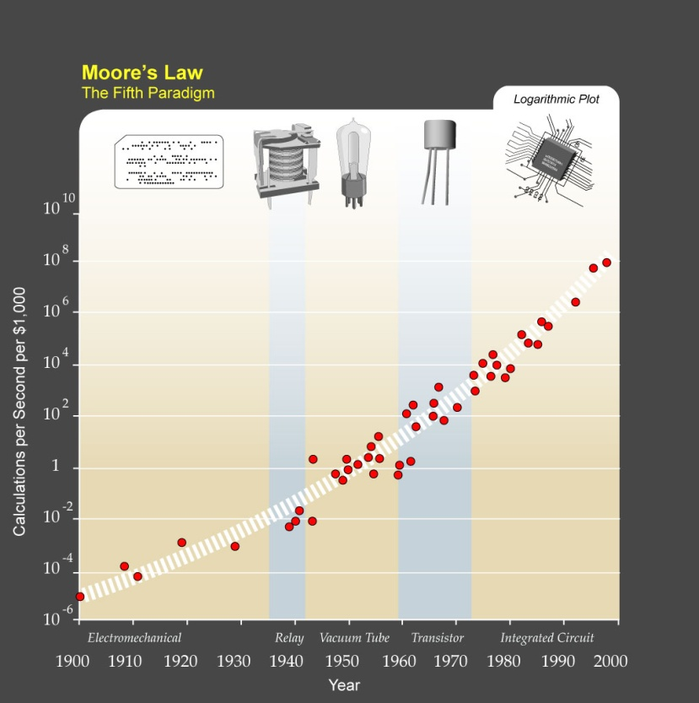
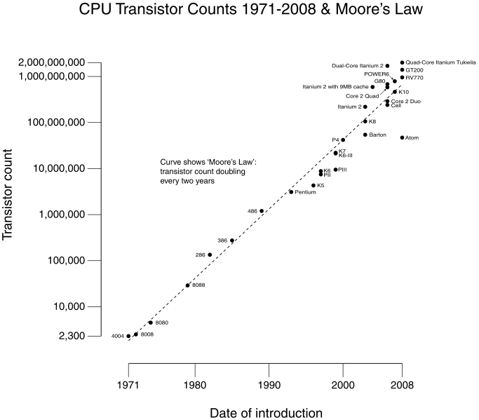
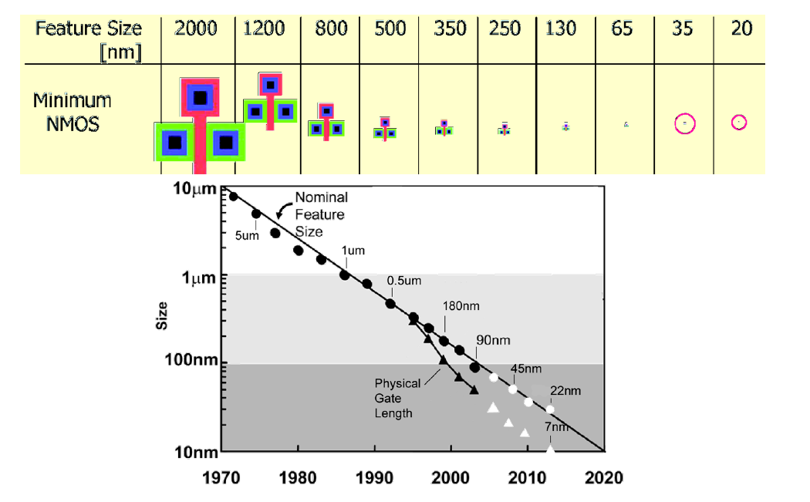
Moore’s Law

Slide 31
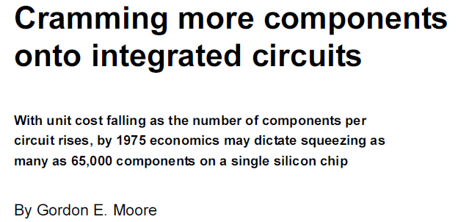

Slide 32
DAQ Concepts

Slide 33
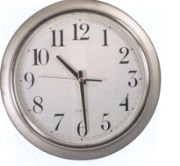
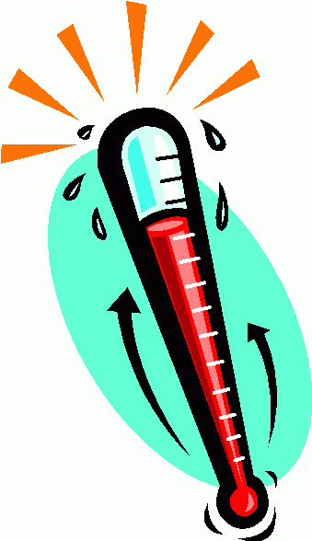
Measuring Temperature
A temperature sensor is connected to an Analog to Digital Converter which is readout out by a PC.
The PC triggers the readout periodically.
Trigger
e.g. Periodic Trigger
Read
out
ADC
Disc

Slide 34
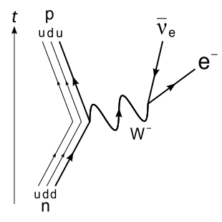
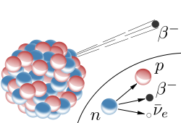
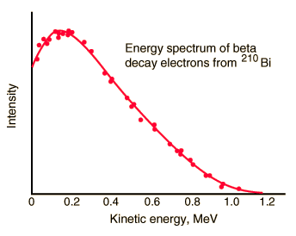
Measuring the β Spectrum
Germanium Detector (Ge)
Trigger starting ADC measurement and Readout
Trigger
Delay
ADC
Delay
Read
out
Disc

Slide 35
Measuring the β Spectrum
Placing a box of scintillators around the detector one can detect the many cosmic rays that will traverse the detector, so by requiring the absence of a signal in the scintillator box together with the signal in the Ge detector one can eliminate the cosmic ray background from the measurement.
Trigger starting ADC measurement and Readout
Trigger
Delay
ADC
Delay
Read
out
Disc

Slide 36
Measuring the Muon Lifetime
Scintillator 1
A Cosmic muon enters the setup and gets stuck in S2.
After some time it decays and the electron leaves through.
Scintillator 2
Scintillator 3
We start a clock with a coincidence of S1 AND S2 and NOT S3
(in a small time window of e.g. 100ns).
We stop the clock with a coincidence of S2 AND S3 and NOT S1
(in a small time window of e.g. 100ns).
The histogram of the measured times is an exponential distribution with an average corresponding to the muon lifetime.

Slide 37
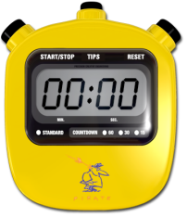
Measuring the Muon Lifetime
Trigger
&
&
TDC
start
stop
Trigger stopping TDC clock and starting readout
This Trigger selects the interesting events (muon getting stuck) from the many more uninteresting events (muons passing through all three scintillators)
Read
out
Disc

Slide 38
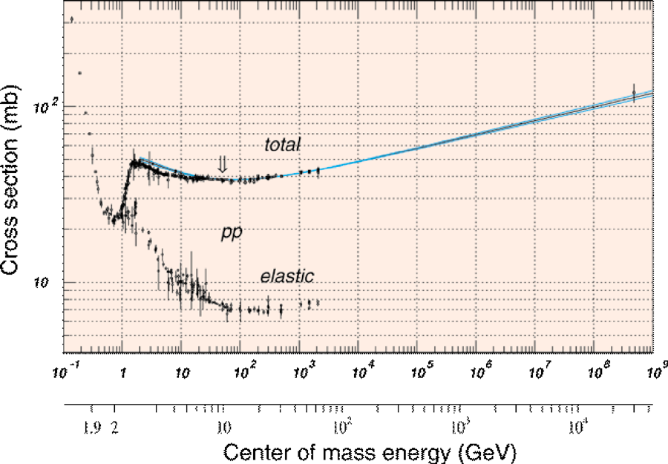
pp cross section and min. bias
# of interactions/crossing:
Interactions/s:
Lum = 10³⁴ cm^{–2}s^{–1}=10⁷mb^{–1}Hz
σ(pp) = 70 mb
Interaction Rate, R = 7x10⁸ Hz
Events/beam crossing:
Δt = 25 ns = 2.5x10^{–8} s
Interactions/crossing=17.5
Not all p bunches are full
2835 out of 3564 only
Interactions/”active” crossing = 17.5 x 3564/2835 = 23
σ(pp)≈70 mb
Operating conditions (summary):
1) A "good" event containing a Higgs decay +
2)
≈
20 extra "bad" (minimum bias) interactions

Slide 39
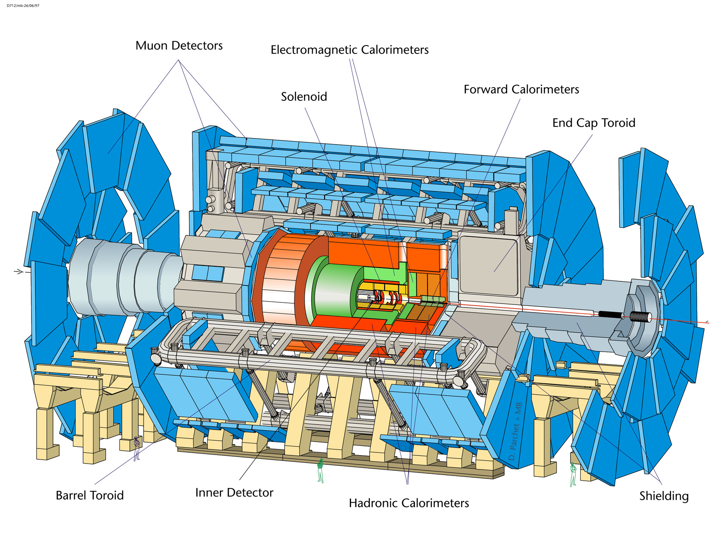
Time of Flight
c=30cm/ns; in 25ns, s=7.5m

Slide 40
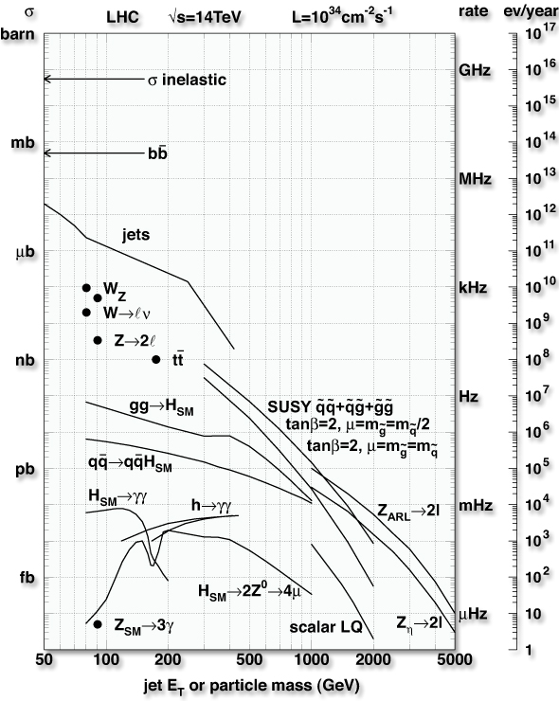
Selectivity: the physics
Cross sections of physics processes vary over many orders of magnitude
Inelastic: 10⁹ Hz
W→ l ν: 10² Hz
t t production: 10 Hz
Higgs (100 GeV/c²): 0.1 Hz
Higgs (600 GeV/c²): 10^{–2} Hz
QCD background
Jet E_{T} ~250 GeV: rate = 1 kHz
Jet fluctuations → electron bkg
Decays of K, π, b → muon bkg
Selection needed: 1:10^{10–11}
Before branching fractions...
Event rate
Level-1
On tape

Slide 41
Basic DAQ: periodic trigger
External View
Measure temperature at a fixed frequency
ADC performs analog to digital conversion (digitization)
Our front-end electronics
CPU does readout and processing
T sensor
Physical View
T sensor
CPU
ADC Card
disk
Logical View
Processing
ADC
storage
Trigger (periodic)

Slide 42
Basic DAQ: periodic trigger
External View
Measure temperature at a fixed frequency
The system is clearly limited by the time to process an “event”
Example =1ms to
ADC conversion +CPU processing +Storage
Sustain ~1/1ms=1kHz periodic trigger rate
T sensor
Physical View
T sensor
CPU
ADC Card
disk
Logical View
Processing
ADC
storage
Trigger (periodic)

Slide 43
Basic DAQ: real trigger
Measure  decay properties
Events are asynchronous and unpredictable
Need a physics trigger
Delay compensates for the trigger latency
Sensor
Trigger
Delay
Discriminator
Start
ADC
Processing
Interrupt
disk

Slide 44
Basic DAQ: real trigger
Measure  decay properties
Need a physics trigger
Stochastic process
Fluctuations
Sensor
Trigger
Delay
Discriminator
Start
Probability of time (in ms) between events for average decay rate of f=1kHz → =1ms
ADC
=1ms
Processing
Interrupt
What if a trigger is created when the system is busy?
disk

Slide 45
Basic DAQ: real trigger & busy logic
f=1kHz
1/f==1ms
Busy logic avoids triggers while processing
Which (average) DAQ rate can we achieve now?
Reminder: =1ms was sufficient to run at 1kHz with a clock trigger
Sensor
Trigger
Delay
Discriminator
Start
ADC
and
not
Processing
Interrupt
=1ms
Set
Clear
Q
Ready
Busy Logic
disk

Slide 46
DAQ Deadtime & Efficiency (1)
Define DAQ deadtime (d) as the ratio between the time the system is busy and the total time. In our example d=0.1%/Hz
Due to the fluctuations introduced by the stochastic process the efficiency will always be less 100%
In our specific example, d=0.1%/Hz, f=1kHz → =500Hz, =50%

Slide 47
DAQ Deadtime & Efficiency (2)
If we want to obtain ~f (~100%) → f<<1 → <<
f=1kHz, =99% → <0.1ms → 1/>10kHz
In order to cope with the input signal fluctuations, we have to over-design our DAQ system by a factor 10. This is very inconvenient! Can we mitigate this effect?

Slide 48
Basic DAQ: De-randomization
f=1kHz
1/f==1ms
First-In First-Out
Buffer area organized as a queue
Depth: number of cells
Implemented in HW and SW
Sensor
Trigger
Delay
Start
Discriminator
ADC
Full
FIFO
Busy Logic
and
Data
ready
Processing
FIFO introduces an additional latency on the data path
disk
The FIFO absorbs and smooths the input fluctuation, providing a ~steady (De-randomized) output rate

Slide 49
De-randomization: queuing theory

FIFO

We can now attain a FIFO efficiency ~100% with ~
Moderate buffer size
Analytic calculation possible for very simple systems only. Otherwise simulations must be used.

Slide 50
De-randomization: summary
f=1kHz
1/f==1ms
Almost 100% efficiency and minimal deadtime are achieved if
ADC is able to operate at rate >>f
Data processing and storing operates at ~f
The FIFO decouples the low latency front-end from the data processing
Minimize the amount of “unnecessary” fast components
Could the delay be replaced with a “FIFO”?
Analog pipelines → Heavily used in LHC DAQs
Sensor
Trigger
Delay
Start
Discriminator
ADC
Full
FIFO
Busy Logic
and
Data
ready
Processing
disk

Slide 51
Basic DAQ: collider mode
Timing
Sensor
Beam crossing
BX
Particle collisions are synchronous
Trigger rejects uninteresting events
Even if collisions are synchronous, the triggers (i.e. good events) are unpredictable
De-randomization is still needed
Start
ADC
Abort
Trigger
Discriminator
FIFO
Full
Busy Logic
Data ready
Processing
disk

