Slide 1
Particle Physics Instrumentation
Werner Riegler, CERN, werner.riegler@cern.ch
The 2011 CERN – Latin-American School of High-Energy Physics
Natal, Brazil, 23 March - 5 April 2011
Lecture1/3
…

Slide 2
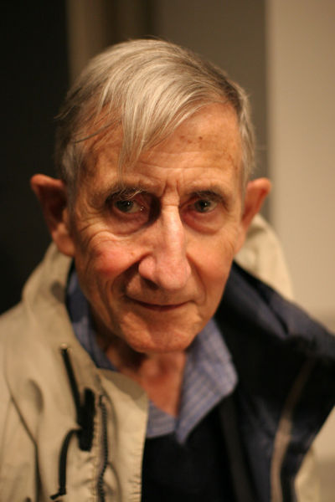
On Tools and Instrumentation
“New directions in science are launched by new tools much more often than by new concepts.
The effect of a concept-driven revolution is to explain old things in new ways.
The effect of a tool-driven revolution is to discover new things that have to be explained”
Freeman Dyson, Imagined Worlds
→ New tools and technologies will be extremely important to go beyond LHC

Slide 3
Physics Nobel Prices for Instrumentation
1927: C.T.R. Wilson, Cloud Chamber
1939: E. O. Lawrence, Cyclotron & Discoveries
1948: P.M.S. Blacket, Cloud Chamber & Discoveries
1950: C. Powell, Photographic Method & Discoveries
1954: Walter Bothe, Coincidence method & Discoveries
1960: Donald Glaser, Bubble Chamber
1968: L. Alvarez, Hydrogen Bubble Chamber & Discoveries
1992: Georges Charpak, Multi Wire Proportional Chamber

Slide 4
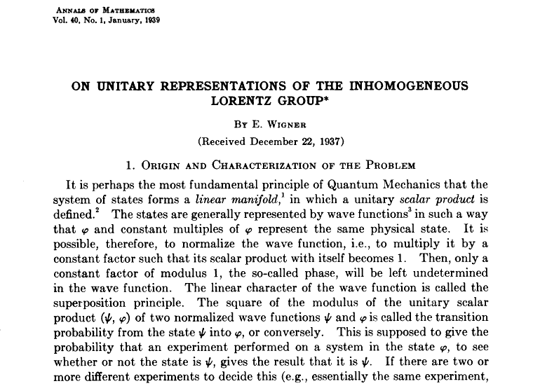
The ‘Real’ World of Particles
E. Wigner:
“A particle is an irreducible representation of the inhomogeneous Lorentz group”
Spin=0,1/2,1,3/2 … Mass>0
E.g. in Steven Weinberg, The Quantum Theory of Fields, Vol1

Slide 5
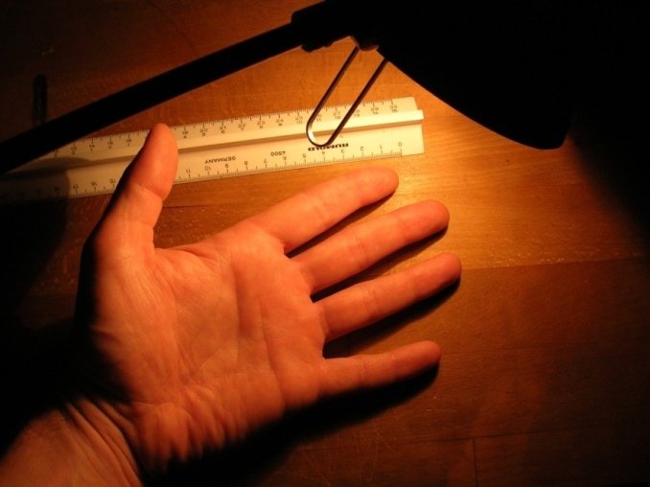
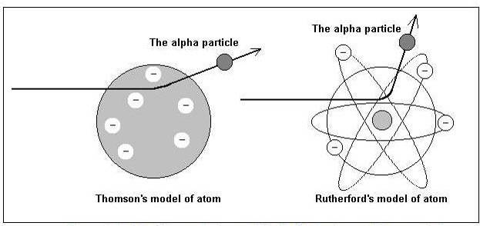
The ‘Real’ World of Particles
W. Riegler:
“…a particle is an object that interacts with your detector such that you can follow it’s track,
it interacts also in your readout electronics and will break it after some time,
and if you a silly enough to stand in an intense particle beam for some time you will be dead …”
Looking at your hand by scattering light off it is the same thing as looking at the nucleons by scattering alpha particles (or electrons) off it.

Slide 6
Before discussing the working principles of detectors let’s have a look at a few modern →
Particle Detector Systems

Slide 7
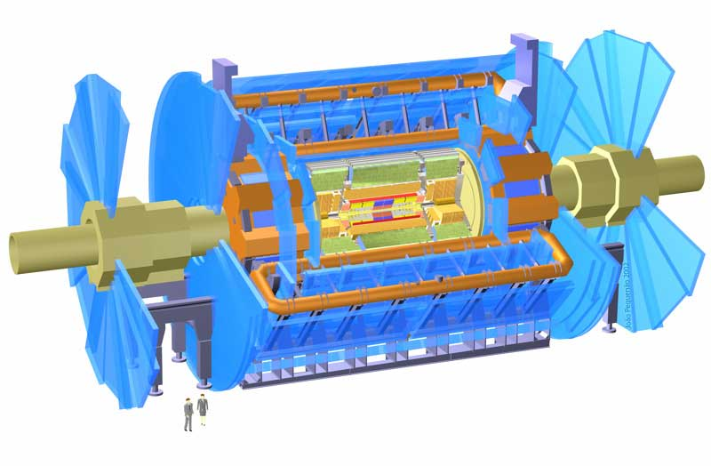
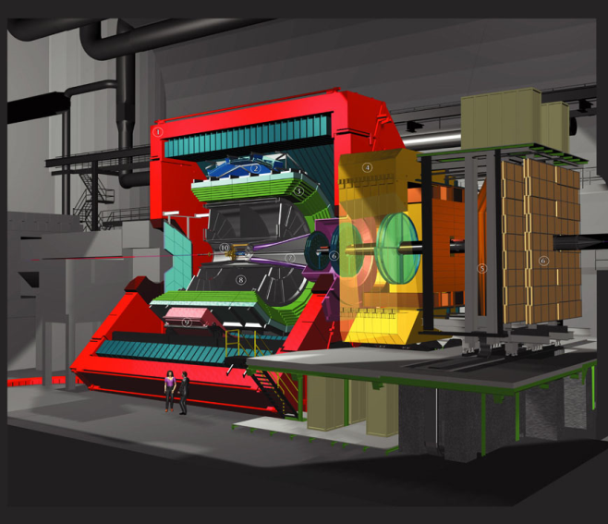
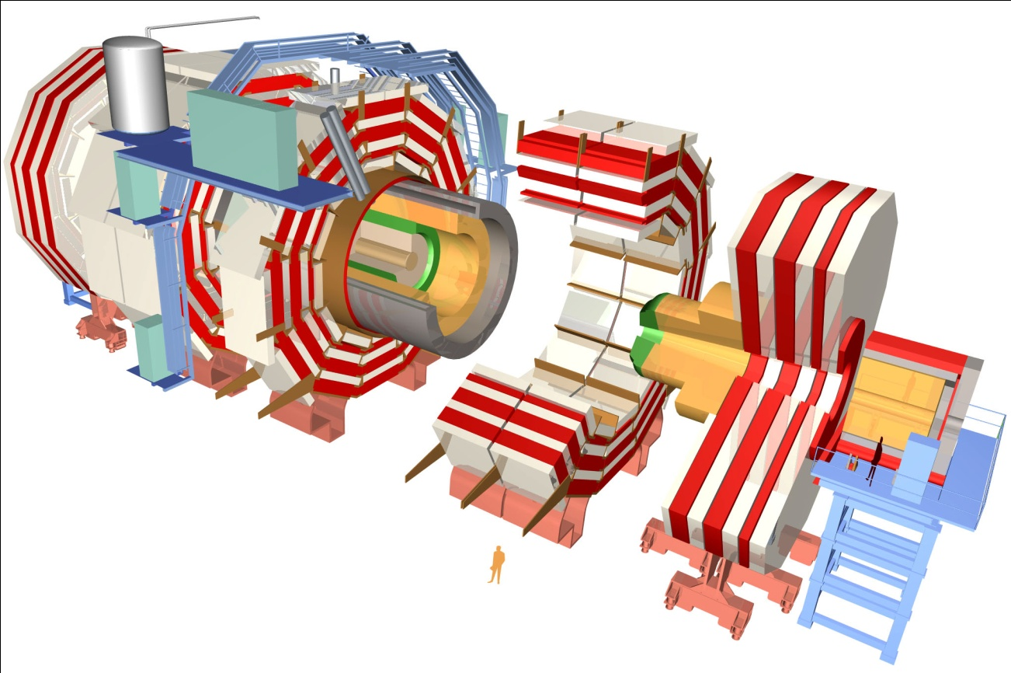
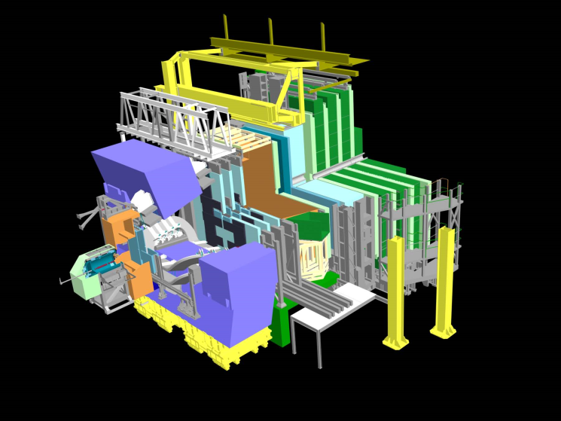
The Giants
ATLAS
ALICE
LHCb
CMS

Slide 8
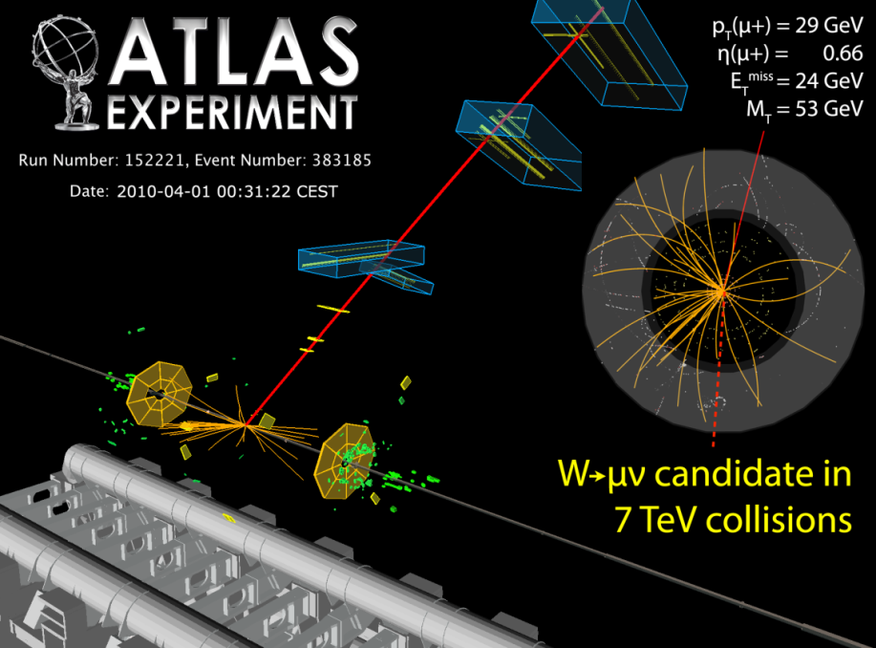
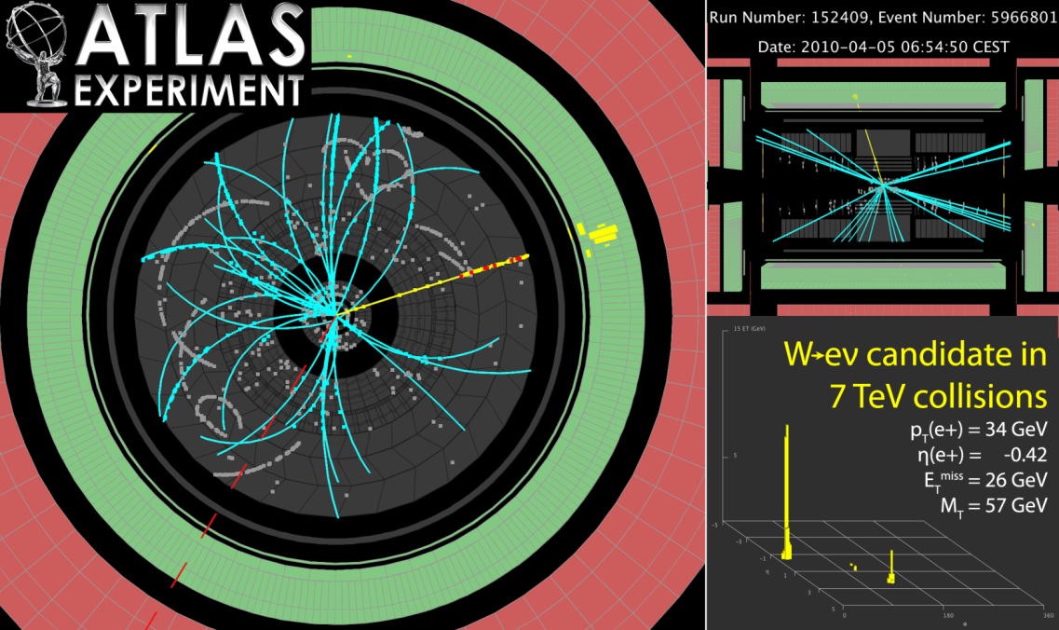
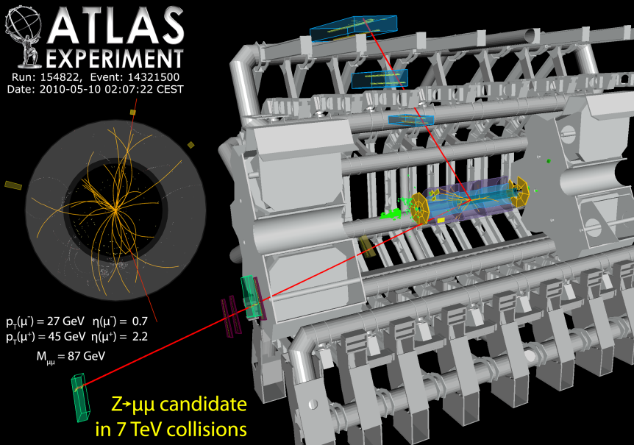
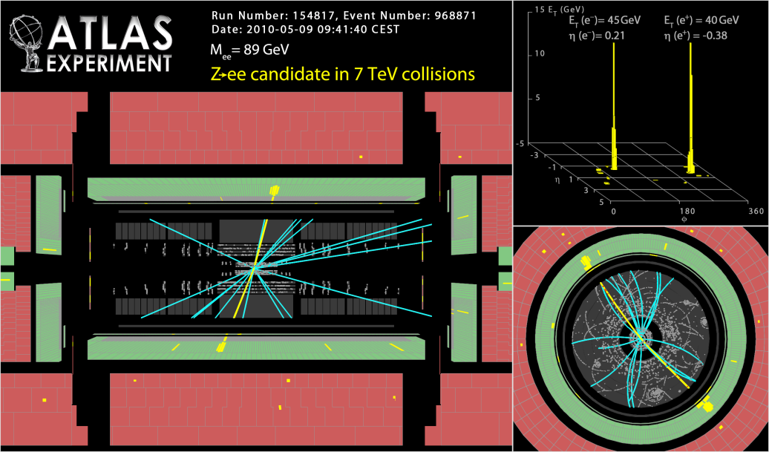

Slide 9
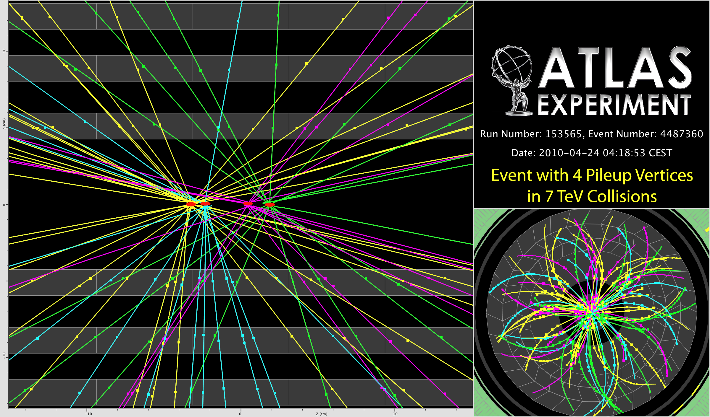
pp Collisions

Slide 10
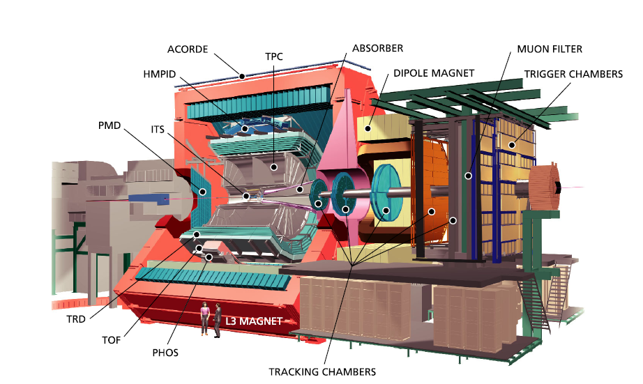
ALICE

Slide 11
ALICE Particle ID
Alice uses ~ all
known techniques!
TPC + ITS
(dE/dx)
π/K
K/p
e /π
TOF
e /π
π/K
K/p
HMPID
(RICH)
π/K
K/p
0 1 2 3 4 5 p (GeV/c)
TPC (rel. rise) π /K/p
TRD e /π
PHOS γ /π⁰
π/K
K/p
1 10 100 p (GeV/c)

Slide 12
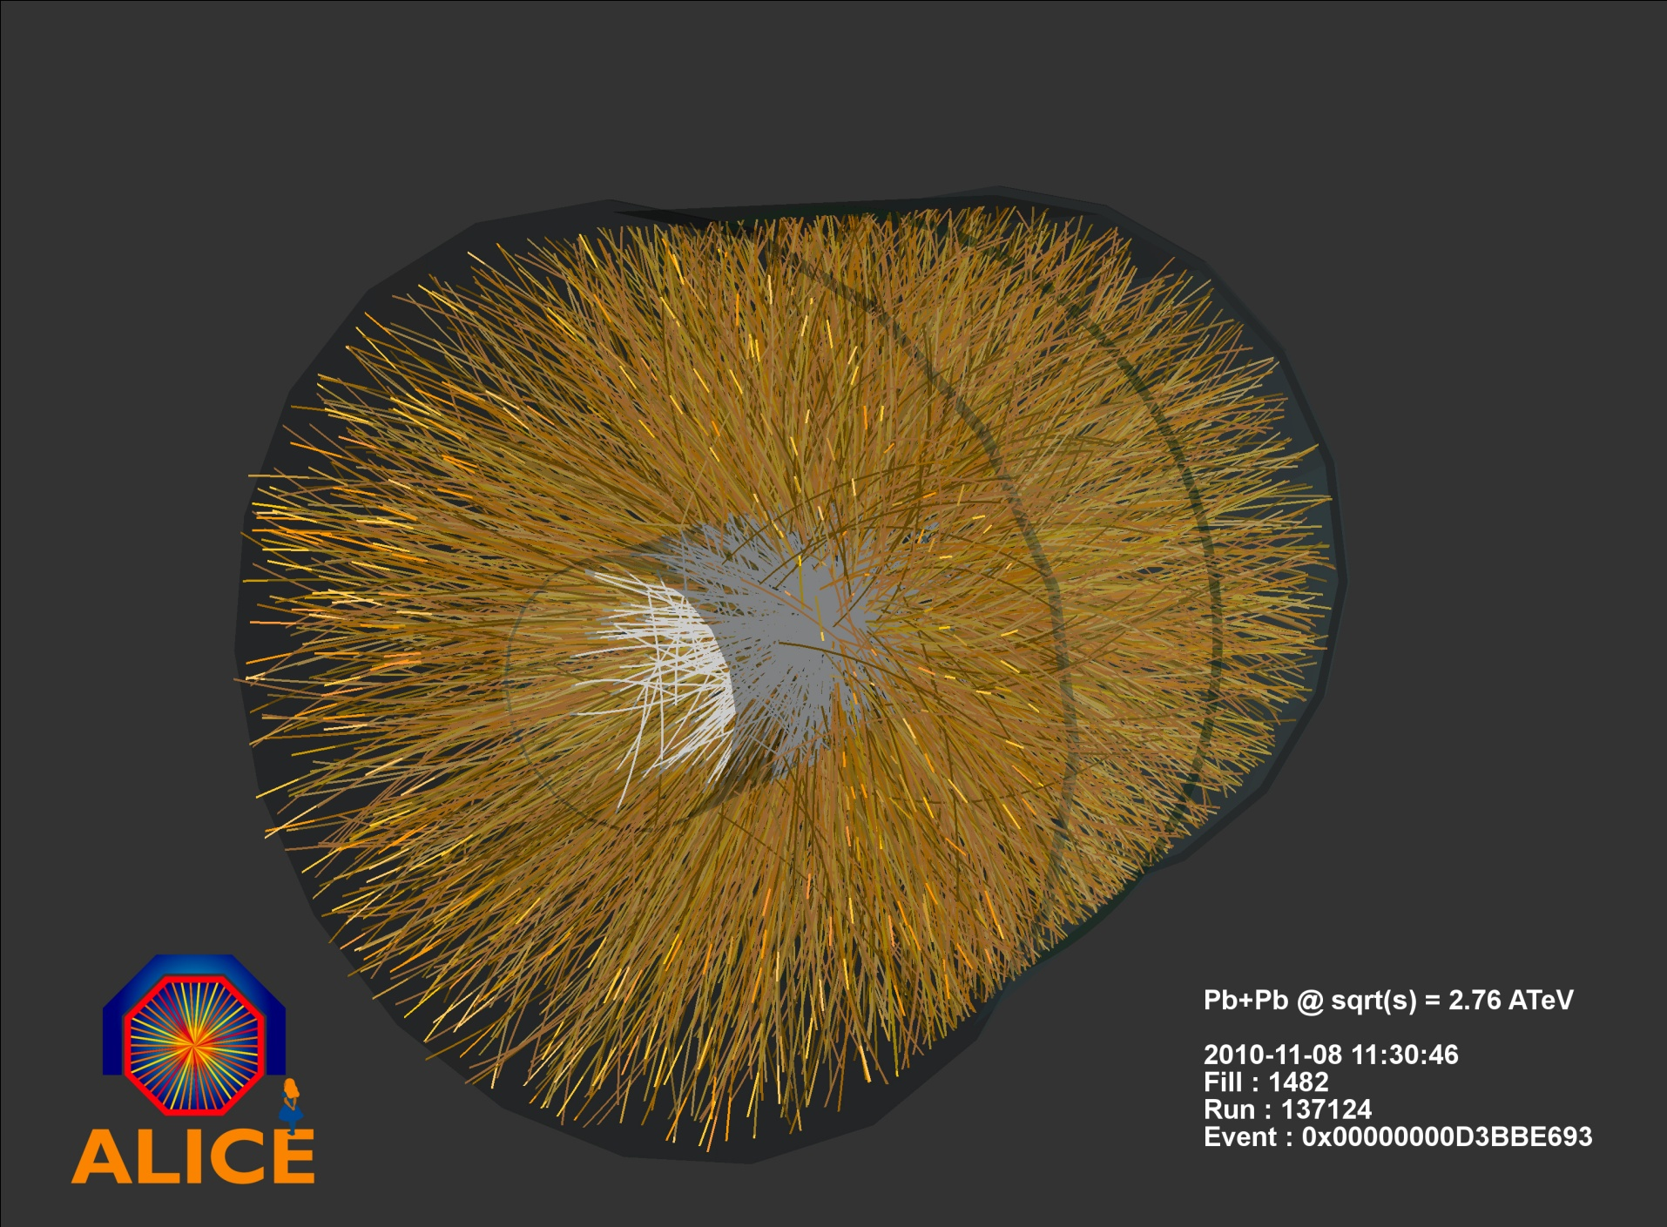
Heavy Ion Collisions

Slide 13
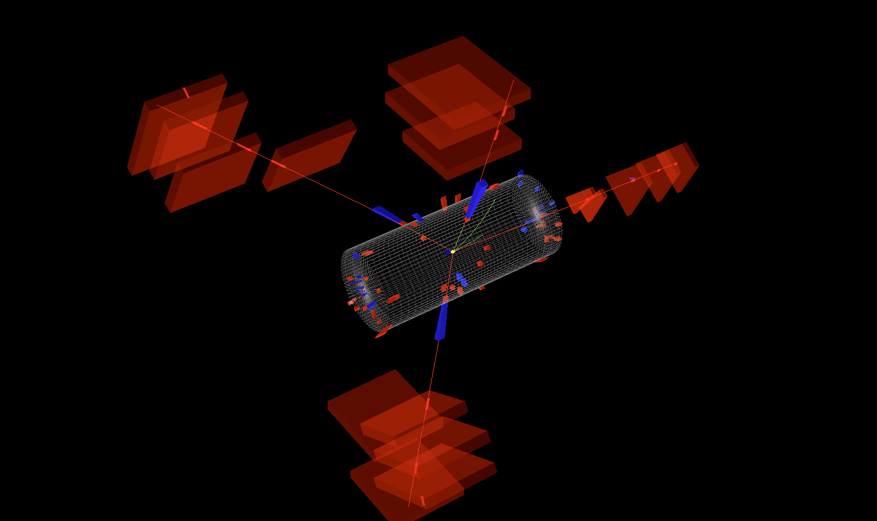
First ZZ→4μ Event
CMS
All 4 muons from the same
vertex:
μ₋₁ 48.1; μ₊₂ 43.4 GeV
μ₊₃ 25.9; μ₋₄ 19.6 GeV
Z₁= 92.15 GeV
Z₂= 92.24 GeV
Combined mass: 201GeV
Probability to find such an
event in the first 22pb⁻¹ of data:
16%.
[N. Pastrone, Talk at Bormio Winter Meeting, 2011]

Slide 14
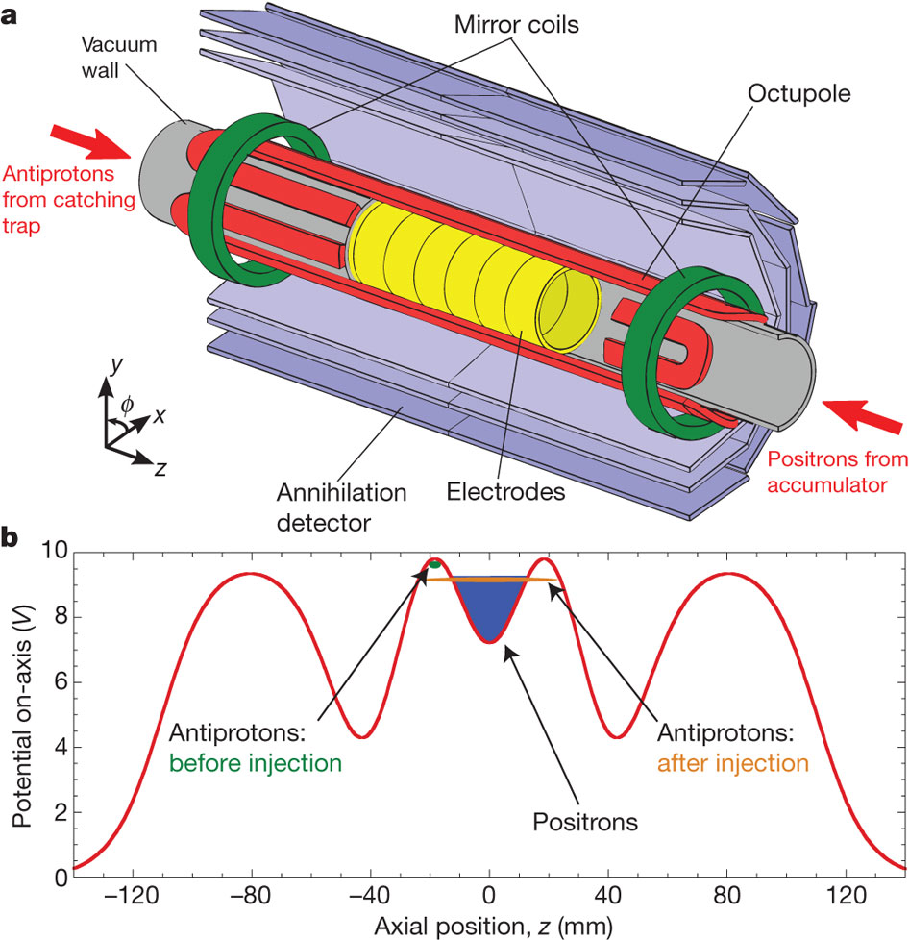
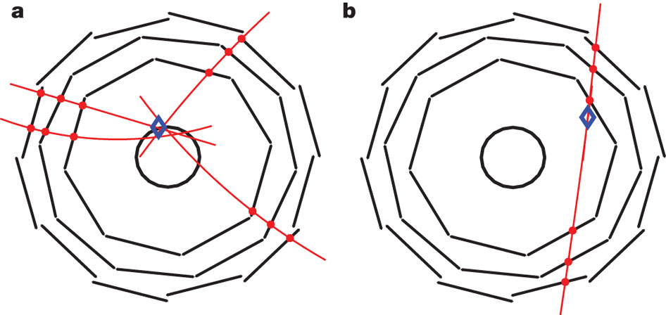
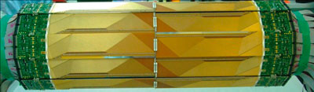
Small is Beautiful
ALPHA
Antiproton annihilation
Cosmic
Trapping of antihydrogen for > 178 ms
GB Andresen et al. Nature 000, 1-4 (2010) doi:10.1038/nature09610

Slide 15
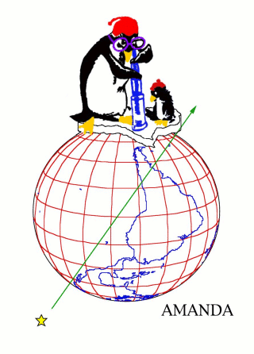

AMANDA
Antarctic Muon And Neutrino Detector Array

Slide 16
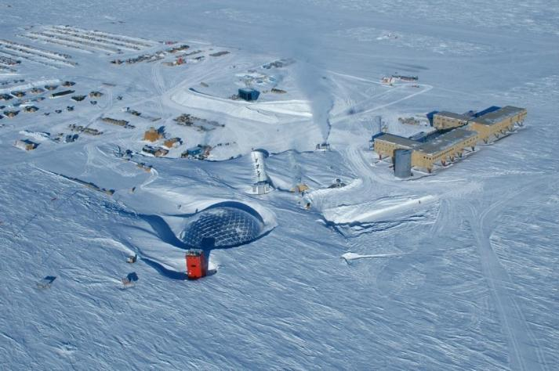
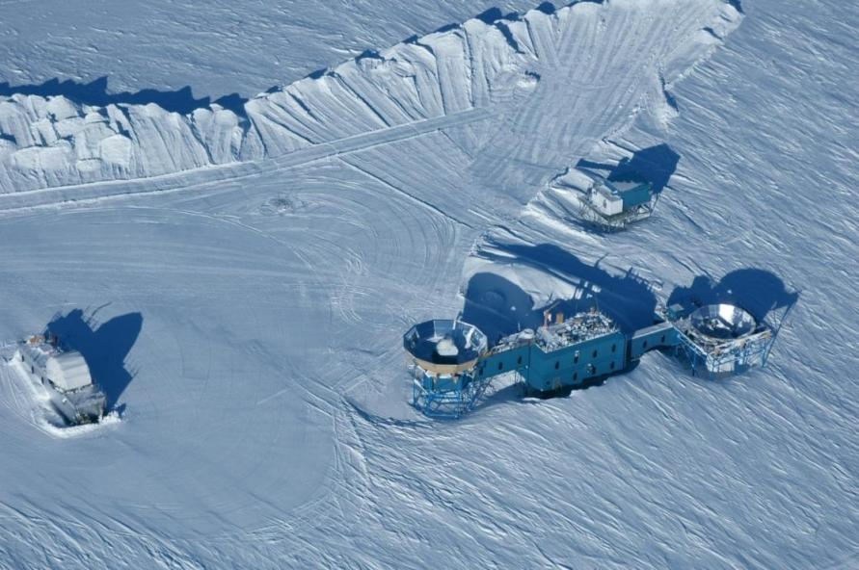
AMANDA
South Pole

Slide 17
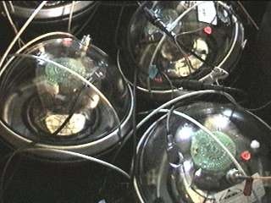
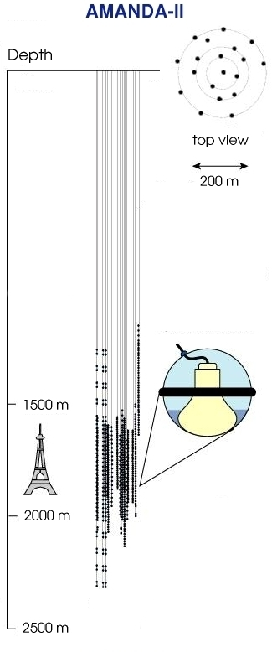
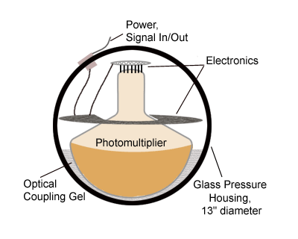
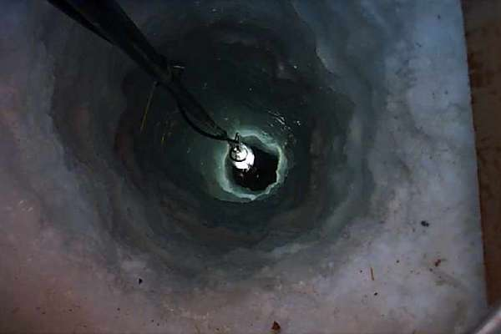
AMANDA
Photomultipliers in the Ice,
looking downwards.
Ice is the detecting medium.

Slide 18
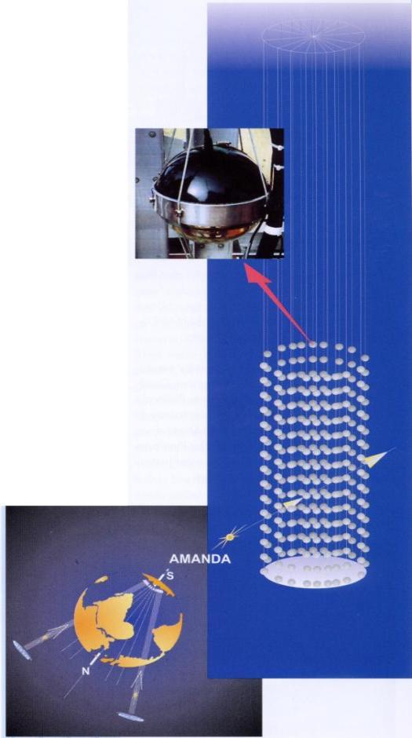
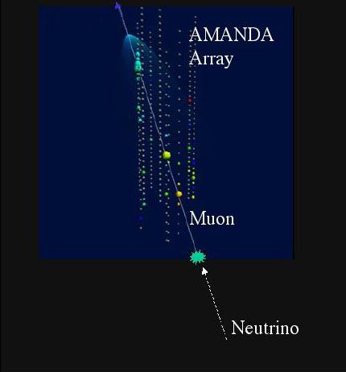
AMANDA
Look for upwards going Muons from Neutrino Interactions.
Cherekov Light propagating through the ice.
Find neutrino point sources in the universe !

Slide 19
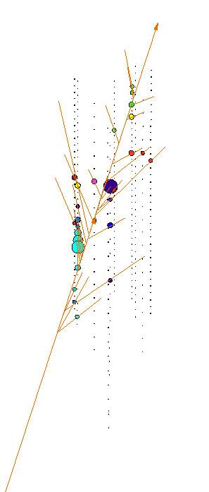
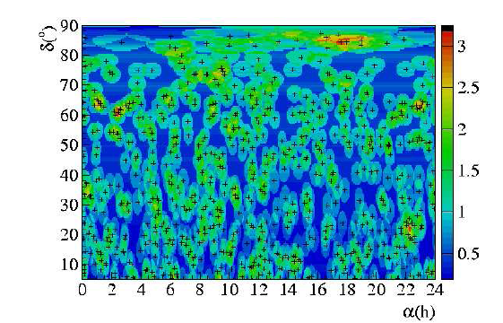
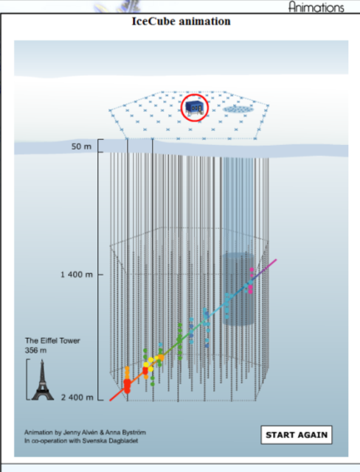
AMANDA
Event Display
Up to now: No significant point sources but just neutrinos from cosmic ray interactions in the atmosphere were found .
→ Ice Cube for more statistics !

Slide 20
CERN Neutrino Gran Sasso
(CNGS)

Slide 21
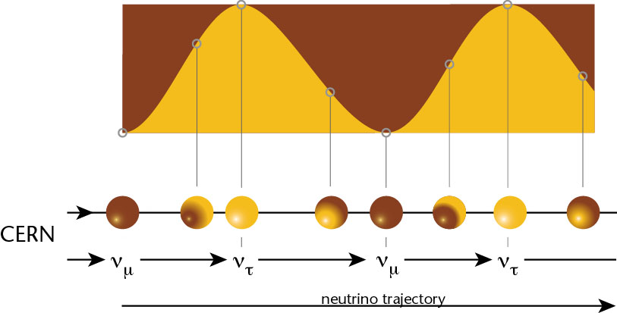
CNGS
If neutrinos have mass:
ν_{e}
Muon neutrinos produced at CERN.
See if tau neutrinos arrive in Italy.
ν_{μ}
ν_{τ}

Slide 22
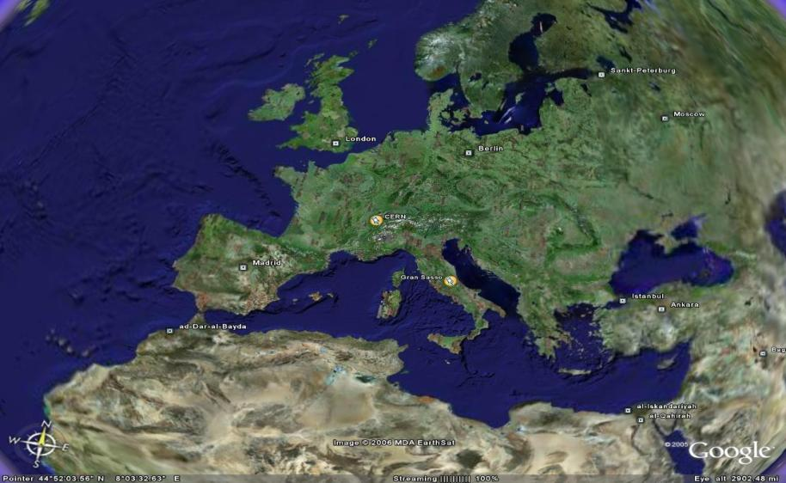
CNGS Project
CNGS (CERN Neutrino Gran Sasso)
  A long base-line neutrino beam facility (732km)
  send ν_{μ} beam produced at CERN
  detect ν_{τ} appearance in OPERA experiment at Gran Sasso
➔ direct proof of ν_{μ} - ν_{τ} oscillation (appearance experiment)

Slide 23
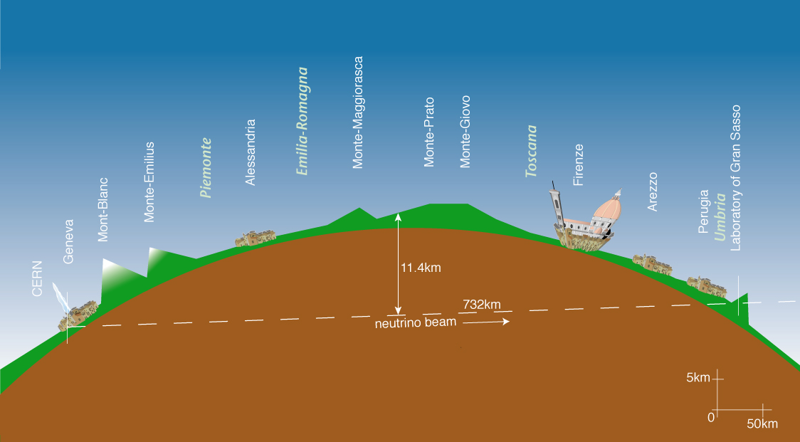
CNGS

Slide 24
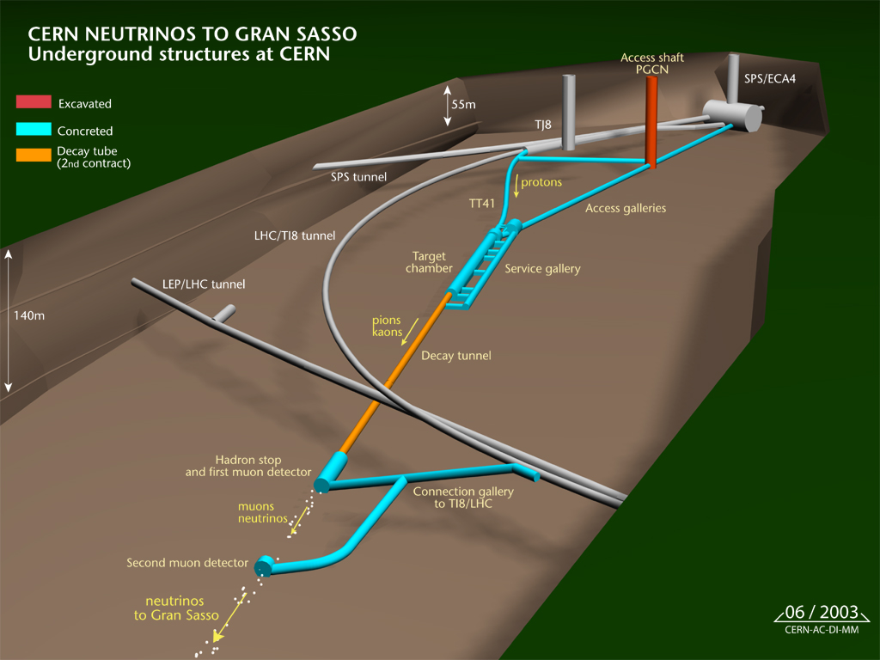
CNGS

Slide 25
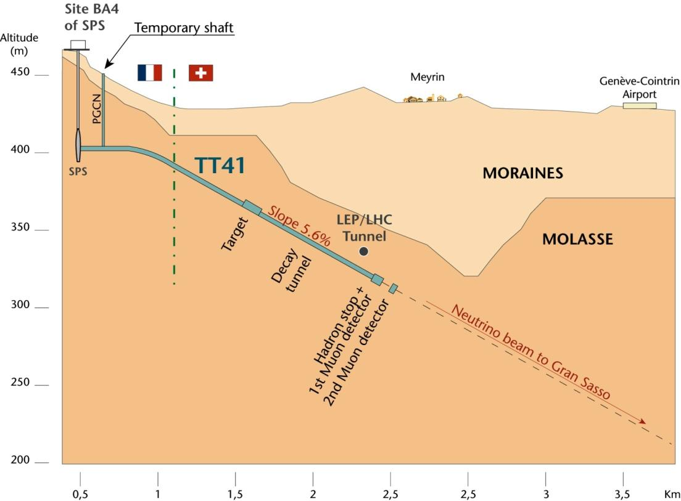
CNGS

Slide 26
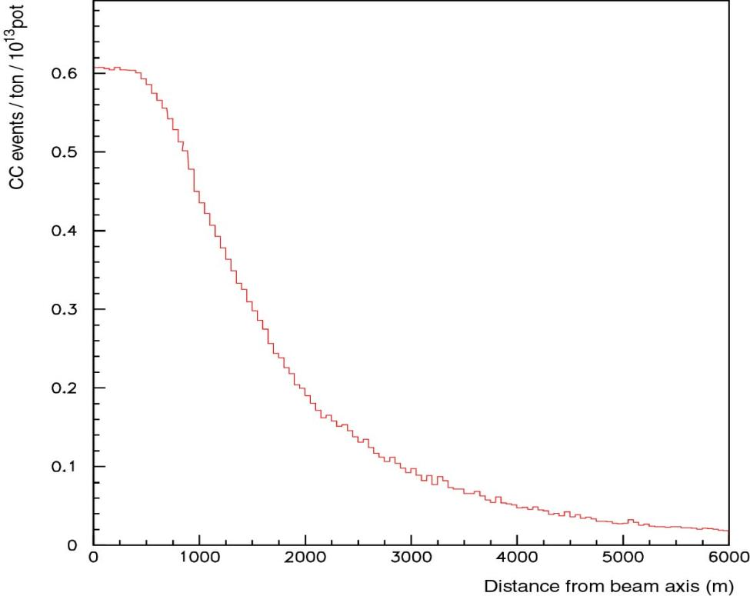
Radial Distribution of the ν_{μ}-Beam at GS
5 years CNGS operation, 1800 tons target:
30000 neutrino interactions
~150 ν_{τ} interactions
~15 ν_{τ} identified
< 1 event of background
Flat top: 500m
FWHM: 2800m
typical size of a detector at Gran Sasso
E. Gschwendtner, CERN

Slide 27
Neutrinos at CNGS: Some Numbers
For 1 year of CNGS operation, we expect:
protons on target 2 x 10¹⁹
pions / kaons at entrance to decay tunnel 3 x 10¹⁹
ν_{μ} in direction of Gran Sasso 10¹⁹
ν_{μ} in 100 m² at Gran Sasso 3 x 10¹⁴
ν_{μ} events per day in OPERA ≈ 2500
ν_{τ} events (from oscillation) ≈ 2

Slide 28
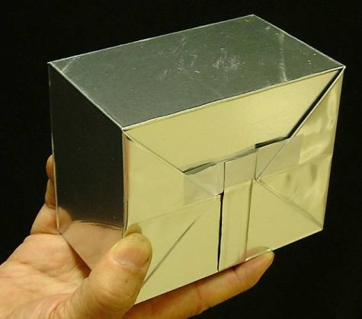
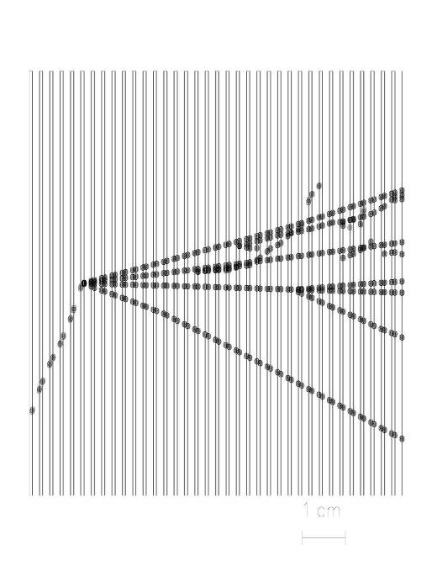
Opera Experiment at Gran Sasso
Basic unit: brick
56 Pb sheets + 56 photographic films (emulsion sheets)
Lead plates: massive target
Emulsions: micrometric precision
brick
Brick
1 mm
τ
8.3kg
ν
10.2 x 12.7 x 7.5 cm³
Pb
Couche de gélatine photographique 40 μm

Slide 29
Opera Experiment at Gran Sasso
31 target planes / supermodule
In total: 206336 bricks, 1766 tons
SM1
SM2
υ
Targets
Magnetic Spectrometers
First observation of CNGS beam neutrinos : August 18th, 2006
Notes:
Lead makes target mass, emulsions allows to see tracks!
Walls are made of bricks, bricks are made of sandwiches, sandwiches are made of lead and emulsion sheets. (type of photographic film)

Slide 30
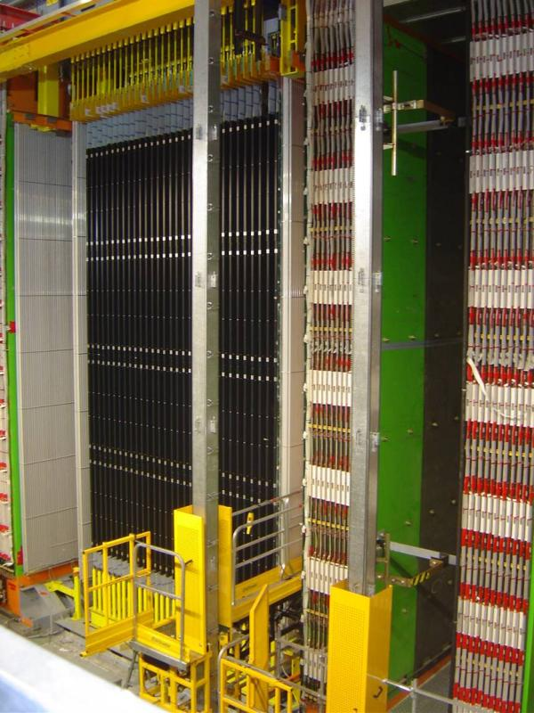
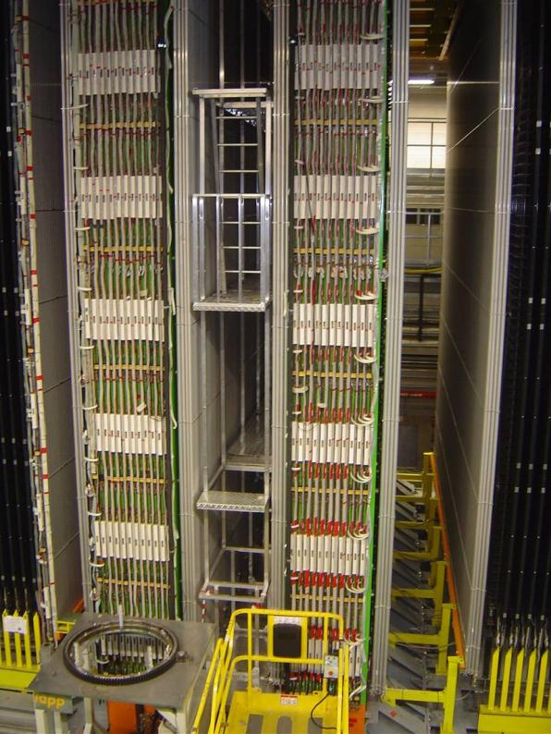
Opera Experiment at Gran Sasso
Second Super-module
Details of the first spectrometer
Scintillator planes 5900 m²
8064 7m long drift tubes
3050 m² Resistive Plate Counters
2000 tons of iron for the two magnets
Notes:
2 photos of OPERA, so we see, experiment exists!

Slide 31
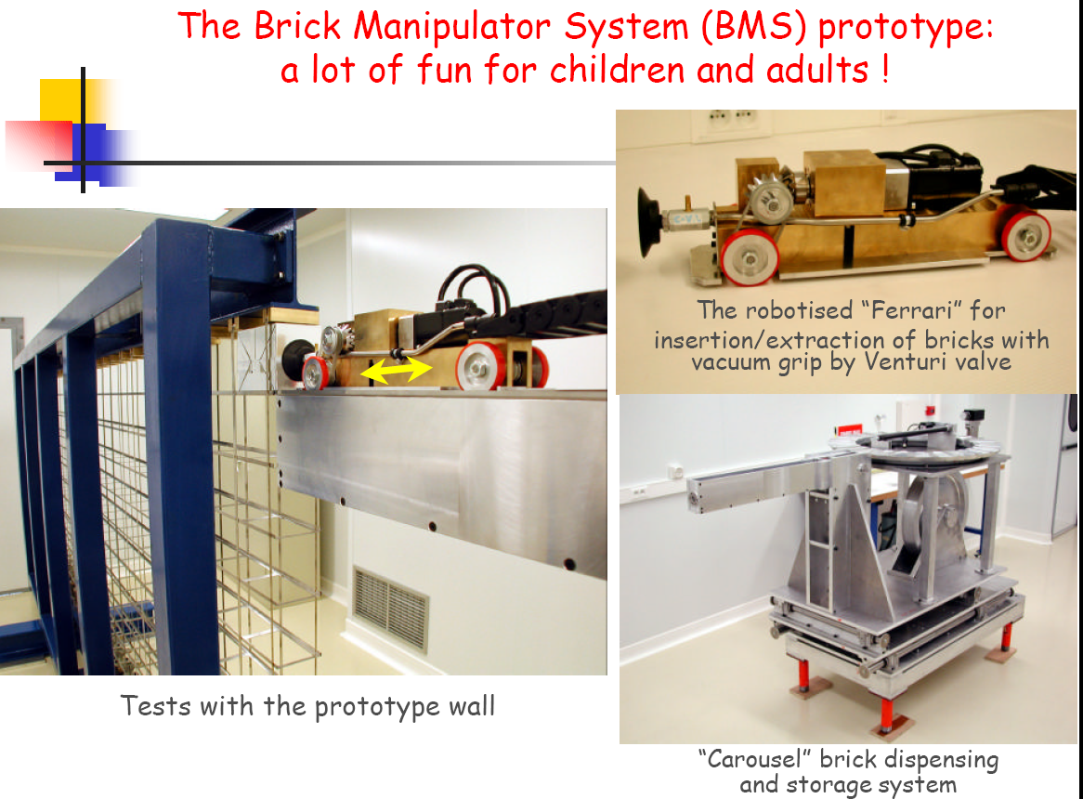
Opera Experiment at Gran Sasso

Slide 32
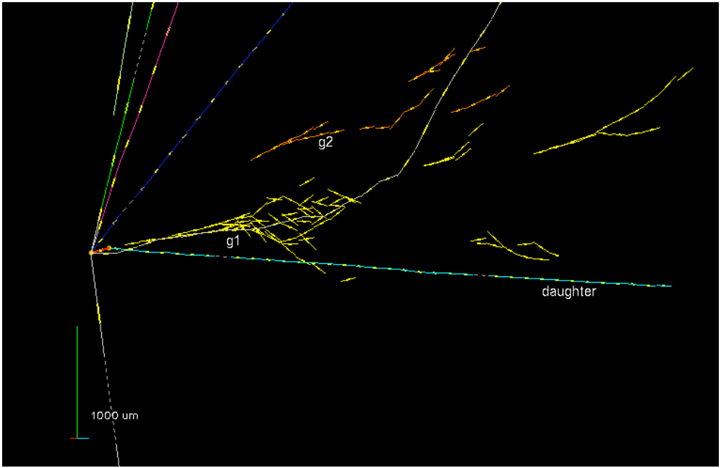
First Tau Candidate seen!

Slide 33

AMS
Alpha Magnetic Spectrometer
Try to find Antimatter in the primary cosmic rays.
Study cosmic ray composition etc. etc.
Launch to Space Station with the last Shuttle flight scheduled for April 19, 2011 7:48 PM Eastern !
Check out the countdown: http://ams-02project.jsc.nasa.gov

Slide 34
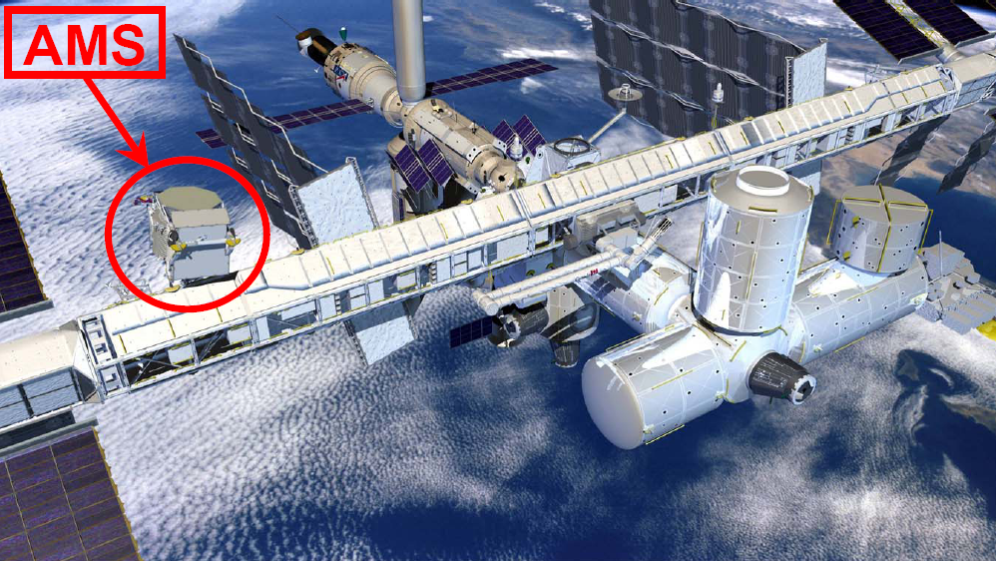
AMS
Will be installed on the space station.

Slide 35
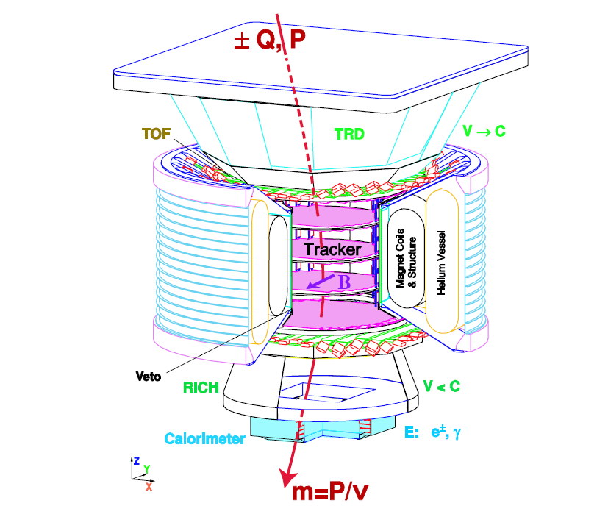
AMS

Slide 36
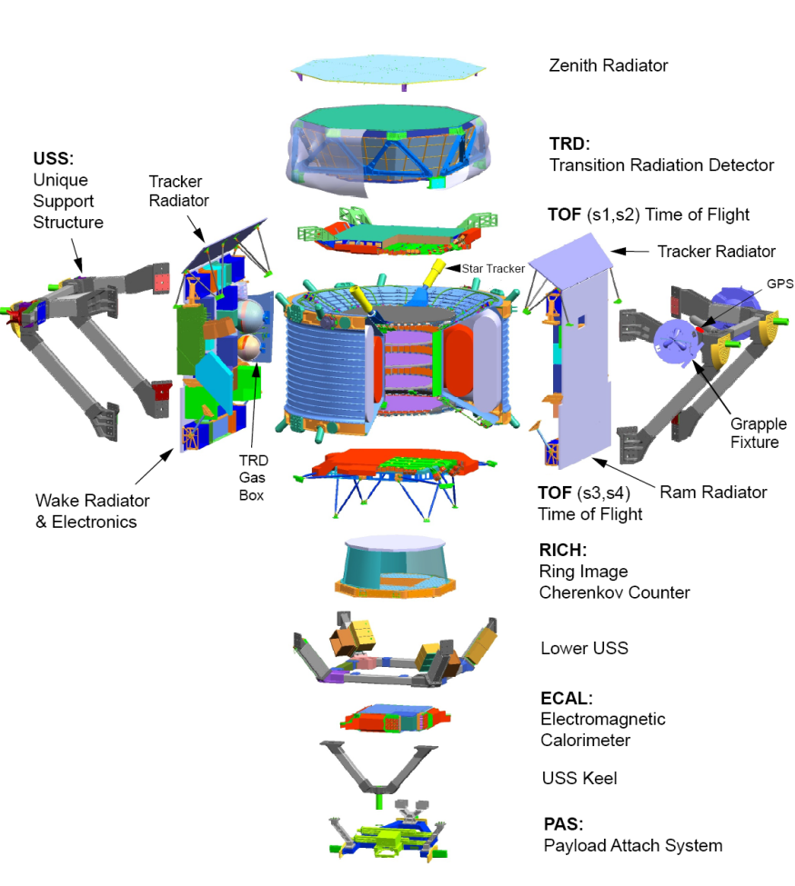
AMS

Slide 37
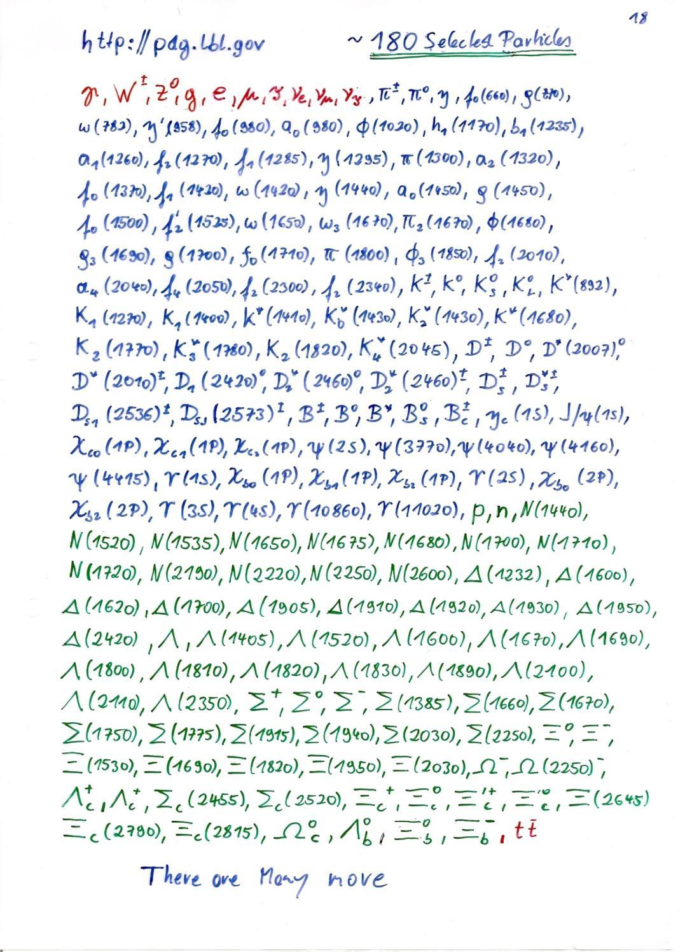

Slide 38
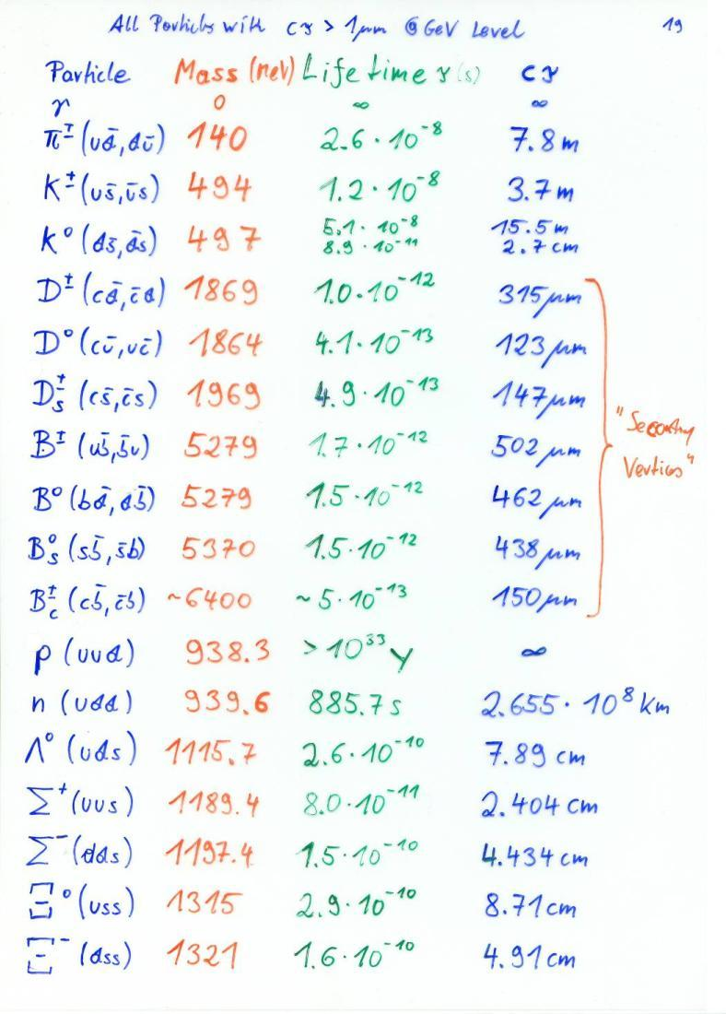
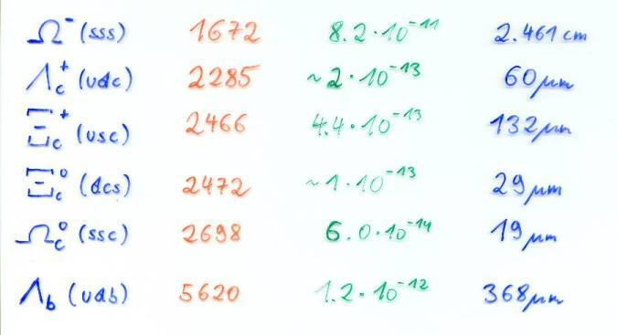

Slide 39
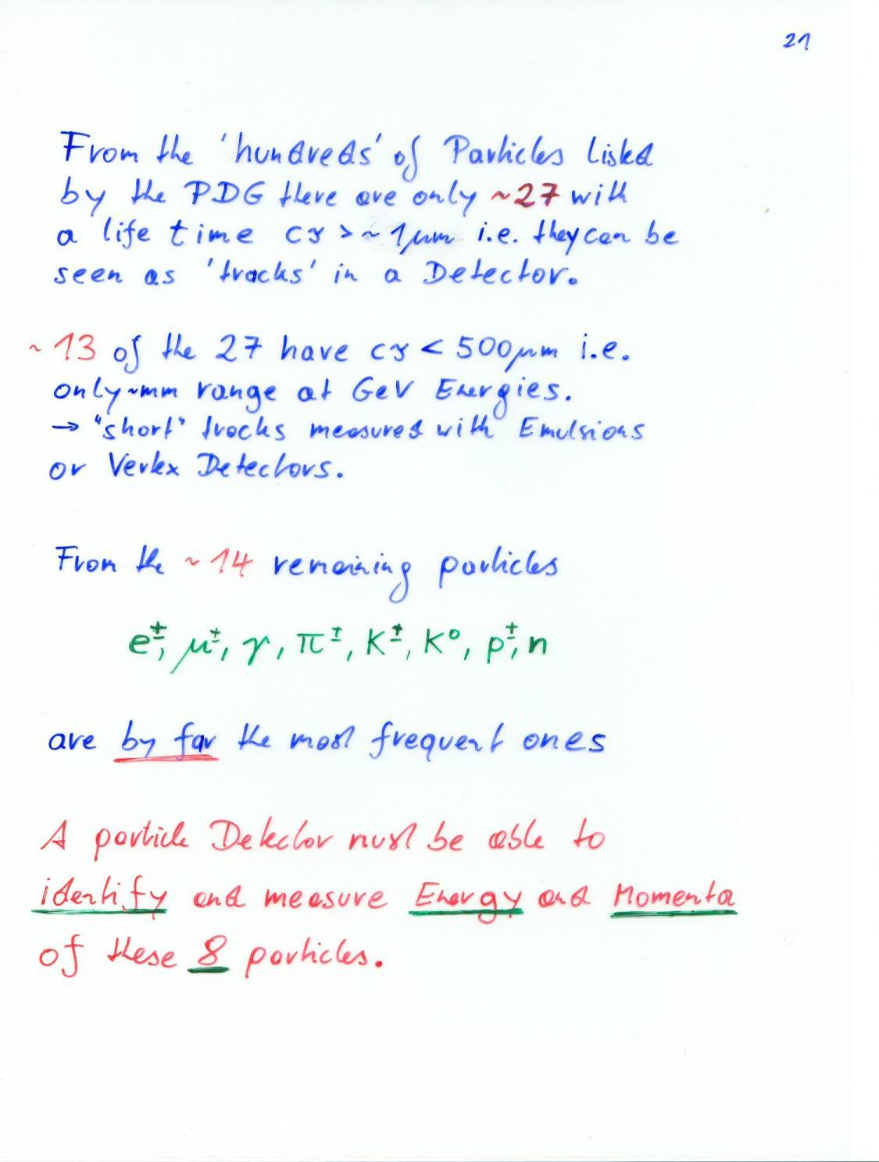

Slide 40


Discovery of the ⁻ in 1964

Slide 41


Slide 42


Slide 43
Detector Physics
Precise knowledge of the processes leading to signals in particle detectors is necessary.
The detectors are nowadays working close to the limits of theoretically achievable measurement accuracy – even in large systems.
Due to available computing power, detectors can be simulated to within 5-10% of reality, based on the fundamental microphysics processes (atomic and nuclear crossections).

Slide 44


Particle Detector Simulation
Electric Fields in a Micromega Detector
Electric Fields in a Micromega Detector
Very accurate simulations
of particle detectors are
possible due to availability of Finite Element simulation programs and computing power.
Follow every single electron by applying first principle laws of physics.
For Gaseous Detectors: GARFIELD by R. Veenhof
Electrons avalanche multiplication

Slide 45

Particle Detector Simulation
I) C. Moore’s Law:
Computing power doubles 18 months.
II) W. Riegler’s Law:
The use of brain for solving a problem is inversely proportional to the available computing power.
→ I) + II) = ...
Knowing the basics of particle detectors is essential …

Slide 46

Interaction of Particles with Matter
Any device that is to detect a particle must interact with it in some way → almost …
In many experiments neutrinos are measured by missing transverse momentum.
E.g. e⁺e⁻ collider. P_{tot}=0,
If the Σ p_{i} of all collision products is ≠0 → neutrino escaped.
Claus Grupen, Particle Detectors, Cambridge University Press, Cambridge 1996 (455 pp. ISBN 0-521-55216-8)

Slide 47

Interaction of Particles with Matter

Slide 48
Electromagnetic Interaction of Particles with Matter
Z₂ electrons, q=-e₀
M, q=Z₁ e₀
Interaction with the atomic electrons. The incoming particle loses energy and the atoms are excited or ionized.
Interaction with the atomic nucleus. The particle is deflected (scattered) causing multiple scattering of the particle in the material. During this scattering a Bremsstrahlung photon can be emitted.
In case the particle’s velocity is larger than the velocity of light in the medium, the resulting EM shockwave manifests itself as Cherenkov Radiation. When the particle crosses the boundary between two media, there is a probability of the order of 1% to produced and X ray photon, called Transition radiation.

Slide 49



Ionization and Excitation
F
b
x
While the charged particle is passing another charged particle, the Coulomb Force is acting, resulting in momentum transfer
The relativistic form of the transverse electric field doesn’t change the momentum transfer. The transverse field is stronger, but the time of action is shorter
The transferred energy is then
→ The incoming particle transfer energy only (mostly) to the atomic electrons !

Slide 50


Ionization and Excitation
Target material: mass A, Z₂, density ρ [g/cm³], Avogadro number N_{A}
A gramm → N_{A} Atoms: Number of atoms/cm³ n_{a} =N_{A} ρ/A [1/cm³]
Number of electrons/cm³ n_{e} =N_{A} ρZ₂/A [1/cm³]
With ΔE(b) → db/b = -1/2 dE/E → E_{max}= ΔE(b_{min}) E_{min} = ΔE(b_{max})
E_{min} ≈ I (Ionization Energy)

Slide 51









Relativistic Collision Kinematics, E_{max}
θ
φ
1)
2)
1+2)

Slide 52


Classical Scattering on Free Electrons
This formula is up to a factor 2 and the density effect identical to the precise QM derivation →
Bethe Bloch Formula
1/ρ
Density effect. Medium is polarized
Which reduces the log. rise.
Electron Spin

Slide 53



Small energy loss
→ Fast Particle
Cosmis rays: dE/dx α Z²
Small energy loss
→ Fast particle
Pion
Large energy loss
→ Slow particle
Discovery of muon and pion
Pion
Kaon
Pion

Slide 54

Bethe Bloch Formula
Für Z>1, I ≈16Z ^{0.9} eV
For Large βγ the medium is being polarized by the
strong transverse fields, which reduces the rise of
the energy loss → density effect
At large Energy Transfers (delta electrons) the
liberated electrons can leave the material.
In reality, E_{max} must be replaced by E_{cut} and the
energy loss reaches a plateau (Fermi plateau).
Characteristics of the energy loss as a function
of the particle velocity (βγ )
The specific Energy Loss 1/ρ dE/dx
first decreases as 1/β²
increases with ln γ for β =1
is ≈ independent of M (M>>m_{e})
is proportional to Z₁² of the incoming particle.
is ≈ independent of the material (Z/A ≈ const)
shows a plateau at large βγ (>>100)
dE/dx ≈ 1-2 x ρ [g/cm³] MeV/cm
1/ρ
Energy Loss by Excitation and Ionization

Slide 55
Bethe Bloch Formula
Bethe Bloch Formula, a few Numbers:
For Z ≈ 0.5 A
1/ρ dE/dx ≈ 1.4 MeV cm ²/g for ßγ ≈ 3
Example :
Iron: Thickness = 100 cm; ρ = 7.87 g/cm³
dE ≈ 1.4 * 100* 7.87 = 1102 MeV
→ A 1 GeV Muon can traverse 1m of Iron
1/ρ
This number must be multiplied with ρ [g/cm³] of the Material → dE/dx [MeV/cm]
Energy Loss by Excitation and Ionization

Slide 56


Energy Loss as a Function of the Momentum
Energy loss depends on the particle
velocity and is ≈ independent of the
particle’s mass M.
The energy loss as a function of particle
Momentum P= Mcβγ IS however
depending on the particle’s mass
By measuring the particle momentum
(deflection in the magnetic field) and
measurement of the energy loss on can
measure the particle mass
→ Particle Identification !
Energy Loss by Excitation and Ionization

Slide 57

Energy Loss as a Function of the Momentum
Measure momentum by curvature of the particle track.
Find dE/dx by measuring the deposited charge along the track.
→Particle ID

Slide 58


Range of Particles in Matter
Particle of mass M and kinetic Energy E₀ enters matter and looses energy until it comes to rest at distance R.
Independent of
the material
Bragg Peak:
For βγ>3 the energy loss is ≈ constant (Fermi Plateau)
If the energy of the particle falls below βγ=3 the energy loss rises as 1/β²
Towards the end of the track the energy loss is largest → Cancer Therapy.
Energy Loss by Excitation and Ionization

Slide 59

Range of Particles in Matter
Average Range:
Towards the end of the track the energy loss is largest → Bragg Peak → Cancer Therapy
Photons 25MeV
Carbon Ions 330MeV
Relative Dose (%)
Depth of Water (cm)
Energy Loss by Excitation and Ionization

Slide 60




Luis Alvarez used the attenuation of muons to look for chambers in the Second Giza Pyramid → Muon Tomography
He proved that there are no chambers present.

Slide 61



Intermezzo: Crossection
Crossection σ: Material with Atomic Mass A and density ρ contains
n Atoms/cm³
E.g. Atom (Sphere) with Radius R: Atomic Crossection σ = R²π
A volume with surface F and thickness dx contains N=nFdx Atoms.
The total ‘surface’ of atoms in this volume is N σ.
The relative area is p = N σ/F = N_{A} ρ σ /A dx =
Probability that an incoming particle hits an atom in dx.
What is the probability P that a particle hits an atom between distance x and x+dx ?
P = probability that the particle does NOT hit an atom in the m=x/dx material layers and that the particle DOES hit an atom in the m^{th} layer
Mean free path
Average number of collisions/cm
F
dx

Slide 62






Intermezzo: Differential Crossection
Differential Crossection:
→ Crossection for an incoming particle of energy E to lose an energy between E’ and E’+dE’
Total Crossection:
Probability P(E) that an incoming particle of Energy E loses an energy between E’ and E’+dE’ in a collision:
Average number of collisions/cm causing an energy loss between E’ and E’+dE’
Average energy loss/cm:

Slide 63


Fluctuation of Energy Loss
Up to now we have calculated the average energy loss. The energy loss is however a statistical process and will therefore fluctuate from event to event.
x=0 x=D
E
Δ
E - Δ
X X X X X
XX X X
X X X
XXX X XX
X XXX X
P(Δ) = ? Probability that a particle loses an energy Δ when traversing a material of thickness D
We have see earlier that the probability of an interaction ocuring between distance x and x+dx is exponentially distributed

Slide 64

Probability for n Interactions in D
We first calculate the probability to find n interactions in D, knowing that the probability to find a distance x between two interactions is P(x)dx = 1/ λ exp(-x/λ) dx with λ = A/ N_{A}ρ σ

Slide 65



Probability for n Interactions in D
For an interaction with a mean free path of λ , the probability for n interactions on a distance D is given by
Poisson Distribution !
If the distance between interactions is exponentially distributed with an mean free path of λ→ the number of interactions on a distance D is Poisson distributed with an average of n=D/λ.
How do we find the energy loss distribution ?
If f(E) is the probability to lose the energy E’ in an interaction, the probability p(E) to lose an energy E over the distance D ?

Slide 66





Fluctuations of the Energy Loss
Probability f(E) for loosing energy between E’ and E’+dE’ in a single interaction is given by the differential crossection dσ (E,E’)/dE’/ σ(E) which is given by the Rutherford crossection at large energy transfers
dσ (E,E’)/dE’/ σ(E)
Excitation and ionization
Scattering on free electrons
P(E,Δ)
Energy Loss by Excitation and Ionization

Slide 67

Landau Distribution
Landau Distribution
P(Δ): Probability for energy loss Δ in matter of thickness D.
Landau distribution is very asymmetric.
Average and most probable energy loss must be distinguished !
Measured Energy Loss is usually smaller that the real energy loss:
3 GeV Pion: E’_{max} = 450MeV → A 450 MeV Electron usually leaves the detector.
Energy Loss by Excitation and Ionization

Slide 68


Landau Distribution
LANDAU DISTRIBUTION OF ENERGY LOSS:
PARTICLE IDENTIFICATION
Requires statistical analysis of hundreds of samples
Counts
4 cm Ar-CH4 (95-5)
5 bars
Counts
15 GeV/c
6000
6000
protons
electrons
N = 460 i.p.
4000
FWHM~250 i.p.
4000
2000
2000
0
0
0
500
1000
0
500
1000
N (i.p.)
N (i.p)
For a Gaussian distribution:
σ_{N} ~ 21 i.p.
FWHM ~ 50 i.p.
I. Lehraus et al, Phys. Scripta 23(1981)727
Energy Loss by Excitation and Ionization

Slide 69



Particle Identification
Measured energy loss
‘average’ energy loss
In certain momentum ranges, particles can be identified by measuring the energy loss.
Energy Loss by Excitation and Ionization

Slide 70
Bremsstrahlung
A charged particle of mass M and charge q=Z₁e is deflected by a nucleus of charge Ze which is partially ‘shielded’ by the electrons. During this deflection the charge is ‘accelerated’ and it therefore radiated → Bremsstrahlung.
Z₂ electrons, q=-e₀
M, q=Z₁ e₀

Slide 71

Bremsstrahlung, Classical
A charged particle of mass M and charge q=Z₁e is deflected by a nucleus of Charge Ze.
Because of the acceleration the particle radiated EM waves → energy loss.
Coulomb-Scattering (Rutherford Scattering) describes the deflection of the particle.
Maxwell’s Equations describe the radiated energy for a given momentum transfer.
→ dE/dx

Slide 72


Bremsstrahlung, QM
Proportional to Z²/A of the Material.
Proportional to Z₁⁴ of the incoming particle.
Proportional to ρ of the material.
Proportional 1/M² of the incoming particle.
Proportional to the Energy of the
Incoming particle →
E(x)=Exp(-x/X₀) – ‘Radiation Length’
X₀ ∝ M²A/ (ρ Z₁⁴ Z²)
X₀: Distance where the Energy E₀ of the incoming particle decreases E₀Exp(-1)=0.37E₀ .

Slide 73

Critical Energy
For the muon, the second lightest particle after the electron, the critical energy is at 400GeV.
The EM Bremsstrahlung is therefore only relevant for electrons at energies of past and present detectors.
Electron Momentum 5 50 500 MeV/c
Critical Energy: If dE/dx (Ionization) = dE/dx (Bremsstrahlung)
Myon in Copper: p ≈ 400GeV
Electron in Copper: p ≈ 20MeV

Slide 74

Pair Production, QM
For Eγ>>m_{e}c²=0.5MeV : λ = 9/7X₀
Average distance a high energy photon has to travel before it converts into an e⁺ e⁻ pair is equal to 9/7 of the distance that a high energy electron has to travel before reducing it’s energy from E₀ to E₀*Exp(-1) by photon radiation.

Slide 75

Bremsstrahlung + Pair Production → EM Shower

Slide 76


Multiple Scattering
Statistical (quite complex) analysis of multiple collisions gives:
Probability that a particle is defected by an angle θ after travelling a distance x in the material is given by a Gaussian distribution with sigma of:
X₀ ... Radiation length of the material
Z₁ ... Charge of the particle
p ... Momentum of the particle

Slide 77

Multiple Scattering
Magnetic Spectrometer: A charged particle describes a circle in a magnetic field:
Limit → Multiple Scattering

Slide 78


Multiple Scattering

Slide 79


Multiple Scattering
ATLAS Muon Spectrometer:
N=3, sig=50um, P=1TeV,
L=5m, B=0.4T
∆p/p ~ 8% for the most energetic muons at LHC

Slide 80

Cherenkov Radiation
If we describe the passage of a charged particle through material of dielectric permittivity  (using Maxwell’s equations) the differential energy crossection is >0 if the velocity of the particle is larger than the velocity of light in the medium is
N is the number of Cherenkov Photons emitted per cm of material. The expression is in addition proportional to Z₁² of the incoming particle.
The radiation is emitted at the characteristic angle _{c} , that is related to the refractive index n and the particle velocity by
M, q=Z₁ e₀

Slide 81



Cherenkov Radiation

Slide 82




Ring Imaging Cherenkov Detector (RICH)
There are only ‘a few’ photons per event →one needs highly sensitive photon detectors to measure the rings !

Slide 83



LHCb RICH

Slide 84
Transition Radiation
Z₂ electrons, q=-e₀
M, q=Z₁ e₀
When the particle crosses the boundary between two media, there is a probability of the order of 1% to produced and X ray photon, called Transition radiation.

Slide 85


Transition Radiation

Slide 86
Electromagnetic Interaction of Particles with Matter
Ionization and Excitation:
Charged particles traversing material are exciting and ionizing the atoms.
The average energy loss of the incoming particle by this process is to a good approximation described by the Bethe Bloch formula.
The energy loss fluctuation is well approximated by the Landau distribution.
Multiple Scattering and Bremsstrahlung:
The incoming particles are scattering off the atomic nuclei which are partially shielded by the atomic electrons.
Measuring the particle momentum by deflection of the particle trajectory in the magnetic field, this scattering imposes a lower limit on the momentum resolution of the spectrometer.
The deflection of the particle on the nucleus results in an acceleration that causes emission of Bremsstrahlungs-Photons. These photons in turn produced e+e- pairs in the vicinity of the nucleus, which causes an EM cascade. This effect depends on the 2nd power of the particle mass, so it is only relevant for electrons.

Slide 87
Electromagnetic Interaction of Particles with Matter
Cherenkov Radiation:
If a particle propagates in a material with a velocity larger than the speed of light in this material, Cherenkov radiation is emitted at a characteristic angle that depends on the particle velocity and the refractive index of the material.
Transition Radiation:
If a charged particle is crossing the boundary between two materials of different dielectric permittivity, there is a certain probability for emission of an X-ray photon.
→ The strong interaction of an incoming particle with matter is a process which is important for Hadron calorimetry and will be discussed later.

Slide 88
Electromagnetic Interaction of Particles with Matter
Z₂ electrons, q=-e₀
M, q=Z₁ e₀
Now that we know all the Interactions we can talk about Detectors !
Interaction with the atomic electrons. The incoming particle loses energy and the atoms are excited or ionized.
Interaction with the atomic nucleus. The particle is deflected (scattered) causing multiple scattering of the particle in the material. During this scattering a Bremsstrahlung photon can be emitted.
In case the particle’s velocity is larger than the velocity of light in the medium, the resulting EM shockwave manifests itself as Cherenkov Radiation. When the particle crosses the boundary between two media, there is a probability of the order of 1% to produced and X ray photon, called Transition radiation.

Slide 89

Now that we know all the Interactions we can talk about Detectors !

