Slide 1
Report from TB
CB, July 2nd 2010
W. Riegler

Slide 2
P2 water interruption – 19th July
Next LHC technical stops
Dates:
19th to 22nd July
30th August to 2nd September
18th to 21st October
The new scheme foresees 4 days of stop every 6 weeks
1 day interruption of cooling (chilled, mixed water), affecting whole P2, in order to install flowmeters on chilled water lines.
Need to stop cooling plants, racks, DAQ, DCS,…
This action is crucial to monitor the total water consumption, and to clearly address the question whether we need to improve the P2 cooling power.

Slide 3
L3 cooling test
Layout of distribution network
Settings:
T_{in} = 20°C
T_{screen} = 17,4°C
Problem: if hot/humid weather, the primary water goes to 26-27°C
→ overconsumption chilled water
→ instabilities detector cooling units
L3
Tscreen=17.4°C
Demineralized water
Tin=20°C
6°C
11°C
Tout=35°C
Detector cooling units
24°C
24°C
11°C
6°C
11°C
UX-25
Surface
Primary water
6°C
34°C
Chilled water

Slide 4
L3 cooling test
Changing the inlet temperature
Increased inlet temperature:
T_{in} = 22°C
T_{out} increases of 2°C (37 instead of 35)
By operating (manually) the heat exchanger of the thermal screen, we have achieved T_{screen} = 17,4°C
L3
Tscreen=17.4°C
Demineralized water
Tin=22°C
6°C
11°C
Tout=37°C
Detector cooling units
24°C
24°C
11°C
6°C
11°C
UX-25
Surface
Primary water
6°C
34°C
Chilled water

Slide 5
2009/2010 end of year technical stop
The current plan is to stop the LHC for 9 weeks, i.e. from December 6th 2010 to February 4th 2011.
This period will be sufficient to provide standard maintenance of the detector and infrastructure and to fix several problems known to this date.
However, this is not enough to install further TRD and/or EMCAL modules, which would require 10 to 11 weeks, if we work in two shifts and through Christmas.
Trying to “squeeze” this plan into 9 weeks is not possible, because the 10 weeks are already compressed. In addition, lifting the space frame is a risky operation that should be done carefully.
On the other hand, it should be possible to remove the PMD, repair and reinstall it.

Slide 6
Update on new storage building
Our request is the following:
  2nd floor bld. 3294: 18 offices
  New storage building: with lockable slots for each detector/group to store small objects (250m²). Preferred installation area: close to SX2
GS will gradually remove the barracks on site.
  Consulting firms to get rid of the 4 red ones
During long shutdowns we might need – as we did in the past – to install barracks (SPIE, sub-contractors,…).

Slide 7
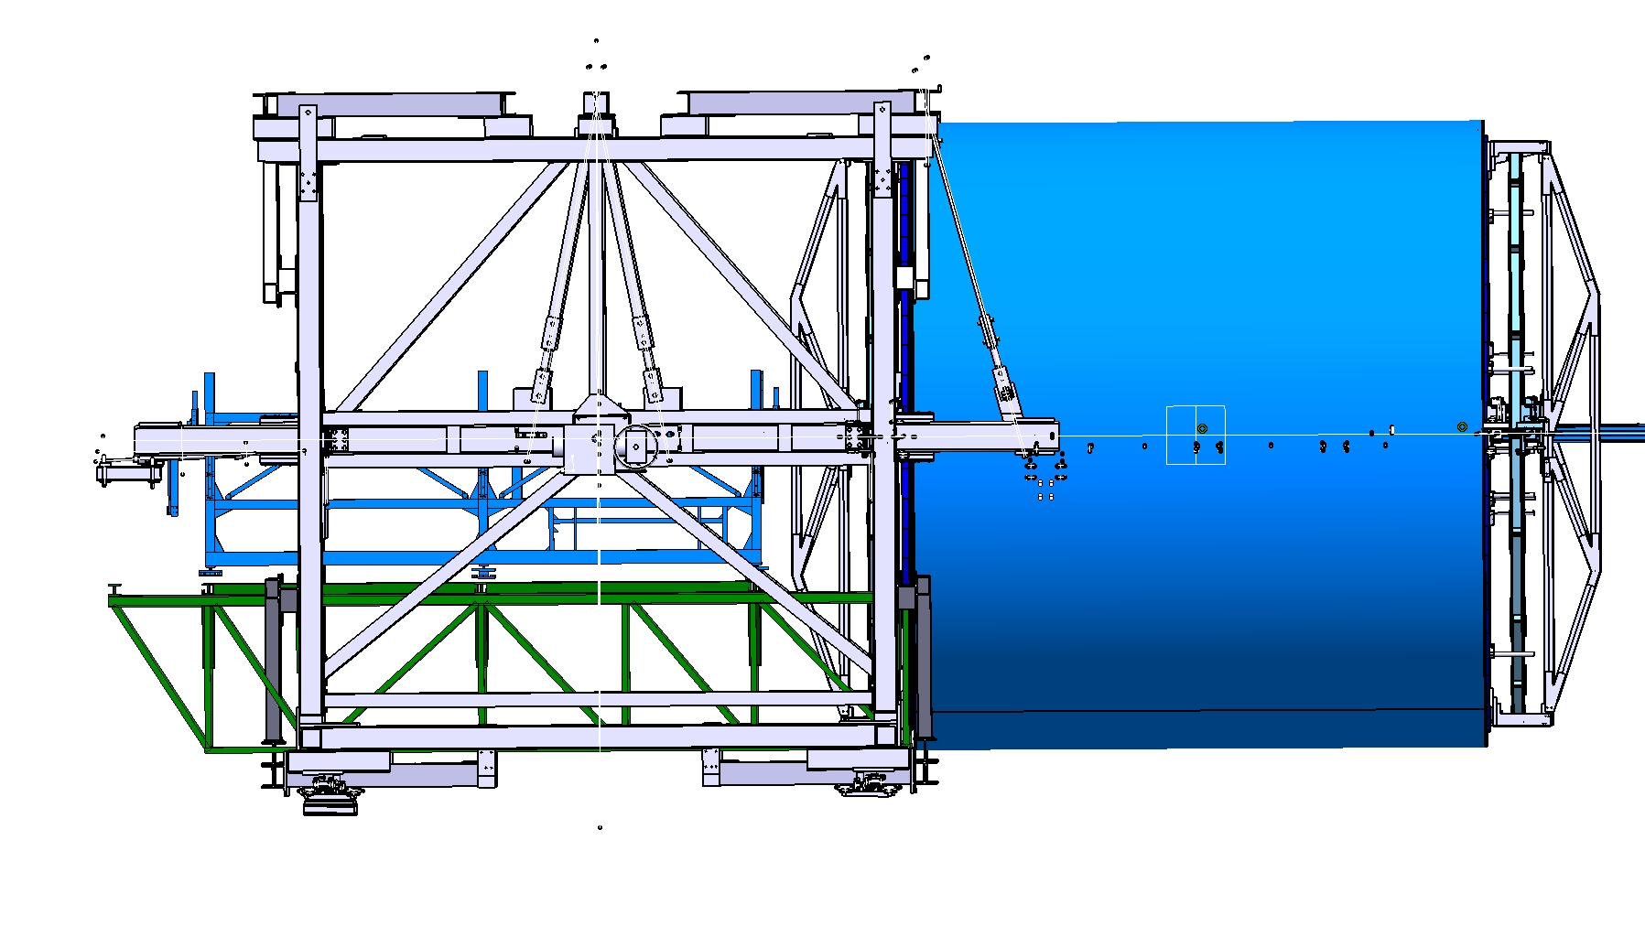
New delphi frame table
P.Lenoir

Slide 8
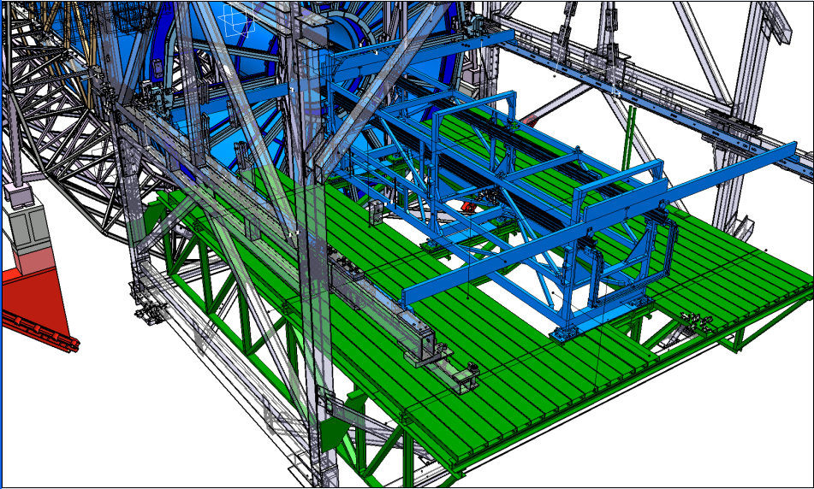
New delphi frame table
P.Lenoir

Slide 9
Perturbations since last ALICE week
Power glitches (7) and power cuts (3)
  Glitches are mainly due to thunderstorms
    Typically drop of 20-30% on 400kV into CERN for 2-3 cycles
    CERN wide, usually loss of beams
    ALICE (typically): Dipole trip, detector equipment trip
  Cuts have different causes and different extend
    Dipole transformer: limited to P2
    18/66kV transformer north area: cern-wide
    Rack in CR3: part of DCS and CTP

Slide 10
Magnets since last ALICE week
Solenoid tripped 7 times:
  Failing temperature sensor (2)
  Stop of cooling
  Power converter fault (2)
  Power cut (2)
Dipole tripped 10 times:
  Power glitches/cut (5)
  Short circuit on power converter
  Power converter fault (2)
  Stop of cooling
  During cooling test

Slide 11

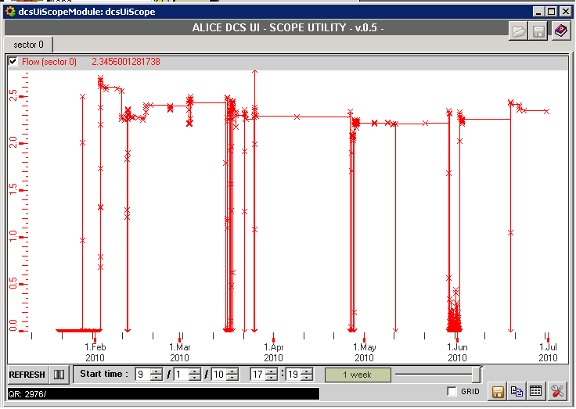
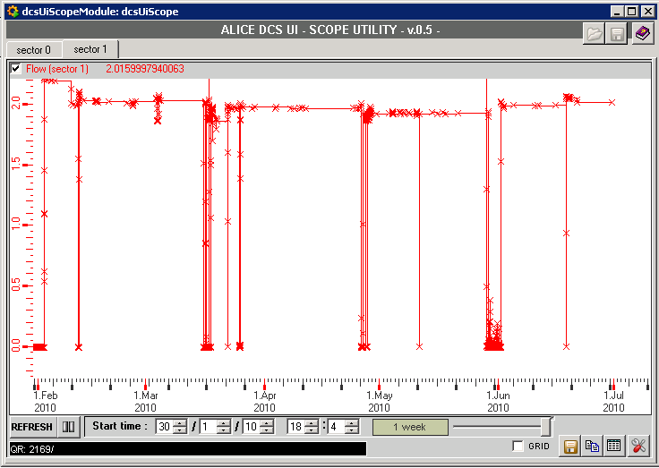
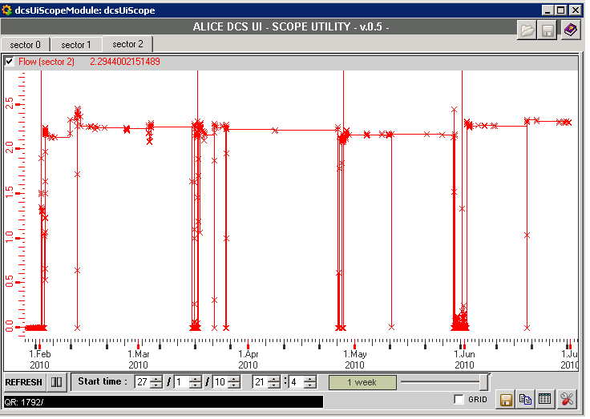
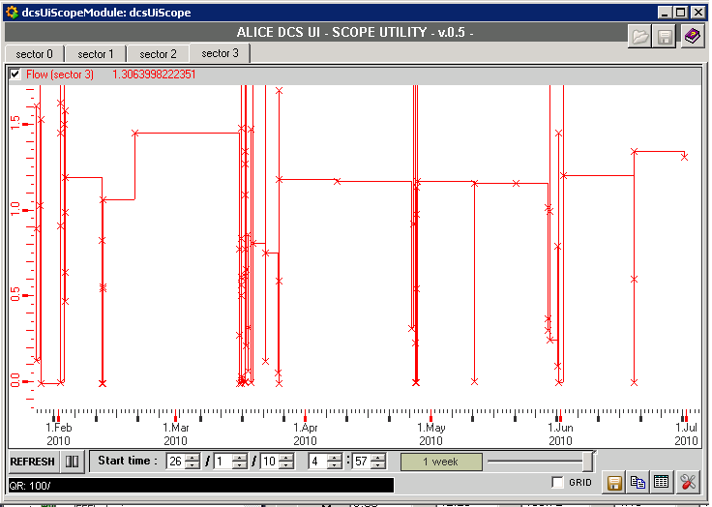
SPD Flow History Sector 0 -3
0
1
2
3

Slide 12
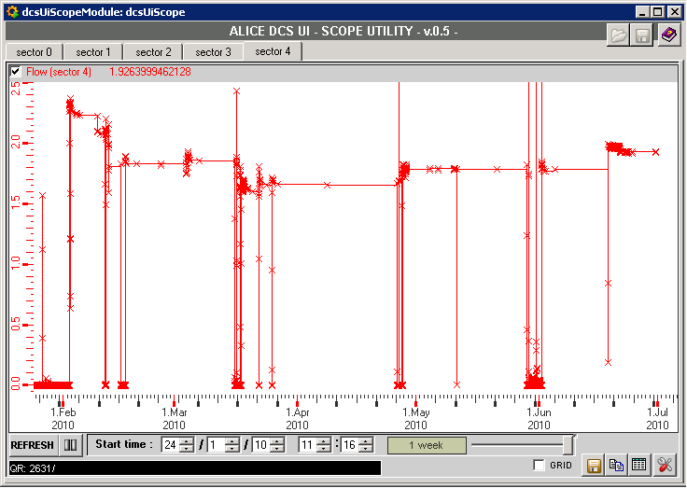
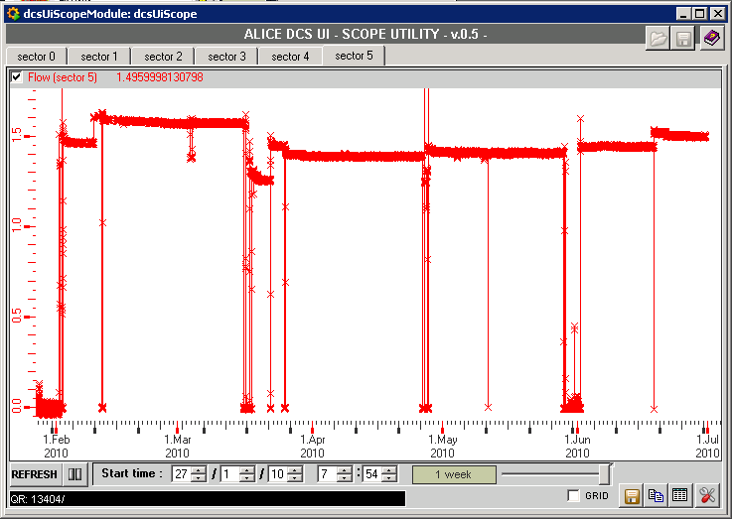
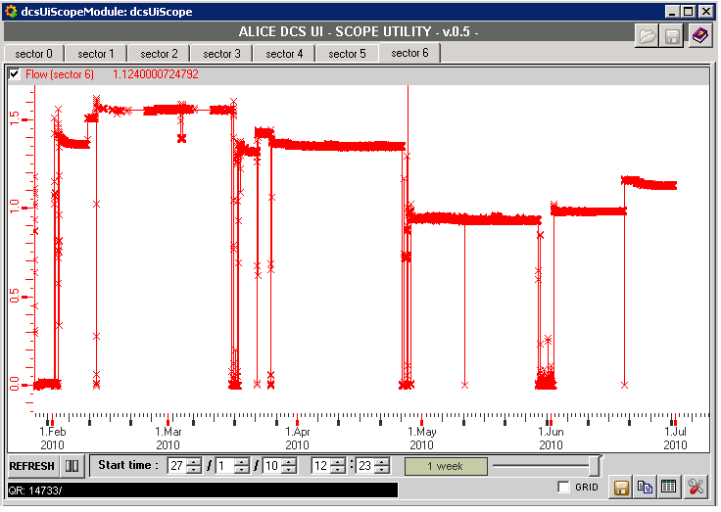
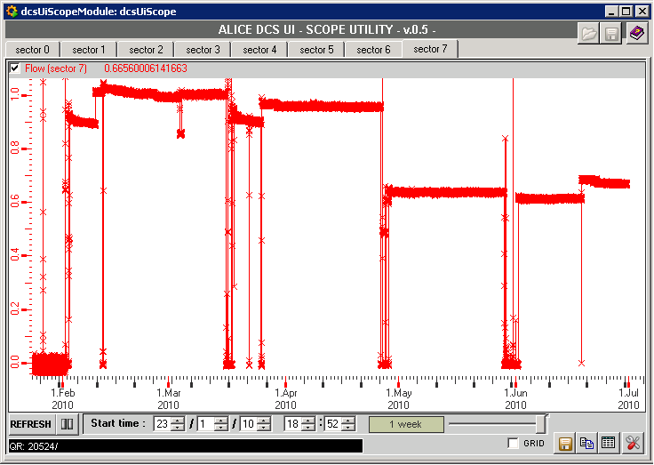
SPD Flow History Sector 4 -7
4
5
6
7

Slide 13
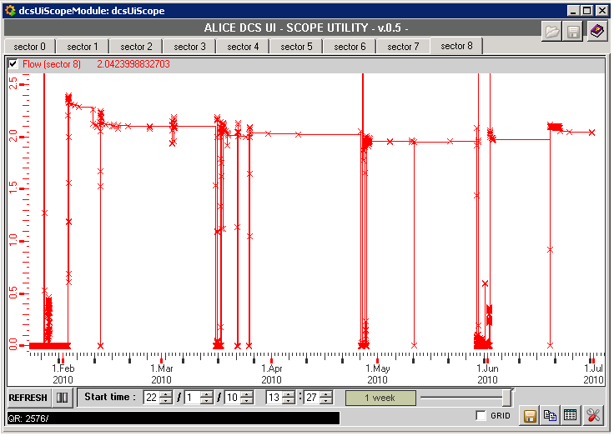
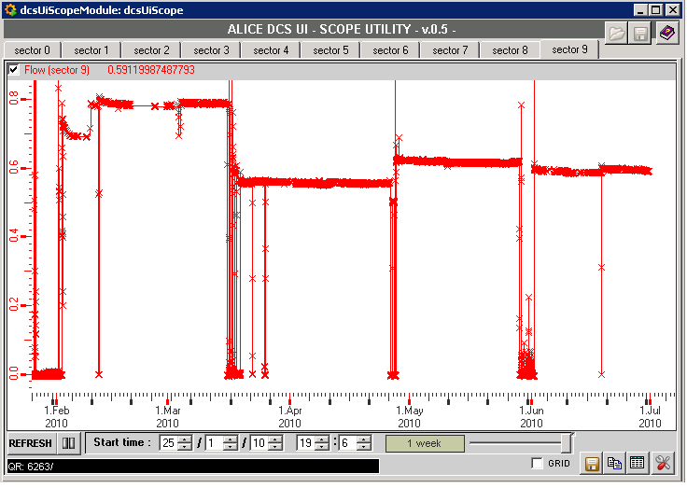
SPD Flow History Sector 8 -9
8
9
Freon flow in SPD always changes slightly whenever the plant stops and is restarted. Situation did not change significantly in the last months.
Currently 97/120 Halfstaves ON
C. Bortolin – R. Turrisi

Slide 14
Machine
Luminosity increasing in steps
  reached 7-8∙10²⁹ cm⁻²s⁻¹
  ‘background’ increases accordingly
Several weeks to commission nominal bunches
Goal is to achieve 1 pb⁻¹ by end of year
4 weeks of HI running (+ 1 week commissioning)

Slide 15
ALICE and nominal bunches
At present nominal conditions μ ≈ 1.5
  Bunch charge = 1.1 10¹¹
  β* = 3.5 m
  average emittance = 5 mm mrad
Trigger rate 30-50 kHz, but saturates at 20 kHz
In order to eliminate pile-up (μ = 0.05), collisions at IR2 with displaced beams (s ≥ 3.8) were tested yesterday !
  Stability of beams and luminosity to be monitored

Slide 16
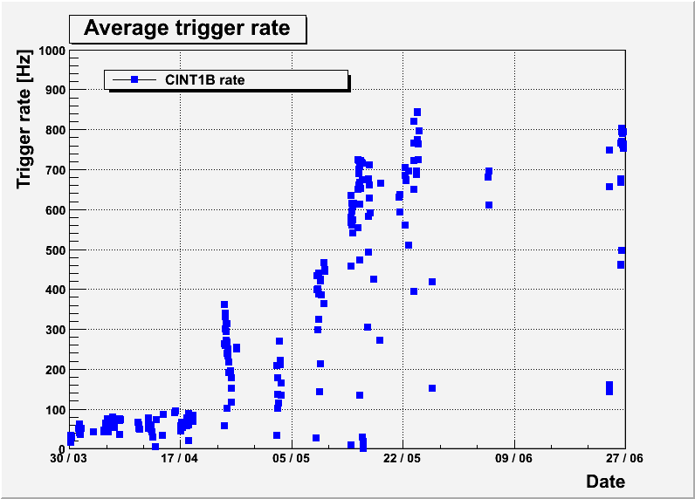
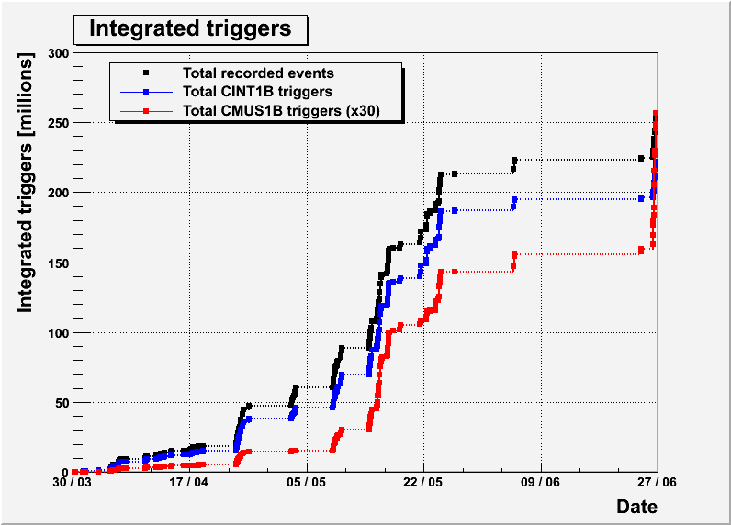
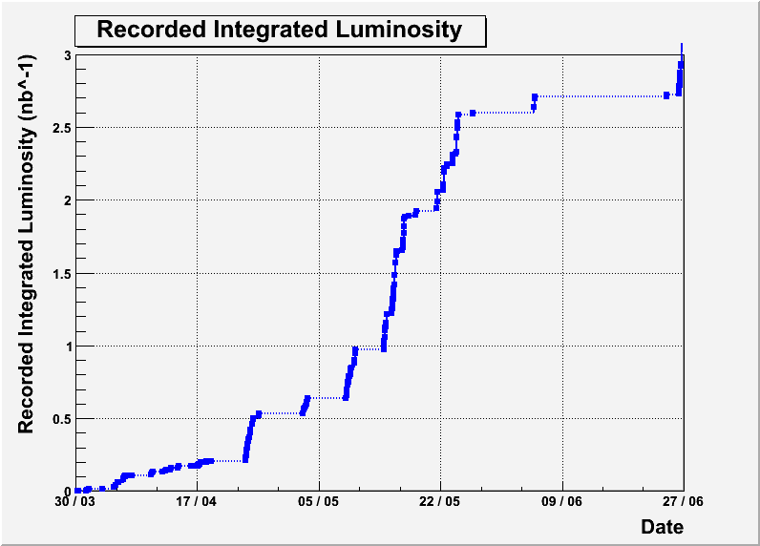
Integrated Triggers and Luminosity
3

Slide 17
Collimation scheme in IR2
Side A
Side C
Beam 1
IP2
TCTH
TDI (V)
TCT VB
TCDD (V)
TCTVB
Beam 2
TCTH
D2
D2
D1
Low β
D1
ZN
Low β
ZN
Beam 2
TCLI (V)
Beam 1
ZP
ZP
not to scale
TCT Collimator partly shadows the ZDC – negotiations
with the machine to change the collimator position
Movable collimators for protection at injection (only vertical plane)
Movable collimators for low β triplet protection in case of peaks
in the secondary beam halo due to transient drops in the beam lifetime:
  TCTH (horizontal plane)
  TCTVB (vertical plane). It is a special single pipe design since no space
  for a standard TCTV between the ALICE ZDCs and D2

Slide 18
Reconstructed Centroid - data
TCTVB effect - pp 7 TeV
Run 119086 ,Trigger CINT1B-ABCE-NOPF-ALL , L3/Dip off/off
-> Vert. Beam Crossing Angle 0 μrad
ZNC
ZNA
3
4
3
4
1
2
1
2
3.5 cm (half dimension)
β* = 2m -> TCTVB gap: 15.1mm side C, 17.2mm side A
Red boxes->projected shadows at ZDC location (22.9mm sideC, 26.4mm sideA)
Platform at nominal positions : ZNC 178 mm, ZNA 182 mm

Slide 19
ALICE EMCal
US Scope:
  7 2/3 Super Modules
    2 SM installed
    2/3 -> DCal
EU Scope (France, Italy):
  3 Super Modules
    2 SM installed
4 SMs installed and fully commissioned in ALICE sectors @ 90º and 70º
SM
Notes:
19

Slide 20
EMCal Production Status
US: 7 EMCal Super Modules
  SM No. 1 and 2: Installed in ALICE
  SM No. 3: Complete at CERN
  SM No. 4: At Grenoble. Ready in July
  SM No. 5: Ready ship to CERN before end of July.
    16 strip modules at Yale
    8 strips are ready to ship from WSU to Yale
  SM No. 6: All modules are complete
    12 strip modules are in Europe (Grenoble-Catania-Nantes)
    WSU will ship 12 stripmodule before the end of July
  SM No. 7: 20 modules are complete. Will ship 24 stripmodule to Grenoble early September
EU: 3 EMCal Super Modules
  SM No. 1 and 2: Installed in ALICE
  SM No. 3: Complete at Grenoble
Remaining 6 SMs will be ready to install by late 2010.

Slide 21
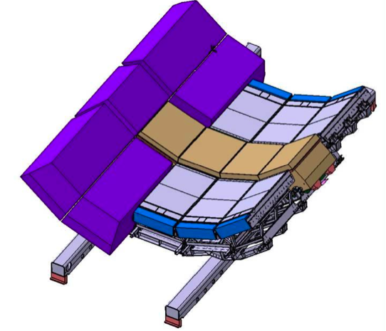
DCal+PHOS+CPV+VHMPID
New DCal super modules
= 2/3 EMCal SM
PHOS modules
VHMPID modules
New Rails & Support
PHOS+DCal Acceptance ΔηxΔφ = 1.4 x 0.7

Slide 22
DCal Status
DCal-PHOS-VHMPID common structure
  Funding to start support structure and rail fabrication - OK
  Design Review - complete
  Raw material order May 2010
  Orders for Rail materials May 2010
  Orders for Cradles July 2010
  Support Structure available January 2011
DCal Modules production (Asia, EU, and US)
  Design : exactly same as EMCal
  Funding approved
  Main component orders underway
  Production to start in July 2010 (earlier in Tsukuba)
  Assembly of first DCal Super Module foreseen September 2010
  First 3 super modules (C-Side) ready February 2011

Slide 23
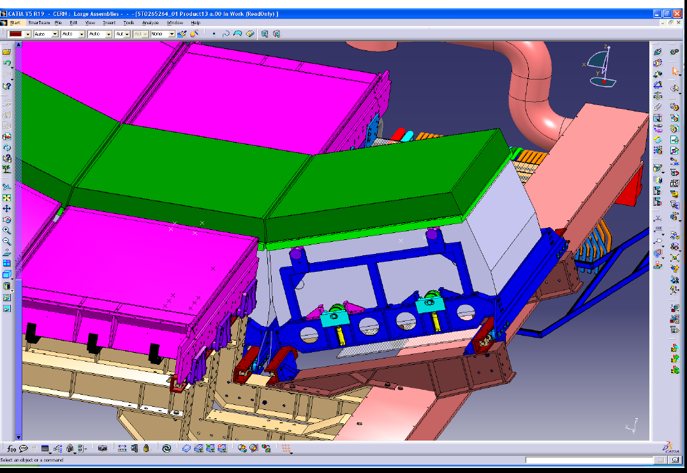
CPV detector 1st module installed in 2012

Slide 24
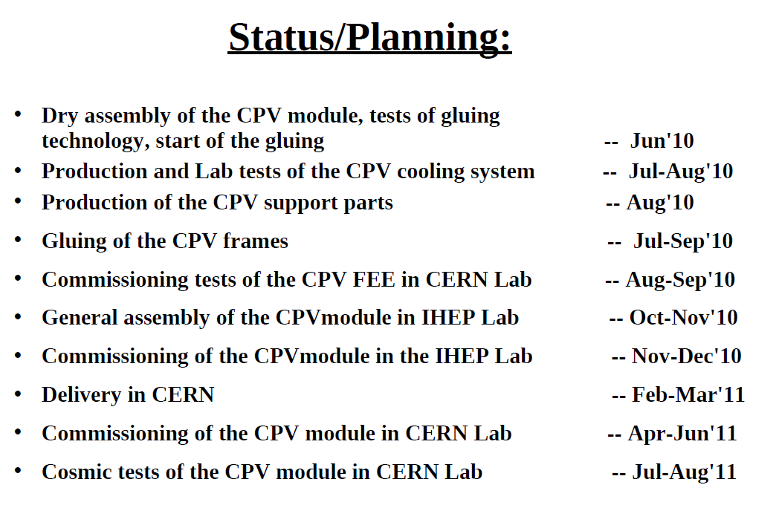
CPV detector 1st module installed in 2012

Slide 25
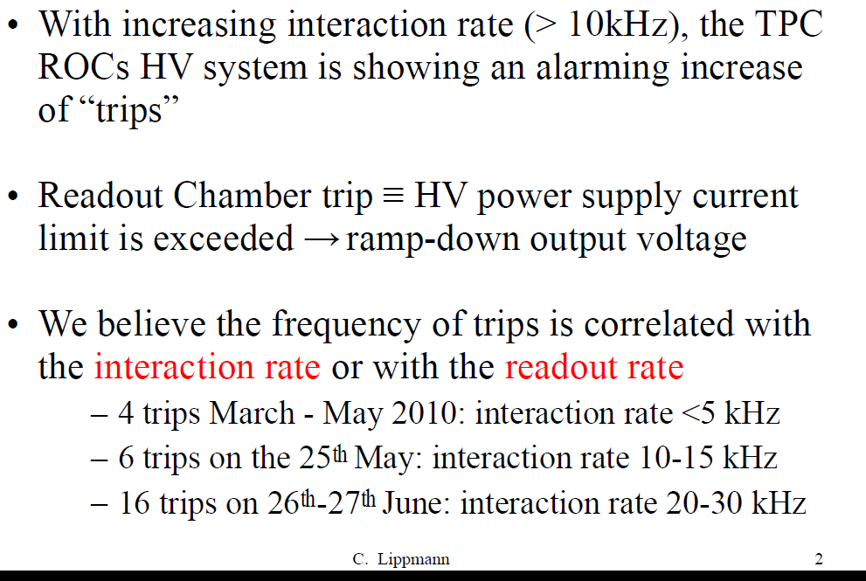
TPC Trips

Slide 26
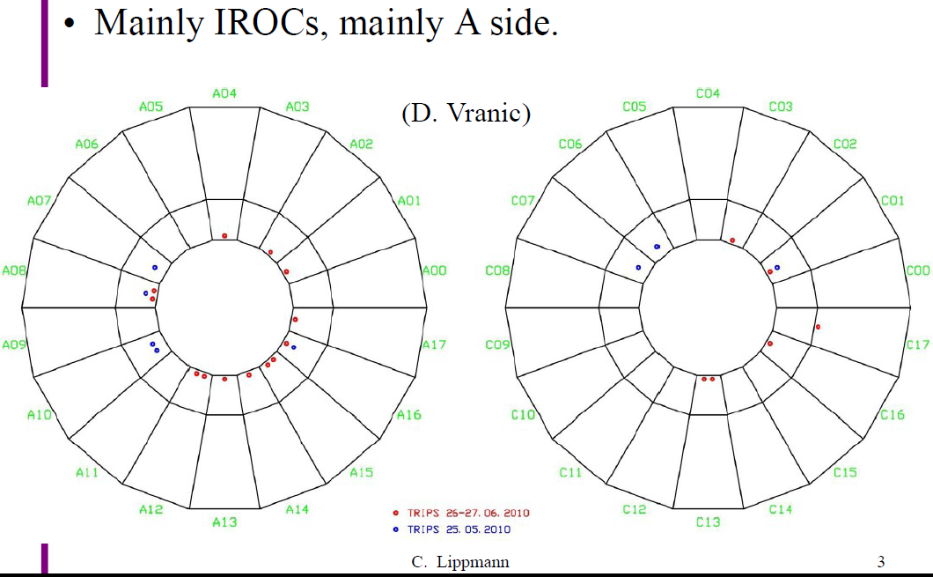
TPC Trips

Slide 27
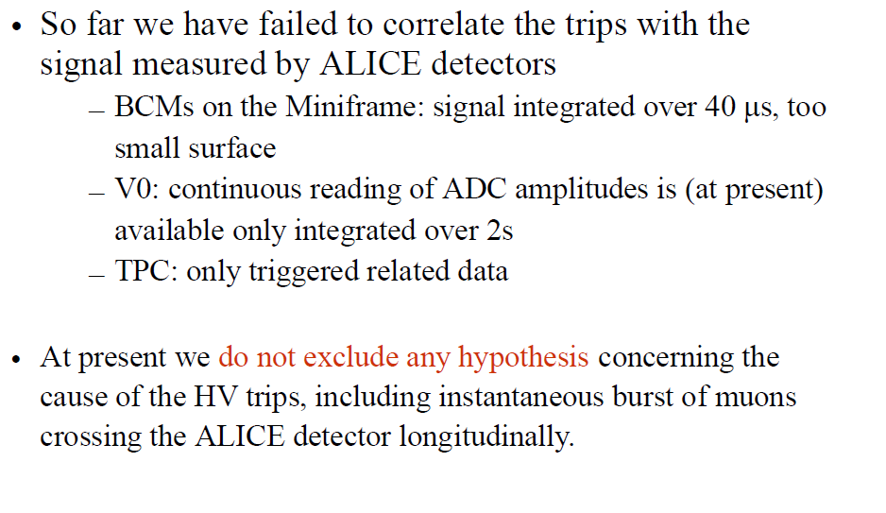
TPC Trips

Slide 28
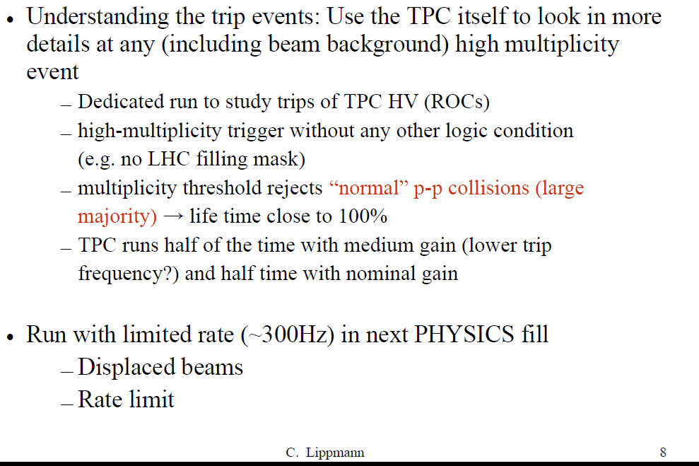
TPC Trips

