Slide 1
39 years at CERN – July 1971 to January 2010 * */ August 2011

Slide 2
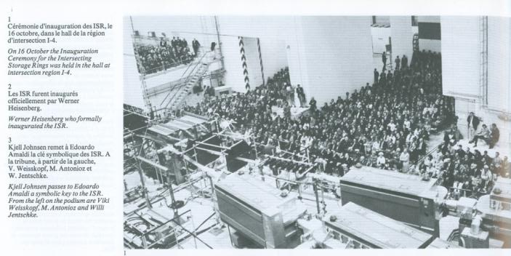
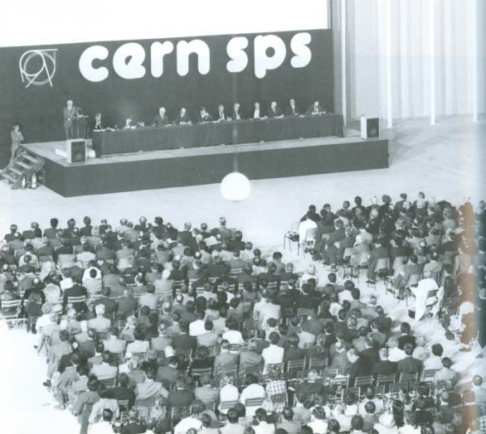
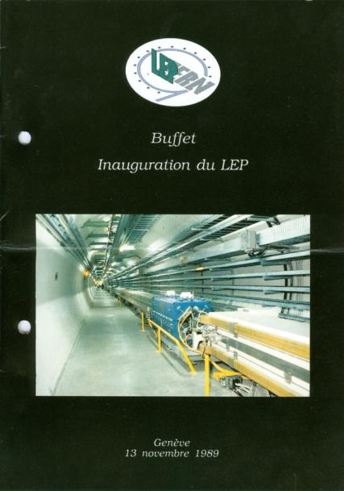
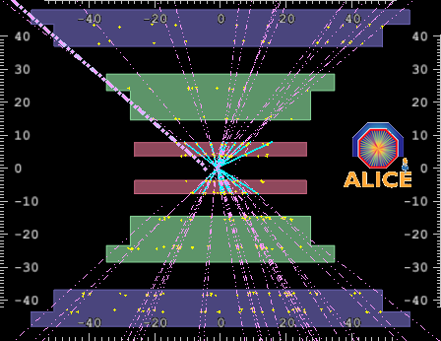
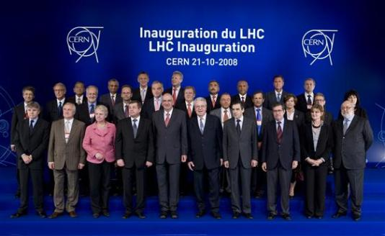
Short summary !
Oct 1971
Oct 1977
Oct 1989

Slide 3
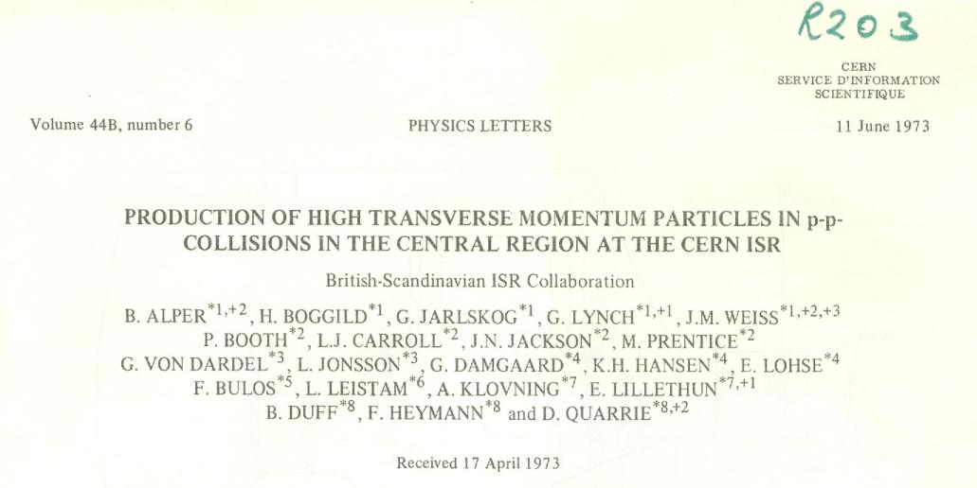
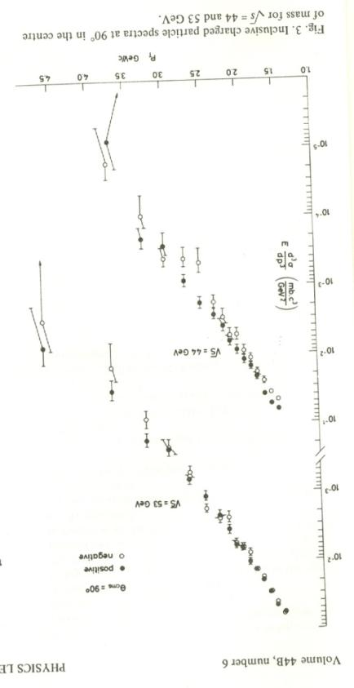
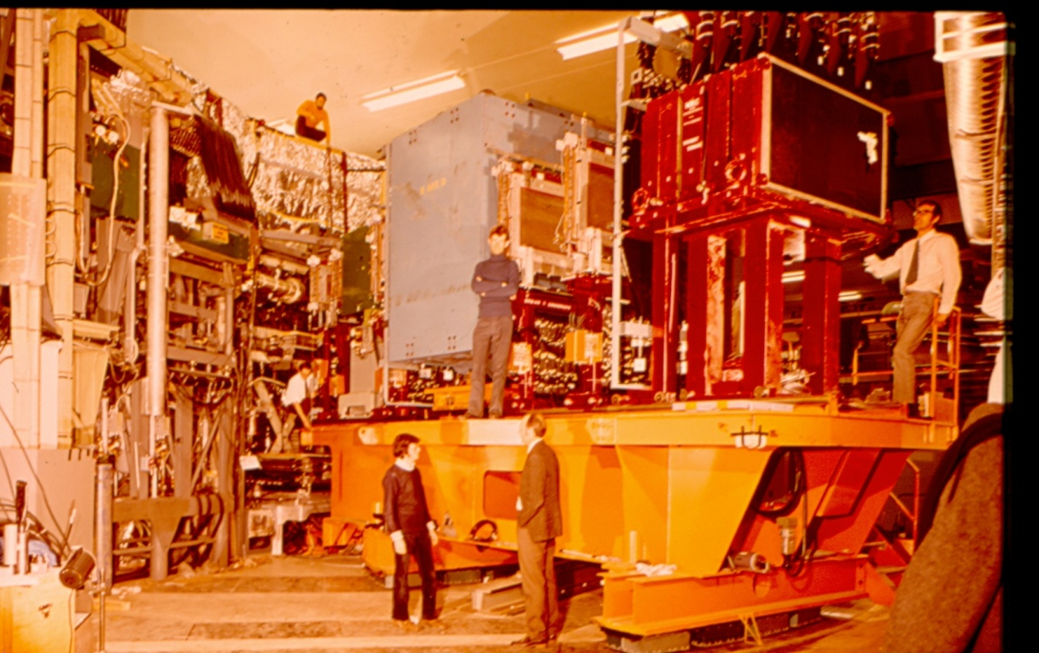
Stone age experiments

Slide 4
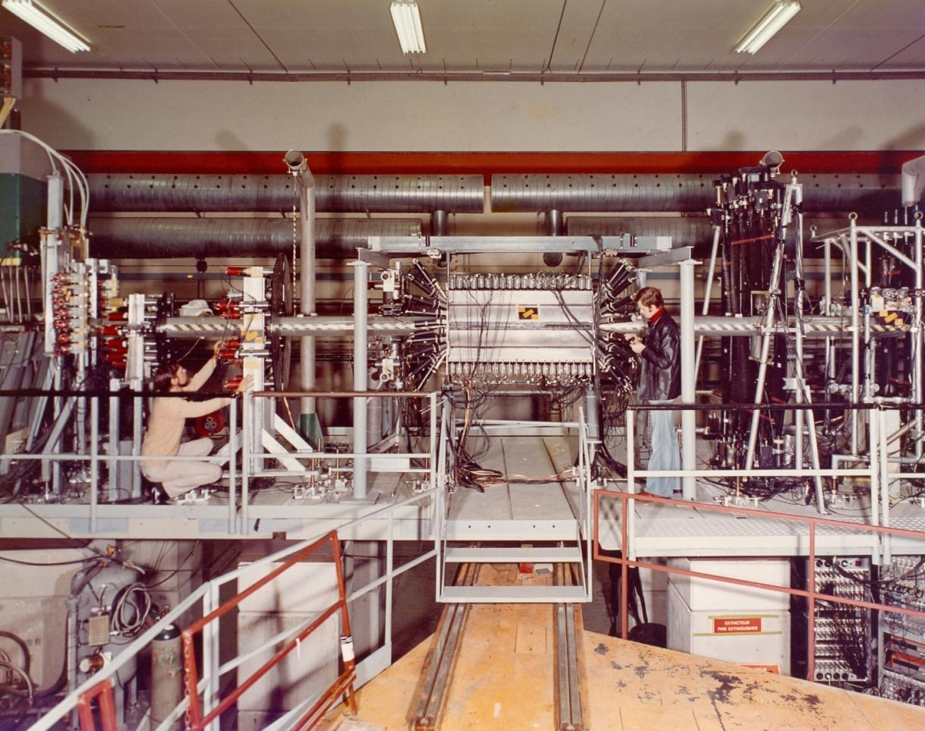
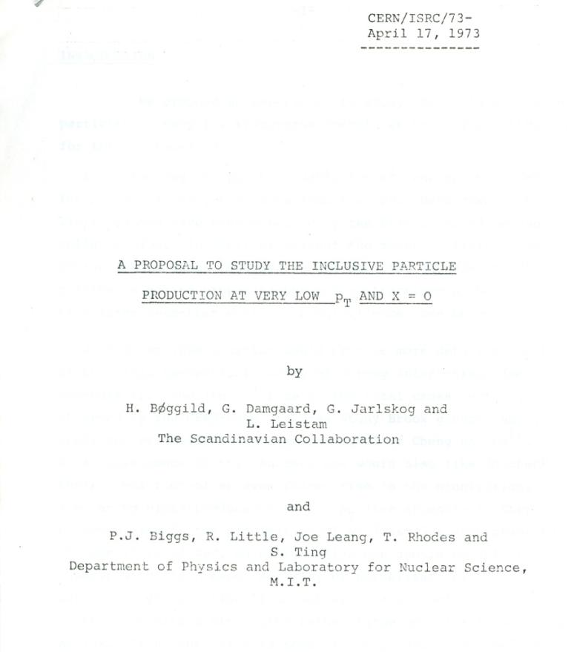
Working with future Nobel price winners ...

Slide 5
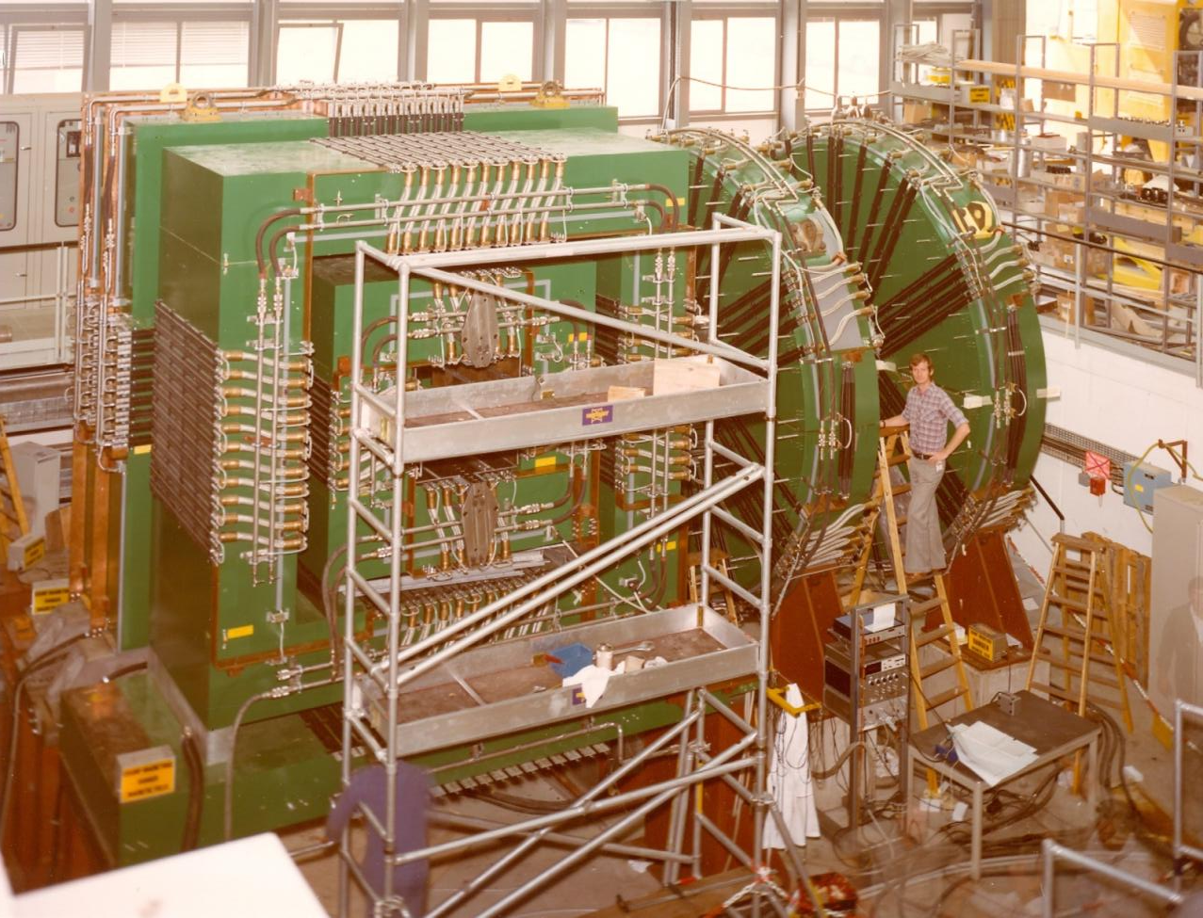
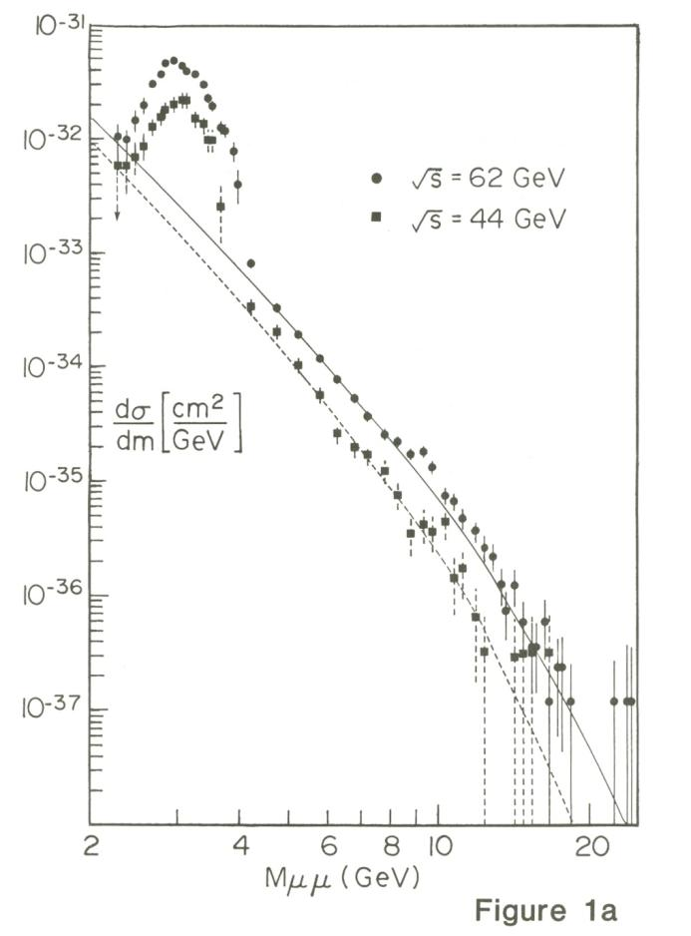
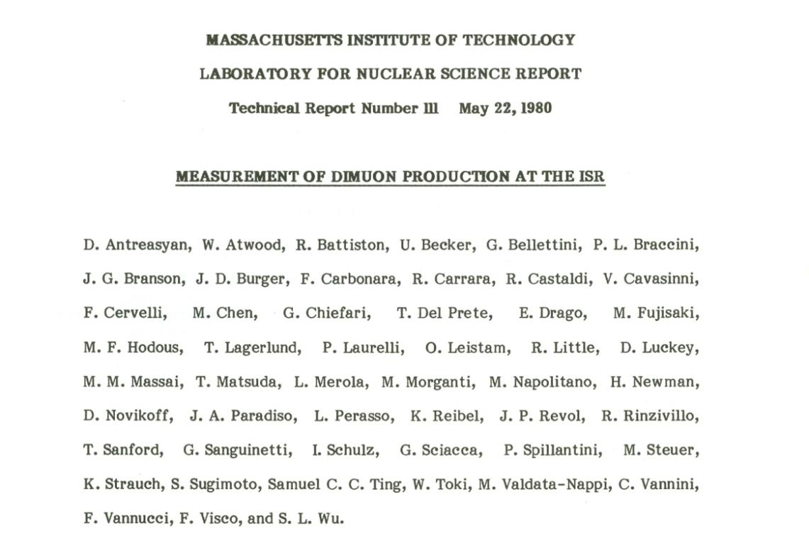
First real job – 350 t of magnetised iron

Slide 6
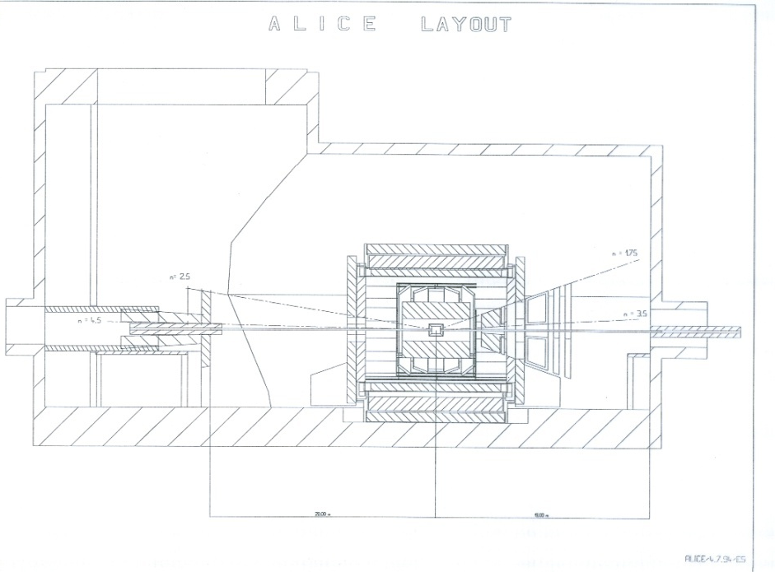
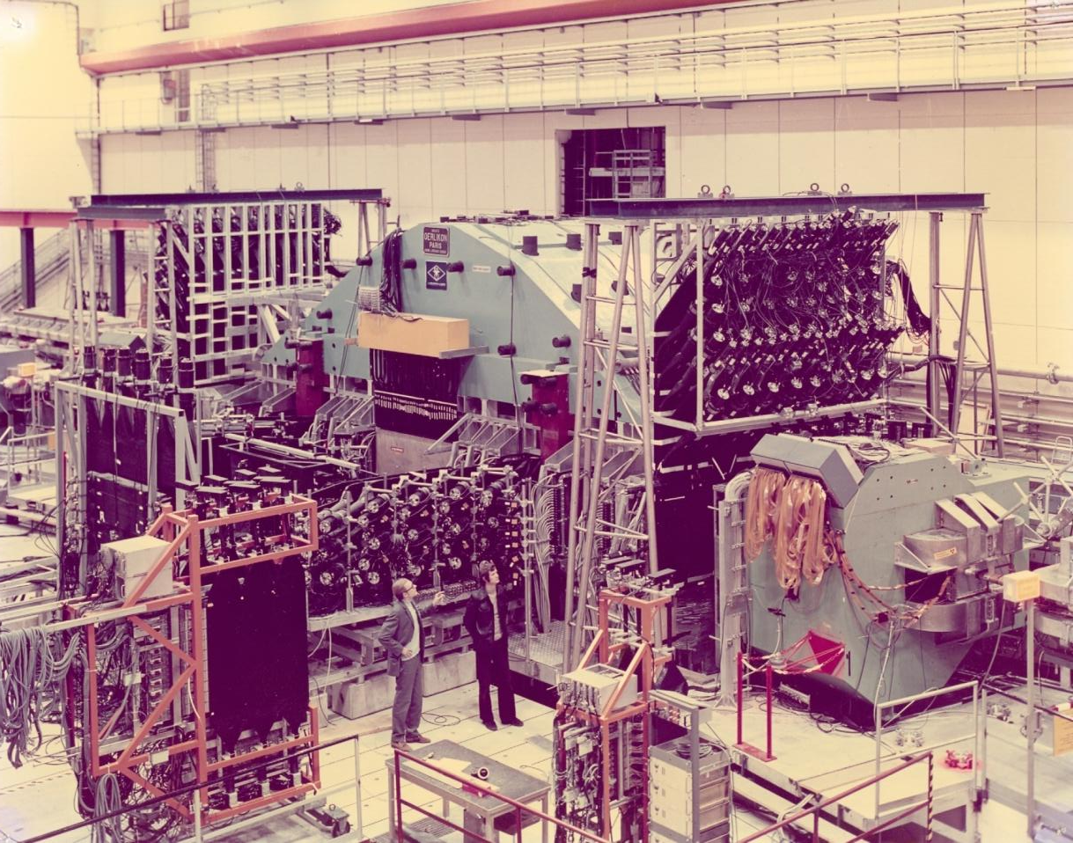
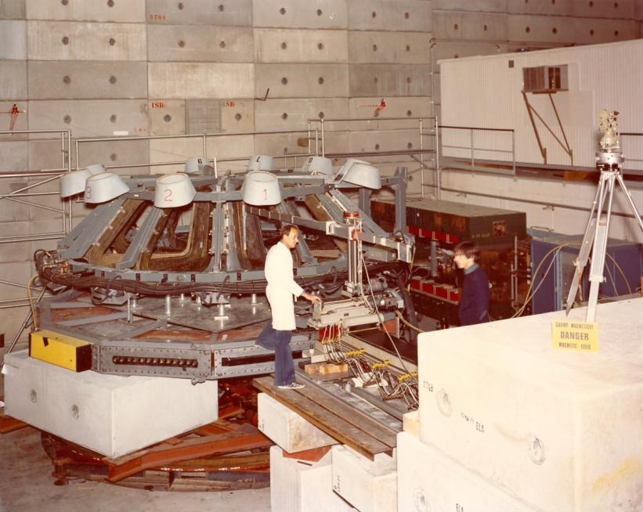
Zichichi, Rubbia and others ...
Zichichi at ISR 1975: scintillator galore
Alice 1994 air-toroid magnet !!
Rubbia at ISR 1976: air-toroid magnet

Slide 7
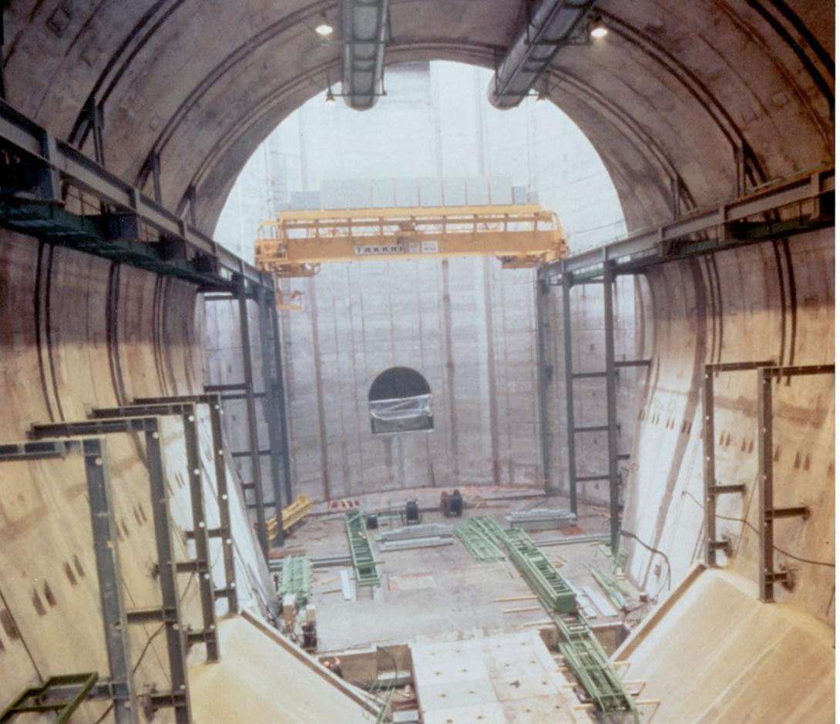
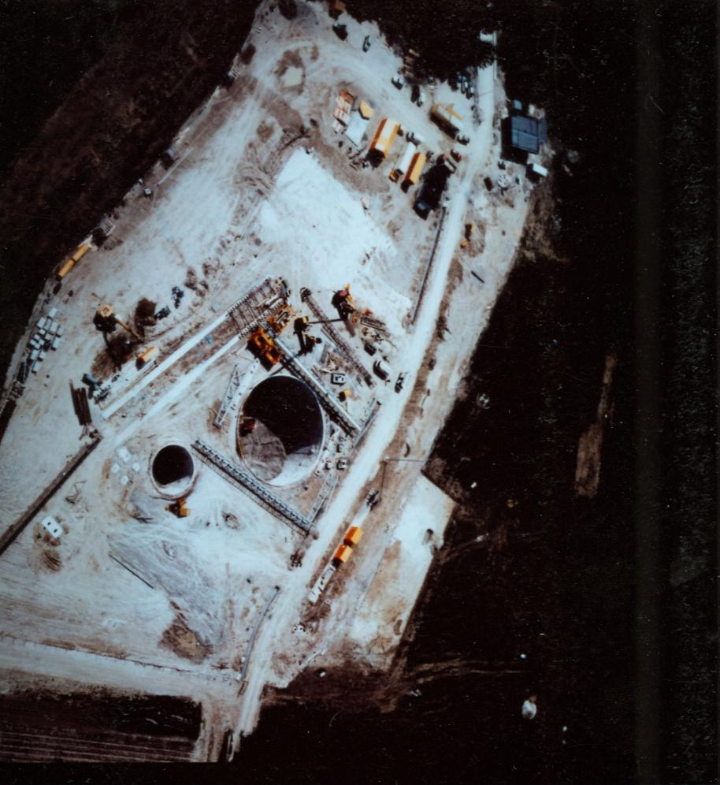
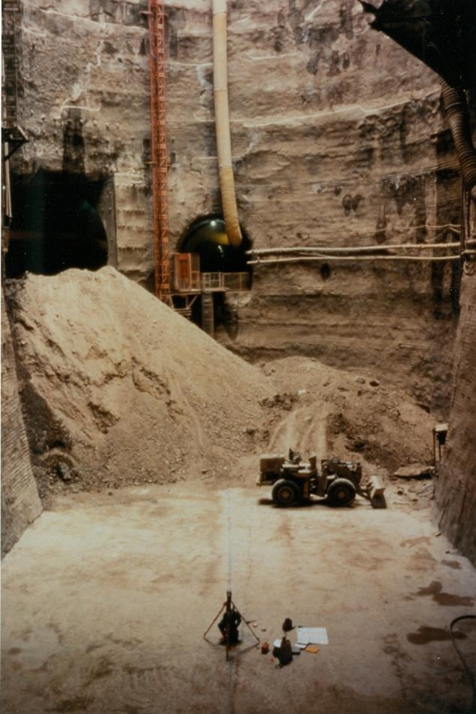
How was the L3 magnet constructed? Easy you start by digging a hole

Slide 8
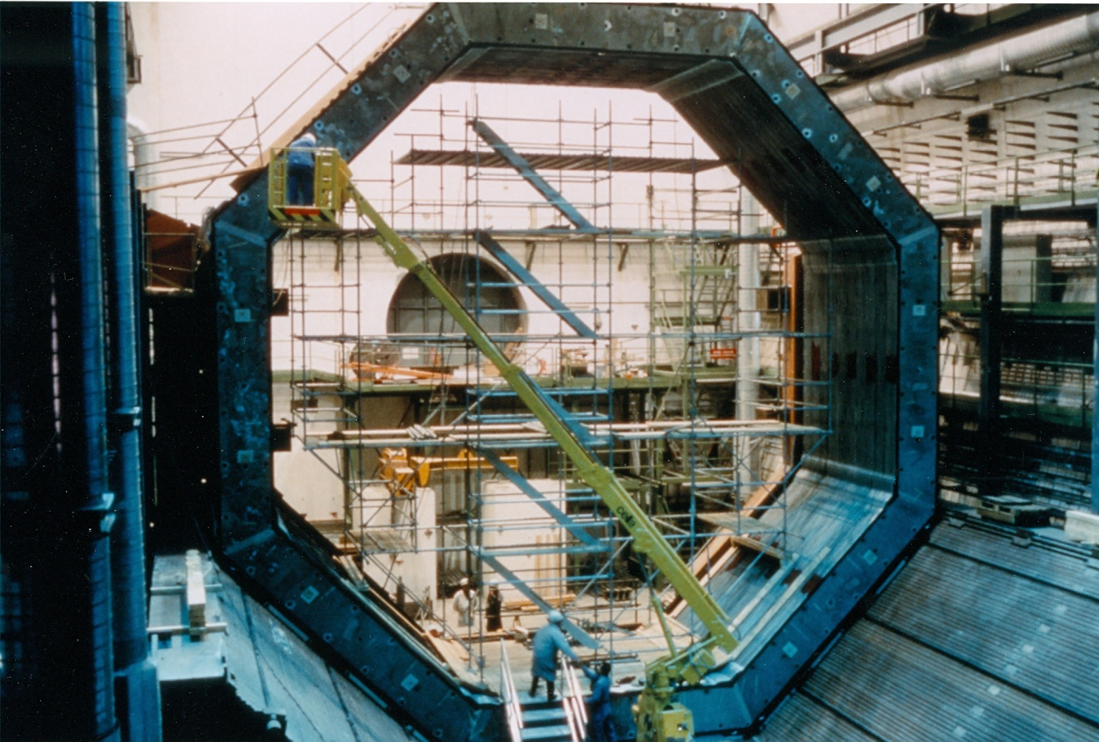
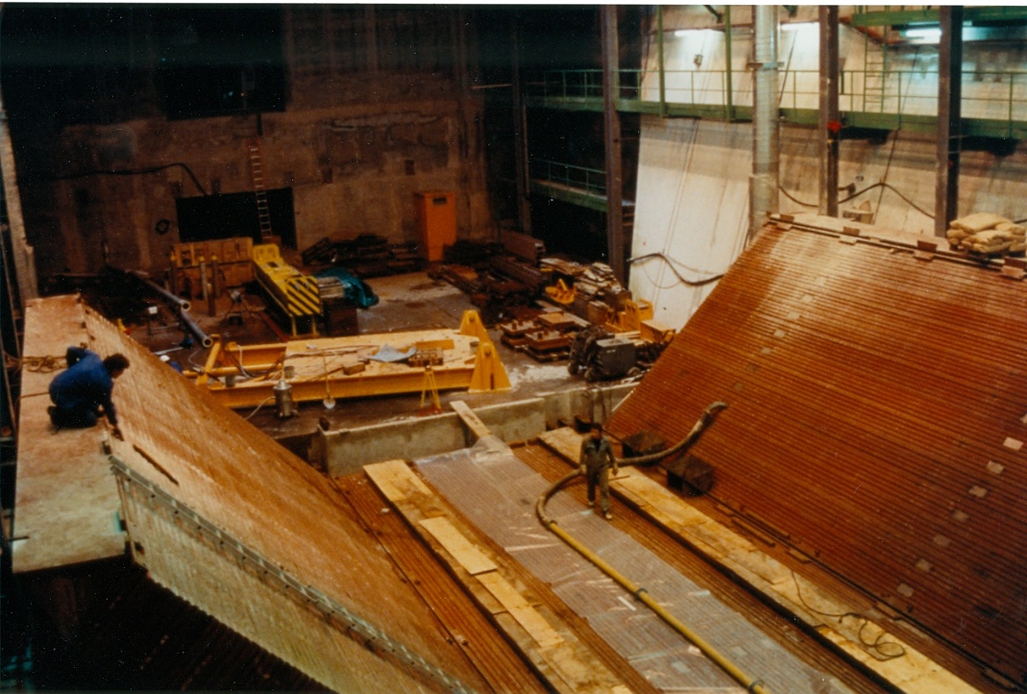
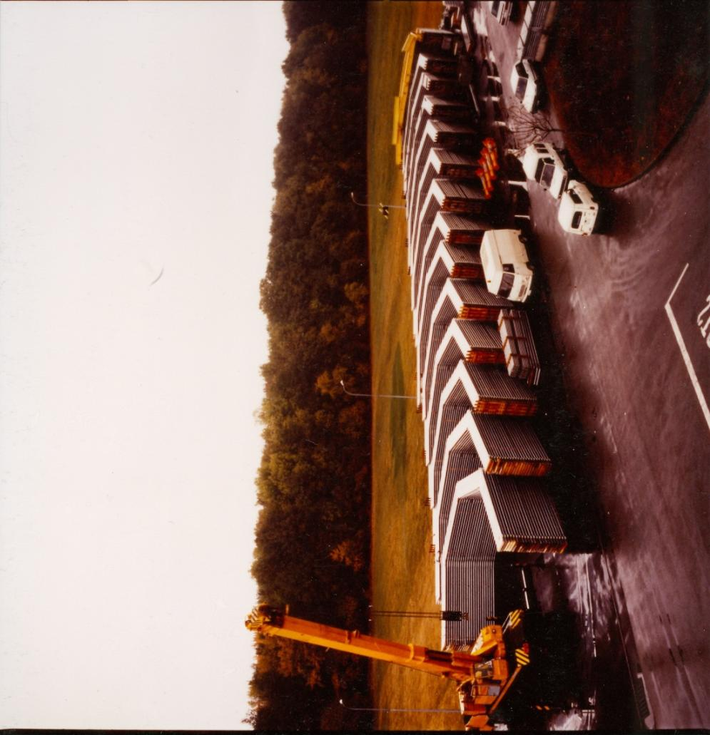
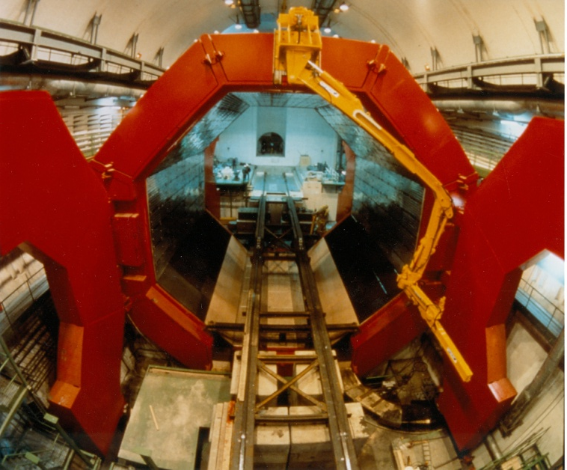
First powering almost 25 years ago
First powering – almost 25 years ago

Slide 9
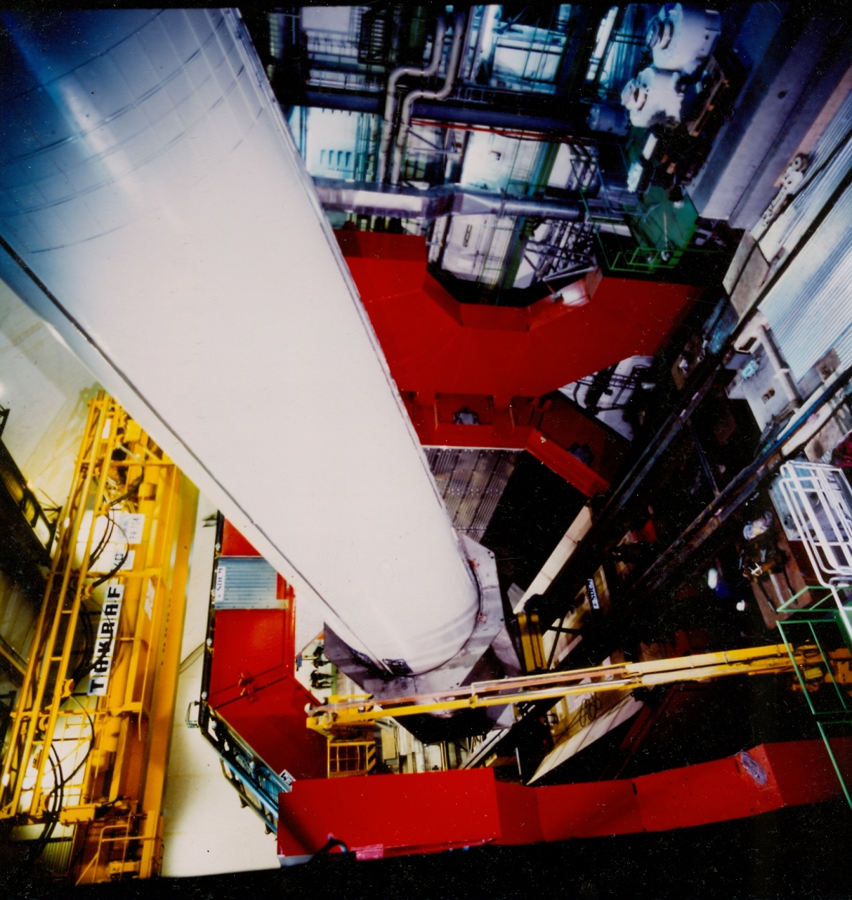
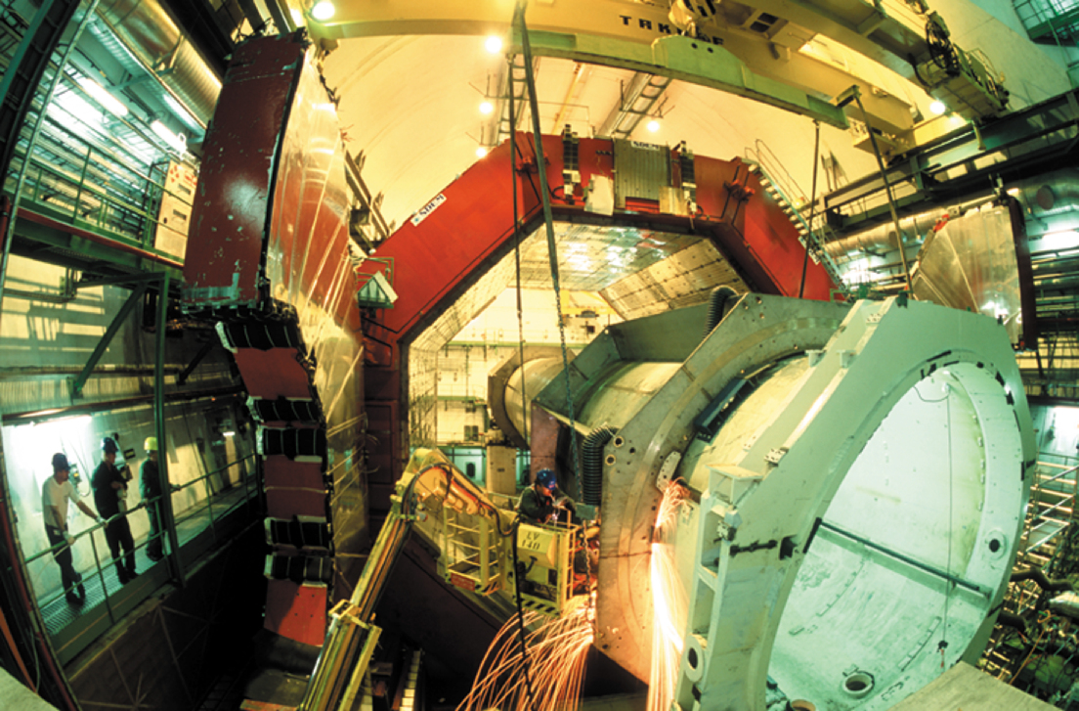
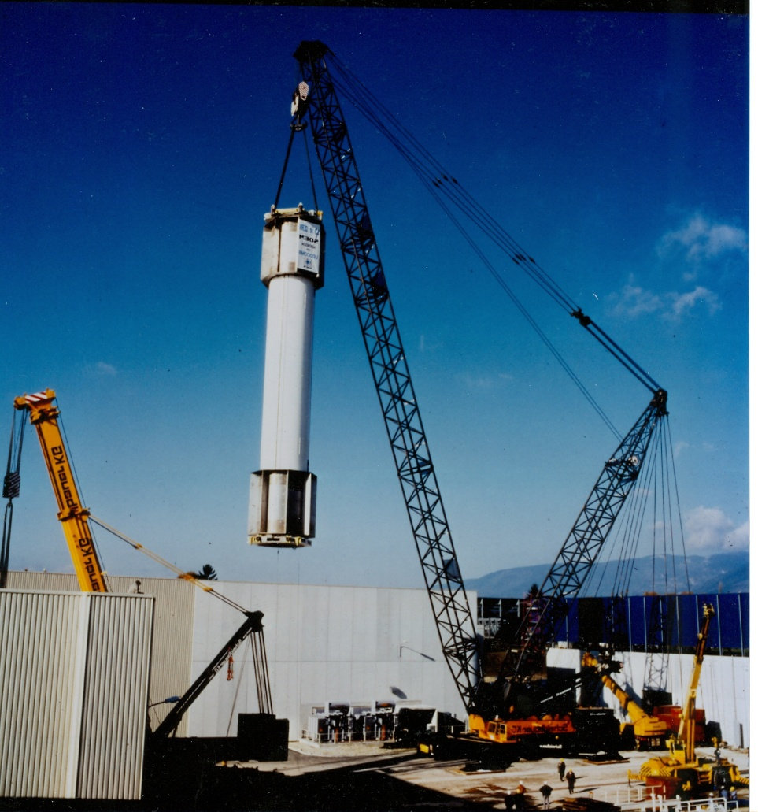
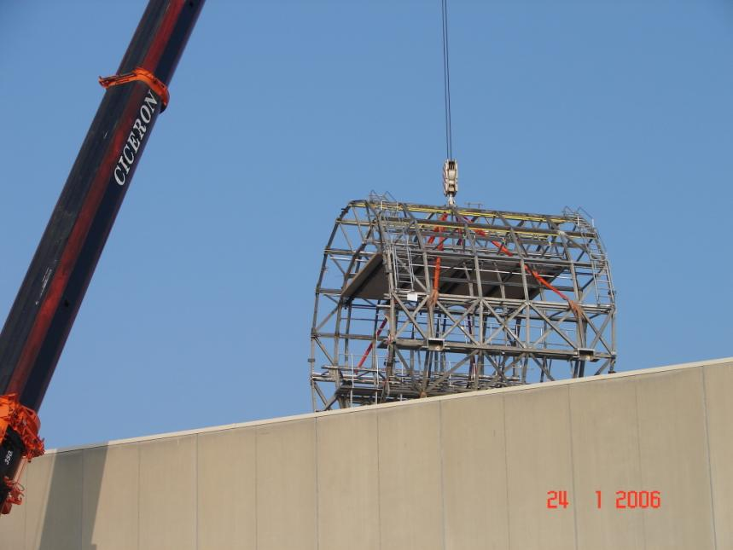
15 years later it is removed !

Slide 10
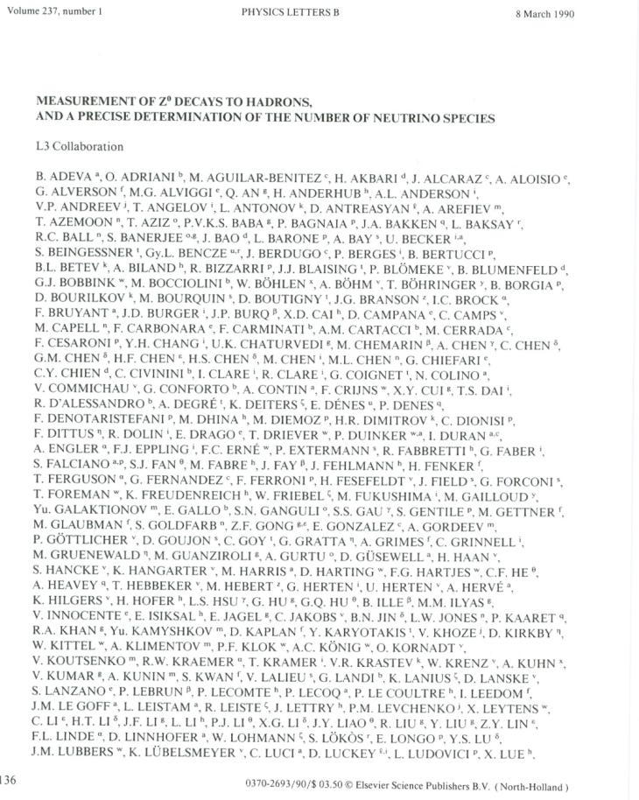
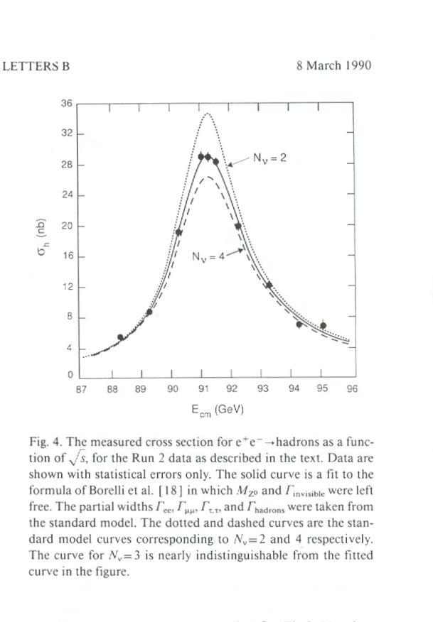
LEP physics

Slide 11
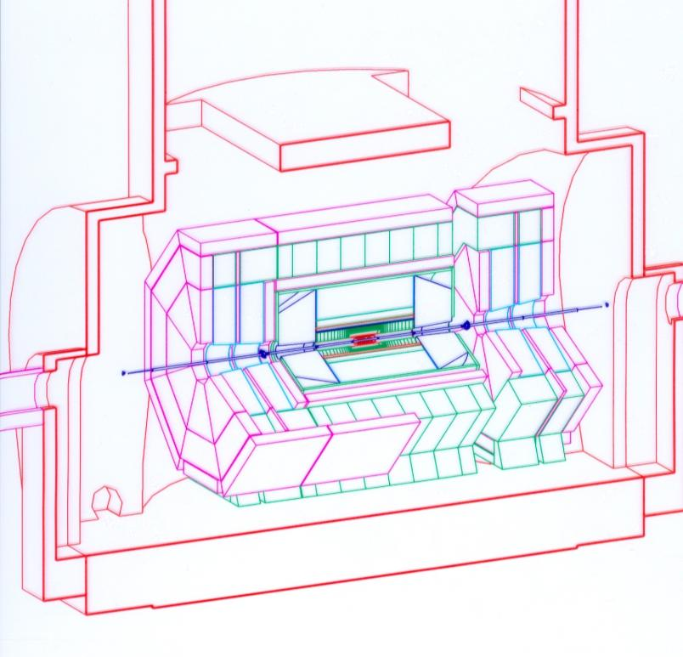
Magnet for EAGLE (Atlas) – 30’000 t of iron

Slide 12
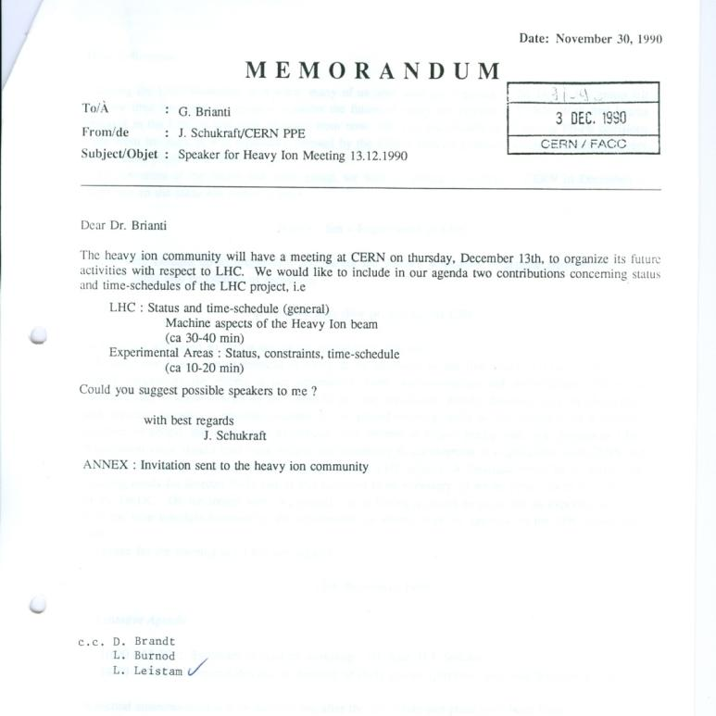
It took a long time to build Alice ……
Preparing for LHC and Alice:
Aachen October 1990
Heavy Ion meeting CERN 13.12.1990
Lund meeting March 1991
Delphi work shop 1991
Evian March 1992
ALICE LOI March 1993
Exactly 19 years or 49% of my time at CERN

Slide 13
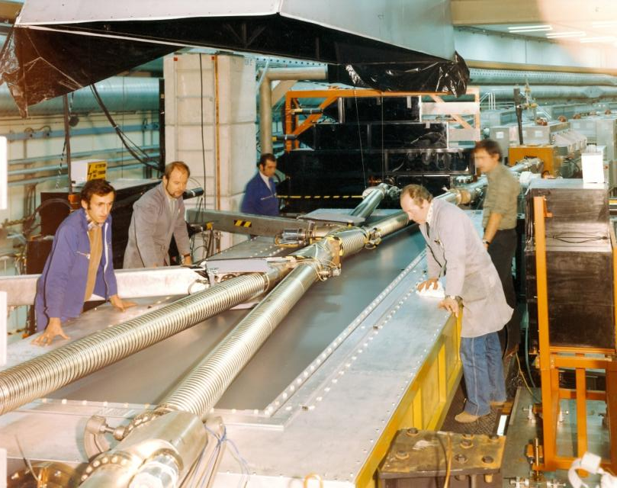
Alice first data – O.K with UA5

Slide 14
The Alice CERN Team
(I believe strongly that..) The Alice CERN Team has played a fundamental role within the Alice collaboration
The size of the Alice team is comparable to a large CERN group. This has allowed frequent contact between the team members and (as far as I am concerned) a very pleasant working environment

Slide 15
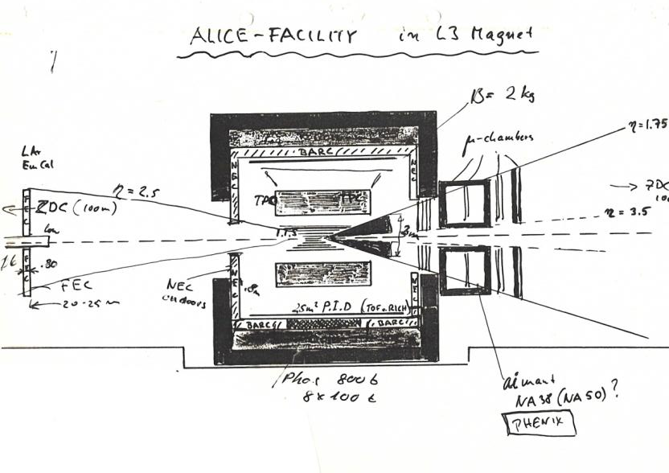
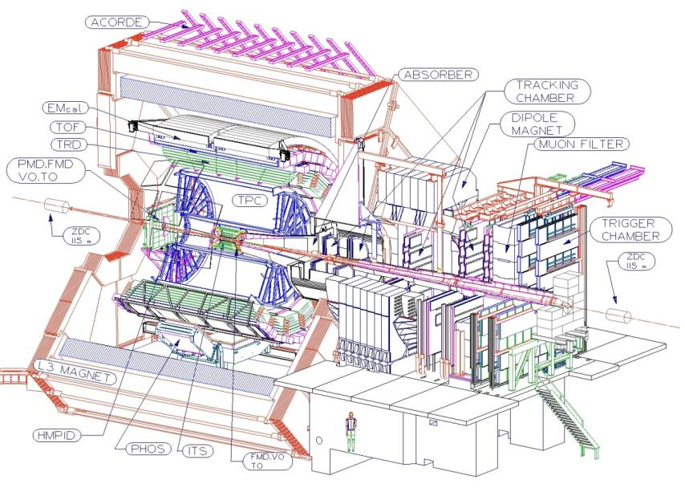
My passion during my time at CERN has been to help outside teams to work and construct experiments at CERN, call it Experimental Support or Technical Coordination
I strongly believe that this is indeed one of the main missions of the CERN staff, not only the PH department
This can sometimes be very frustrating – but personally I have found great pleasure in interacting with the international physics community
19 years in Alice has provided both frustration and satisfaction

Slide 16
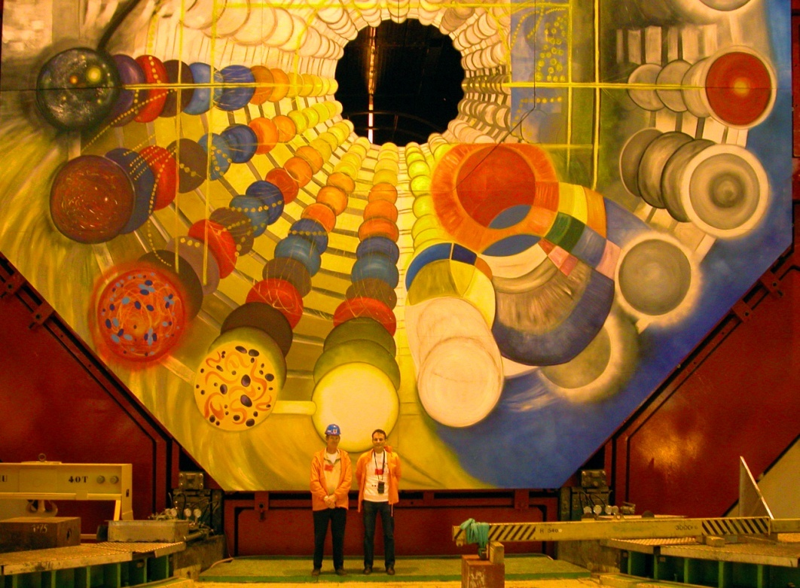
Finally – the Alice TCion
The Alice TCion has lately undergone several changes: people retiring or moved to different groups or departments
Werner together with his brand new deputy; Arturo, have a fascinating but challenging time ahead of them
Good luck

