Slide 1
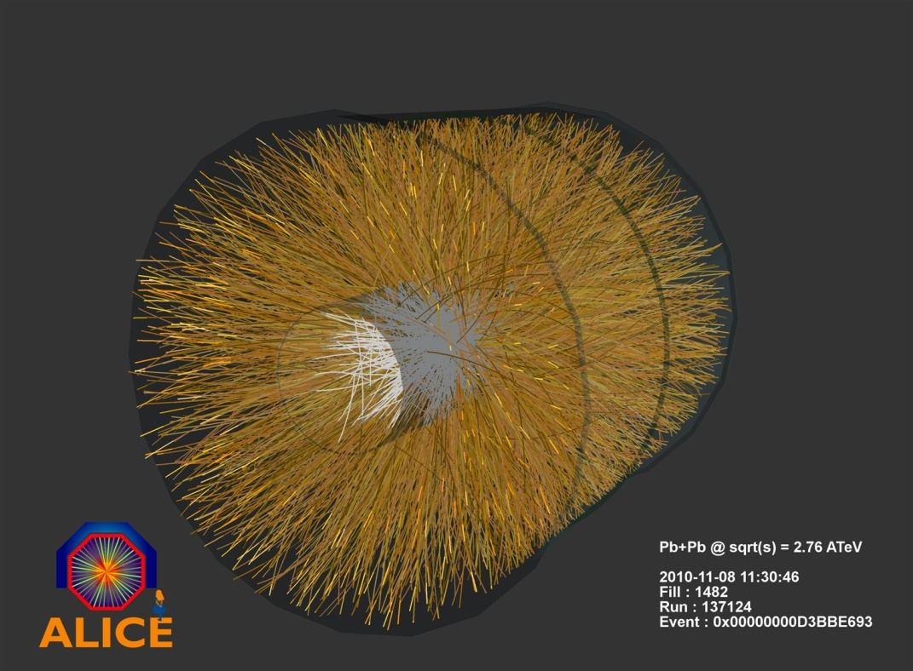
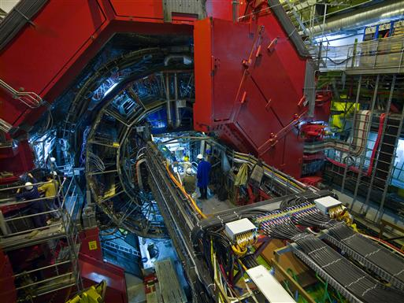
ALICE
The 2010
LHC Experience

Slide 2
Where is Jurgen ... ?
Jurgen Schukraft is off to a conference to tell the world on how beautiful the LHC works.
He transmits his apologies for not being present and congratulates LHC for an incredible achievement.
Note: The reason of Jurgen’s absence is not the fact that he got too annoyed about the 2010 heavy Ion schedule discussions.

Slide 3

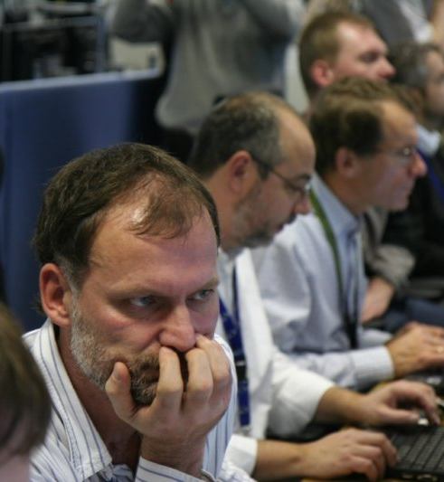
The LHC (and everything else) accelerates ..
.. and tense anticipation..
Monday, 23rd November 2009, ~15:30
in the ALICE Control Room
..after concentrated preparations..

Slide 4
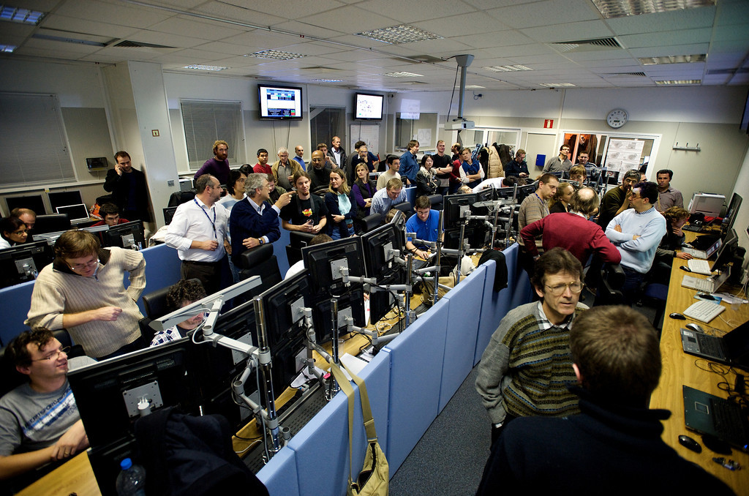
some anxious minutes waiting for collisions..
~ 16:35

Slide 5
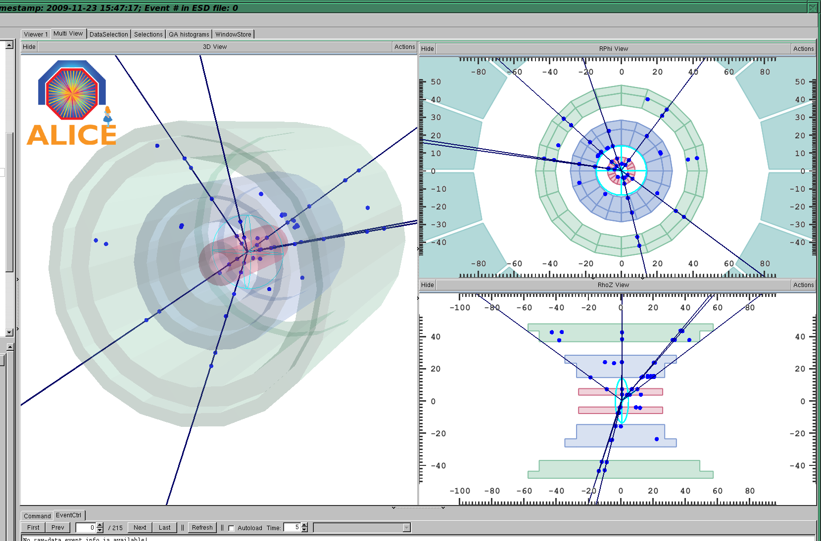
The first ‘event’ pops up in the ACR
~ 16:41

Slide 6
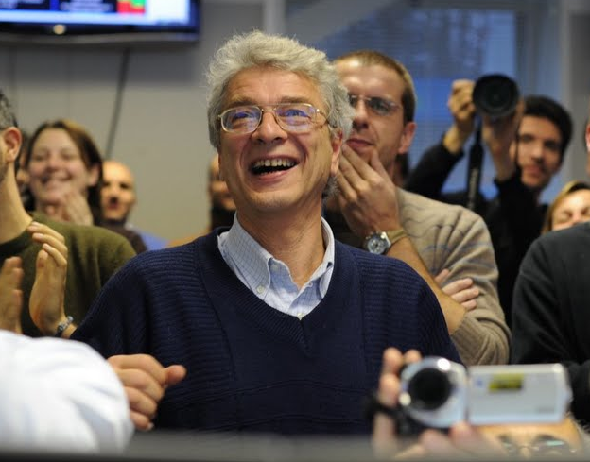
Relief and jubilation..
Collisions in ALICE !!
.. and some celebration..
~ 16:42

Slide 7
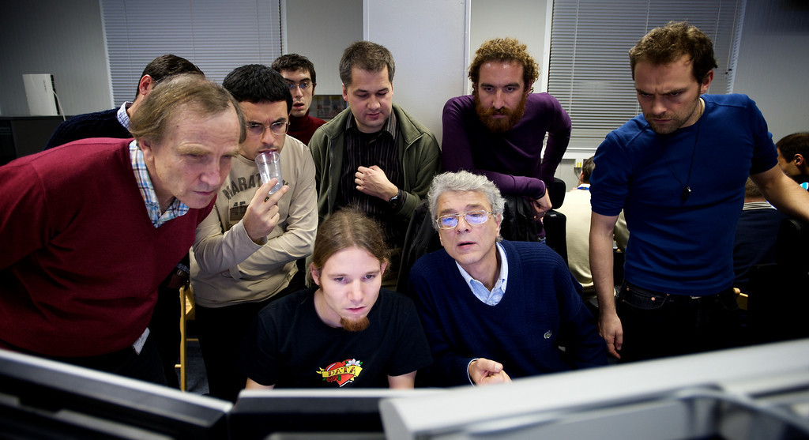
‘First Physics’ in the making
~ 18:00
After years of looking at simulated data, there was no holding back:
First physics results examined,
ca 1 hour after data taking finished (284 events !)..

Slide 8
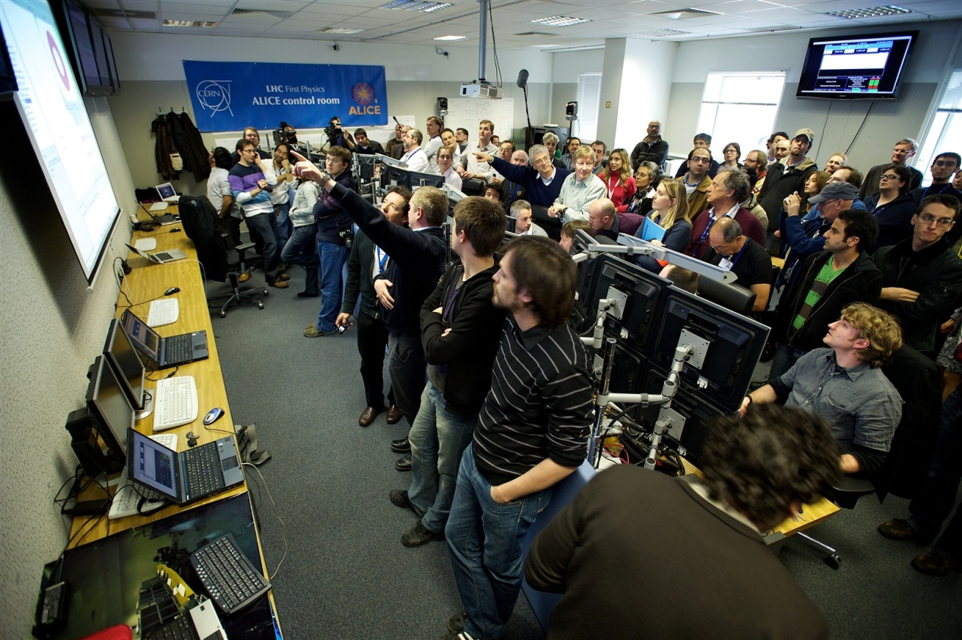
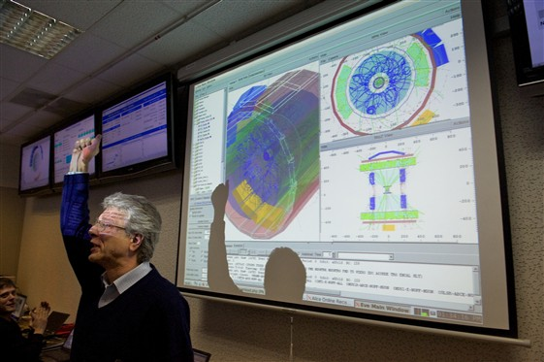
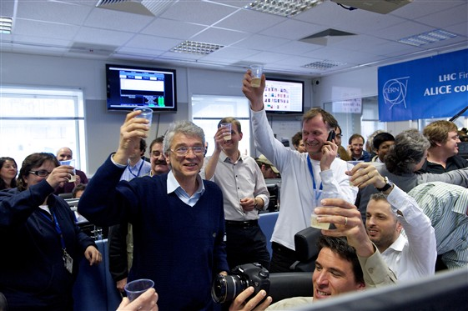
First High Energy Proton Collisions
March 30th 2010
More Drinks …

Slide 9
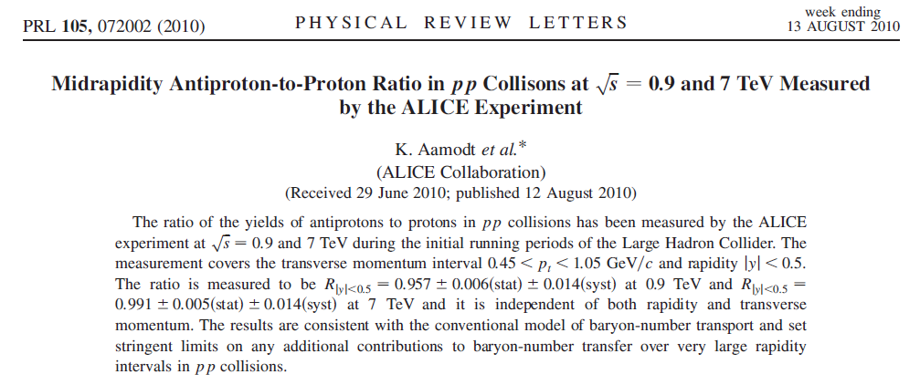
p/p Ratio @ LHC
Can we stop a proton at LHC ?
Where does the conserved Baryon
Number reappear ?
p/anti-p ratio at mid rapidity goes to one → you cant’s stop a proton at LHC !
0.9 TeV: p/p = 0.957±0.006(stat) ±0.014(syst)
7 TeV: p/p = 0.991±0.005(stat) ±0.014(syst)
p
p
p
anti-p

Slide 10
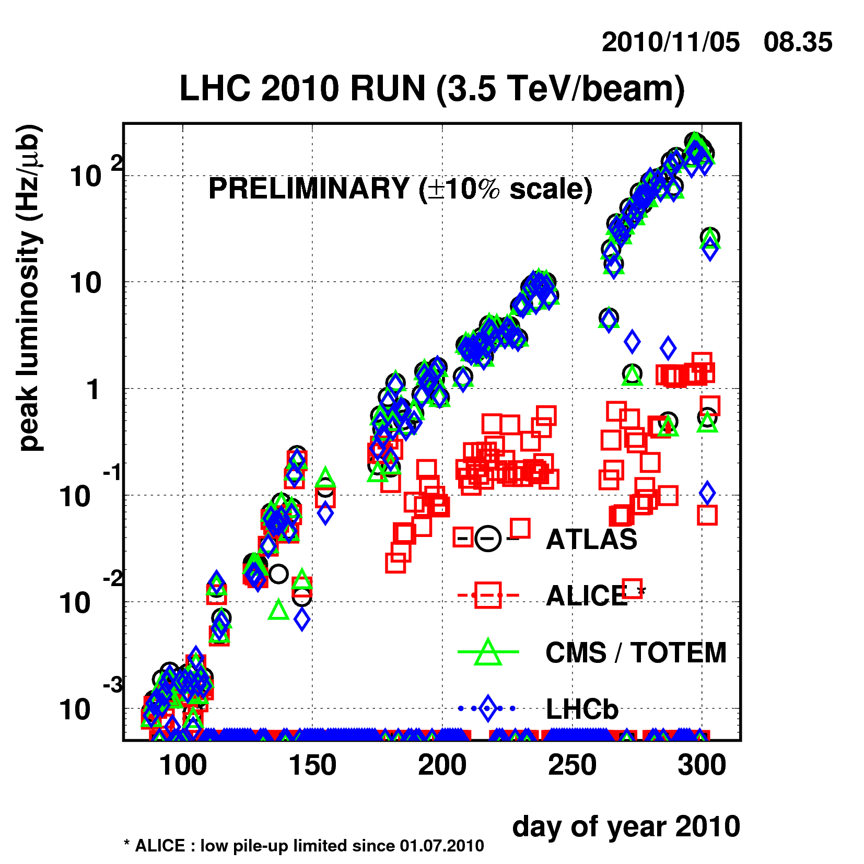
LHC p-p Peak Luminosity Evolution
! >5 orders of magnitude in 200 days !
You could have done much better if you would have not only worked on the high side …

Slide 11

ALICE: The LHC has switched from
Large HadronCollider (pp) to
LargeHadron Collider (Pb-Pb)

Slide 12
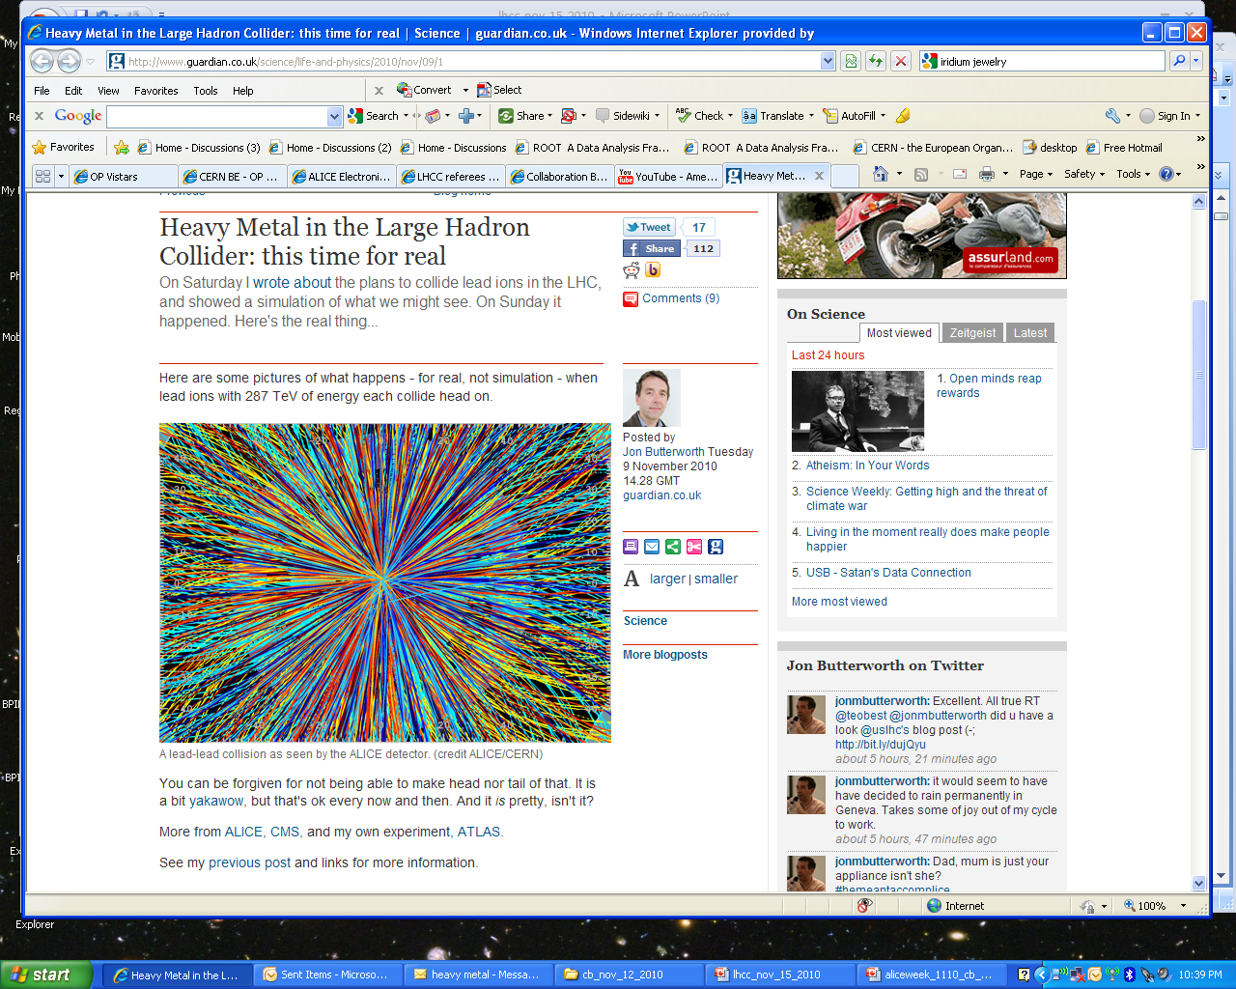

Slide 13
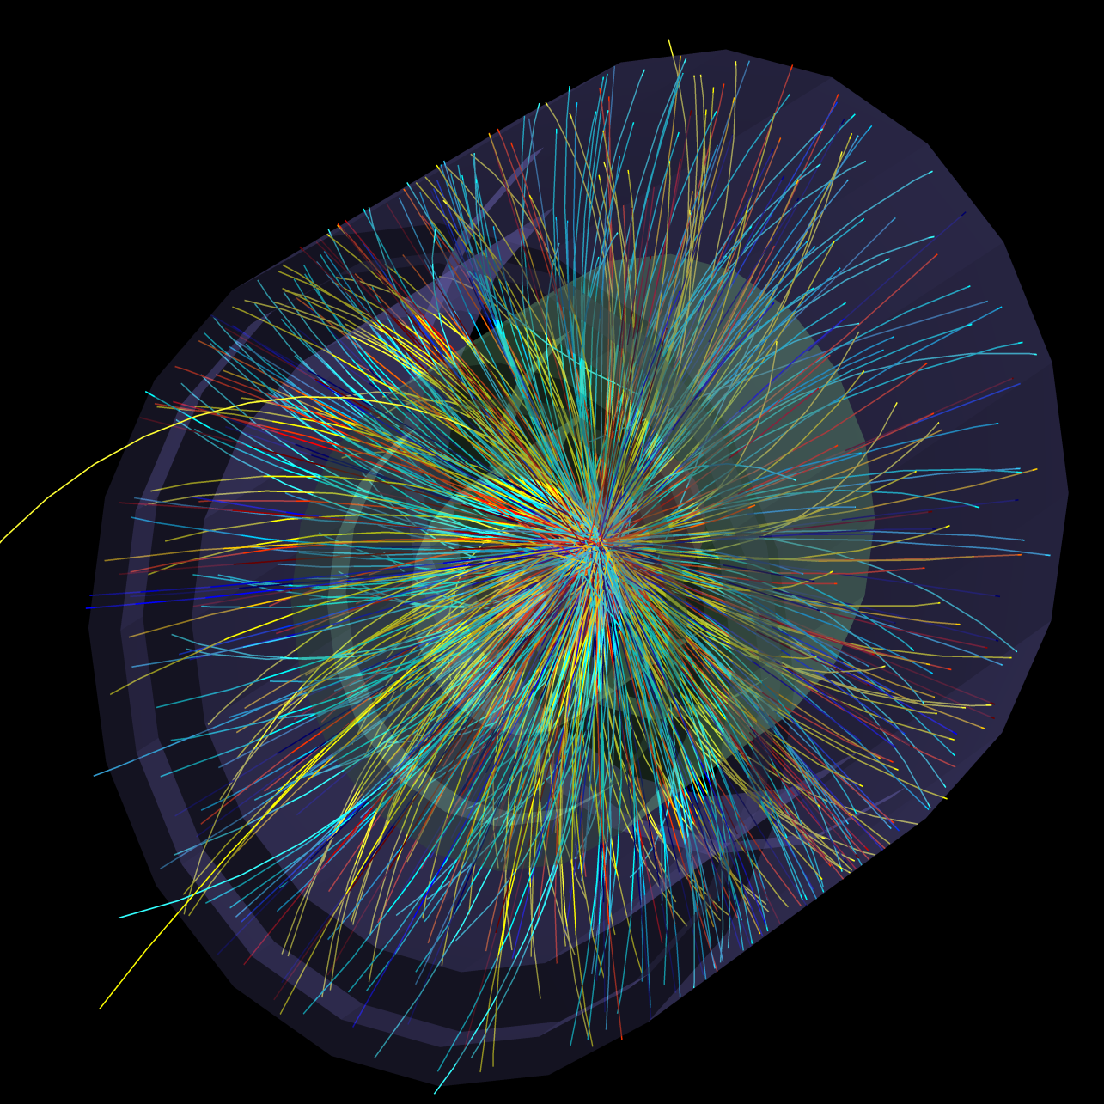
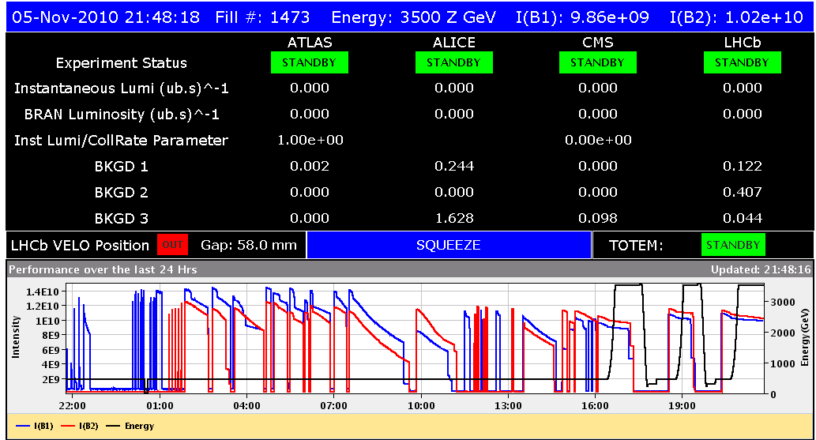
Ion Commissioning at Incredible Speed
First Ion Collisions
Sunday 7 Nov., ca 1:00 am
Thursday evening
Friday evening
Optics Checks
BI Checks
Collimation Checks
First Ramp
Collimation Checks
Squeeze
B1 Inj., Circ.
& Capture
B2 Inj., Circ.
& Capture
08/11/2010
LHC 8:30 meeting
Notes:
13

Slide 14
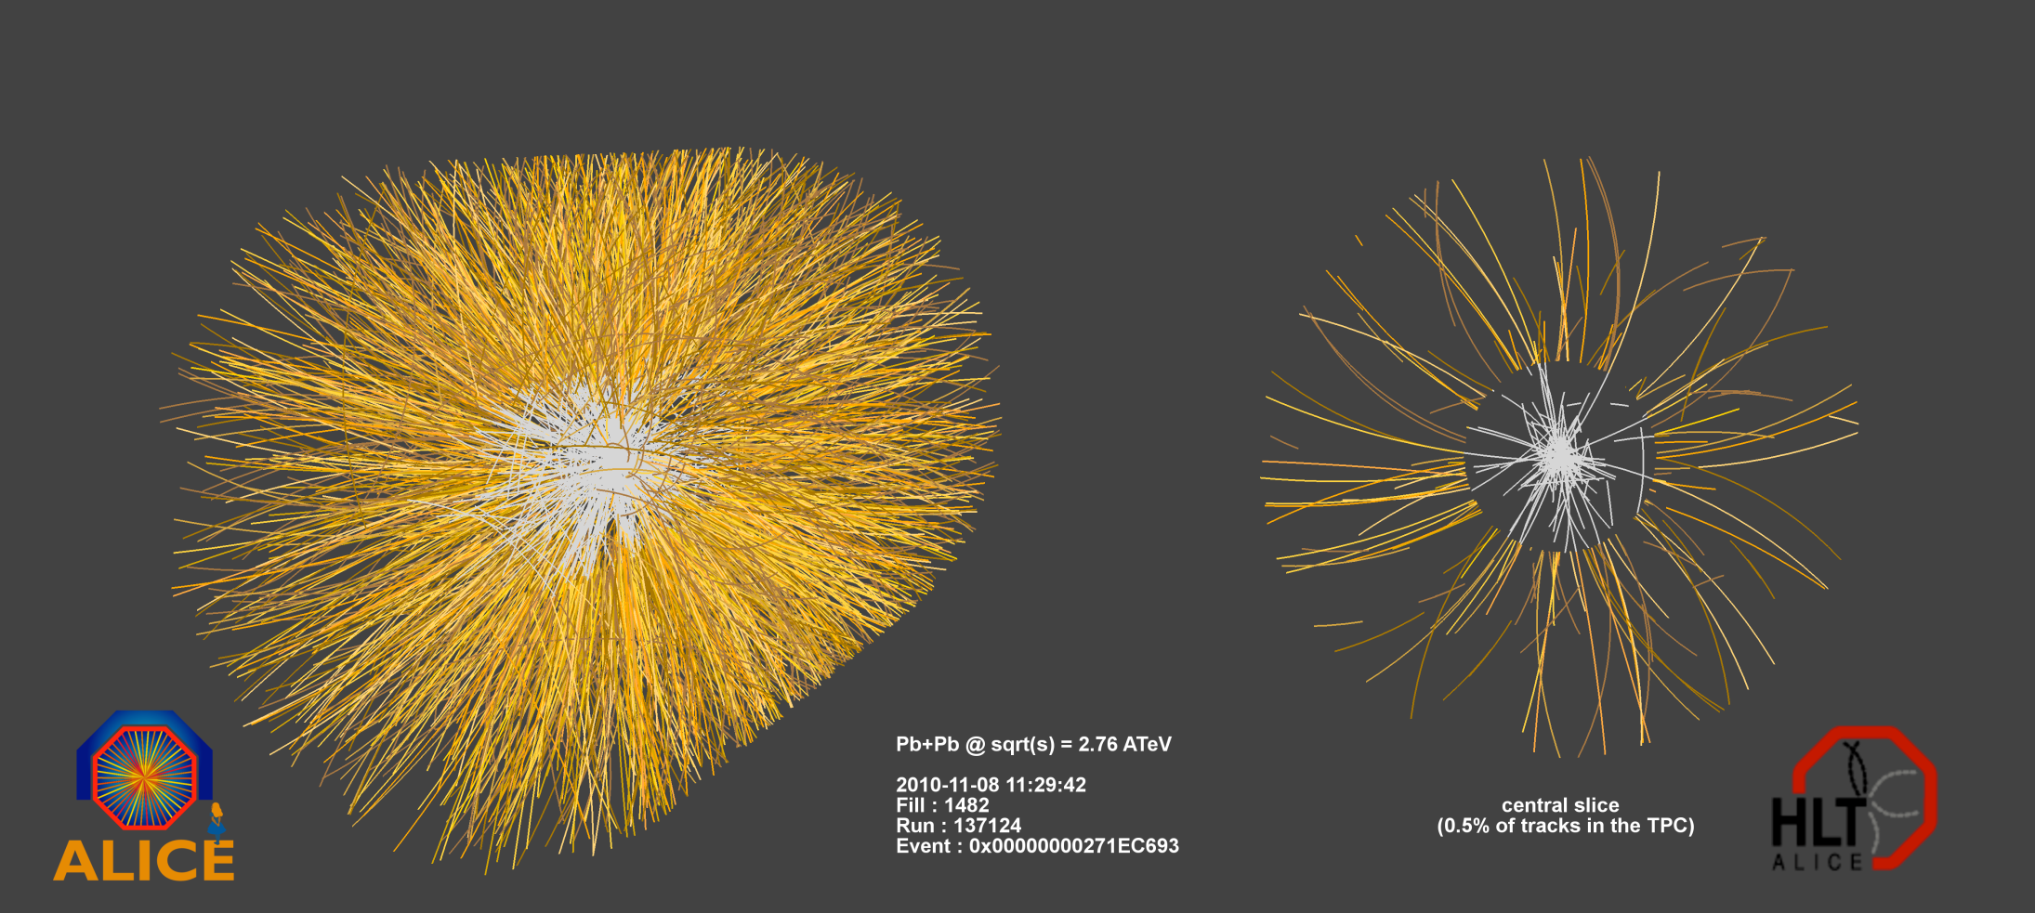
! Pb Pb Collisions !
Mon. Nov 8th Fill 1482 – stable beam –
! All detectors running smoothly !
From an e-mail exchange in concerning the ALICE collaboration week:
… we advance the ALICE drink from Thu. Nov. 11th to Wed. Nov. 10 because we might already expect heavy Ion collisions on Thursday …

Slide 15
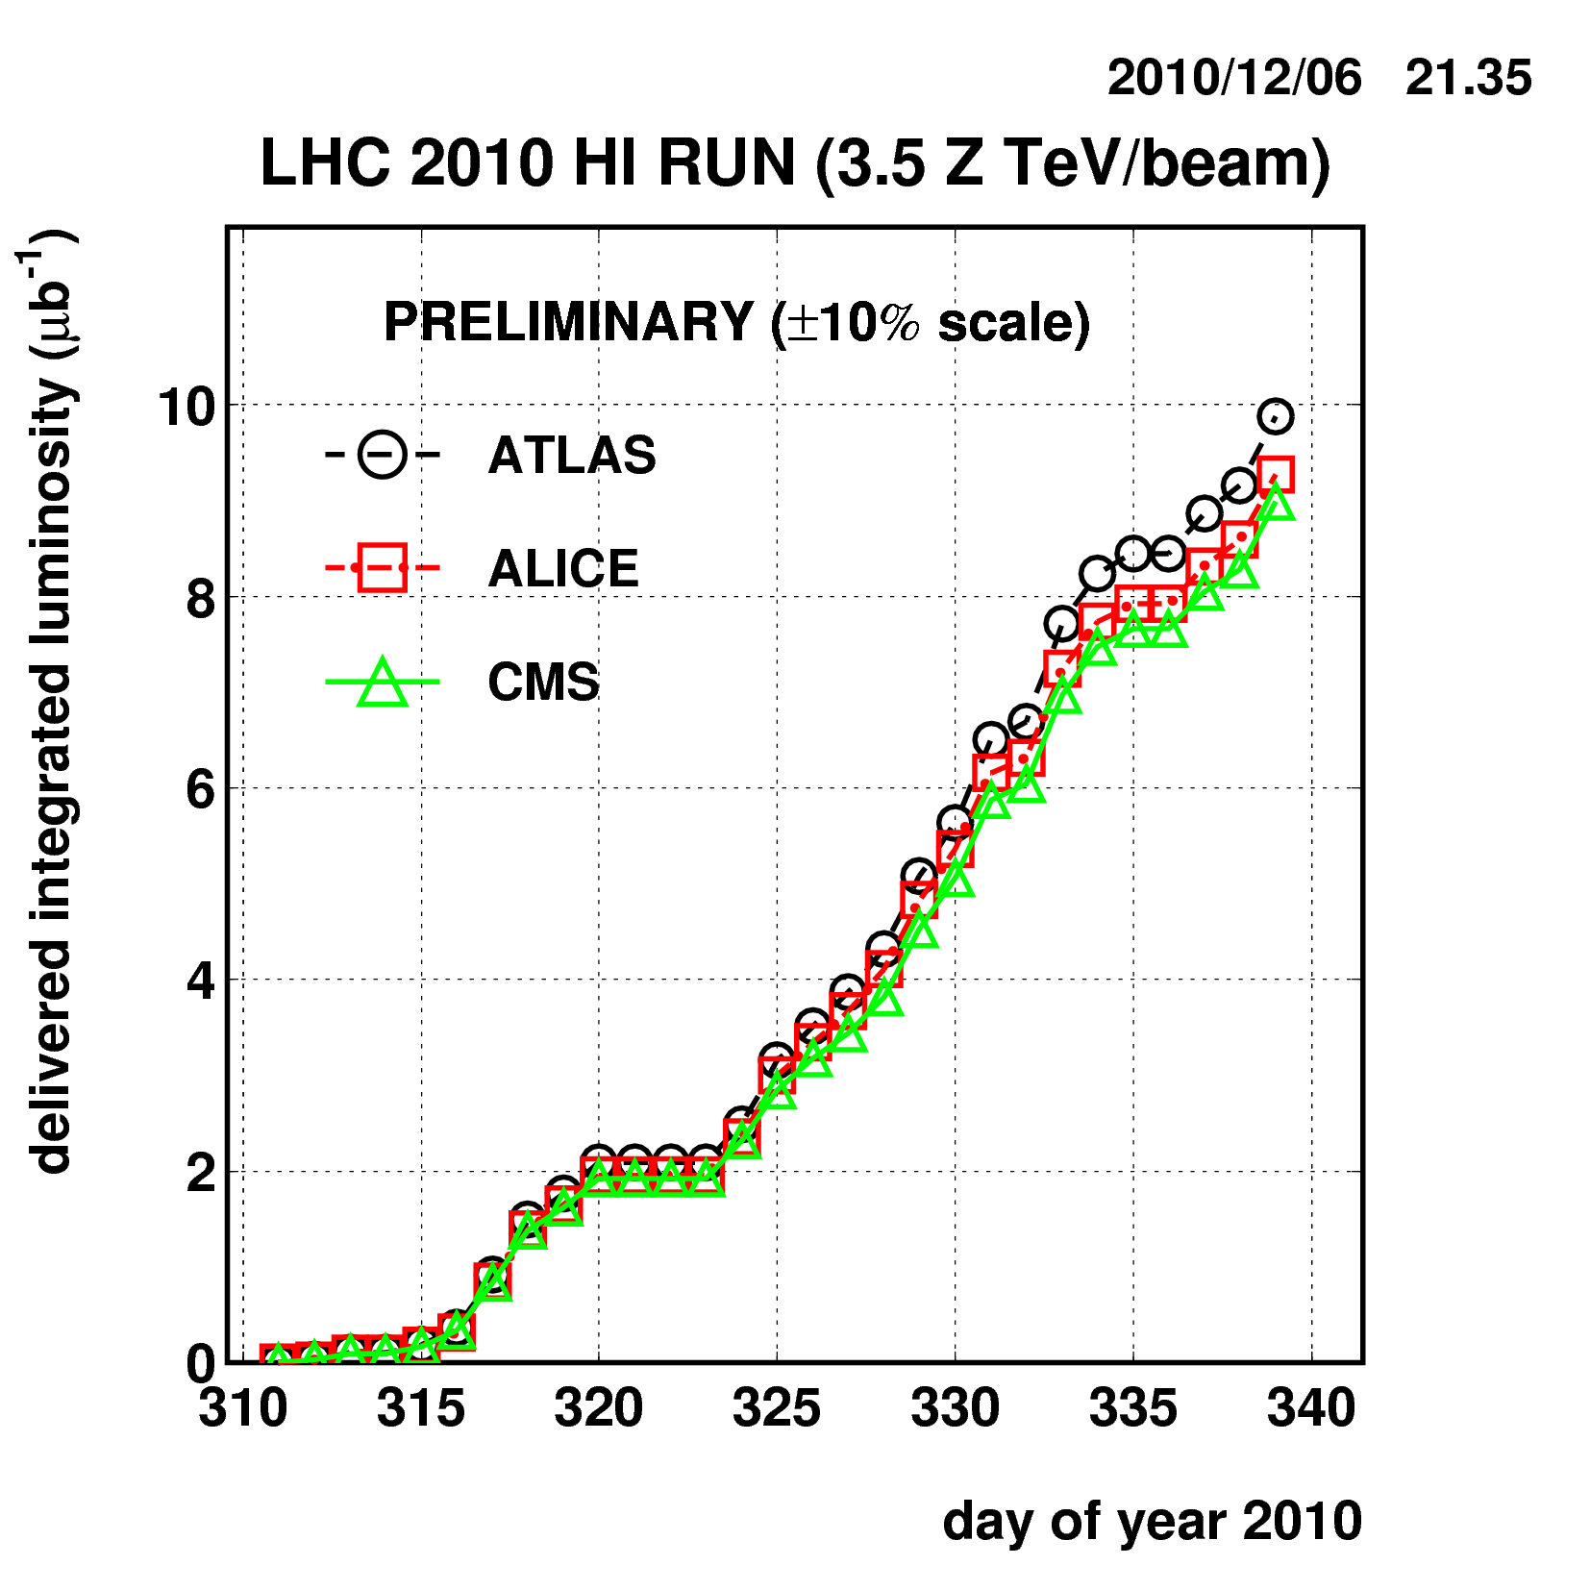
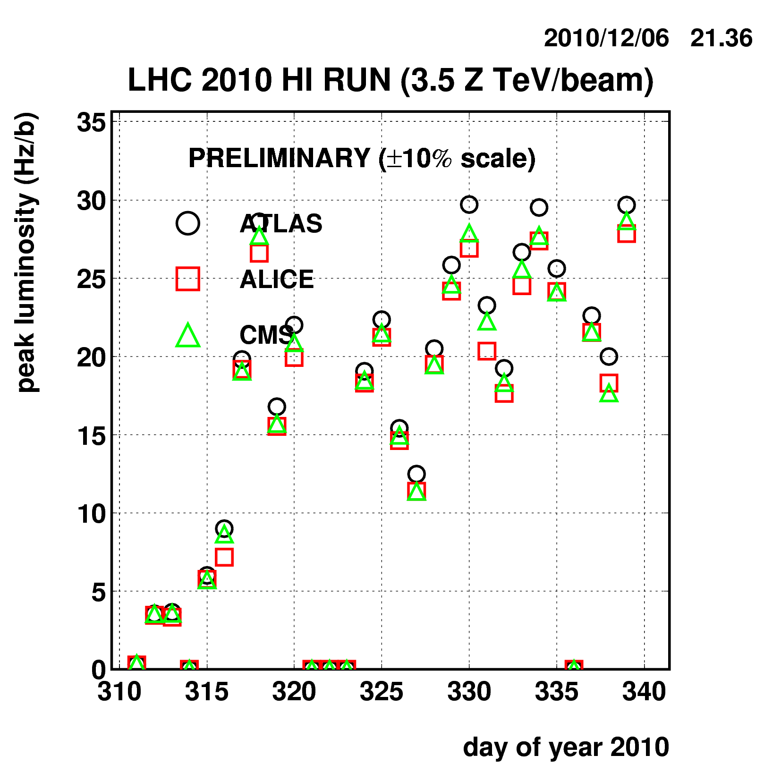
Pb-Pb Integrated Luminosity
LHC had to stop on Monday Dec 6th because otherwise it would have missed the 2010 goal of 1-10 ub⁻¹ !

Slide 16
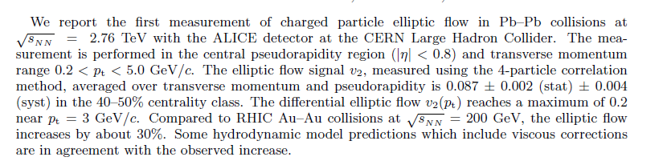

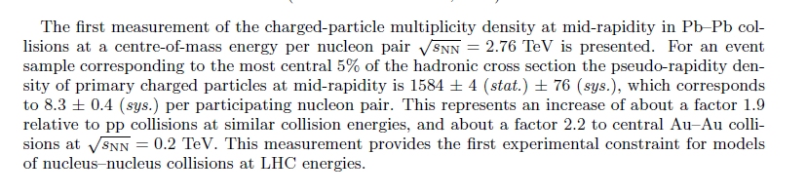
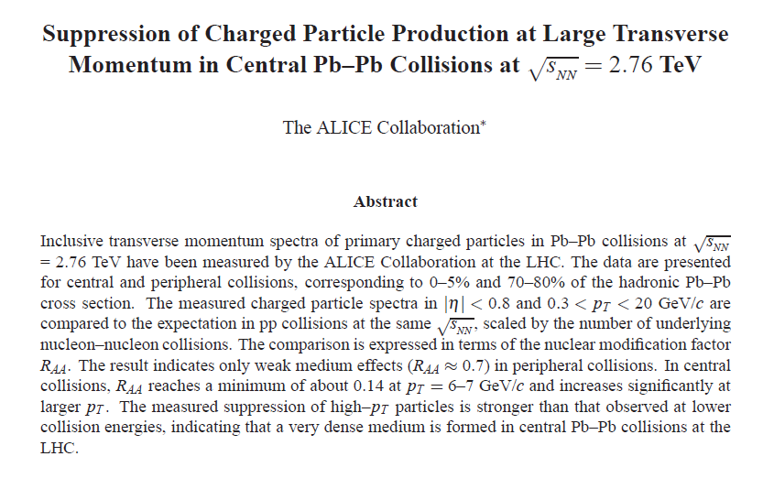
Very intense Days of Data Analysis

Slide 17
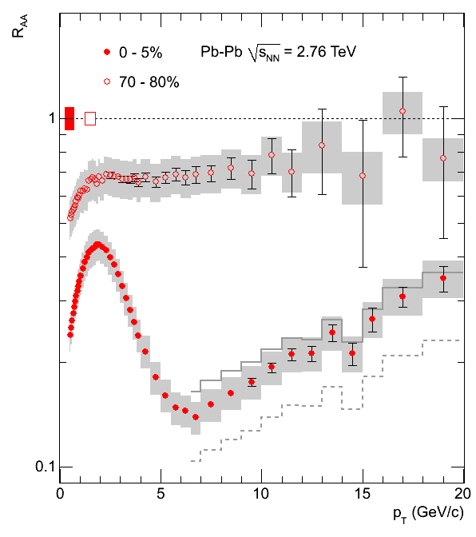
‘Jet Quenching’ as seen by p_{t} spectra
Suppression of high p_{t} particles ( ~ leading jet fragments)
  Minimum R_{AA} ~ 1.5 – 2 x smaller than at RHIC
  Rising with p_{t} ! (ambiguous at RHIC !)
  accuracy limited by pp reference
  => need pp at 2.76 TeV !
R_{AA} = 1 for (very) hard QCD processes
in absence of nuclear modifications
Data driven Interpolation
900 GeV & 7 TeV
or using NLO for change in shape
7 TeV * NLO (2.76 TeV)/NLO(7 TeV)
Including CDF data
0.9 TeV * NLO (2.76 TeV)/NLO(0.9 TeV)

Slide 18
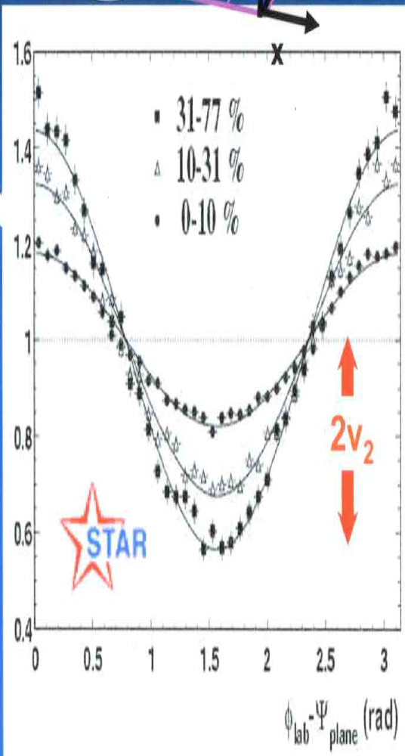
2) Testing the HI ‘Standard Model’
Elliptic Flow: one of the most anticipated answers from LHC
  experimental observation: particles are distributed with azimuthally anisotropic around the scattering plane
  Are we sure Hydro interpretation is correct ?
φ
Z
P_{y}
P_{z}
P_{x}
Reaction plane
Y
X
N_{ch} yield
Elliptic Flow v₂ as interpreted by Hydrodynamics
Pressure gradient converts
spatial anisotropy → momentum anisotropy
→ particle yield anisotropy

Slide 19
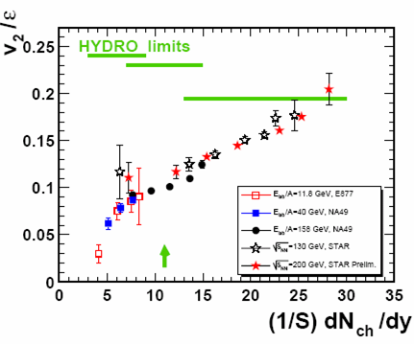
Testing the HI ‘Standard Model’
Hydro seems to work very well for first time at RHIC
  LHC prediction: modest rise (Depending on EoS, viscosity, speed of sound, dN_{ch}/dη, ..)
    (‘better than ideal is impossible’)
  experimental trend & scaling predicts large increase of flow
    (‘RHIC = Hydro is just a chance coincidence’)
LHC ?
BNL Press release, April 18, 2005:
Data = ideal Hydro
"Perfect" Liquid
New state of matter more remarkable than predicted –
raising many new questions
(scaled) Flow
LHC will either
confirm the RHIC interpretation
(and measure parameters of the QGP EoS)
OR
????????
Multiplicity

Slide 20
Testing the HI ‘Standard Model’
Hydro passed the first test !
  many more tests of Hydro and the HI-SM to come….
LHC !
CERN Press release, November 26, 2010:
‘confirms that the much hotter plasma
produced at the LHC behaves as a
very low viscosity liquid (a perfect fluid)..’

Slide 21
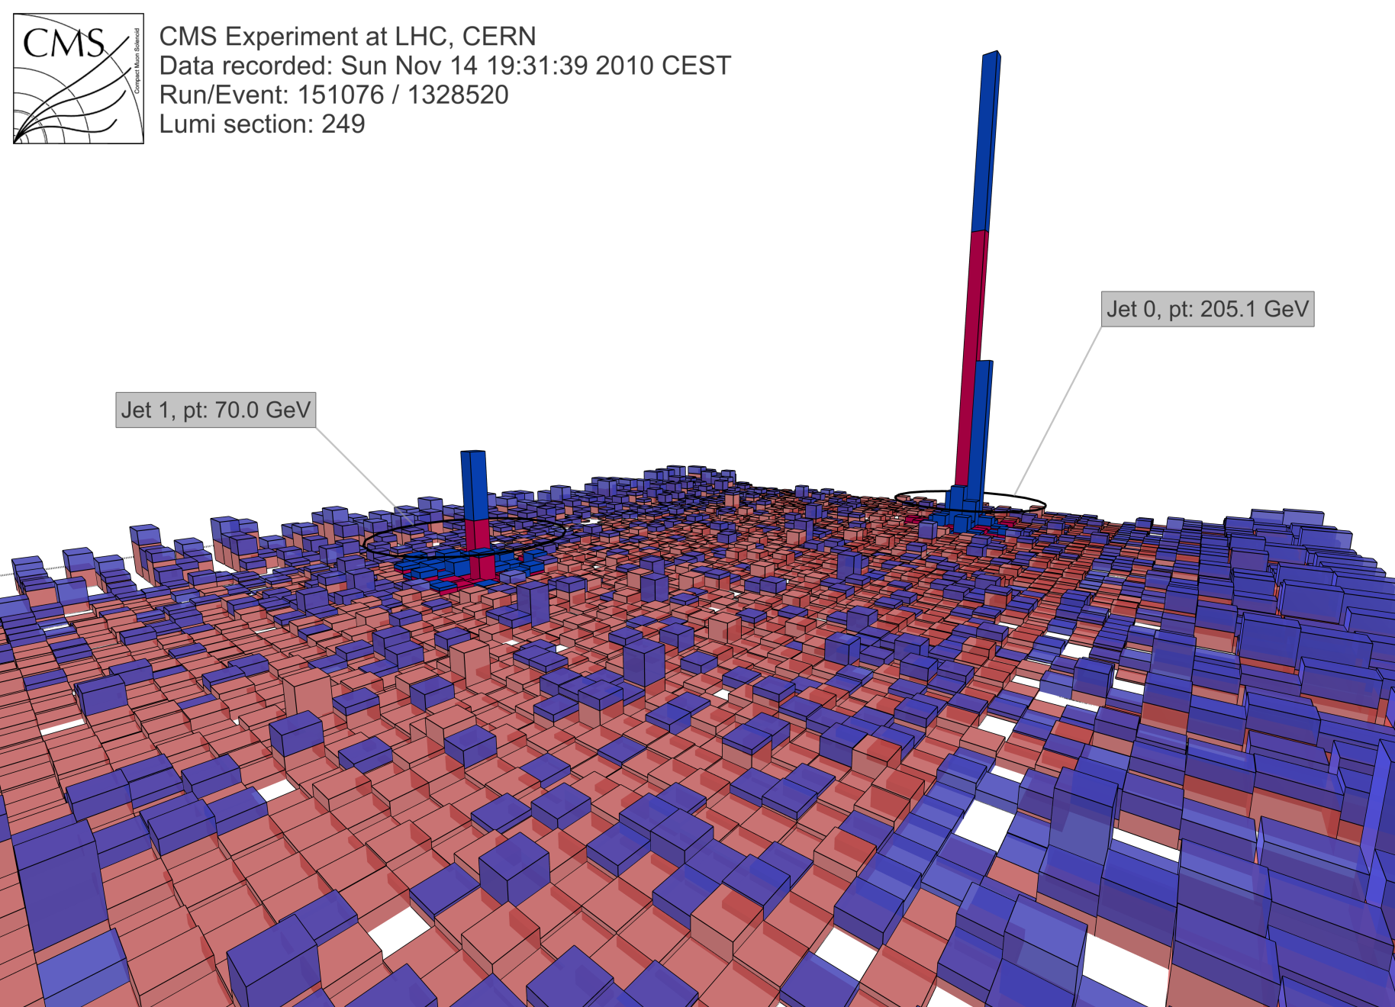
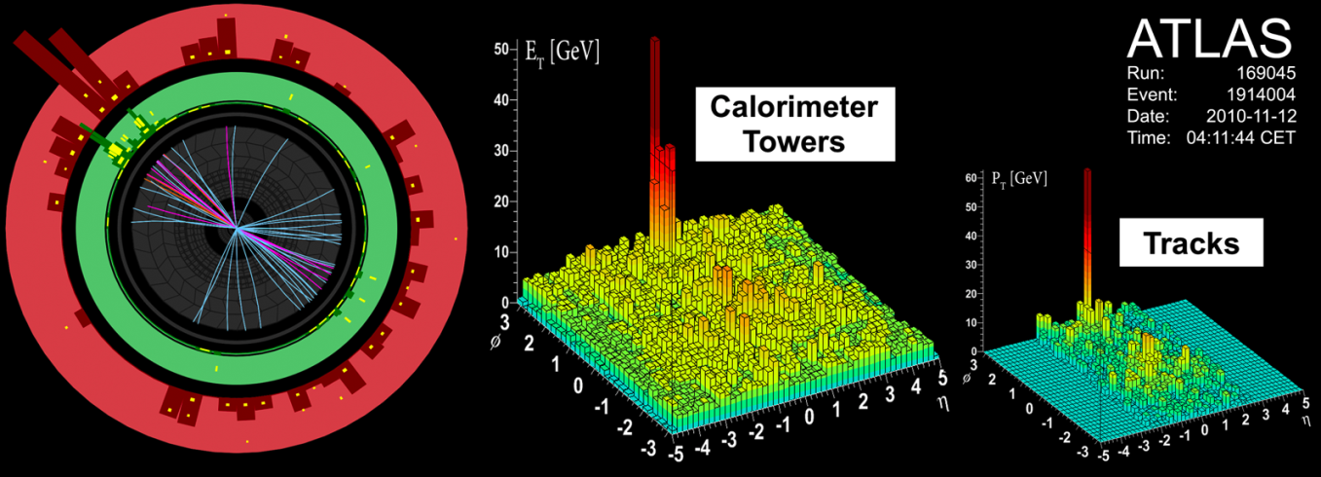
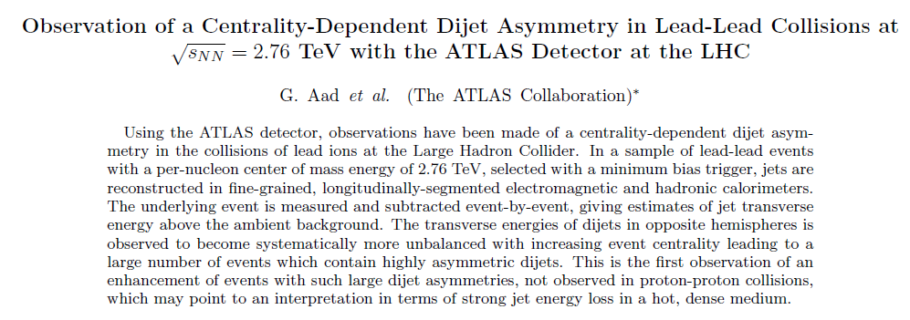
Pb-Pb ALICE, CMS
ALICE is of course very happy about the excitement that the Heavy Ion program has also generated within the other experiments.
The competitive and complementary views on the Heavy Ion Collisions have and will certainly boost this field of research at LHC !

Slide 22
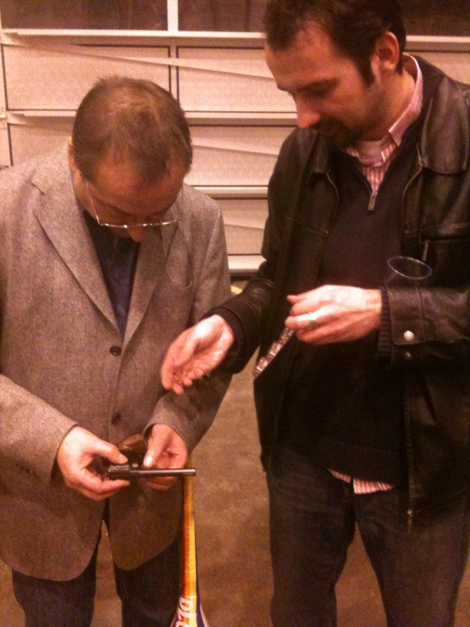
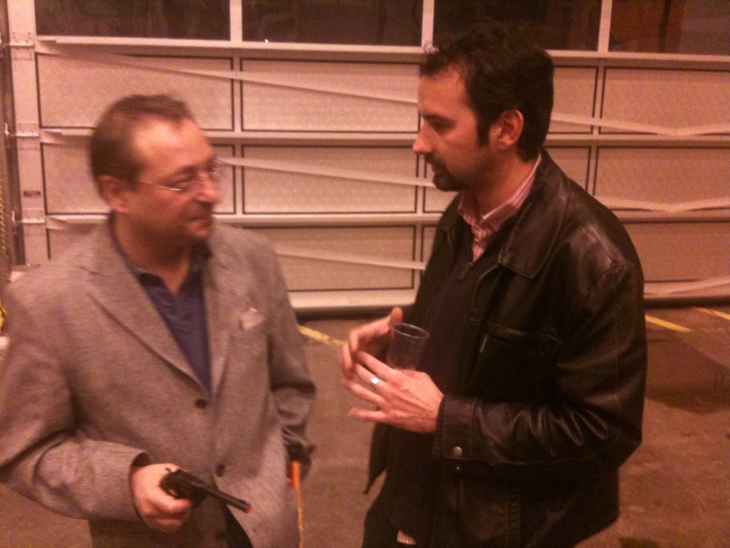
End of Run Parties
The ALICE run coordinator discussing more efficient ways of enforcing discipline in the control room …

Slide 23


Jurgen’s Summary
LHC is a fantastic ‘Big Bang’ machine
  even for LHC standards, speed and quality of ion run is outstanding
  unprecedented powerful and complementary set of detectors
  physics looks to be even more interesting than anticipated
Looking forward to the
‘terra incognita’ of HI at LHC
While waiting for Mr. Higgs and Ms. Susy, there is plenty of exciting physics (and fun) exploring QCD in a new domain,
where the strong interaction is really strong !
Big THANKS to the CERN crew
from ion source all the way to LHC
Hic sunt Leones !
23
PLC 20J. Schukraft

Slide 24
Acknowledgements
ALICE (thanks) congratulates the Accelerator Team for an incredible performance during 2010, surpassing all possible expectations.
Commissioning a machine while having all eyes of the particle physics community following every step did certainly not make the task easier.
The Heavy Ion performance and speed of commissioning, starting from the source, LEIR, etc. up to LHC was mindblowing.
We hope very much that the accelerator team feels like being part of the physics exploitation of the machine.
We do sincerely thank the LHC operations team for supporting the sometimes difficult ALICE running requirements. This made it possible for us to take full advantage of the proton period for physics exploitation and reference running for the Heavy Ion physics.
Congratulations, thank you & looking forward for exciting years ahead !

