Slide 1
ROUTING AIR DUCT CR5 TO « ITS VENTIL. UNIT »
Reference smarteam :
INFRA GENERAL : ST0036167_01
ROUTING AIR DUCT : ST0254667_01

Slide 2
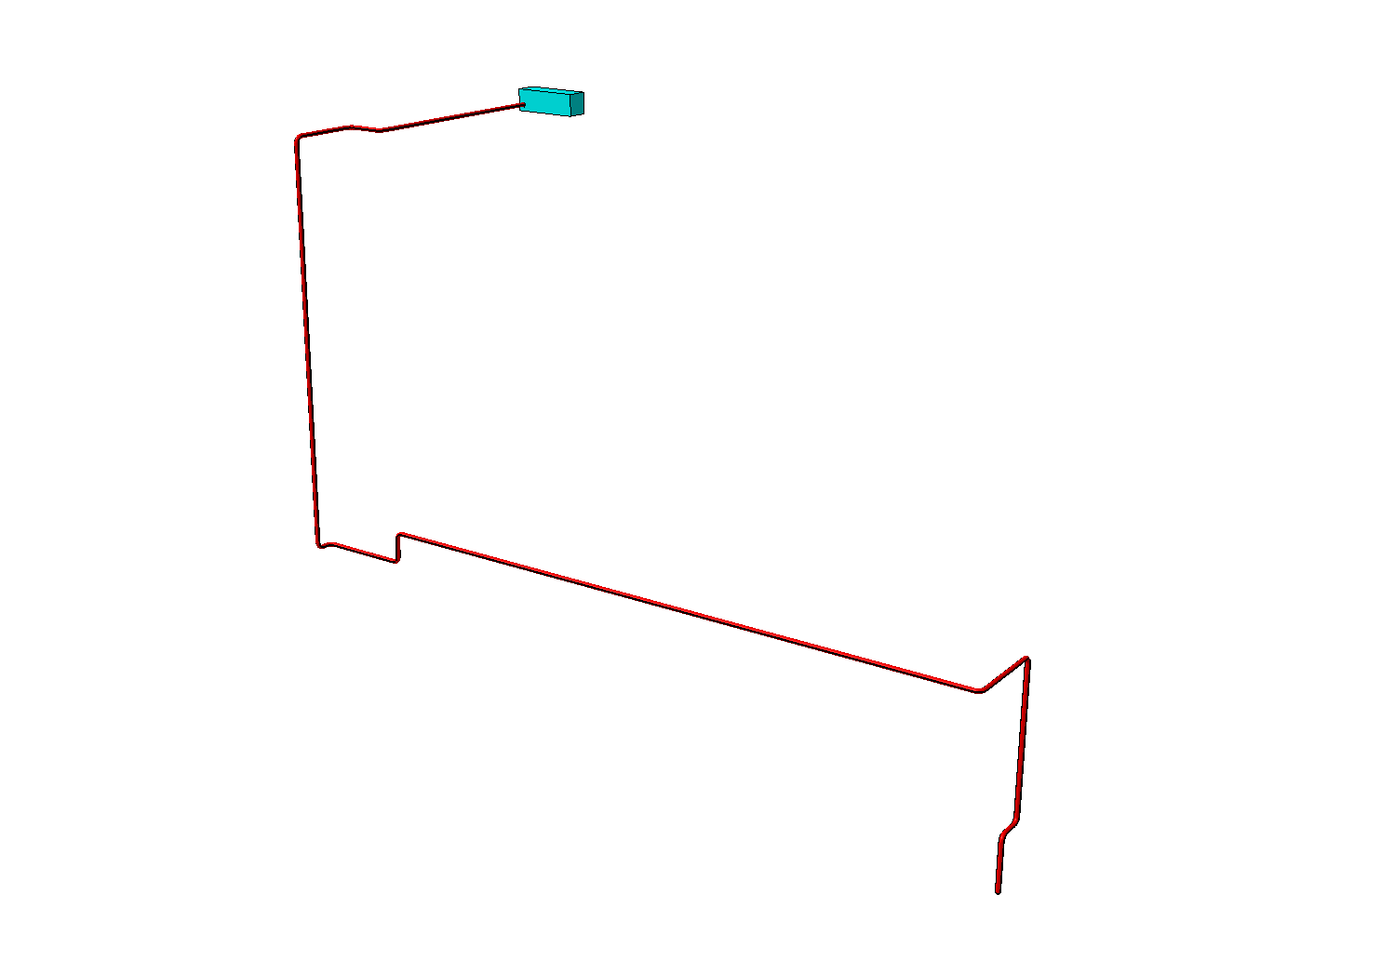

Slide 3
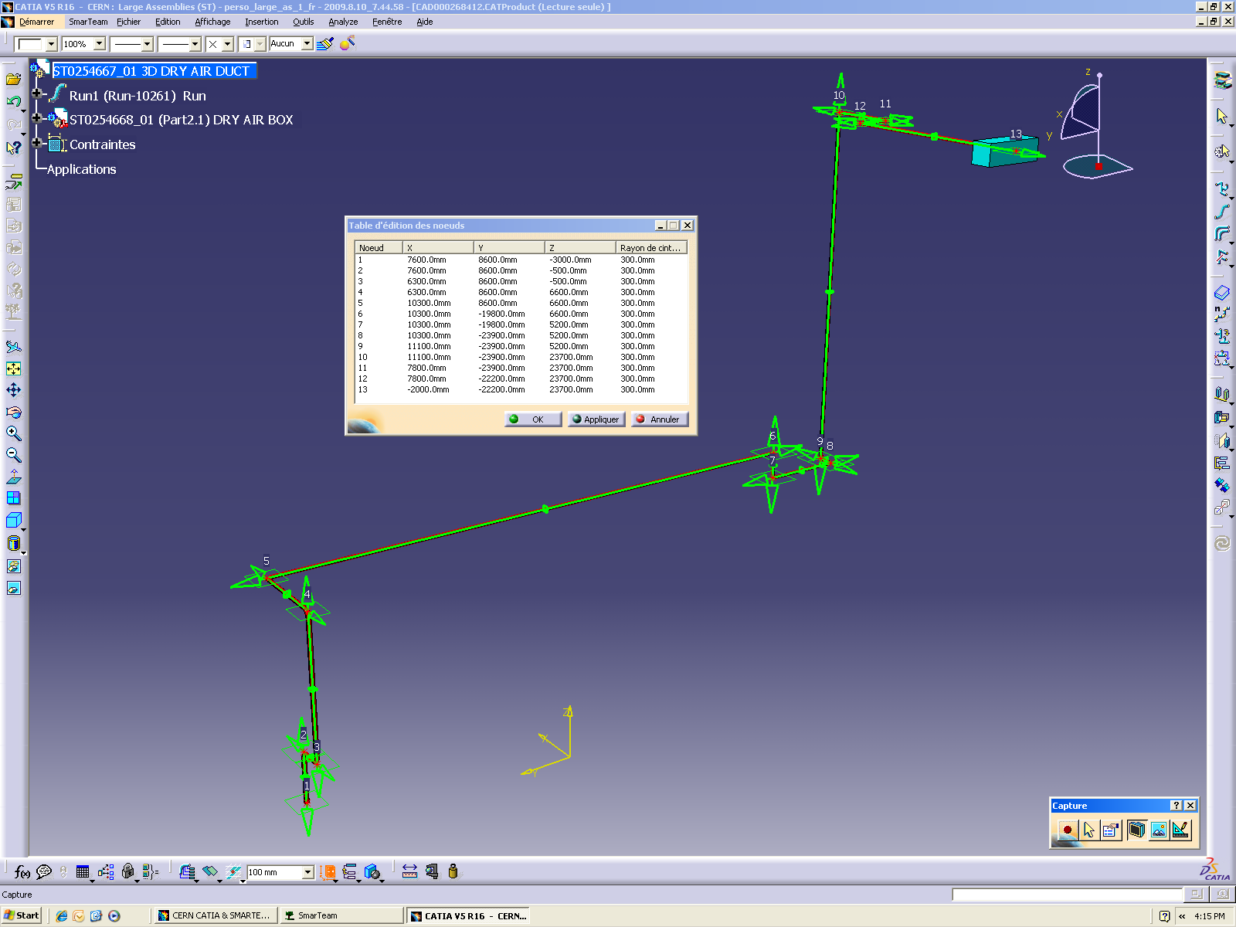

Slide 4
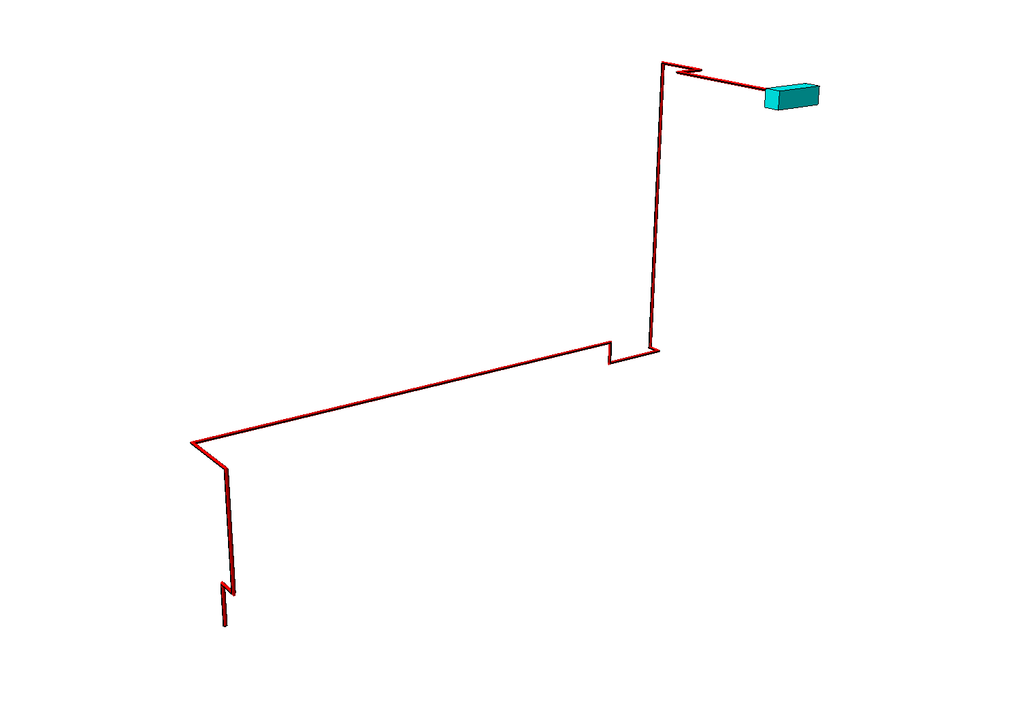
LENGHT ≈81500 mm

Slide 5
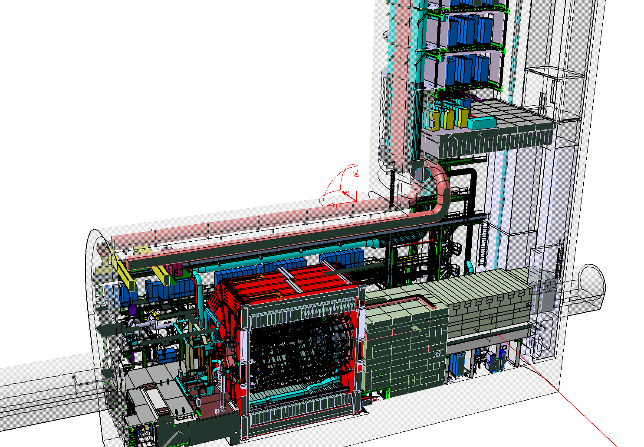

Slide 6
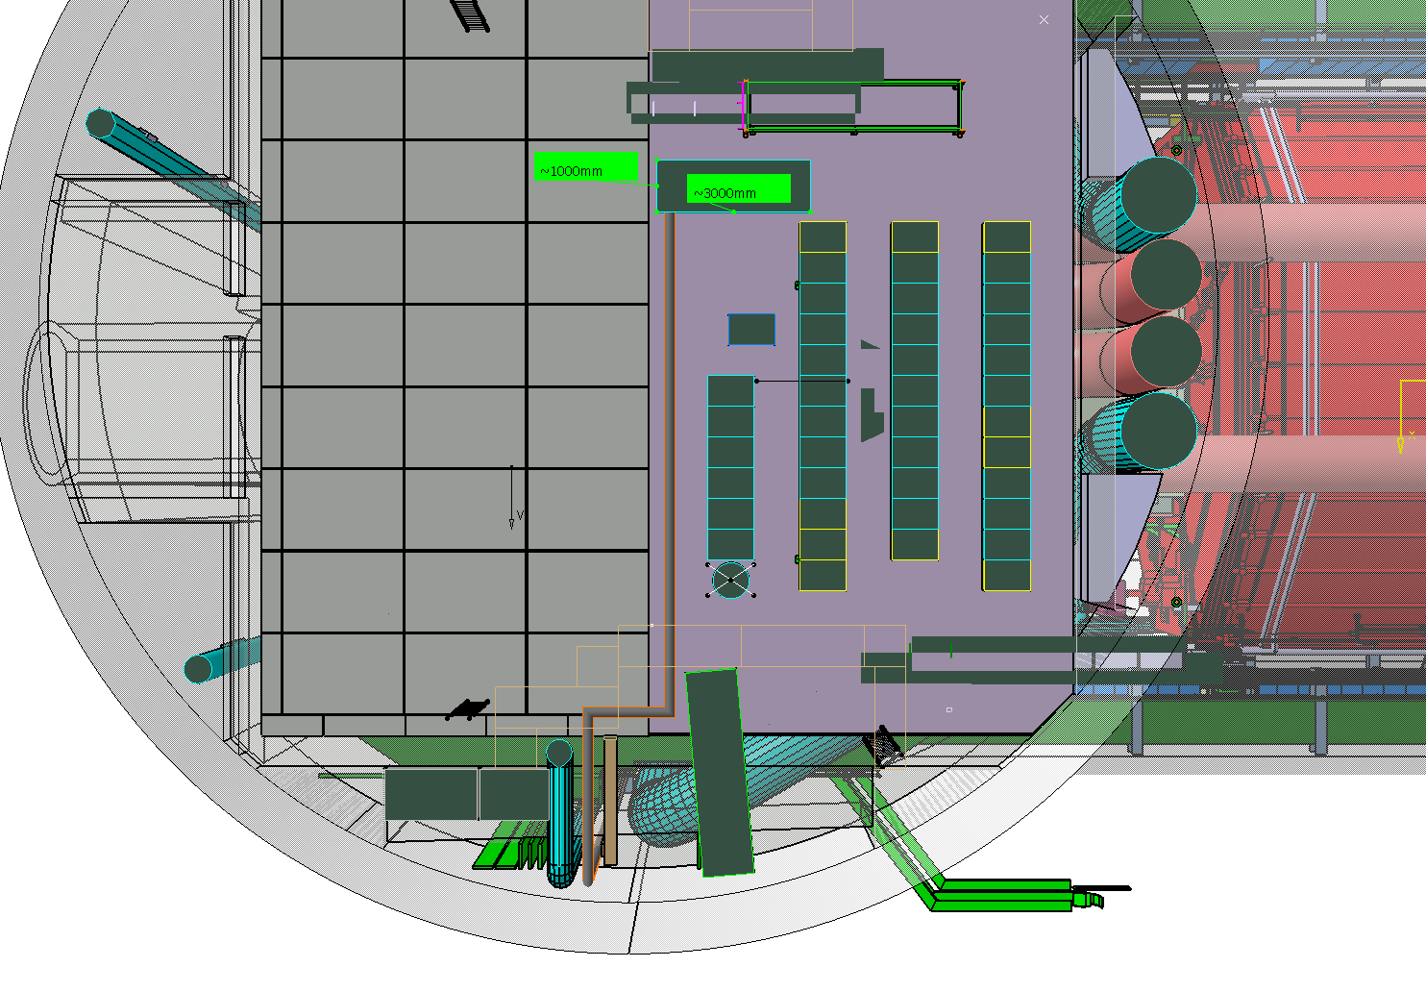

Slide 7
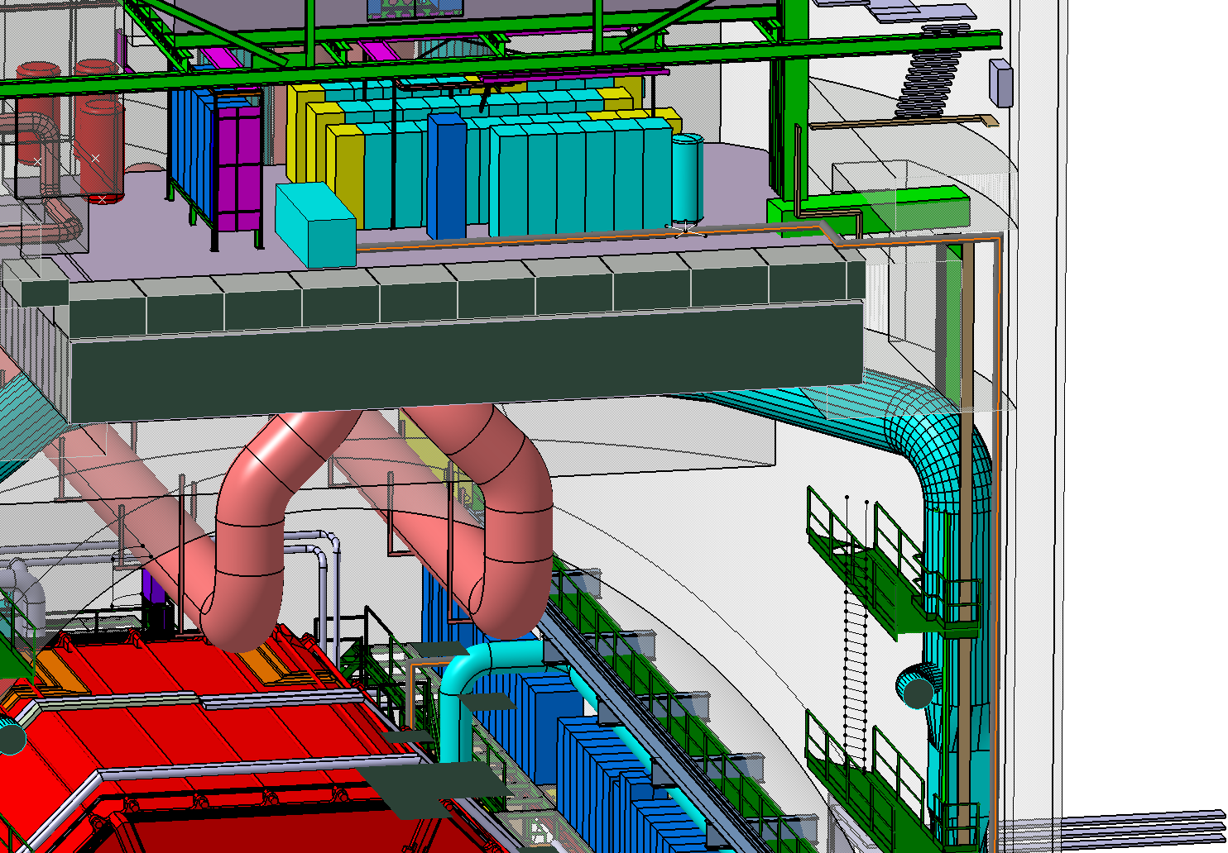

Slide 8
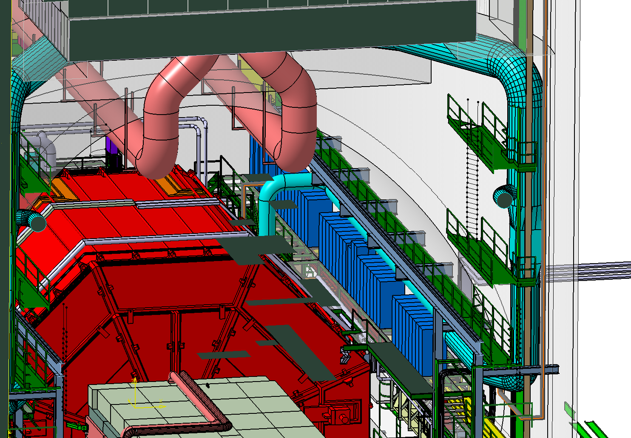

Slide 9
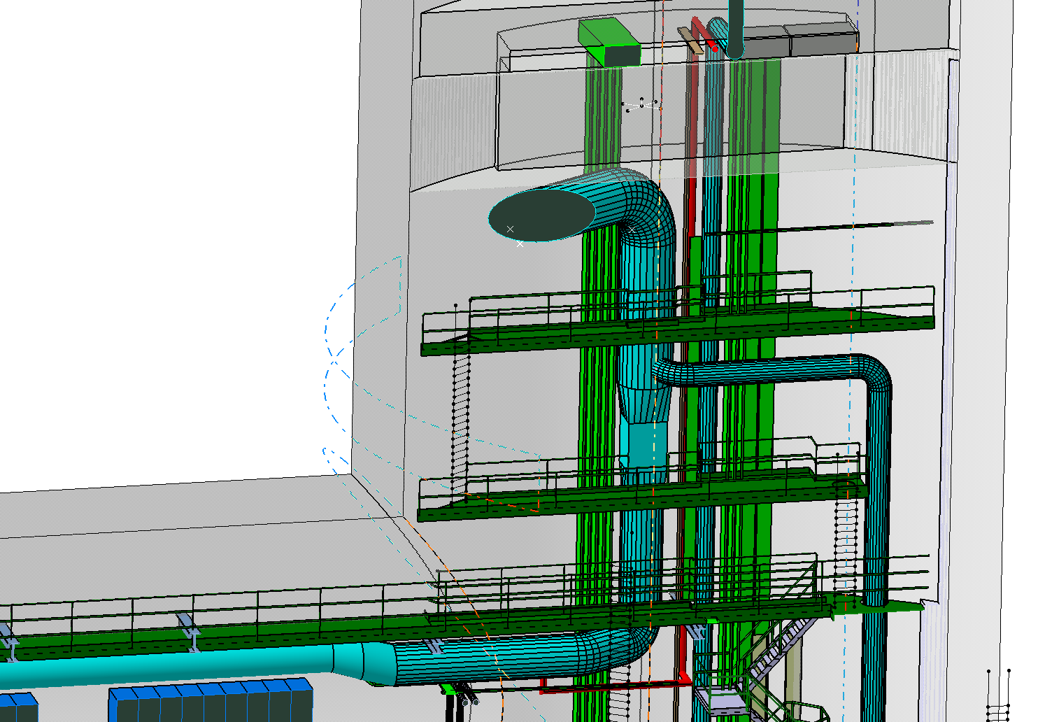

Slide 10
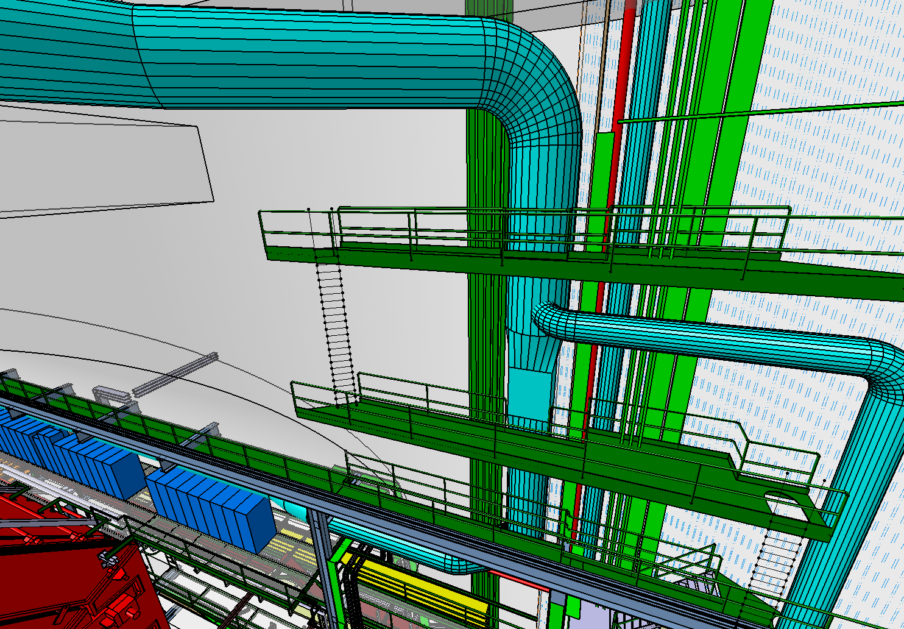

Slide 11
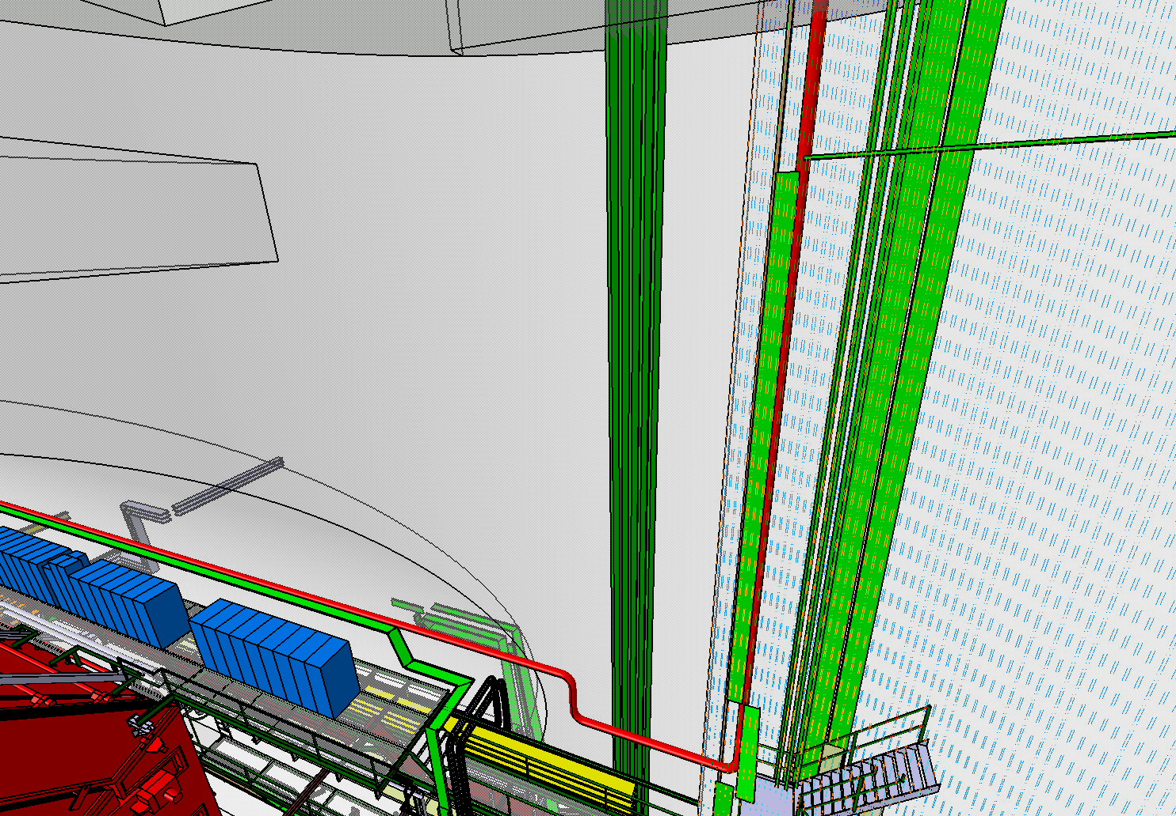

Slide 12
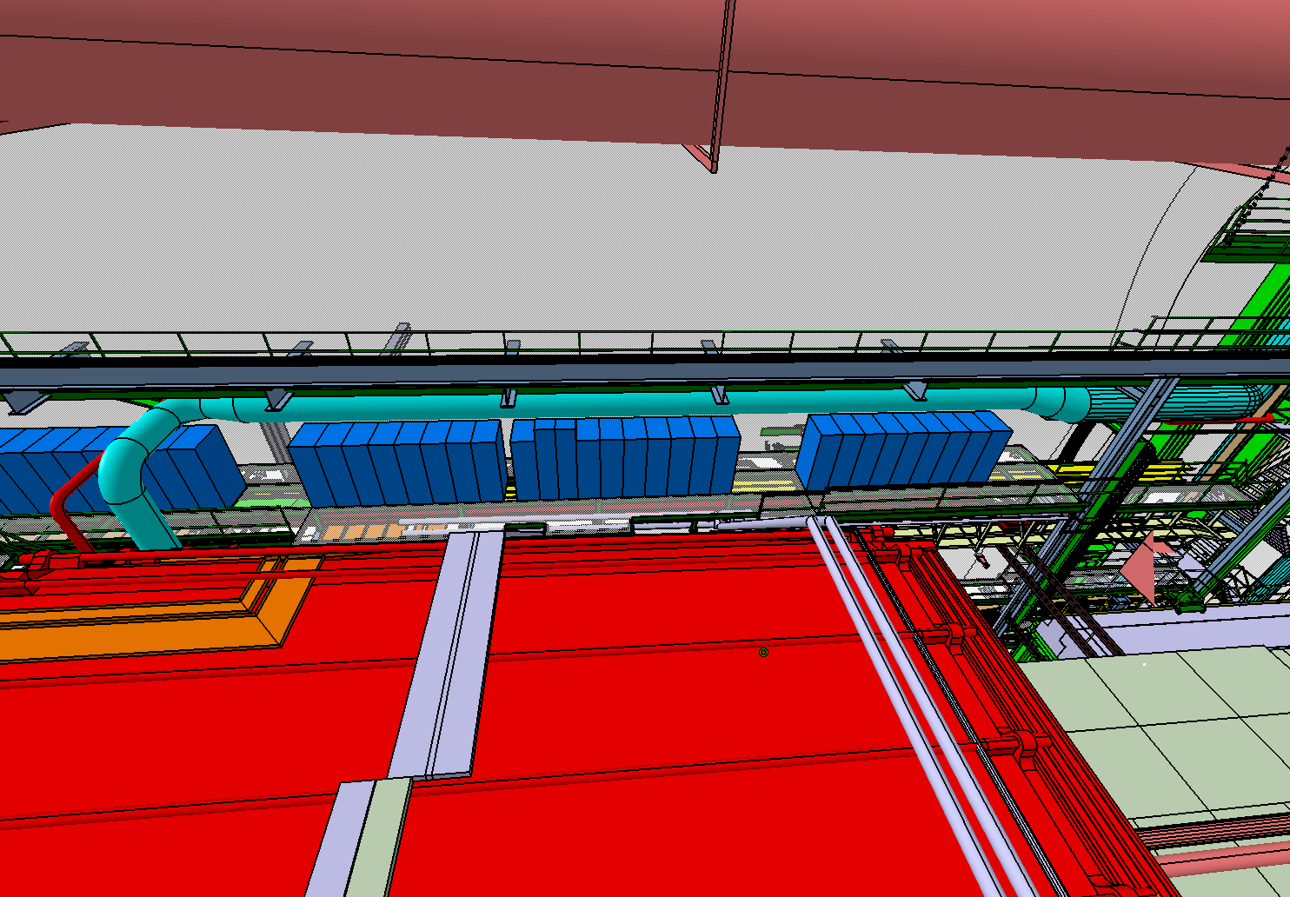

Slide 13
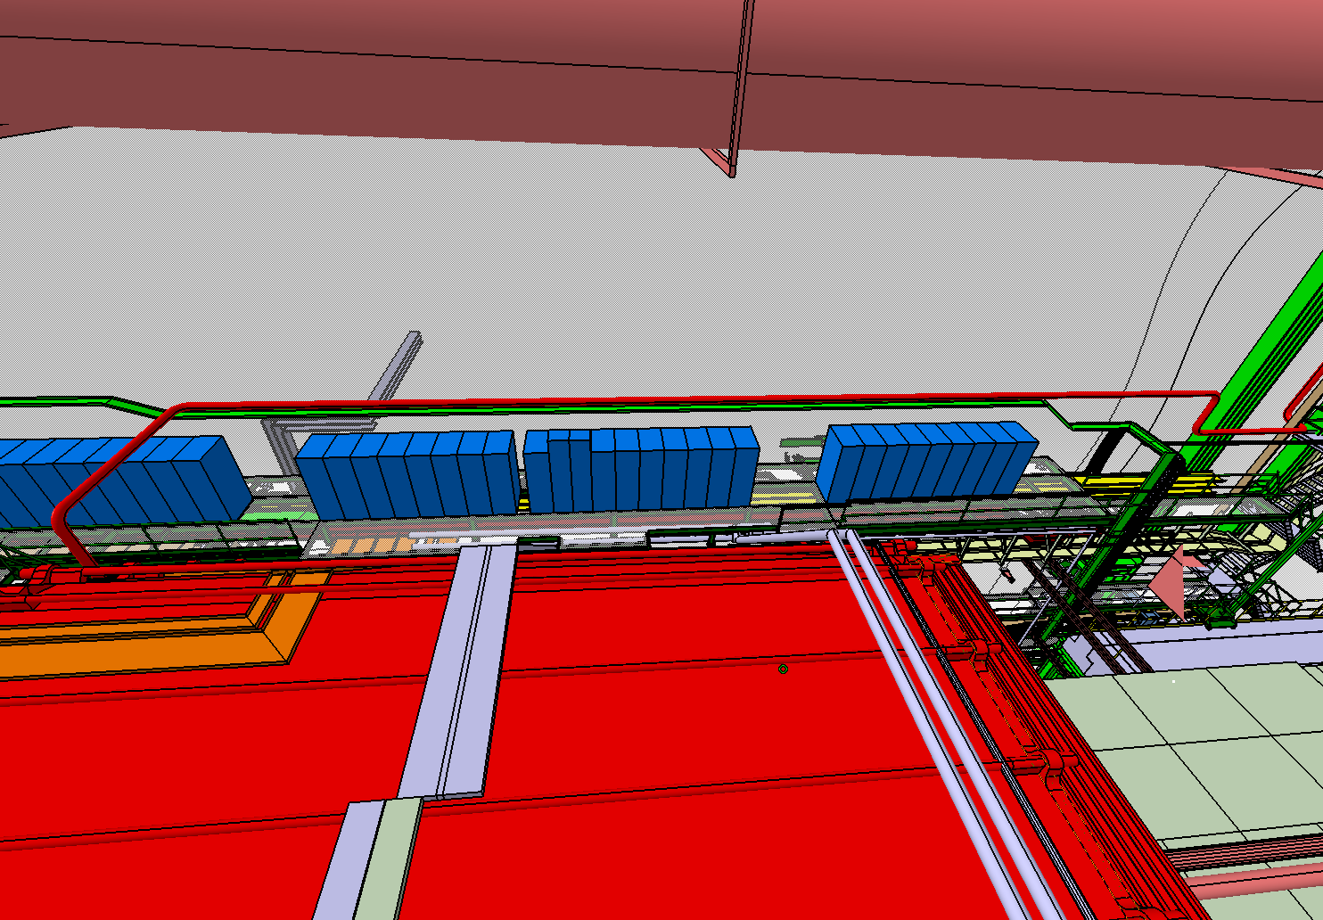

Slide 14
